Slide 1
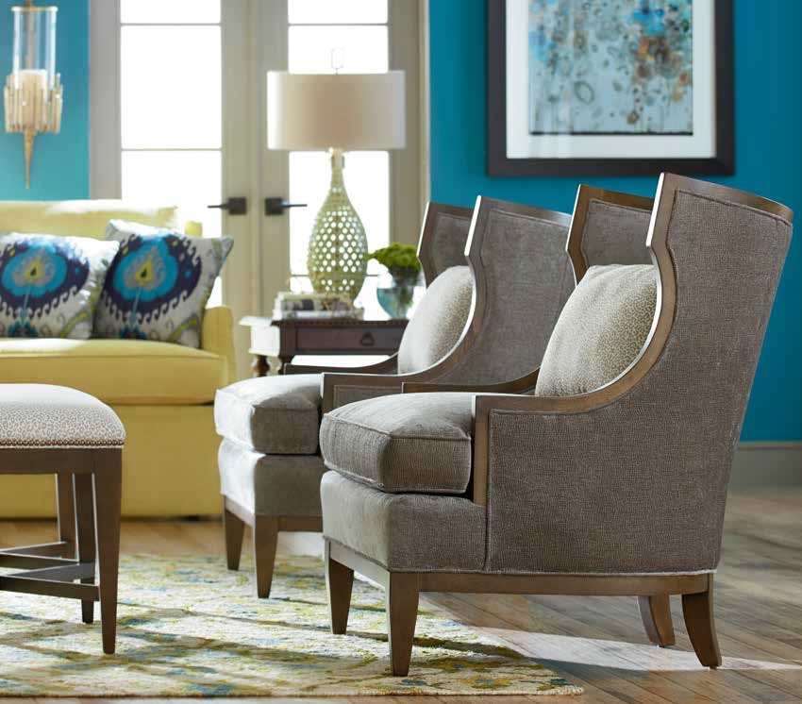

STYLE
ADD A LITTLE
TO YOUR LIFE
UPHOLSTERY
SOLID HERITAGE. QUALITY CRAFTSMANSHI P. STYLISH SELECTION. DEDICATED SER VICE.

Slide 2
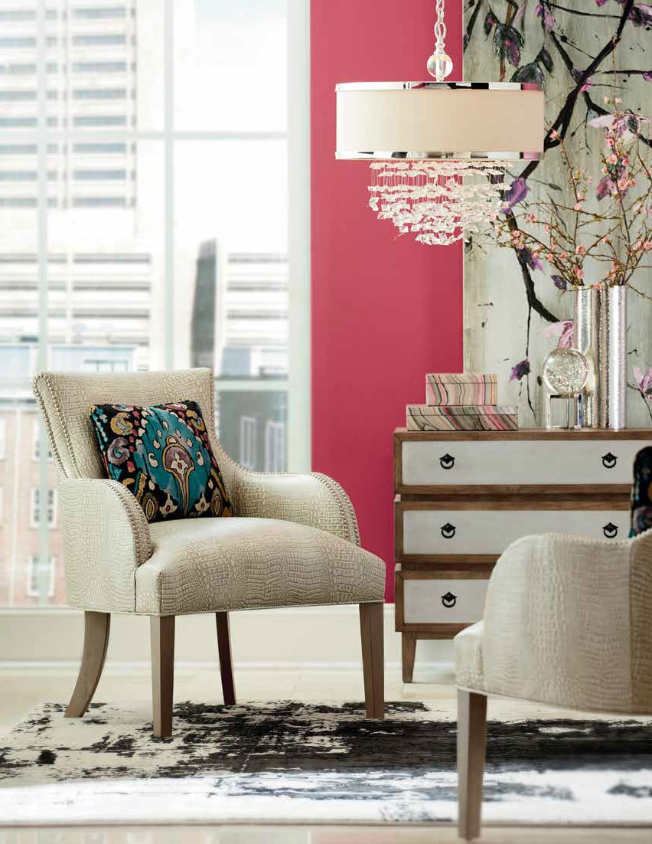
SHOWN: 8117 COLLECTION | 5204-01 OCCASIONAL CHAIR

Slide 3
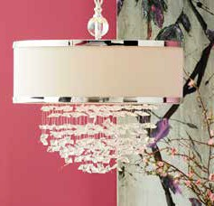
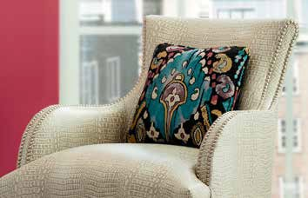
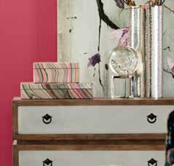
STYLE
ADD A LITTLE
TO YOUR LIFE
EVER YTHING WE DO STARTS AND FINISHES WITH YOU.
SOLID HERITAGE
For nearly a century, we’ve combined masterful craftsmanship with fashion-forward design of fine furnishings for the home. We’re a family of craftspeople who care about our community, the environment, and you.
QUALITY CRAFTSMANSHIP
It’s part of our DNA. It’s the fabric of our company, and it’s woven into everything we do. It’s why we put attention to detail first, second, and third.
STYLISH SELECTION
Choose from a wide variety of fashionable style and comfort for the living
room, dining room, and everywhere in between.
DEDICATED SERVICE
We make it easy for you. Quality, value, style, and comfort delivered in a timely fashion by people who care.

Slide 4
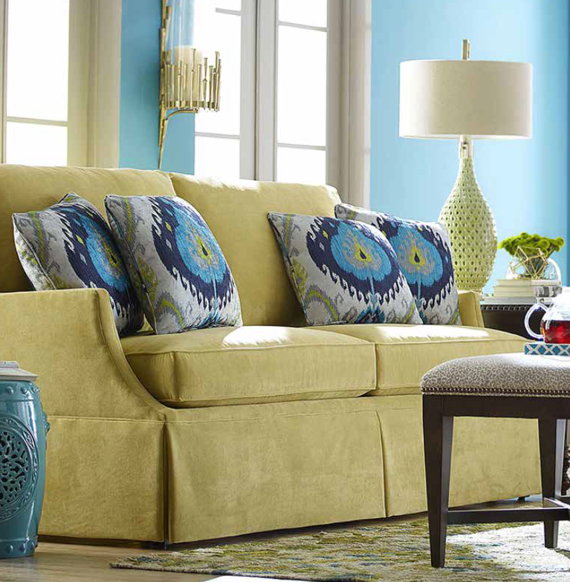

CONTENTS
SHOWN: 2726-50 SOFA | 1770-10 BENCH | 5183-01 LOUNGE CHAIR
O
4 CHAIRS
Accent | Wing | Lounge |
Swivel | Reclining | Dining | Bar & Counter | Game
108OPPORTUNITIES
Your Style. Your Way.
114 SOFAS
Sofa | Loveseat | Sectional |
Sleeper
148 SETTEE/CHAISE
162 BENCHES

Slide 5
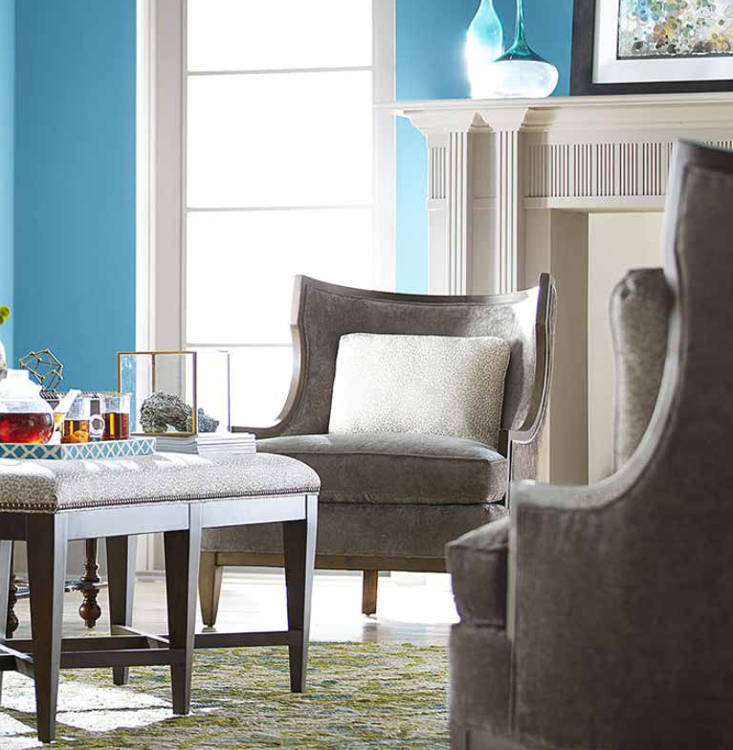

ADD A LITTLE
STYLE
TO YOUR LIFE
F
I
168 OTTOMANS
Cocktail | Cube | Storage
174 OFFICE/COMMERCIAL
222 FINISHES
Nail-Head Trim |
Construction | Warranty
234 INDEX
Numerical Index
Essentials | Desk Swivel | Accent | Dining | Bar and Counter | Game | Stackable | Settees | Sofas

Slide 6
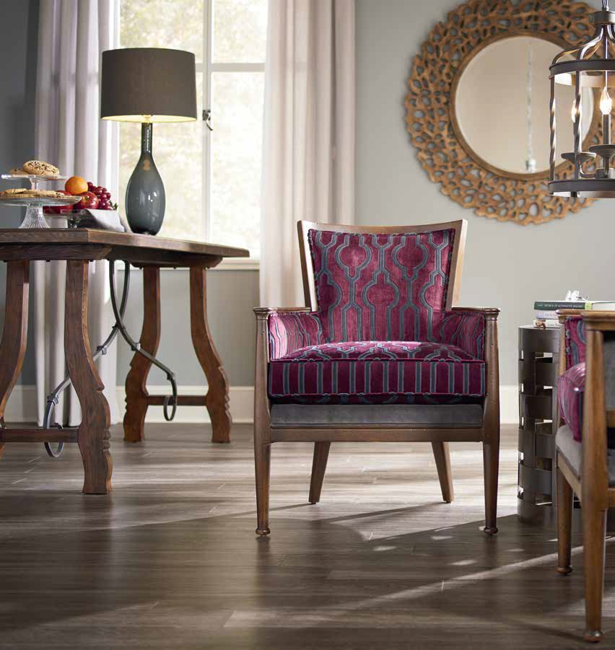
SHOWN: 8337-01 LOUNGE CHAIR | 8109 COLLECTION

Slide 7
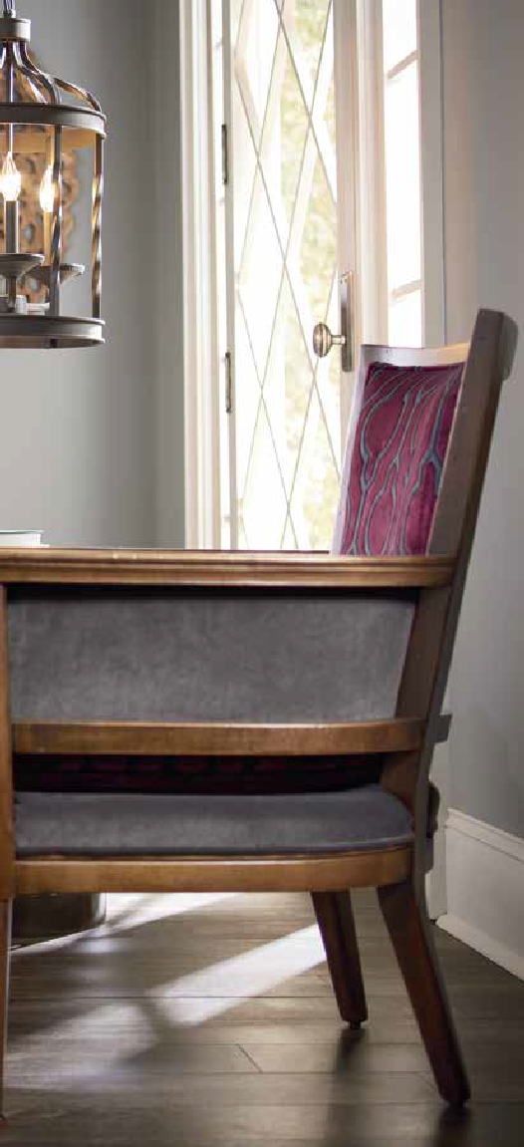


CHAIR
COLLECTION
FUNCTION MEETS FORM
While a chair is certainly one of the most practical pieces of furniture ever created, that doesn’t mean your choices can’t convey your singular sense
of style. Our Chair Collection, with its extensive offerings, grants you the ability to personalize your living spaces. Whether you’re lounging, dining, or reclining, you can select a seat with textured fabric, luxurious leather, or high-quality cushioning—the combinations are endless.
For formal or relaxed living spaces, and classic or contemporary styles, our Chair Collection brilliantly merges function with form.

Slide 8
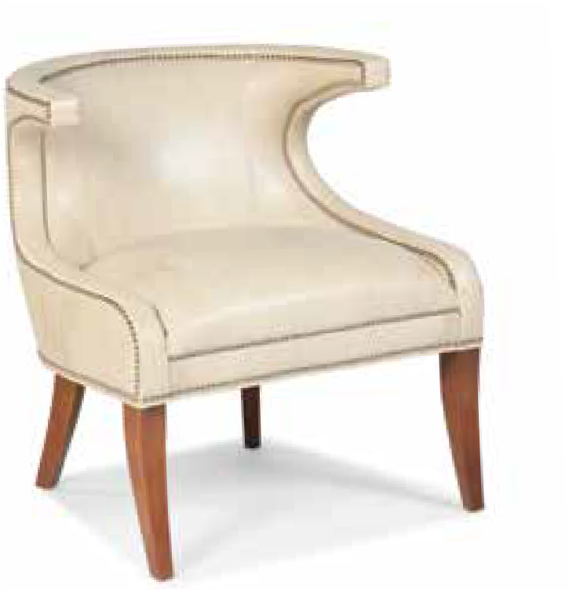
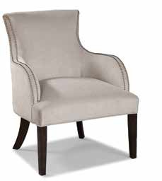

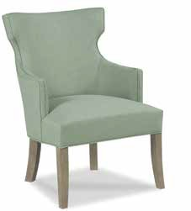
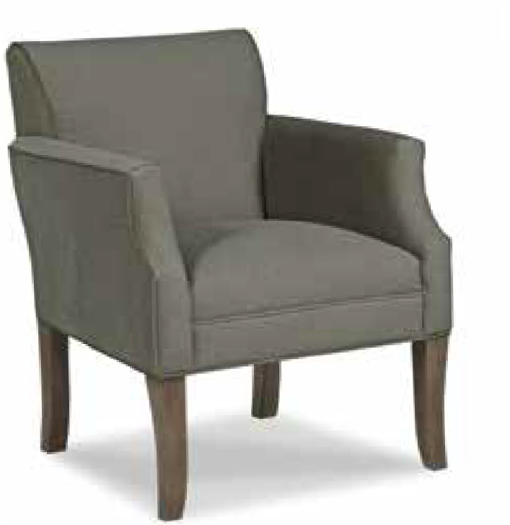

6 | CHAIR COLLECTION – ACCENT
5322-01 OCCASIONAL CHAIR ^{L N}
w 28.5 | d 28 | h 32 in.
ah 32 | sh 20.5 | sd 20 | iw 24 in.
Due to frame design, this Occasional Chair is available in solid fabrics or leathers only, as patterns will not align on the frame per our upholstering standards.
5204-01 OCCASIONAL CHAIR ^{L N}
w 28 | d 29.5 | h 35 in.
ah 24.5 | sh 20 | sd 21 | iw 21 in.
Due to frame design, this Occasional Chair is available in solid fabrics or leathers only, as patterns will not align on the frame per our upholstering standards.
6062-01 OCCASIONAL CHAIR ^{L}
w 25.5 | d 26 | h 37 in.
ah 24.5 | sh 19 | sd 19 | iw 19 in.
8375-01 OCCASIONAL CHAIR ^{L}
w 27 | d 29 | h 34.5 in.
ah 27 | sh 20.5 | sd 20 | iw 19.5 in.
L Available in Leather
N Nail-head trim standard

Slide 9
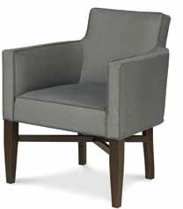
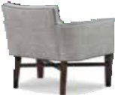
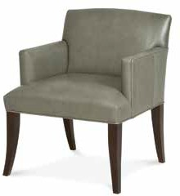

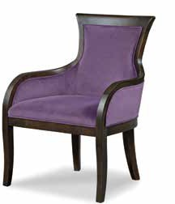
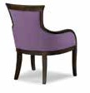
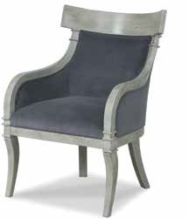

CHAIR COLLECTION – ACCENT | 7
6079-01 OCCASIONAL CHAIR ^{L}
w 27 | d 27 | h 31.5 in.
ah 26.5 | sh 18.5 | sd 18.5 | iw 19.5 in.
Also available: 6079-A4, see pages 97, 207.
8704-01 OCCASIONAL CHAIR ^{L}
w 26 | d 26 | h 32 in.
ah 25 | sh 19.5 | sd 19.5 | iw 19 in.
6058-01 OCCASIONAL CHAIR ^{L}
w 25 | d 25.5 | h 35.5 in.
ah 24 | sh 20 | sd 18.5 | iw 20.5 in.
5496-01 OCCASIONAL CHAIR ^{L}
w 26 | d 28.5 | h 39 in.
ah 25.5 | sh 20.5 | sd 20 | iw 22 in.
L Available in Leather
N Nail-head trim standard

Slide 10
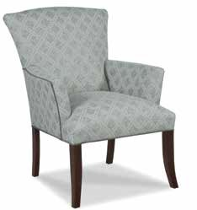
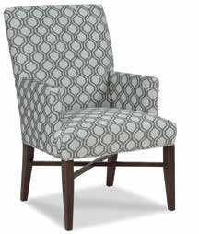
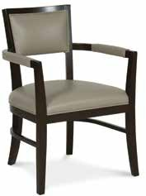
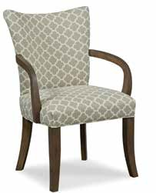
8 | CHAIR COLLECTION – ACCENT
6021-01 OCCASIONAL CHAIR ^{L}
w 28 | d 31 | h 37.5 in.
ah 26 | sh 20 | sd 20 | iw 18.5 in.
6064-01 OCCASIONAL CHAIR ^{L}
w 25.5 | d 28.5 | h 41 in.
ah 27.5 | sh 20 | sd 19 | iw 19 in.
8759-04 OCCASIONAL CHAIR ^{L}
w 23.5 | d 24 | h 33.5 in.
ah 26 | sh 19 | sd 19 | iw 19.5 in.
6069-04 OCCASIONAL CHAIR ^{L}
w 25 | d 25.5 | h 38 in.
ah 26 | sh 20 | sd 17.5 | iw 22 in.
L Available in Leather
N Nail-head trim standard

Slide 11
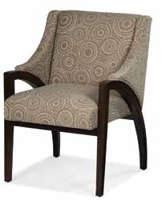
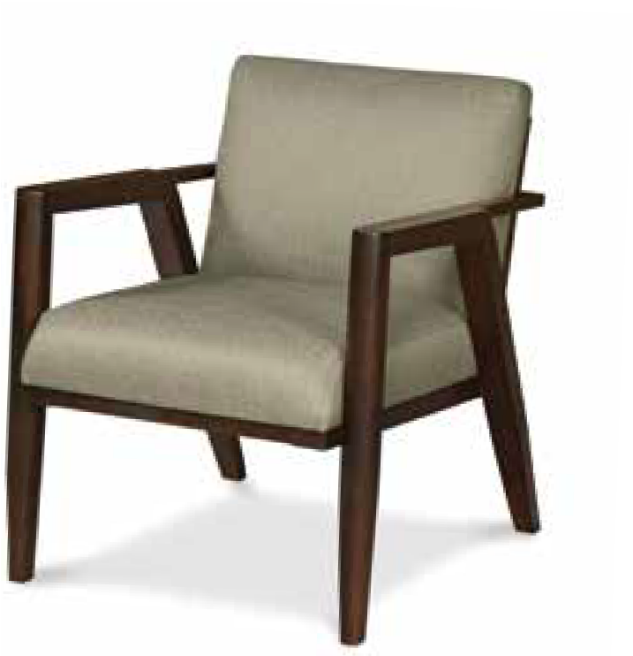
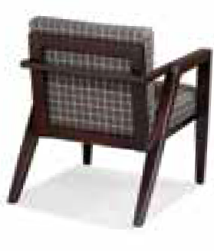
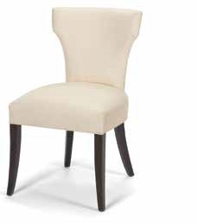
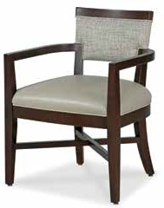
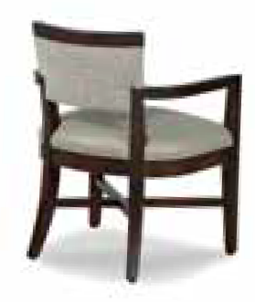
CHAIR COLLECTION – ACCENT | 9
6053-01 OCCASIONAL CHAIR ^{L}
w 24.5 | d 27 | h 35 in.
ah 24.5 | sh 21 | sd 19 | iw 20 in.
6002-01 OCCASIONAL CHAIR ^{L}
w 25 | d 29.5 | h 31.5 in.
ah 25 | sh 18 | sd 21.5 | iw 20.5 in.
8319-01 SIDE CHAIR ^{L}
w 21 | d 24.5 | h 36.5 in.
sh 21.5 | sd 21 in.
Also available: 8329-01, see page 200.
6068-04 OCCASIONAL CHAIR ^{L}
w 22.5 | d 23 | h 31.5 in.
ah 24.5 | sh 19.5 | sd 19.5 | iw 19 in.
Also available: 6068-A4, see pages 100, 209.
L Available in Leather
N Nail-head trim standard

Slide 12
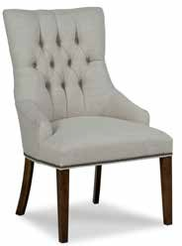
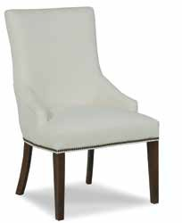
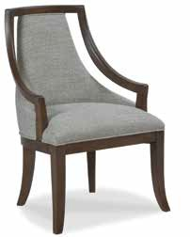
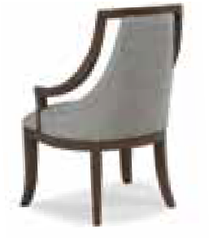
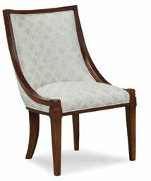
10 | CHAIR COLLECTION – ACCENT
8389-01 OCCASIONAL CHAIR ^{L}
w 24.5 | d 28 | h 37.5 in.
ah 23 | sh 19.5 | sd 19 | iw 18 in.
Shown with optional nail-head trim.
8379-01 OCCASIONAL CHAIR ^{L}
w 24.5 | d 28 | h 37.5 in.
ah 23 | sh 19.5 | sd 19 | iw 18 in.
Shown with optional nail-head trim.
5229-01 OCCASIONAL CHAIR ^{L}
w 25.5 | d 26.5 | h 39.5 in.
ah 24.5 | sh 19.5 | sd 18.5 | iw 21 in.
1476-01 OCCASIONAL CHAIR ^{L}
w 24.5 | d 26 | h 38 in.
sh 19.5 | sd 19 | iw 21 in.
L Available in Leather
N Nail-head trim standard

Slide 13
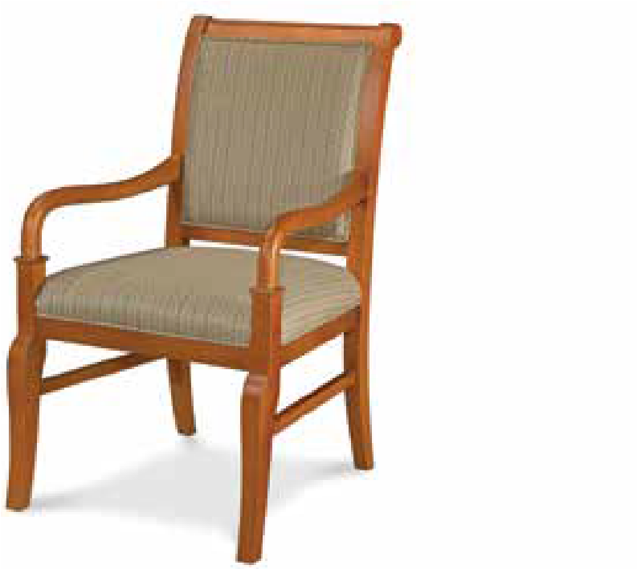
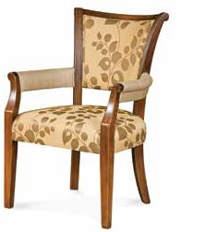
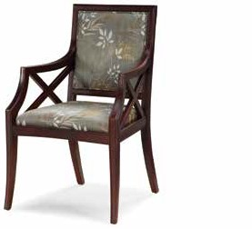
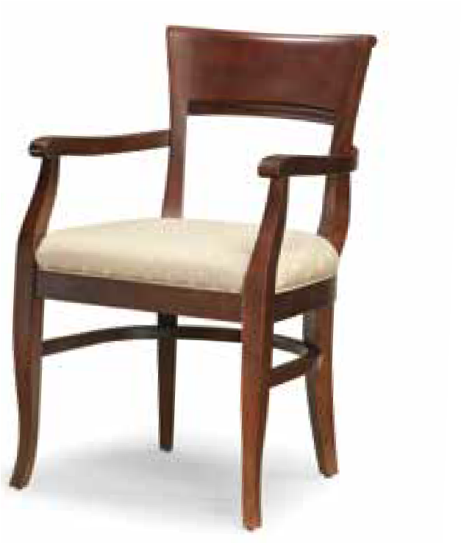
CHAIR COLLECTION – ACCENT | 11
7830-01 OCCASIONAL CHAIR ^{L}
w 23 | d 27.5 | h 37.5 in.
ah 25 | sh 19 | sd 19 | iw 19 in.
8756-04 OCCASIONAL CHAIR ^{L}
w 25 | d 26 | h 37 in.
ah 26 | sh 19 | sd 19 | iw 20 in.
8309-04 ARM CHAIR ^{L}
w 24.5 | d 25 | h 39 in.
ah 28 | sh 19.5 | sd 18 | iw 21 in.
Also available: 8339-04, see pages 75, 198, 203.
8370-01 OCCASIONAL CHAIR ^{L}
w 21.5 | d 22 | h 34 in.
ah 27 | sh 19.5 | sd 19 | iw 18.5 in.
L Available in Leather
N Nail-head trim standard

Slide 14
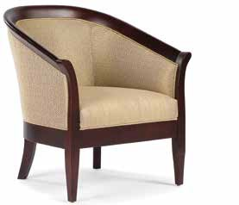
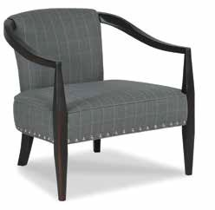
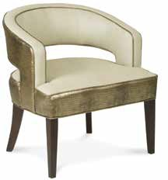
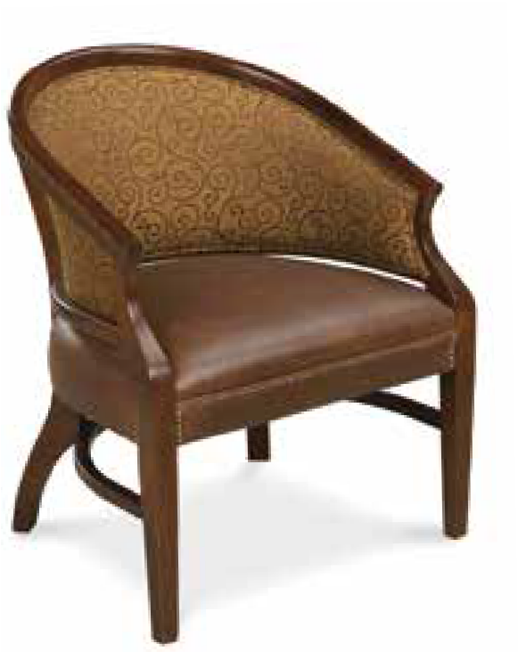
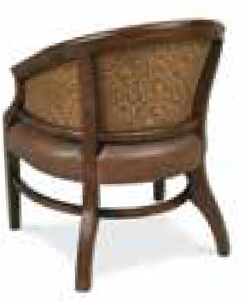
12 | CHAIR COLLECTION – ACCENT
6089-01 OCCASIONAL CHAIR ^{L}
w 30 | d 29 | h 33 in.
ah 25 | sh 18.5 | sd 20.5 | iw 20 in.
6052-01 OCCASIONAL CHAIR ^{L}
w 30.5 | d 29 | h 29.5 in.
ah 24 | sh 17.5 | sd 22.5 | iw 26 in.
Shown with optional nail-head trim.
8784-04 OCCASIONAL CHAIR ^{L}
w 27 | d 24.5 | h 30.5 in.
ah 25 | sh 19.5 | sd 20 | iw 19 in.
Also available: 8784-A4, see pages 96, 207.
6080-01 OCCASIONAL CHAIR ^{L N}
w 26 | d 25 | h 33 in.
ah 26 | sh 19.5 | sd 20 | iw 21.5 in.
Also available: 6080-A4, see pages 95, 207.
L Available in Leather
N Nail-head trim standard

Slide 15
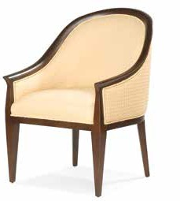
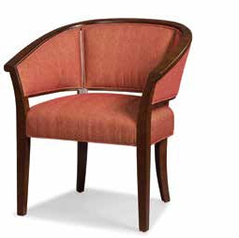
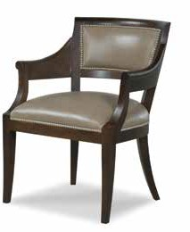
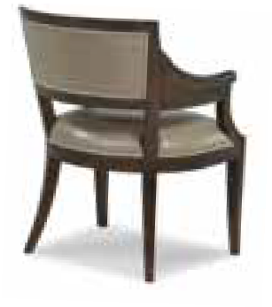
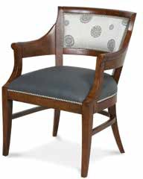
CHAIR COLLECTION – ACCENT | 13
6074-01 OCCASIONAL CHAIR ^{L}
w 28.5 | d 29 | h 38 in.
ah 24.5 | sh 21.5 | sd 19.5 | iw 21 in.
6046-01 OCCASIONAL CHAIR ^{L}
w 28.5 | d 24.5 | h 33 in.
ah 26 | sh 20 | sd 19 | iw 20 in.
Nail-head trim standard with leather/vinyl application. Also available: 6046-A4, see pages 95, 207.
6022-01 OCCASIONAL CHAIR ^{L N}
w 25.5 | d 25.5 | h 33 in.
ah 26 | sh 20 | sd 20.5 | iw 21 in.
Also available: 8322-01, see pages 13, 194.
8322-01 OCCASIONAL CHAIR ^{L N}
w 25.5 | d 25.5 | h 33 in.
ah 26 | sh 20.5 | sd 20 | iw 20.5 in.
Also available: 6022-01, see pages 13, 195.
L Available in Leather
N Nail-head trim standard

Slide 16
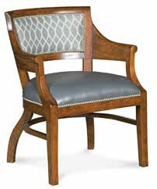
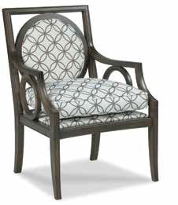



14 | CHAIR COLLECTION – ACCENT
8732-01 OCCASIONAL CHAIR ^{L N}
w 26 | d 24.5 | h 33 in.
ah 26 | sh 19.5 | sd 19.5 | iw 21 in.
Also available: 8732-A4, see pages 101, 210.
5422-01 OCCASIONAL CHAIR ^{L}
w 27.5 | d 28.5 | h 40 in.
ah 27.5 | sh 22.5 | sd 20.5 | iw 24 in.
Standard with Blend Down seat.
5459-01 OCCASIONAL CHAIR ^{L}
w 29 | d 30 | h 39 in.
ah 27 | sh 20 | sd 21 | iw 24 in.
5444-01 OCCASIONAL CHAIR ^{L}
w 26 | d 28 | h 43 in.
ah 25 | sh 22 | sd 20 | iw 20 in.
Shown with optional nail-head trim.
L Available in Leather
N Nail-head trim standard

Slide 17




CHAIR COLLECTION – ACCENT | 15
8703-01 OCCASIONAL CHAIR ^{L}
w 26.5 | d 28.5 | h 35 in.
ah 25 | sh 17.5 | sd 20 | iw 18 in.
5480-01 OCCASIONAL CHAIR ^{L}
w 24.5 | d 26.5 | h 39.5 in.
ah 21 | sh 20.5 | sd 17.5 | iw 19 in.
5405-01 OCCASIONAL CHAIR ^{L}
w 25 | d 30.5 | h 39.5 in.
ah 27 | sh 20.5 | sd 20 | iw 19 in.
5719-01 OCCASIONAL CHAIR ^{L}
w 26.5 | d 31 | h 37.5 in.
ah 25.5 | sh 19 | sd 21 | iw 19.5 in.
L Available in Leather
N Nail-head trim standard

Slide 18




16 | CHAIR COLLECTION – ACCENT
6001-01 OCCASIONAL CHAIR ^{L}
w 24.5 | d 30 | h 42.5 in.
ah 26 | sh 20.5 | sd 20.5 | iw 20.5 in.
Shown with optional nail-head trim. Also available: 6001-A4, see page 97.
6028-01 OCCASIONAL CHAIR ^{L}
w 24.5 | d 24.5 | h 35 in.
ah 26 | sh 20 | sd 18 | iw 19 in.
1092-04 OCCASIONAL CHAIR ^{L}
w 24.5 | d 27.5 | h 40 in.
ah 26.5 | sh 19.5 | sd 19.5 | iw 21 in.
Also available: 1092-A4, 1093-05, and 1093-S4, see pages 19, 70, 97, 213.
1082-01 OCCASIONAL CHAIR ^{L}
w 24.5 | d 28.5 | h 40.5 in.
ah 26.5 | sh 19.5 | sd 19.5 | iw 20 in.
Also available: 1082-A4, see pages 98, 212.
L Available in Leather
N Nail-head trim standard

Slide 19





CHAIR COLLECTION – ACCENT | 17
5491-01 OCCASIONAL CHAIR ^{L}
w 27 | d 31.5 | h 45.5 in.
ah 26.5 | sh 20 | sd 20.5 | iw 22 in.
8747-04 ARM CHAIR ^{L}
w 23.5 | d 24.5 | h 39 in.
ah 25.5 | sh 19 | sd 18 | iw 19 in.
5163-01 OCCASIONAL CHAIR ^{L}
w 27 | d 31 | h 42 in.
ah 26 | sh 17.5 | sd 19 | iw 21.5 in.
1036-01 OCCASIONAL CHAIR ^{L}
w 25 | d 28.5 | h 40.5 in.
ah 26 | sh 19.5 | sd 20 | iw 20.5 in.
Also available: 1036-A4, see pages 98, 213.
L Available in Leather
N Nail-head trim standard

Slide 20




18 | CHAIR COLLECTION – ACCENT
5354-04 OCCASIONAL CHAIR ^{L}
w 23.5 | d 27 | h 36 in.
ah 25.5 | sh 19.5 | sd 19.5 | iw 19.5 in.
5374-01 OCCASIONAL CHAIR ^{L}
w 24.5 | d 26.5 | h 35 in.
ah 26 | sh 20 | sd 20 | iw 19.5 in.
5457-01 OCCASIONAL CHAIR ^{L}
w 23 | d 27 | h 37 in.
ah 25.5 | sh 20.5 | sd 20.5 | iw 19.5 in.
5357-01 OCCASIONAL CHAIR ^{L}
w 25 | d 27 | h 36.5 in.
ah 26.5 | sh 19.5 | sd 20 | iw 21 in.
L Available in Leather
N Nail-head trim standard

Slide 21




CHAIR COLLECTION – ACCENT | 19
5490-01 OCCASIONAL CHAIR ^{L}
w 26 | d 26 | h 40.5 in.
ah 27.5 | sh 21 | sd 20.5 | iw 20 in.
5449-04 ARM CHAIR ^{L}
w 24 | d 23.5 | h 39.5 in.
ah 27.5 | sh 20.5 | sd 18 | iw 19.5 in.
Frame not warranted for contract/commercial application.
1060-01 OCCASIONAL CHAIR ^{L}
w 19 | d 25 | h 37 in.
sh 20.5 | sd 17.5 in.
Shown with optional nail-head trim.
1093-05 OCCASIONAL CHAIR ^{L}
w 22 | d 27 | h 40.5 in.
sh 20 | sd 18 in.
Also available: 1093-S4, 1092-04, and 1092-A4, see pages 16, 97, 193, 213.
L Available in Leather
N Nail-head trim standard

Slide 22




20 | CHAIR COLLECTION – ACCENT
5400-01 OCCASIONAL CHAIR ^{L}
w 28 | d 28 | h 40.5 in.
ah 28.5 | sh 20.5 | sd 20 | iw 23.5 in.
3514-01 OCCASIONAL CHAIR ^{L}
w 24 | d 25.5 | h 36.5 in.
ah 27.5 | sh 20.5 | sd 19.5 | iw 21 in.
1432-01 OCCASIONAL CHAIR ^{L}
w 29 | d 34 | h 41 in.
ah 27.5 | sh 19.5 | sd 20 | iw 21 in.
8060-01 OCCASIONAL CHAIR ^{L}
w 28 | d 31.5 | h 38.5 in.
ah 25.5 | sh 20 | sd 23 | iw 23 in.
L Available in Leather
N Nail-head trim standard

Slide 23






CHAIR COLLECTION – ACCENT | 21
6091-01 OCCASIONAL CHAIR ^{L}
w 27 | d 27 | h 35.5 in.
ah 25 | sh 20 | sd 20 | iw 19.5 in.
8337-01 LOUNGE CHAIR ^{L}
w 26 | d 26.5 | h 34 in.
ah 24 | sh 20.5 | sd 20.5 | iw 20 in.
5382-01 OCCASIONAL CHAIR ^{L}
w 30 | d 30.5 | h 42.5 in.
ah 28 | sh 20.5 | sd 21.5 | iw 20 in.
5255-01 OCCASIONAL CHAIR ^{L}
w 32 | d 31 | h 39 in.
ah 26 | sh 19.5 | sd 19 | iw 18 in.
L Available in Leather
N Nail-head trim standard

Slide 24





22 | CHAIR COLLECTION – ACCENT
5315-01 OCCASIONAL CHAIR ^{L}
w 29.5 | d 31 | h 41 in.
ah 25.5 | sh 22 | sd 23.5 | iw 25 in.
5765-01 OCCASIONAL CHAIR ^{L}
w 24.5 | d 27 | h 46.5 in.
ah 25.5 | sh 20 | sd 18.5 | iw 20 in.
Shown with optional nail-head trim.
5412-01 OCCASIONAL CHAIR ^{L}
w 26 | d 26.5 | h 37.5 in.
ah 24 | sh 19.5 | sd 21 | iw 23 in.
5409-04 ARM CHAIR ^{L}
w 25.5 | d 26 | h 48 in.
ah 28 | sh 20.5 | sd 19 | iw 20.5 in.
Nail-head trim standard with leather/vinyl application.
L Available in Leather
N Nail-head trim standard

Slide 25




CHAIR COLLECTION – ACCENT | 23
5443-01 OCCASIONAL CHAIR ^{L N}
w 28.5 | d 30 | h 42.5 in.
ah 26 | sh 20 | sd 20 | iw 24 in.
5416-01 OCCASIONAL CHAIR ^{L}
w 31 | d 29 | h 46 in.
ah 27 | sh 21 | sd 22.5 | iw 22.5 in.
5781-01 OCCASIONAL CHAIR ^{L}
w 28.5 | d 31 | h 38 in.
ah 25.5 | sh 20 | sd 21 | iw 22 in.
5455-01 LOUNGE CHAIR ^{L}
w 30 | d 33 | h 39 in.
ah 26 | sh 21 | sd 24 | iw 24 in.
L Available in Leather
N Nail-head trim standard

Slide 27

SHOWN: 5135-01 WING CHAIRS | 8105 COLLECTION

Slide 28




26 | CHAIR COLLECTION – WING
5135-01 WING CHAIR ^{L}
w 33 | d 32.5 | h 42 in.
ah 21.5 | sh 20 | sd 21.5 | iw 21.5 in.
5147-01 WING CHAIR ^{L N}
w 28 | d 35 | h 43.5 in.
ah 26 | sh 21 | sd 22.5 | iw 21 in.
5147-20 OTTOMAN ^{L N}
w 24.5 | d 19 | h 20 in.
Also available: 5145-01 (without nail-head trim), 5145-20 (without nail-head trim), 5146-01, and
5146-20, see page 26.
5426-01 WING CHAIR ^{L N}
w 30.5 | d 29 | h 41 in.
ah 26 | sh 19.5 | sd 21 | iw 21 in.
5146-01 WING CHAIR ^{L}
w 28 | d 35 | h 43.5 in.
ah 26 | sh 21 | sd 22.5 | iw 21 in.
Features 5 buttons on inside back. Also available: 5146-20 Ottoman (w-24.5 d-19 h-20 in.), 5147-01, and 5147-20, see page 26.
L Available in Leather
N Nail-head trim standard

Slide 29





CHAIR COLLECTION – WING | 27
5192-01 WING CHAIR ^{L N}
w 32.5 | d 33.5 | h 44.5 in.
ah 22.5 | sh 22 | sd 17.5 | iw 26 in.
Standard with (1) kidney pillow. Not available in Black, Cordovan, Manhattan, or Mica finishes.
5165-01 WING CHAIR ^{L}
w 31 | d 34 | h 41 in.
ah 25.5 | sh 21 | sd 21 | iw 20.5 in.
5138-01 WING CHAIR ^{L}
w 29.5 | d 33 | h 43 in.
ah 22.5 | sh 19 | sd 22 | iw 21.5 in.
Shown with optional nail-head trim.
5103-01 LOUNGE CHAIR ^{L}
w 32 | d 36.5 | h 44.5 in.
ah 25 | sh 21 | sd 22 | iw 24 in.
Standard with (1) 23.5" x 15.5" kidney pillow. Shown with optional nail-head trim.
L Available in Leather
N Nail-head trim standard

Slide 30




28 | CHAIR COLLECTION – WING
5155-01 WING CHAIR ^{L}
w 32.5 | d 35 | h 42 in.
ah 24 | sh 20.5 | sd 23 | iw 22 in.
5155-20 OTTOMAN ^{L}
w 25 | d 19 | h 20 in.
Shown with optional nail-head trim.
5158-01 WING CHAIR ^{L}
w 29.5 | d 33 | h 41.5 in.
ah 24.5 | sh 20 | sd 21.5 | iw 22.5 in.
5197-01 LOUNGE CHAIR ^{L}
w 31.5 | d 34 | h 42 in.
ah 25 | sh 21 | sd 16 | iw 25.5 in.
Standard with (1) 14.5" x 22.5" kidney pillow.
5183-01 LOUNGE CHAIR ^{L}
w 34 | d 35 | h 38.5 in.
ah 21.5 | sh 21.5 | sd 18 | iw 28 in.
Features a loose pillow back.
L Available in Leather
N Nail-head trim standard

Slide 31




CHAIR COLLECTION – WING | 29
5216-01 LOUNGE CHAIR ^{L}
w 32 | d 34.5 | h 43 in.
ah 23 | sh 21.5 | sd 23.5 | iw 24 in.
5166-01 WING CHAIR ^{L}
w 36 | d 33 | h 42 in.
ah 25 | sh 20 | sd 22 | iw 22 in.
5209-01 WING CHAIR ^{L N}
w 30 | d 37 | h 38.5 in.
ah 23.5 | sh 20 | sd 21 | iw 19.5 in.
Features a loose back cushion.
5172-01 WING CHAIR ^{L}
w 29.5 | d 33.5 | h 43 in.
ah 23.5 | sh 22.5 | sd 24.5 | iw 22 in.
L Available in Leather
N Nail-head trim standard

Slide 32




30 | CHAIR COLLECTION – WING
2756-01 LOUNGE CHAIR ^{L}
w 32 | d 33 | h 41 in.
ah 26.5 | sh 19.5 | sd 20 | iw 21.5 in.
1411-01 LOUNGE CHAIR ^{L}
w 31 | d 36.5 | h 40 in.
ah 27 | sh 21.5 | sd 22.5 | iw 23 in.
Shown with optional nail-head trim.
1419-01 LOUNGE CHAIR ^{L}
w 33 | d 38 | h 43.5 in.
ah 26 | sh 21.5 | sd 22 | iw 22.5 in.
1080-01 WING CHAIR ^{L}
w 30.5 | d 31 | h 44 in.
ah 25 | sh 21.5 | sd 18.5 | iw 20 in.
L Available in Leather
N Nail-head trim standard

Slide 33




CHAIR COLLECTION – WING | 31
5187-01 WING CHAIR ^{L}
w 28.5 | d 37 | h 44 in.
ah 25.5 | sh 21.5 | sd 22 | iw 21 in.
Also available: 5187-20 Ottoman (w-25 d-19 h-20 in.).
1072-01 WING CHAIR ^{L}
w 30.5 | d 31 | h 44 in.
ah 25 | sh 21.5 | sd 18.5 | iw 20 in.
5184-01 WING CHAIR ^{L}
w 31 | d 37.5 | h 50 in.
ah 25 | sh 20 | sd 18 | iw 24 in.
Standard with (1) 17" x 25" kidney pillow. Shown with optional nail-head trim.
2779-01 LOUNGE CHAIR ^{L}
w 28.5 | d 41.5 | h 43.5 in.
ah 25.5 | sh 22 | sd 21.5 | iw 21.5 in.
2779-20 OTTOMAN ^{L}
w 25 | d 19 | h 20 in.
Features a loose back cushion. Lounge Chair shown with optional nail-head trim.
L Available in Leather
N Nail-head trim standard

Slide 34




32 | CHAIR COLLECTION – WING
5352-01 WING CHAIR ^{L}
w 35 | d 34.5 | h 49 in.
ah 27 | sh 21.5 | sd 21 | iw 20.5 in.
5129-01 WING CHAIR ^{L}
w 30.5 | d 31 | h 44 in.
ah 25 | sh 21.5 | sd 18.5 | iw 20 in.
5118-01 WING CHAIR ^{L}
w 30.5 | d 31 | h 44 in.
ah 25 | sh 21.5 | sd 18.5 | iw 20 in.
5125-01 WING CHAIR ^{L}
w 30.5 | d 31 | h 44 in.
ah 25 | sh 21.5 | sd 18.5 | iw 20 in.
L Available in Leather
N Nail-head trim standard

Slide 35

CHAIR COLLECTION – WING | 33
5102-01 WING CHAIR ^{L}
w 29 | d 32.5 | h 43.5 in.
ah 25.5 | sh 21.5 | s d 20 | iw 22 in.
L Available in Leather
N Nail-head trim standard

Slide 36

SHOWN: 5138-01 WING CHAIR | 8107 COLLECTION

Slide 37


Slide 38




36 | CHAIR COLLECTION – LOUNGE
1412-01 LOUNGE CHAIR ^{L}
w 32.5 | d 34.5 | h 32.5 in.
ah 27 | sh 20 | sd 19 | iw 21.5 in.
6118-01 LOUNGE CHAIR ^{L}
w 29 | d 32 | h 32 in.
ah 27 | sh 21 | sd 22 | iw 22 in.
Also available: 6118-31, see page 56.
1839-01 LOUNGE CHAIR ^{L}
w 33 | d 31 | h 33 in.
ah 28 | sh 19 | sd 21 | iw 19.5 in.
1470-01 LOUNGE CHAIR ^{L}
w 31.5 | d 32.5 | h 36 in.
ah 25.5 | sh 21 | sd 19.5 | iw 20.5 in.
L Available in Leather
N Nail-head trim standard

Slide 39





CHAIR COLLECTION – LOUNGE | 37
1405-01 LOUNGE CHAIR ^{L}
w 29 | d 37 | h 36.5 in.
ah 26 | sh 19 | sd 21.5 | iw 21 in.
2775-01 LOUNGE CHAIR ^{L}
w 33.5 | d 32.5 | h 31 in.
ah 31 | sh 19.5 | sd 21 | iw 22 in.
1814-01 LOUNGE CHAIR ^{L}
w 33 | d 31.5 | h 36 in.
ah 27.5 | sh 20 | sd 21 | iw 22 in.
1434-01 LOUNGE CHAIR ^{L}
w 28.5 | d 35 | h 31.5 in.
ah 25.5 | sh 20 | sd 23 | iw 22 in.
Shown with optional nail-head trim. Also available: 1434-20 Ottoman (w-26.5 d-21 h-17.5 in.).
L Available in Leather
N Nail-head trim standard

Slide 40




38 | CHAIR COLLECTION – LOUNGE
2601-01 LOUNGE CHAIR ^{L}
w 28.5 | d 35 | h 37 in.
ah 18.5 | sh 19.5 | sd 19 | iw 23 in.
Standard with (1) kidney pillow. Standard with Blend Down seat and pillow. Shown with optional nail-head trim.
6033-01 LOUNGE CHAIR ^{L}
w 30 | d 33.5 | h 40.5 in.
sh 21.5 | sd 17 | iw 29.5 in.
Standard with (1) 15.5” x 26.5" kidney pillow. Shown with optional nail-head trim.
2786-01 LOUNGE CHAIR ^{L}
w 29.5 | d 35.5 | h 35.5 in.
ah 22 | sh 20 | sd 21.5 | iw 25 in.
2786-20 OTTOMAN ^{L}
w 25.5 | d 19.5 | h 19 in.
Features a semi-attached back cushion.
1447-01 LOUNGE CHAIR ^{L}
w 27 | d 30 | h 31 in.
ah 24.5 | sh 20 | sd 20 | iw 20 in.
Shown with optional nail-head trim.
L Available in Leather
N Nail-head trim standard

Slide 41




CHAIR COLLECTION – LOUNGE | 39
5462-01 LOUNGE CHAIR ^{L}
w 30 | d 38.5 | h 39.5 in.
ah 23.5 | sh 17 | sd 22.5 | iw 21.5 in.
5462-20 OTTOMAN ^{L}
w 26.5 | d 20 | h 18 in.
Shown with optional nail-head trim.
5706-01 LOUNGE CHAIR ^{L}
w 28.5 | d 36 | h 35 in.
ah 25 | sh 20 | sd 22.5 | iw 20 in.
5706-20 OTTOMAN ^{L}
w 23 | d 17.5 | h 16 in.
Shown with optional nail-head trim.
1430-01 LOUNGE CHAIR ^{L}
w 29 | d 34.5 | h 35 in.
ah 24.5 | sh 20.5 | sd 19.5 | iw 22.5 in.
Features a loose pillow back.
5356-01 LOUNGE CHAIR ^{L N}
w 34 | d 35 | h 40.5 in.
ah 24.5 | sh 21 | sd 20 | iw 24 in.
5356-20 OTTOMAN ^{L N}
w 28 | d 21.5 | h 18 in.
Also available without nail-head trim: 5366-01 and 5366-20.
L Available in Leather
N Nail-head trim standard

Slide 42




40 | CHAIR COLLECTION – LOUNGE
6036-01 LOUNGE CHAIR ^{L}
w 28.5 | d 33 | h 38.5 in.
ah 24.5 | sh 21 | sd 22 | iw 20 in.
1499-01 LOUNGE CHAIR ^{L}
w 29.5 | d 36 | h 37.5 in.
ah 22.5 | sh 18.5 | sd 22 | iw 23 in.
1499-20 OTTOMAN ^{L}
w 22 | d 18 | h 15.5 in.
Shown with optional nail-head trim.
1491-01 LOUNGE CHAIR ^{L N}
w 30.5 | d 36 | h 43.5 in.
ah 25.5 | sh 21 | sd 20 | iw 24 in.
1491-20 OTTOMAN ^{L N}
w 28 | d 21 | h 21 in.
Standard with (1) 11” x 21” kidney pillow.
5361-01 LOUNGE CHAIR ^{L}
w 29.5 | d 34.5 | h 44 in.
ah 26.5 | sh 20 | sd 21.5 | iw 23 in.
L Available in Leather
N Nail-head trim standard

Slide 43




CHAIR COLLECTION – LOUNGE | 41
1166-01 LOUNGE CHAIR ^{L}
w 31 | d 37.5 | h 36.5 in.
ah 25 | sh 20.5 | sd 23 | iw 23 in.
2710-01 LOUNGE CHAIR ^{L}
w 34 | d 34 | h 36.5 in.
ah 24 | sh 21.5 | sd 22 | iw 22 in.
2788-01 LOUNGE CHAIR ^{L}
w 33 | d 37 | h 36.5 in.
ah 24.5 | sh 21.5 | sd 20 | iw 27.5 in.
Features a loose back cushion.
5223-01 LOUNGE CHAIR ^{L}
w 28.5 | d 30.5 | h 36 in.
ah 24 | sh 19.5 | sd 17.5 | iw 21 in.
Standard with (1) 10" x 21" kidney pillow. Shown with optional nail-head trim.
L Available in Leather
N Nail-head trim standard

Slide 44






42 | CHAIR COLLECTION – LOUNGE
6066-01 LOUNGE CHAIR ^{L}
w 31.5 | d 35 | h 40.5 in.
ah 24.5 | sh 21.5 | sd 21 | iw 25.5 in.
6066-20 OTTOMAN ^{L}
w 27 | d 23 | h 20 in.
Features a loose back cushion. Lounge Chair standard with Blend Down seat.
6023-01 LOUNGE CHAIR ^{L}
w 27 | d 31.5 | h 37 in.
ah 19.5 | sh 21.5 | sd 22.5 | iw 24.5 in.
6010-01 LOUNGE CHAIR ^{L}
w 31.5 | d 32 | h 36.5 in.
ah 26 | sh 21.5 | sd 22 | iw 23 in.
6025-01 LOUNGE CHAIR ^{L}
w 29.5 | d 32 | h 38 in.
ah 27 | sh 19.5 | sd 20.5 | iw 24 in.
L Available in Leather
N Nail-head trim standard

Slide 45





CHAIR COLLECTION – LOUNGE | 43
5729-01 LOUNGE CHAIR ^{L}
w 32 | d 34 | h 37 in.
ah 25.5 | sh 20 | sd 21 | iw 20 in.
5183-01 LOUNGE CHAIR ^{L}
w 34 | d 35 | h 38.5 in.
ah 21.5 | sh 21.5 | sd 18 | iw 28 in.
Features a loose pillow back.
5415-01 LOUNGE CHAIR ^{L}
w 30.5 | d 33 | h 44.5 in.
ah 26.5 | sh 20 | sd 22 | iw 23.5 in.
Shown with optional nail-head trim.
5425-01 LOUNGE CHAIR ^{L}
w 30 | d 32 | h 37 in.
ah 24 | sh 18.5 | sd 22.5 | iw 24.5 in.
Available in Mahogany finish only.
L Available in Leather
N Nail-head trim standard

Slide 46




44 | CHAIR COLLECTION – LOUNGE
5216-01 LOUNGE CHAIR ^{L}
w 32 | d 34.5 | h 43 in.
ah 23 | sh 21.5 | sd 23.5 | iw 24 in.
6041-01 LOUNGE CHAIR ^{L N}
w 29.5 | d 35.5 | h 45 in.
ah 25 | sh 21.5 | sd 22.5 | iw 22 in.
2779-01 LOUNGE CHAIR ^{L}
w 28.5 | d 41.5 | h 43.5 in.
ah 25.5 | sh 22 | sd 21.5 | iw 21.5 in.
2779-20 OTTOMAN ^{L}
w 25 | d 19 | h 20 in.
Features a loose back cushion. Shown with optional nail-head trim.
6011-01 LOUNGE CHAIR ^{L}
w 27 | d 30 | h 38.5 in.
ah 25.5 | sh 21 | sd 21 | iw 22 in.
6011-20 OTTOMAN ^{L}
w 26 | d 21 | h 18.5 in.
L Available in Leather
N Nail-head trim standard

Slide 47




CHAIR COLLECTION – LOUNGE | 45
6009-01 LOUNGE CHAIR ^{L}
w 32 | d 32.5 | h 43 in.
ah 22.5 | sh 20 | sd 22 | iw 28 in.
5197-01 LOUNGE CHAIR ^{L}
w 31.5 | d 34 | h 42 in.
ah 25 | sh 21 | sd 16 | iw 25.5 in.
Standard with (1) 14.5” x 22.5” kidney pillow.
5155-01 WING CHAIR ^{L}
w 32.5 | d 35 | h 42 in.
ah 24 | sh 20.5 | sd 23 | iw 22 in.
5155-20 OTTOMAN ^{L}
w 25 | d 19 | h 20 in.
Shown with optional nail-head trim.
1403-01 LOUNGE CHAIR ^{L N}
w 35.5 | d 37.5 | h 38 in.
ah 25.5 | sh 21 | sd 22.5 | iw 22 in.
1403-20 OTTOMAN ^{L}
w 27.5 | d 21 | h 19 in.
Also available without nail-head trim: 1423-01 and 1423-20.
L Available in Leather
N Nail-head trim standard

Slide 48




46 | CHAIR COLLECTION – LOUNGE
5103-01 LOUNGE CHAIR ^{L}
w 32 | d 36.5 | h 44.5 in.
ah 25 | sh 21 | sd 22 | iw 24 in.
Standard with (1) 23.5” x 15.5” kidney pillow. Shown with optional nail-head trim.
1419-01 LOUNGE CHAIR ^{L}
w 33 | d 38 | h 43.5 in.
ah 26 | sh 21.5 | sd 22 | iw 22.5 in.
5138-01 WING CHAIR ^{L}
w 29.5 | d 33 | h 43 in.
ah 22.5 | sh 19 | sd 22 | iw 21.5 in.
Shown with optional nail-head trim.
1404-01 LOUNGE CHAIR ^{L}
w 39 | d 36.5 | h 39.5 in.
ah 24.5 | sh 21 | sd 22.5 | iw 25.5 in.
Shown with optional nail-head trim.
L Available in Leather
N Nail-head trim standard

Slide 49




CHAIR COLLECTION – LOUNGE | 47
6035-01 LOUNGE CHAIR ^{L}
w 34 | d 35 | h 36.5 in.
ah 27 | sh 21 | sd 22 | iw 21 in.
Features a semi-attached back. Shown with optional nail-head trim. Also available: 6035-31, see page 58.
2742-01 LOUNGE CHAIR ^{L}
w 34.5 | d 34.5 | h 36.5 in.
ah 25 | sh 18.5 | sd 20 | iw 21.5 in.
2790-01 LOUNGE CHAIR ^{L}
w 33 | d 35 | h 36 in.
ah 24.5 | sh 21.5 | sd 20.5 | iw 20.5 in.
Features a loose back cushion. Shown with optional nail-head trim.
1408-01 LOUNGE CHAIR ^{L}
w 32.5 | d 37 | h 36.5 in.
ah 26 | sh 21.5 | sd 20 | iw 23 in.
Features a semi-attached back cushion. Standard with (1) kidney pillow. Shown with optional nail-head trim. Also available: 1408-31, see page 58.
L Available in Leather
N Nail-head trim standard

Slide 50




48 | CHAIR COLLECTION – LOUNGE
3778-21 CHAIR & 1/2 ^{L}
w 47 | d 42.5 | h 38.5 in.
ah 25.5 | sh 21 | sd 19.5 | iw 30 in.
3778-20 OTTOMAN ^{L}
w 37 | d 23 | h 21 in.
Features a loose back cushion. Standard with
(1) kidney pillow.
3722-01 LOUNGE CHAIR ^{L}
w 41 | d 35.5 | h 37.5 in.
ah 24.5 | sh 20.5 | sd 20 | iw 23.5 in.
3722-20 OTTOMAN ^{L}
w 29.5 | d 23.5 | h 19 in.
Features a semi-attached back cushion.
3792-01 LOUNGE CHAIR ^{L}
w 41 | d 35.5 | h 37.5 in.
ah 24.5 | sh 20.5 | sd 20 | iw 23.5 in.
3792-20 OTTOMAN ^{L}
w 29.5 | d 23.5 | h 19 in.
Features a semi-attached back cushion.
3720-01 LOUNGE CHAIR
w 41 | d 35.5 | h 37.5 in.
ah 24.5 | sh 20.5 | sd 20 | iw 23.5 in.
3720-20 OTTOMAN
w 29.5 | d 23.5 | h 19 in.
Features a semi-attached back cushion.
L Available in Leather
N Nail-head trim standard

Slide 51




CHAIR COLLECTION – LOUNGE | 49
1443-01 LOUNGE CHAIR
w 34 | d 41 | h 38.5 in.
ah 26 | sh 21.5 | sd 22.5 | iw 22.5 in.
1443-20 OTTOMAN
w 29.5 | d 23.5 | h 20 in.
Features a loose back cushion. Also available: 1443-31 and 1443-32, see page 61.
1454-01 LOUNGE CHAIR
w 37 | d 38.5 | h 37.5 in.
ah 23.5 | sh 21 | sd 22 | iw 21 in.
1454-20 OTTOMAN
w 27 | d 23 | h 19 in.
Features a loose back cushion. Also available: 1454-31 and 1454-32, see page 61.
1457-01 LOUNGE CHAIR ^{L}
w 32.5 | d 40 | h 38 in.
ah 26.5 | sh 18 | sd 21 | iw 22 in.
1457-20 OTTOMAN ^{L}
w 28.5 | d 22 | h 17.5 in.
Features a semi-attached back cushion. Also available: 1458-01 and 1458-20, see page 49.
1458-01 LOUNGE CHAIR ^{L}
w 32.5 | d 40 | h 38 in.
ah 26.5 | sh 18 | sd 21 | iw 22 in.
1458-20 OTTOMAN ^{L}
w 28.5 | d 22 | h 17.5 in.
Features a semi-attached back cushion. Lounge Chair standard with casters, front only. Ottoman standard with casters, all legs. Also available: 1457-01 and
1457-20, see page 49.
L Available in Leather
N Nail-head trim standard

Slide 52




50 | CHAIR COLLECTION – LOUNGE
5191-01 LOUNGE CHAIR
w 31.5 | d 39 | h 37.5 in.
ah 22.5 | sh 20 | sd 21 | iw 24 in.
Features a loose back cushion. Also available: 5191-31 and 5191-32, see page 60.
1413-01 LOUNGE CHAIR
w 35.5 | d 41 | h 39.5 in.
ah 25 | sh 20 | sd 22 | iw 21 in.
1413-20 OTTOMAN
w 31 | d 24 | h 18.5 in.
Features a loose back cushion. Also available: 1413-31 and 1413-32, see page 61.
1165-01 LOUNGE CHAIR
w 31 | d 37.5 | h 36.5 in.
ah 25 | sh 20.5 | sd 23 | iw 23 in.
Also available: 1165-31 and 1165-32, see page 60.
2729-01 LOUNGE CHAIR
w 30 | d 35 | h 37.5 in.
ah 25.5 | sh 21 | sd 21 | iw 21 in.
Standard with Blend Down seat. Also available: 2729-31 and 2729-32, see page 59.
L Available in Leather
N Nail-head trim standard

Slide 53




CHAIR COLLECTION – LOUNGE | 51
1466-01 LOUNGE CHAIR
w 31 | d 35.2 | h 36.5 in.
ah 23.5 | sh 20.5 | sd 22 | iw 23 in.
Also available: 1466-31 and 1466-32, see page 59.
1429-01 LOUNGE CHAIR
w 29 | d 34.5 | h 35 in.
ah 24.5 | sh 20.5 | sd 19.5 | iw 22.5 in.
Features a loose back cushion. Also available: 1429-31 and 1429-32, see page 60.
1492-01 LOUNGE CHAIR ^{L}
w 33 | d 40 | h 36 in.
ah 23 | sh 17 | sd 21 | iw 20 in.
1492-20 OTTOMAN ^{L}
w 28 | d 22 | h 17 in.
1141-01 LOUNGE CHAIR ^{L}
w 32 | d 34 | h 35.5 in.
ah 24 | sh 19.5 | sd 22 | iw 20.5 in.
1141-20 OTTOMAN ^{L}
w 27.5 | d 21 | h 17.5 in.
Shown with optional nail-head trim.
L Available in Leather
N Nail-head trim standard

Slide 54




52 | CHAIR COLLECTION – LOUNGE
1420-01 LOUNGE CHAIR ^{L}
w 31 | d 36.5 | h 40 in.
ah 24.5 | sh 19.5 | sd 20.5 | iw 23 in.
Features a loose back cushion. Also available: 1422-01, see page 52.
1422-01 LOUNGE CHAIR ^{L}
w 31 | d 36.5 | h 40.5 in.
ah 24.5 | sh 19.5 | sd 20.5 | iw 23 in.
Features a loose back cushion. Standard with casters, front only. Also available: 1420-01, see page 52.
1459-01 LOUNGE CHAIR ^{L}
w 37 | d 45 | h 42 in.
ah 27.5 | sh 21 | sd 22 | iw 22 in.
1459-20 OTTOMAN ^{L}
w 28 | d 21 | h 20.5 in.
Features a loose back cushion.
1415-01 LOUNGE CHAIR ^{L}
w 36 | d 37.5 | h 37 in.
ah 24.5 | sh 20 | sd 21 | iw 21 in.
1415-20 OTTOMAN ^{L}
w 24.5 | d 18.5 | h 18 in.
Features a loose back cushion. Shown with optional nail-head trim.
L Available in Leather
N Nail-head trim standard

Slide 55





CHAIR COLLECTION – LOUNGE | 53
1464-01 LOUNGE CHAIR ^{L N}
w 33.5 | d 35 | h 39 in.
ah 27 | sh 20 | sd 22 | iw 19 in.
5206-01 LOUNGE CHAIR ^{L}
w 31 | d 32 | h 39 in.
ah 27 | sh 19.5 | sd 20.5 | iw 20.5 in.
2756-01 LOUNGE CHAIR ^{L}
w 32 | d 33 | h 41 in.
ah 26.5 | sh 19.5 | sd 20 | iw 21.5 in.
1411-01 LOUNGE CHAIR ^{L}
w 31 | d 36.5 | h 40 in.
ah 27 | sh 21.5 | sd 22.5 | iw 23 in.
Shown with optional nail-head trim.
L Available in Leather
N Nail-head trim standard

Slide 56







54 | CHAIR COLLECTION – LOUNGE
5274-01 LOUNGE CHAIR ^{L}
w 29.5 | d 33.5 | h 38.5 in.
ah 23.5 | sh 20.5 | sd 22 | iw 23 in.
5274-20 OTTOMAN ^{L}
w 25 | d 21 | h 17.5 in.
Features a loose back cushion. Frame not warranted for contract/commercial application.
5217-01 LOUNGE CHAIR ^{L}
w 35 | d 38.5 | h 42 in.
ah 24 | sh 21 | sd 18 | iw 29 in.
5217-20 OTTOMAN ^{L}
w 35 | d 26 | h 20 in.
Features a loose back cushion. Standard with
(1) 12” x 24.5” kidney pillow.
5327-01 LOUNGE CHAIR ^{L}
w 29.5 | d 32 | h 36 in.
ah 23 | sh 20.5 | sd 20 | iw 24.5 in.
Features a loose back cushion.
5267-01 LOUNGE CHAIR ^{L}
w 34 | d 41 | h 37.5 in.
ah 22.5 | sh 21 | sd 24 | iw 27 in.
5267-20 OTTOMAN ^{L}
w 33 | d 24 | h 19 in.
Features a loose back cushion. Standard with Blend Down seat.
L Available in Leather
N Nail-head trim standard

Slide 57


CHAIR COLLECTION – LOUNGE | 55
1485-01 LOUNGE CHAIR ^{L}
w 31.5 | d 38 | h 39 in.
ah 25.5 | sh 21 | sd 22 | iw 24.5 in.
Features a loose back cushion. Standard with nickel finish casters, front only (brushed brass casters
also available). Frame not warranted for contract/ commercial application.
1416-01 LOUNGE CHAIR ^{L}
w 32.5 | d 39.5 | h 40.5 in.
ah 24.5 | sh 22 | sd 22 | iw 25 in.
1416-20 OTTOMAN ^{L}
w 30 | d 20.5 | h 21 in.
Features a loose back cushion. Standard with Blend Down seat.
L Available in Leather
N Nail-head trim standard

Slide 58




56 | CHAIR COLLECTION - SWIvEL
6118-31 SWIVEL CHAIR ^{L}
w 29 | d 32 | h 32 in.
ah 27 | sh 21 | sd 22 | iw 22 in.
Also available: 6118-01, see pages 36, 186.
6101-31 SWIVEL CHAIR ^{L}
6101-32 SWIVEL GLIDER ^{L}
w 33.5 | d 34.5 | h 35 in.
ah 27 | sh 20.5 | s d 22 | iw 21 in.
1116-31 SWIVEL CHAIR ^{L}
w 33 | d 37 | h 36 in.
ah 24 | sh 20.5 | sd 20.5 | iw 21 in.
Features a loose back cushion.
1111-31 SWIVEL CHAIR ^{L}
w 32 | d 34 | h 36 in.
ah 25.5 | sh 20.5 | sd 19 | iw 22 in.
Standard with (1) kidney pillow.
L Available in Leather
N Nail-head trim standard

Slide 59




CHAIR COLLECTION - SWIvEL | 57
1152-31 SWIVEL CHAIR ^{L}
1152-32 SWIVEL GLIDER ^{L}
w 31 | d 35 | h 36.5 in.
ah 24.5 | sh 21 | sd 23.5 | iw 21 in.
1154-31 SWIVEL CHAIR ^{L}
w 35 | d 39.5 | h 39.5 in.
ah 25.5 | sh 20.5 | sd 20 | iw 25 in.
Features a loose back cushion.
1161-31 SWIVEL CHAIR ^{L}
1161-32 SWIVEL GLIDER ^{L}
w 34 | d 34 | h 36 in.
ah 23 | sh 20.5 | sd 22 | iw 20.5 in.
6121-31 SWIVEL CHAIR ^{L}
6121-32 SWIVEL GLIDER ^{L}
w 33.5 | d 34 | h 37.5 in.
ah 27 | sh 21.5 | sd 21 | iw 23 in.
L Available in Leather
N Nail-head trim standard

Slide 60




58 | CHAIR COLLECTION - SWIvEL
1137-31 SWIVEL CHAIR ^{L}
w 31 | d 32 | h 38 in.
ah 24 | sh 20 | sd 21.5 | iw 21.5 in.
1121-31 SWIVEL CHAIR ^{L}
w 32 | d 37.5 | h 36.5 in.
ah 25.5 | sh 21 | sd 20 | iw 23 in.
Features a loose pillow back.
6035-31 SWIVEL CHAIR ^{L}
w 34 | d 35 | h 36.5 in.
ah 27 | sh 21 | sd 22 | iw 21 in.
Features a semi-attached back cushion. Also available: 6035-01, see page 47.
1408-31 SWIVEL CHAIR ^{L}
w 32.5 | d 37 | h 36.5 in.
ah 26 | sh 21.5 | sd 20 | iw 23 in.
Features a semi-attached back cushion. Standard with (1) kidney pillow. Also available: 1408-01, see page 47.
L Available in Leather
N Nail-head trim standard

Slide 61




CHAIR COLLECTION - SWIvEL | 59
1189-31 SWIVEL CHAIR ^{L}
1189-32 SWIVEL GLIDER ^{L}
w 31 | d 33 | h 36 in.
ah 26.5 | sh 20 | sd 18 | iw 22 in.
Features a loose back cushion.
1466-31 SWIVEL CHAIR
1466-32 SWIVEL GLIDER
w 31 | d 35.5 | h 36.5 in.
ah 23.5 | sh 20.5 | sd 22 | iw 23 in.
Also available: 1466-01, see page 51.
1126-31 SWIVEL CHAIR
w 30 | d 38 | h 38 in.
ah 24 | sh 21.5 | sd 20 | iw 23 in.
Features a loose back cushion.
2729-31 SWIVEL CHAIR
2729-32 SWIVEL GLIDER
w 30 | d 35 | h 37.5 in.
ah 25.5 | sh 21 | sd 21 | iw 21 in.
Standard with Blend Down seat. Also available: 2729-01, see page 50.
L Available in Leather
N Nail-head trim standard

Slide 62




60 | CHAIR COLLECTION - SWIvEL
1165-31 SWIVEL CHAIR
1165-32 SWIVEL GLIDER
w 31 | d 37.5 | h 36.5 in.
ah 25 | sh 20.5 | s d 23 | iw 23 in.
Also available: 1165-01, see page 50.
1429-31 SWIVEL CHAIR
1429-32 SWIVEL GLIDER
w 29 | d 34.5 | h 35 in.
ah 24.5 | sh 20.5 | sd 19.5 | iw 22.5 in.
Features a loose pillow back. Also available: 1429-01, see page 51.
5191-31 SWIVEL CHAIR
5191-32 SWIVEL GLIDER
w 31.5 | d 39 | h 37.5 in.
ah 22.5 | sh 20 | sd 21 | iw 24 in.
Features a loose back cushion. Also available: 5191-01, see page 50.
1170-32 SWIVEL GLIDER
w 31 | d 34 | h 38 in.
ah 26.5 | sh 20 | sd 20 | iw 19.5 in.
Features a loose back cushion.
L Available in Leather
N Nail-head trim standard

Slide 63




CHAIR COLLECTION - SWIvEL | 61
1443-31 SWIVEL CHAIR
1443-32 SWIVEL GLIDER
w 34 | d 41 | h 38.5 in.
ah 26 | sh 21.5 | sd 22.5 | iw 22.5 in.
Features a loose back cushion. Also available: 1443-01 and 1443-20, see page 49.
1454-31 SWIVEL CHAIR
1454-32 SWIVEL GLIDER
w 37 | d 38.5 | h 37.5 in.
ah 23.5 | sh 21 | sd 22 | iw 21 in.
1454-20 OTTOMAN
w 27 | d 23 | h 19 in.
Features a loose back cushion. Also available 1454-01, see page 49.
1413-31 SWIVEL CHAIR
1413-32 SWIVEL GLIDER
w 35.5 | d 41 | h 39.5 in.
ah 25 | sh 20 | sd 22 | iw 21 in.
1413-20 OTTOMAN
w 31 | d 24 | h 18.5 in.
Features a loose back cushion. Also available: 1413-01, see page 50.
1110-31 SWIVEL CHAIR ^{L N}
w 38 | d 40.5 | h 39 in.
ah 22.5 | sh 20 | sd 24 | iw 27 in.
1110-20 OTTOMAN ^{L N}
w 32 | d 24.5 | h 19.5 in.
Ottoman standard with casters.
L Available in Leather
N Nail-head trim standard

Slide 64


62 | CHAIR COLLECTION - SWIvEL
1445-31 SWIVEL CHAIR
1445-32 SWIVEL GLIDER
w 30 | d 35 | h 39 in.
ah 25.5 | sh 19.5 | sd 22.5 | iw 20.5 in.
1134-31 SWIVEL CHAIR
1134-32 SWIVEL GLIDER
w 34.5 | d 34.5 | h 36 in.
ah 24.5 | sh 20.5 | sd 19.5 | iw 23.5 in.
Features a loose back cushion.
L Available in Leather
N Nail-head trim standard

Slide 65











CHAIR COLLECTION – RECLINING | 63
7023-33 RECLINER ^{L}
w 33.5 | d 39 | h 42 in.
ah 25.5 | sh 21.5 | sd 22.5 | iw 22 in.
Reclining depth: 69". Required wall clearance: 17"
Features push back recline.
7023-ER MOTORIZED RECLINER ^{L R}
w 31.5 | d 40.5 | h 44 in.
ah 26.5 | sh 22 | sd 20.5 | iw 21 in.
Reclining depth: 70". Required wall clearance: 13.25".
7086-33 RECLINER ^{L}
w 31 | d 39.5 | h 41.5 in.
ah 25.5 | sh 21 | sd 21 | iw 23.5 in.
Reclining depth: 77.5”. Required wall clearance: 16”.
Features push back recline.
7086-ER MOTORIZED RECLINER ^{L R}
w 31 | d 39.5 | h 41.5 in.
ah 25.5 | sh 21 | sd 21 | iw 23.5 in.
Reclining depth: 77.5”. Required wall clearance: 16”. Features a semi-attached back cushion.
7016-33 RECLINER ^{L}
w 33.5 | d 39 | h 41.5 in.
ah 26 | sh 21 | sd 21 | iw 23.5 in.
Reclining depth: 77.5”. Required wall clearance: 16”.
Features push back recline.
7016-ER MOTORIZED RECLINER ^{L R}
w 33.5 | d 39 | h 41.5 in.
ah 26 | sh 21 | sd 21 | iw 23.5 in.
Reclining depth: 77.5”. Required wall clearance: 16”. Features a semi-attached back cushion. Shown with optional nail-head trim.
L Available in Leather N Nail-head trim standard
7048-33 RECLINER ^{L}
w 30 | d 38 | h 43.5 in.
ah 24.5 | sh 22 | sd 21 | iw 23 in.
Reclining depth: 68”. Required wall clearance: 17”.
Features push back recline.
7048-ER MOTORIZED RECLINER ^{L R}
w 30 | d 38 | h 43.5 in.
ah 24.5 | sh 22 | sd 21 | iw 23 in.
Reclining depth: 68”. Required wall clearance: 17”.
R Remote with motorized recliner

Slide 66








64 | CHAIR COLLECTION – RECLINING
7054-33 RECLINER ^{L}
w 33 | d 40 | h 42 in.
ah 26.5 | sh 22.5 | sd 20 | iw 21.5 in.
Reclining depth: 70”. Required wall clearance: 16.5”.
Features push back recline.
7054-ER MOTORIZED RECLINER ^{L R}
w 33 | d 40 | h 42 in.
ah 26.5 | sh 22.5 | sd 20 | iw 21.5 in.
Reclining depth: 70”. Required wall clearance: 16.5”. Shown with optional nail-head trim.
7055-33 RECLINER ^{L}
w 30 | d 40 | h 42 in.
ah 26.5 | sh 22.5 | sd 20 | iw 21.5 in.
Reclining depth: 70”. Required wall clearance: 16.5”.
Features push back recline.
7055-ER MOTORIZED RECLINER ^{L R}
w 30 | d 40 | h 42 in.
ah 26.5 | sh 22.5 | sd 20 | iw 21.5 in.
Reclining depth: 70”. Required wall clearance: 16.5”. Shown with optional nail-head trim.
7047-33 RECLINER ^{L}
w 30 | d 38 | h 43.5 in.
ah 24.5 | sh 22 | sd 20 | iw 23 in.
Reclining depth: 68”. Required wall clearance: 17”.
Features push back recline.
7047-ER MOTORIZED RECLINER ^{L R}
w 30 | d 38 | h 43.5 in.
ah 24.5 | sh 22 | sd 20 | iw 23 in.
Reclining depth: 68”. Required wall clearance: 17”. Shown with optional nail-head trim.
7003-33 RECLINER ^{L}
w 31 | d 40 | h 42 in.
ah 25 | sh 21.5 | sd 22 | iw 21.5 in.
Reclining depth: 68”. Required wall clearance: 15.5”.
Features push back recline.
7003-ER MOTORIZED RECLINER ^{L R}
w 31 | d 41 | h 42 in.
ah 25 | sh 21.5 | sd 20.5 | iw 21 in.
Reclining depth: 68”. Required wall clearance: 15.5”. Features a semi-attached back cushion. Nail-head trim standard with vinyl/leather application.
N Nail-head trim standard R Remote with motorized recliner
L Available in Leather

Slide 67




CHAIR COLLECTION – RECLINING | 65
7004-33 RECLINER ^{L}
w 35 | d 42 | h 43.5 in.
ah 27.5 | sh 21.5 | sd 21.5 | iw 22 in.
Reclining depth: 69”. Required wall clearance: 14”.
Features push back recline.
7004-ER MOTORIZED RECLINER ^{L R}
w 35 | d 42 | h 43.5 in.
ah 27.5 | sh 21.5 | sd 21.5 | iw 22 in.
Reclining depth: 69”. Required wall clearance: 14”. Features a semi-attached back cushion.
7058-33 RECLINER ^{L}
w 31.5 | d 40.5 | h 44.5 in.
ah 26.5 | sh 22 | sd 20 | iw 22 in.
Reclining depth: 66.5”. Required wall clearance: 14.25”.
Features push back recline.
7058-ER MOTORIZED RECLINER ^{L R}
w 32 | d 41 | h 44.5 in.
ah 26 | sh 22 | sd 20.5 | iw 21.5 in.
Reclining depth: 66.5”. Required wall clearance: 14.25”. Features a semi-attached back cushion.
L Available in Leather
N Nail-head trim standard
R Remote with motorized recliner

Slide 68

SHOWN: 6018-05 SIDE CHAIR | 6048-04 ARM CHAIR | 8127 COLLECTION

Slide 69










CHAIR COLLECTION – DINING | 67
6064-01 OCCASIONAL CHAIR ^{L}
w 25.5 | d 28.5 | h 41 in.
ah 27.5 | sh 20 | sd 19 | iw 19 in.
6018-04 ARM CHAIR ^{L}
w 24.5 | d 29 | h 44 in.
ah 24 | sh 21 | sd 18.5 | iw 19 in.
6018-05 SIDE CHAIR ^{L}
w 21 | d 29 | h 44 in.
sh 21 | sd 18.5 in.
Side Chair not warranted for contract/commercial application. Side Chair also available with stretchers (warranted for contract/commercial application): 8773-05. Also available: 6018-07 and 6018-C7, see page 87.
6001-01 OCCASIONAL CHAIR ^{L}
w 24.5 | d 30 | h 42.5 in.
ah 26 | sh 20.5 | sd 20.5 | iw 20.5 in.
Shown with optional nail-head trim. Also available: 6001-A4, see page 97.
6013-04 ARM CHAIR ^{L}
w 26 | d 28.5 | h 42.5 in.
ah 27 | sh 20.5 | sd 18.5 | iw 19.5 in.
6013-05 SIDE CHAIR ^{L}
w 23 | d 28.5 | h 42.5 in.
sh 20.5 | sd 18.5 in.
Frame not warranted for contract/commercial application. Also available with stretchers (warranted for contract/commercial application): 8713-04 and 8713-05.
L Available in Leather
N Nail-head trim standard

Slide 70








68 | CHAIR COLLECTION – DINING
8379-01 OCCASIONAL CHAIR ^{L}
w 24.5 | d 28 | h 37.5 in.
ah 23 | sh 19.5 | sd 19 | iw 18 in.
Shown with optional nail-head trim.
6062-01 OCCASIONAL CHAIR ^{L}
w 25.5 | d 26 | h 37 in.
ah 24.5 | sh 19 | sd 19 | iw 19 in.
8389-01 OCCASIONAL CHAIR ^{L}
w 24.5 | d 28 | h 37.5 in.
ah 23 | sh 19.5 | sd 19 | iw 18 in.
Shown with optional nail-head trim.
5436-04 ARM CHAIR ^{L N}
w 30 | d 28 | h 39.5 in.
ah 24.5 | sh 21 | sd 20 | iw 21 in.
5436-05 SIDE CHAIR ^{L N}
w 25.5 | d 28 | h 39.5 in.
sh 21 | sd 20.5 in.
Also available with casters, front only: 5436-A2.
L Available in Leather
N Nail-head trim standard

Slide 71





CHAIR COLLECTION – DINING | 69
6078-01 SIDE CHAIR ^{L}
w 25.5 | d 29.5 | h 45 in.
ah 21 | sh 20.5 | sd 18.5 | iw 18 in.
8319-01 SIDE CHAIR ^{L}
w 21 | d 24.5 | h 36.5 in.
sh 21.5 | sd 21 in.
Also available: 8329-01, 8329-07, and 8329-C7,
see pages 87, 200.
8321-01 SIDE CHAIR ^{L}
w 22 | d 24.5 | h 35.5 in.
sh 19.5 | sd 18.5 in.
Due to frame design, this Side Chair is available in solid fabrics or leathers only, as patterns will not align on the frame per our upholstering standards.
1013-05 SIDE CHAIR ^{L N}
w 19.5 | d 26 | h 40 in.
sh 20 | sd 18 in.
Also available without nail-head trim: 1015-05.
L Available in Leather
N Nail-head trim standard

Slide 72






70 | CHAIR COLLECTION – DINING
1060-01 OCCASIONAL CHAIR ^{L}
w 19 | d 25 | h 37 in.
sh 20.5 | sd 17.5 in.
Shown with optional nail-head trim.
1093-05 OCCASIONAL CHAIR ^{L}
w 22 | d 27 | h 40.5 in.
sh 20 | sd 18 in.
Also available: 1093-S4, 1092-04, and 1092-A4, see pages 16, 97, 193, 213.
8794-04 ARM CHAIR ^{L}
w 24 | d 23 | h 32 in.
ah 27 | sh 19.5 | sd 19 | iw 17.5 in.
Also available: 8794-06 and 8794-C6, see pages 88, 206.
5026-05 SIDE CHAIR ^{L}
w 21 | d 24.5 | h 34 in.
sh 20 | sd 19.5 in.
Also available: 5026-S4, 5026-07, and 5026-C7, see pages 88, 96.
L Available in Leather
N Nail-head trim standard

Slide 73








CHAIR COLLECTION – DINING | 71
5403-04 ARM CHAIR ^{L}
w 25 | d 26 | h 39.5 in.
ah 23.5 | sh 20.5 | sd 18.5 | iw 17 in.
5403-05 SIDE CHAIR ^{L}
w 23.5 | d 26 | h 39.5 in.
sh 20.5 | sd 18.5 in.
Frame not warranted for contract/commercial application. Also available with stretchers: 8403-04, 8403-05, and 8403-A2 (casters, front only).
8727-04 ARM CHAIR ^{L}
w 23.5 | d 22.5 | h 34.5 in.
ah 26 | sh 18.5 | sd 18.5 | iw 18 in.
Also available: 8727-A4, see page 208.
8720-04 OCCASIONAL CHAIR ^{L}
w 23 | d 23.5 | h 31.5 in.
ah 25.5 | sh 19.5 | sd 20.5 | iw 18.5 in.
Due to frame design, the inside back on this Occasional Chair is available in solid fabrics or leathers only, as patterns will not align on the frame per our upholstering standards. Also available: 8720-06 and 8720-C6, see page 87.
1476-01 OCCASIONAL CHAIR ^{L}
w 24.5 | d 26 | h 38 in.
sh 19.5 | sd 19 in. | iw 21 in.
L Available in Leather
N Nail-head trim standard

Slide 74







72 | CHAIR COLLECTION – DINING
5480-01 OCCASIONAL CHAIR ^{L}
w 24.5 | d 26.5 | h 39.5 in.
ah 21 | sh 20.5 | sd 17.5 | iw 19 in.
5444-01 OCCASIONAL CHAIR ^{L}
w 26 | d 28 | h 43 in.
ah 25 | sh 22 | sd 20 | iw 20 in.
Shown with optional nail-head trim.
5229-01 OCCASIONAL CHAIR ^{L}
w 25.5 | d 26.5 | h 39.5 in.
ah 24.5 | sh 19.5 | sd 18.5 | iw 21 in.
6069-04 OCCASIONAL CHAIR ^{L}
w 25 | d 25.5 | h 38 in.
ah 26 | sh 20 | sd 17.5 | iw 22 in.
6069-05 OCCASIONAL CHAIR ^{L}
w 22.5 | d 25.5 | h 38 in.
sh 20 | sd 17.5 in.
L Available in Leather
N Nail-head trim standard

Slide 75









CHAIR COLLECTION – DINING | 73
8759-04 OCCASIONAL CHAIR ^{L}
w 23.5 | d 24 | h 33.5 in.
ah 26 | sh 19 | sd 19 | iw 19.5 in.
Also available: 8759-07 and 8759-C7, see page 90.
8772-04 OCCASIONAL CHAIR ^{L}
w 22.5 | d 24 | h 33 in.
ah 25.5 | sh 19 | sd 19 | iw 19.5 in.
Also available: 8772-A4, 8772-06, and 8772-C6, see pages 92, 100, 209.
8729-04 ARM CHAIR ^{L}
w 23.5 | d 21.5 | h 31.5 in.
ah 25.5 | sh 18.5 | sd 19.5 | iw 21 in.
8729-05 SIDE CHAIR ^{L}
w 20.5 | d 21 | h 31 in.
sh 18.5 | sd 19 in.
Also available: 8729-A4, 8729-07, and 8729-C7, see pages 90, 101.
8368-04 ARM CHAIR ^{L}
w 24.5 | d 27 | h 40 in.
ah 26.5 | sh 20 | sd 19 | iw 21 in.
8368-05 SIDE CHAIR ^{L}
w 23.5 | d 26 | h 40 in.
sh 19 | sd 18 in.
Also available: 8368-A2 (casters, front only) and 8368-A4, see page 103.
L Available in Leather
N Nail-head trim standard

Slide 76









74 | CHAIR COLLECTION – DINING
8363-04 ARM CHAIR ^{L}
w 24.5 | d 23 | h 38 in.
ah 24.5 | sh 20 | sd 17.5 | iw 20.5 in.
8363-05 SIDE CHAIR ^{L}
w 21.5 | d 23 | h 37 in.
sh 19.5 | sd 18 in.
Also available: 8363-A4, see page 102.
8484-04 ARM CHAIR ^{L}
w 23 | d 25 | h 38 in.
ah 26 | sh 20 | sd 19.5 | iw 19.5 in.
8484-05 SIDE CHAIR ^{L}
w 23.5 | d 24 | h 38.5 in.
sh 19.5 | sd 19.5 in.
Also available: 8484-A4, see page 103.
8486-04 ARM CHAIR ^{L}
w 23 | d 24.5 | h 38 in.
ah 26.5 | sh 20.5 | sd 19 | iw 20 in.
Also available: 8486-A4, see page 102.
8362-04 ARM CHAIR ^{L}
w 24.5 | d 22.5 | h 38 in.
ah 25 | sh 20.5 | sd 18 | iw 20.5 in.
8362-05 SIDE CHAIR ^{L}
w 21.5 | d 22.5 | h 38 in.
sh 20.5 | sd 18 in.
L Available in Leather
N Nail-head trim standard

Slide 77










CHAIR COLLECTION – DINING | 75
8365-04 ARM CHAIR ^{L}
w 24.5 | d 23 | h 38 in.
ah 24.5 | sh 20 | sd 17.5 | iw 20.5 in.
Also available: 8365-A4, see page 100.
8328-04 ARM CHAIR ^{L}
w 23.5 | d 25 | h 38 in.
ah 26 | sh 19.5 | sd 18.5 | iw 20.5 in.
8339-04 ARM CHAIR ^{L}
w 24.5 | d 25 | h 39 in.
ah 28 | sh 19.5 | sd 18 | iw 21 in.
8339-05 SIDE CHAIR ^{L}
w 22 | d 25 | h 39 in.
sh 19.5 | sd 18 in.
Also available: 8309-04 and 8309-05, see pages 11, 79.
8411-04 ARM CHAIR ^{L}
w 23 | d 23 | h 36.5 in.
ah 26 | sh 19.5 | sd 17.5 | iw 19 in.
8411-05 SIDE CHAIR ^{L}
w 23 | d 24 | h 36.5 in.
sh 19.5 | sd 18 in.
Also available: 8411-A4, see page 104.
L Available in Leather
N Nail-head trim standard

Slide 78









76 | CHAIR COLLECTION – DINING
8444-04 ARM CHAIR ^{L}
w 24.5 | d 26.5 | h 38.5 in.
ah 25 | sh 18.5 | sd 18.5 | iw 19.5 in.
Also available: 8444-A4, see pages 102, 211.
5039-04 ARM CHAIR ^{L}
w 22.5 | d 23.5 | h 35.5 in.
ah 25.5 | sh 19 | sd 19.5 | iw 19 in.
5039-05 SIDE CHAIR ^{L}
w 19 | d 23 | h 35.5 in.
sh 19 | sd 19 in.
Due to frame design, the inside back and outside back of this Arm or Side Chair are not available in plaids or stripes, as they will not align on the frame per our upholstering standards. Also available: 5039-A4, 5039-07, and 5039-C7, see pages 89, 99,
209.
8721-04 ARM CHAIR ^{L}
w 24 | d 25 | h 39.5 in.
ah 25.5 | sh 19 | sd 19 | iw 20 in.
8721-05 SIDE CHAIR ^{L}
w 24 | d 24.5 | h 39 in.
sh 19.5 | sd 19.5 in.
8771-04 ARM CHAIR ^{L}
w 22 | d 23.5 | h 36.5 in.
ah 26.5 | sh 18.5 | sd 18 | iw 20 in.
Also available: 8771-A4, see pages 99, 210.
L Available in Leather
N Nail-head trim standard

Slide 79










CHAIR COLLECTION – DINING | 77
8770-04 ARM CHAIR ^{L}
w 22 | d 23.5 | h 36.5 in.
ah 26.5 | sh 18.5 | sd 18 | iw 20 in.
5434-04 ARM CHAIR ^{L}
w 24 | d 27 | h 38 in.
ah 25.5 | sh 19 | sd 20 | iw 20.5 in.
5434-05 SIDE CHAIR ^{L}
w 21.5 | d 25 | h 38.5 in.
sh 19 | sd 17 in.
Also available: 5434-A4, see pages 102, 211.
5432-04 ARM CHAIR ^{L}
w 23 | d 24 | h 37.5 in.
ah 24.5 | sh 19.5 | sd 19 | iw 18.5 in.
Also available: 5432-A4, see pages 101, 211.
5218-04 ARM CHAIR ^{L}
w 22.5 | d 25 | h 38.5 in.
ah 25.5 | sh 19.5 | sd 19.5 | iw 20 in.
5218-05 SIDE CHAIR ^{L}
w 22 | d 24.5 | h 38.5 in.
sh 19.5 | sd 19.5 in.
Also available: 8718-04 and 8718-05, see page 79.
L Available in Leather
N Nail-head trim standard

Slide 80






78 | CHAIR COLLECTION – DINING
8730-04 OCCASIONAL CHAIR ^{L}
w 23.5 | d 25.5 | h 36.5 in.
ah 25.5 | sh 18.5 | sd 18.5 | iw 20 in.
8790-04 ARM CHAIR ^{L}
w 24 | d 25.5 | h 38 in.
ah 26 | sh 19 | sd 19 | iw 20 in.
Also available: 8790-A4, see page 103.
8326-05 SIDE CHAIR ^{L}
w 20 | d 23 | h 38 in.
sh 19.5 | sd 19 in.
Also available: 8326-07 and 8326-C7, see page 91.
8366-04 ARM CHAIR ^{L}
w 24 | d 23.5 | h 38.5 in.
ah 26 | sh 19.5 | sd 18.5 | iw 21 in.
8366-05 SIDE CHAIR ^{L}
w 21 | d 23.5 | h 38.5 in.
sh 19.5 | sd 18.5
Also available: 8366-07 and 8366-C7, see page 91.
L Available in Leather
N Nail-head trim standard

Slide 81










CHAIR COLLECTION – DINING | 79
8331-01 SIDE CHAIR ^{L}
w 19 | d 21.5 | h 34 in.
sh 20 | sd 17 in.
8309-04 ARM CHAIR ^{L}
w 24.5 | d 25 | h 39 in.
ah 28 | sh 19.5 | sd 18 | iw 21 in.
8309-05 SIDE CHAIR ^{L}
w 22 | d 25 | h 39 in.
sh 19.5 | sd 18 in.
Also available: 8339-04 and 8339-05, see pages 75,
198, 203.
8378-04 ARM CHAIR ^{L}
w 22 | d 24 | h 36 in.
ah 26 | sh 19 | sd 17.5 | iw 19 in.
8378-05 SIDE CHAIR ^{L}
w 21.5 | d 24 | h 36 in.
sh 19.5 | sd 17.5 in.
8718-04 ARM CHAIR ^{L}
w 22.5 | d 25 | h 38.5 in.
ah 25.5 | sh 19.5 | sd 19.5 | iw 20 in.
8718-05 SIDE CHAIR ^{L}
w 22 | d 24.5 | h 38.5 in.
sh 19.5 | sd 19.5 in.
Also available: 5218-04 and 5218-05, see page 77.
L Available in Leather
N Nail-head trim standard

Slide 82






80 | CHAIR COLLECTION – DINING
8742-04 ARM CHAIR ^{L}
w 24 | d 23 | h 35 in.
ah 26.5 | sh 19 | sd 18.5 | iw 20 in.
Also available: 8742-A4, 8742-06, and 8742-C6, see pages 87, 99, 206, 208.
8778-04 ARM CHAIR ^{L}
w 24.5 | d 24.5 | h 38.5 in.
ah 26.5 | sh 19 | sd 18 | iw 19.5 in.
Also available: 8778-A4, see page 105.
5424-04 ARM CHAIR ^{L}
w 24 | d 23 | h 37.5 in.
ah 24 | sh 20 | sd 18.5 | iw 21 in.
8334-04 ARM CHAIR ^{L}
w 24 | d 25 | h 38 in.
ah 26.5 | sh 19.5 | sd 19 | iw 20.5 in.
L Available in Leather
N Nail-head trim standard

Slide 83









CHAIR COLLECTION – DINING | 81
8705-04 ARM CHAIR ^{L}
w 23 | d 23.5 | h 39 in.
ah 25.5 | sh 19.5 | sd 18.5 | iw 19 in.
8336-04 ARM CHAIR ^{L}
w 25 | d 23.5 | h 38 in.
ah 26.5 | sh 19.5 | sd 19 | iw 20.5 in.
8336-05 SIDE CHAIR ^{L}
w 20 | d 24.5 | h 38 in.
sh 19.5 | sd 19 in.
8736-04 ARM CHAIR ^{L}
w 23.5 | d 25.5 | h 38 in.
ah 25.5 | sh 19 | sd 19.5 | iw 20 in.
8736-05 SIDE CHAIR ^{L}
w 24 | d 26 | h 37.5 in.
sh 19 | sd 19.5 in.
5484-04 ARM CHAIR ^{L}
w 25.5 | d 30 | h 46.5 in.
ah 26 | sh 21 | sd 19 | iw 21.5 in.
5484-05 SIDE CHAIR ^{L}
w 24 | d 30 | h 46.5 in.
sh 21 | sd 19 in.
Shown with optional nail-head trim.
L Available in Leather
N Nail-head trim standard

Slide 84







82 | CHAIR COLLECTION – DINING
5095-04 ARM CHAIR ^{L}
w 25 | d 24 | h 39.5 in.
ah 25 | sh 19 | sd 19.5 | iw 20.5 in.
5095-05 SIDE CHAIR ^{L}
w 22 | d 24 | h 39.5 in.
sh 19.5 | sd 19.5 in.
Also available: 5095-C6, see page 91.
1011-04 ARM CHAIR ^{L N}
w 24 | d 25.5 | h 40 in.
ah 25.5 | sh 20 | sd 18 | iw 20.5 in.
1011-05 SIDE CHAIR ^{L N}
w 22.5 | d 25.5 | h 40 in.
sh 20 | sd 18 in.
Also available without nail-head trim: 1021-04 and 1021-05.
5409-04 ARM CHAIR ^{L}
w 25.5 | d 26 | h 48 in.
ah 28 | sh 20.5 | sd 19 | iw 20.5 in.
Nail-head trim standard with leather/vinyl application.
5474-04 ARM CHAIR ^{L N}
w 25.5 | d 30 | h 46.5 in.
ah 26 | sh 21 | sd 19 | iw 21.5 in.
5474-05 SIDE CHAIR ^{L N}
w 24 | d 30 | h 46.5 in.
sh 21 | sd 19 in.
Shown with optional nail-head trim.
L Available in Leather
N Nail-head trim standard

Slide 85





CHAIR COLLECTION – DINING | 83
1067-05 SIDE CHAIR ^{L}
w 21 | d 22 | h 40 in.
sh 20 | sd 18 in.
5473-04 ARM CHAIR ^{L}
w 25.5 | d 26.5 | h 43 in.
ah 24.5 | sh 19.5 | sd 19 | iw 21 in.
Shown with optional nail-head trim.
5428-04 ARM CHAIR ^{L N}
w 25 | d 25.5 | h 42.5 in.
ah 25.5 | sh 18 | sd 19.5 | iw 18.5 in.
5428-05 SIDE CHAIR ^{L N}
w 21 | d 25.5 | h 42.5 in.
sh 18 | sd 19.5 in.
8499-04 ARM CHAIR ^{L}
w 23.5 | d 23 | h 41.5 in.
ah 27 | sh 20 | sd 17.5 | iw 20 in.
L Available in Leather
N Nail-head trim standard

Slide 86






84 | CHAIR COLLECTION – DINING
8788-04 ARM CHAIR ^{L}
w 23 | d 24 | h 40 in.
ah 25.5 | sh 19 | sd 19 | iw 20 in.
Also available: 8788-A4, see page 106.
8338-04 ARM CHAIR ^{L}
w 23.5 | d 26 | h 38.5 in.
ah 26 | sh 19 | sd 21 | iw 21 in.
8338-05 SIDE CHAIR ^{L}
w 22.5 | d 26 | h 38.5 in.
sh 19 | sd 21 in.
Also available: 8338-A4, 8318-04, and 8318-05, see pages 85, 106.
8798-04 ARM CHAIR ^{L}
w 23 | d 25.5 | h 40.5 in.
ah 25 | sh 19.5 | sd 20 | iw 20 in.
8780-04 ARM CHAIR ^{L}
w 23 | d 24 | h 37.5 in.
ah 25.5 | sh 19 | sd 18 | iw 20.5 in.
Also available: 8780-A4, 8780-06, and 8780-C6, see pages 92, 106.
L Available in Leather
N Nail-head trim standard

Slide 87







CHAIR COLLECTION – DINING | 85
8318-04 ARM CHAIR ^{L}
w 23.5 | d 26 | h 38.5 in.
ah 26 | sh 19 | sd 21 | iw 21 in.
8318-05 SIDE CHAIR ^{L}
w 22.5 | d 26 | h 38.5 in.
sh 19 | sd 21 in.
Also available: 8338-04, 8338-05, and 8338-A4, see pages 84, 106.
8398-04 ARM CHAIR ^{L}
w 25.5 | d 25 | h 42 in.
ah 27 | sh 19.5 | sd 19 | iw 20 in.
5449-04 ARM CHAIR ^{L}
w 24 | d 23.5 | h 39.5 in.
ah 27.5 | sh 20.5 | sd 18 | iw 19.5 in.
5449-05 SIDE CHAIR ^{L}
w 20.5 | d 24 | h 39.5 in.
sh 20.5 | sd 17.5 in.
Frame not warranted for contract/commercial application.
L Available in Leather
N Nail-head trim standard

Slide 88





86 | CHAIR COLLECTION – DINING
1073-05 SIDE CHAIR
w 19.5 | d 26 | h 40 in.
sh 20 | sd 18 in.
Also available with nail-head trim: 1063-05.
6003-04 ARM CHAIR
w 26 | d 28.5 | h 42.5 in.
ah 27 | sh 20.5 | sd 18.5 | iw 19.5 in.
6003-05 SIDE CHAIR
w 23 | d 28.5 | h 42.5 in.
sh 20.5 | sd 18.5 in.
Frame not warranted for contract/commercial application. Also available with stretchers (warranted for contract/commercial application): 8733-04 and 8733-05.
6048-04 ARM CHAIR
w 24.5 | d 29.5 | h 44.5 in.
ah 24.5 | sh 20 | sd 18 | iw 17.5 in.
6048-05 SIDE CHAIR
w 21 | d 29.5 | h 44.5 in.
sh 20 | sd 18 in.
Side Chair not warranted for contract/commercial application. Side Chair also available with stretchers (warranted for contract/ commercial application): 8774-05.
L Available in Leather
N Nail-head trim standard

Slide 89









CHAIR COLLECTION – BAR AND COUNTER | 87
8329-07 BAR STOOL ^{L}
w 20 | d 22.5 | h 45.5 in.
sh 30 | sd 17.5 in.
8329-C7 COUNTER STOOL ^{L}
w 20 | d 22.5 | h 42 in.
sh 26.5 | sd 17.5 in.
Also available: 8319-01 and 8329-01, see pages 9, 69,
200.
6018-07 BAR STOOL ^{L}
w 20.5 | d 25 | h 46 in.
sh 30.5 | sd 17.5
6018-C7 COUNTER STOOL ^{L}
w 20.5 | d 25 | h 42 in.
sh 26.5 | sd 17.5 in.
Shown with optional nail-head trim. Also available: 6018-04 and 6018-05, see page 67.
8720-06 BAR STOOL ^{L}
w 23 | d 23.5 | h 42 in.
ah 36 | sh 30 | sd 20.5 | iw 18.5 in.
8720-C6 COUNTER STOOL ^{L}
w 23 | d 23.5 | h 38 in.
ah 32 | sh 26 | sd 20.5 | iw 18.5 in.
Due to frame design, the inside back on this Bar or Counter Stool is available in solid fabrics or leathers only, as patterns will not align on the frame per our upholstering standards. Also available: 8720-04, see page 71.
L Available in Leather N Nail-head trim standard
8742-06 BAR STOOL ^{L}
w 22 | d 22.5 | h 44 in.
ah 35.5 | sh 30 | sd 18 | iw 19 in.
8742-C6 COUNTER STOOL ^{L}
w 22 | d 22.5 | h 40 in.
ah 31.5 | sh 26 | sd 18 | iw 19 in.
Also available: 8742-04 and 8742-A4, see pages 80, 99, 201, 208.

Slide 90








88 | CHAIR COLLECTION – BAR AND COUNTER
5026-07 BAR STOOL ^{L}
w 21 | d 24.5 | h 44.5 in.
sh 30.5 | sd 19.5 in.
5026-C7 COUNTER STOOL ^{L}
w 21 | d 24.5 | h 40.5 in.
sh 26.5 | sd 19.5 in.
Shown with optional nail-head trim. Also available: 5026-05 and 5026-S4, see pages 70, 96.
8794-06 BAR STOOL ^{L}
w 24 | d 23 | h 42 in.
ah 37 | sh 30 | sd 19 | iw 17.5 in.
8794-C6 COUNTER STOOL ^{L}
w 24 | d 23 | h 38 in.
ah 33 | sh 26 | sd 19 | iw 17.5 in.
Also available: 8794-04, see pages 70, 189.
5075-C7 COUNTER STOOL ^{L}
w 20 | d 23 | h 37 in.
sh 24 | sd 16 in.
5045-07 BAR STOOL ^{L}
w 19.5 | d 22.5 | h 43.5 in.
sh 29 | sd 16.5 in.
5045-C7 COUNTER STOOL ^{L}
w 19.5 | d 22.5 | h 38 in.
sh 24 | sd 16.5 in.
Nail-head trim standard with leather/vinyl application. Features a swivel seat.
L Available in Leather
N Nail-head trim standard

Slide 91








CHAIR COLLECTION – BAR AND COUNTER | 89
5039-07 BAR STOOL ^{L}
w 19.5 | d 22 | h 41 in.
sh 30 | sd 19 in.
5039-C7 COUNTER STOOL ^{L}
w 19.5 | d 22 | h 37 in.
sh 26 | sd 19 in.
Due to frame design, the inside back and outside back of this Bar or Counter Stool are not available in plaids or stripes, as they will not align on the frame per our
upholstering standards. Also available: 5039-04, 5039-05,
and 5039-A4, see pages 76, 99, 202, 209.
5035-07 BAR STOOL ^{L}
w 19 | d 20 | h 41.5 in.
sh 29.5 | sd 18 in.
5035-C7 COUNTER STOOL ^{L}
w 19 | d 20 | h 37.5 in.
sh 25.5 | sd 18 in.
Shown with optional nail-head trim.
8748-06 BAR STOOL ^{L}
w 22 | d 22 | h 43.5 in.
ah 35.5 | sh 30 | sd 18 | iw 18.5 in.
8748-C6 COUNTER STOOL ^{L}
w 22 | d 22 | h 39 in.
ah 31 | sh 26 | sd 18 | iw 18.5 in.
Also available: 8748-04 and 8748-A4, see pages 99, 201, 208.
6068-06 BAR STOOL ^{L}
w 22.5 | d 22.5 | h 43 in.
ah 36 | sh 30 | sd 19 | iw 19 in.
6068-C6 COUNTER STOOL ^{L}
w 22.5 | d 22.5 | h 39 in.
ah 32 | sh 26 | sd 19 | iw 19 in.
Also available: 6068-04 and 6068-A4, see pages 9, 100, 196, 209.
L Available in Leather
N Nail-head trim standard

Slide 92







90 | CHAIR COLLECTION – BAR AND COUNTER
5033-07 BAR STOOL ^{L}
w 19.5 | d 21.5 | h 43.5 in.
sh 30.5 | sd 18 in.
5033-C7 COUNTER STOOL ^{L}
w 19.5 | d 21.5 | h 37.5 in.
sh 24.5 | sd 18 in.
Bar Stool shown with optional nail-head trim.
8759-07 BAR STOOL ^{L}
w 20.5 | d 22 | h 44 in.
sh 30 | sd 17.5 in.
8759-C7 COUNTER STOOL ^{L}
w 20.5 | d 22 | h 40 in.
sh 26 | sd 17.5 in.
Also available: 8759-04, see pages 8, 73, 196, 203.
8104-B7 BISTRO STOOL ^{L}
w 20 | d 22.5 | h 42.5 in.
sh 26 | sd 17 in.
Available in Weathered Pecan finish only with an Aged Bronze kickplate.
8729-07 BAR STOOL ^{L}
w 20 | d 21 | h 43.5 in.
sh 29.5 | sd 18.5 in.
8729-C7 COUNTER STOOL ^{L}
w 20 | d 21 | h 39.5 in.
sh 25.5 | sd 18.5 in.
Also available: 8729-04, 8729-05, and 8729-A4, see pages 73, 101.
L Available in Leather
N Nail-head trim standard

Slide 93







CHAIR COLLECTION – BAR AND COUNTER | 91
5095-C6 COUNTER STOOL ^{L}
w 22 | d 21.5 | h 38.5 in.
ah 29.5 | sh 24 | sd 17.5 | iw 18 in.
Shown with optional nail-head trim. Also available: 5095-04 and 5095-05, see page 82.
8326-07 BAR STOOL ^{L}
w 18.5 | d 20.5 | h 44.5 in.
sh 31 | sd 17.5 in.
8326-C7 COUNTER STOOL ^{L}
w 18.5 | d 20.5 | h 40 in.
sh 27 | sd 17 in.
Also available: 8326-05, see page 78.
8366-07 BAR STOOL ^{L}
w 18.5 | d 21 | h 44.5 in.
sh 31 | sd 17 in.
8366-C7 COUNTER STOOL ^{L}
w 18.5 | d 21 | h 40.5 in.
sh 27.5 | sd 17 in.
Also available: 8366-04 and 8366-05, see page 78.
8324-07 BAR STOOL ^{L}
w 18.5 | d 20.5 | h 44.5 in.
sh 31 | sd 16.5 in.
8324-C7 COUNTER STOOL ^{L}
w 18.5 | d 20.5 | h 40.5 in.
sh 28 | sd 16.5 in.
Also available: 8334-04, see page 80.
L Available in Leather
N Nail-head trim standard

Slide 94







92 | CHAIR COLLECTION – BAR AND COUNTER
6022-06 BAR STOOL ^{L N}
w 24 | d 24 | h 43.5 in.
ah 36.5 | sh 30.5 | sd 19 | iw 19.5 in.
6022-C6 COUNTER STOOL ^{L N}
w 24 | d 24 | h 39.5 in.
ah 32.5 | sh 26.5 | sd 19 | iw 19.5 in.
Also available: 6022-01 and 8322-01, see pages 13,
194, 195.
5034-06 BAR STOOL ^{L N}
w 23 | d 24.5 | h 47 in.
ah 36 | sh 32 | sd 19.5 | iw 19.5 in.
5034-C6 COUNTER STOOL ^{L N}
w 23 | d 24.5 | h 42.5 in.
ah 32 | sh 27.5 | sd 19.5 | iw 19.5 in.
Features a swivel seat.
8772-06 BAR STOOL ^{L}
w 21.5 | d 23 | h 44 in.
ah 36.5 | sh 30 | sd 19.5 | iw 18.5 in.
8772-C6 COUNTER STOOL ^{L}
w 21.5 | d 23 | h 40 in.
ah 32.5 | sh 26 | sd 19.5 | iw 18.5 in.
Also available: 8772-04 and 8772-A4, see pages 73, 100, 195, 209.
8780-06 BAR STOOL ^{L}
w 23 | d 23.5 | h 50.5 in.
ah 36.5 | sh 30 | sd 17 | iw 20 in.
8780-C6 COUNTER STOOL ^{L}
w 23 | d 23.5 | h 46.5 in.
ah 32 | sh 26 | sd 17 | iw 20 in.
Also available: 8780-04 and 8780-A4, see pages 84, 106.
L Available in Leather
N Nail-head trim standard

Slide 95

CHAIR COLLECTION – BAR AND COUNTER | 93
8104-07 BAR STOOL
w 18 | d 18 | h 32.5 in.
sh 28.5 in.
Available only as shown in Weathered Pecan finish.
L Available in Leather
N Nail-head trim standard

Slide 96

SHOWN: 6046-01 OCCASIONAL CHAIRS | 8105 COLLECTION

Slide 97






CHAIR COLLECTION – GAME | 95
6015-A4 OCCASIONAL CHAIR ^{L}
w 26.5 | d 27 | h 34 in.
ah 26.5 | sh 20.5 | sd 19 | iw 19 in.
6046-A4 OCCASIONAL CHAIR ^{L}
w 28.5 | d 24.5 | h 33 in.
ah 26 | sh 20 | sd 19 | iw 20 in.
Nail-head trim standard with leather/vinyl application. Also available: 6046-01, see pages 13, 189.
6080-A4 OCCASIONAL CHAIR ^{L N}
w 26 | d 25 | h 33 in.
ah 26 | sh 19.5 | sd 20 | iw 21.5 in.
Also available: 6080-01, see pages 12, 189.
6031-A4 OCCASIONAL CHAIR ^{L N}
w 26.5 | d 27 | h 34.5 in.
ah 26 | sh 19.5 | sd 20 | iw 22 in.
L Available in Leather
N Nail-head trim standard

Slide 98





96 | CHAIR COLLECTION – GAME
6098-A4 OCCASIONAL CHAIR ^{L N}
w 27 | d 25 | h 36 in.
ah 25.5 | sh 20 | sd 19.5 | iw 21 in.
6024-A4 OCCASIONAL CHAIR ^{L N}
w 25.5 | d 27 | h 30 in.
ah 26 | sh 18 | sd 22 | iw 20.5 in.
8784-A4 OCCASIONAL CHAIR ^{L}
w 27 | d 24.5 | h 30.5 in.
ah 25 | sh 19.5 | sd 20 | iw 19 in.
Also available: 8784-04, see pages 12, 189.
5026-S4 SIDE CHAIR ^{L}
w 21 | d 24.5 | h 34 in.
sh 20 | sd 19.5 in.
Also available: 5026-05, 5026-07, and 5026-C7, see pages 70, 88.
L Available in Leather
N Nail-head trim standard

Slide 99





CHAIR COLLECTION – GAME | 97
6079-A4 OCCASIONAL CHAIR ^{L}
w 27 | d 27 | h 31.5 in.
ah 26.5 | sh 18.5 | sd 18.5 | iw 19 in.
Also available: 6079-01, see pages 7, 187.
6001-A4 OCCASIONAL CHAIR ^{L}
w 24.5 | d 30 | h 42.5 in.
ah 26 | sh 20.5 | sd 20.5 | iw 20.5 in.
Shown with optional nail-head trim.
Also available: 6001-01, see pages 16, 67.
1093-S4 OCCASIONAL CHAIR ^{L}
w 22 | d 27 | h 40.5 in.
sh 20 | sd 18 in.
Also available:1093-05, 1092-04, and 1092-A4, see pages 16, 19, 70, 97, 193, 213.
1092-A4 OCCASIONAL CHAIR ^{L}
w 24.5 | d 27.5 | h 40 in.
ah 26.5 | sh 19.5 | sd 19.5 | iw 21 in.
Also available: 1092-04, 1093-05, and 1093-S4, see pages 16, 19, 70, 97, 193.
L Available in Leather
N Nail-head trim standard

Slide 100





98 | CHAIR COLLECTION – GAME
1082-A4 OCCASIONAL CHAIR ^{L}
w 24.5 | d 28.5 | h 40.5 in.
ah 26.5 | sh 19.5 | sd 19.5 | iw 20 in.
Also available: 1082-01, see pages 16, 193.
1036-A4 OCCASIONAL CHAIR ^{L}
w 25 | d 28.5 | h 40.5 in.
ah 26 | sh 19.5 | sd 20 | iw 20.5 in.
Also available: 1036-01, see pages 17, 194.
5199-A4 OCCASIONAL CHAIR ^{L N}
w 23.5 | d 26.5 | h 35 in.
ah 25.5 | sh 17.5 | sd 19 | iw 18 in.
Available without nail-head trim: 5198-01, 5198-A2, and 5198-A4. Also available: 5199-01, and 5199-A2 (casters, front only), see page 192.
8700-A4 OCCASIONAL CHAIR ^{L}
w 23.5 | d 23.5 | h 38 in.
ah 25 | sh 19 | sd 19.5 | iw 20 in.
Also available: 8700-04 and 8700-11, see pages 202,
214.
L Available in Leather
N Nail-head trim standard

Slide 101








CHAIR COLLECTION – GAME | 99
8748-A4 OCCASIONAL CHAIR ^{L}
w 23 | d 22.5 | h 34 in.
ah 26 | sh 19.5 | sd 19 | iw 19.5 in.
Also available: 8748-04, 8748-06, and 8748-C6, see pages 89, 201.
5039-A4 ARM CHAIR ^{L}
w 22.5 | d 23.5 | h 35.5 in.
ah 25.5 | sh 19 | sd 19.5 | iw 19 in.
Due to frame design, the inside back and outside back of this Arm Chair are not available in plaids or stripes, as they will not align on the frame per our upholstering standards. Also available: 5039-04, 5039-05, 5039-07,
and 5039-C7, see pages 76, 89, 202.
8742-A4 ARM CHAIR ^{L}
w 24 | d 23 | h 35 in.
ah 26.5 | sh 19 | sd 18.5 | iw 20 in.
Also available: 8742-04, 8742-06, and 8742-C6, see pages 80, 87, 201, 206.
8771-A4 ARM CHAIR ^{L}
w 22 | d 23.5 | h 36.5 in.
ah 26.5 | sh 18.5 | sd 18 | iw 20 in.
Also available: 8771-04, see pages 76, 204.
L Available in Leather
N Nail-head trim standard

Slide 102





100 | CHAIR COLLECTION – GAME
8746-A4 OCCASIONAL CHAIR ^{L}
w 24 | d 22 | h 33.5 in.
ah 26 | sh 18.5 | sd 18 | iw 20.5 in.
Also available: 8746-04 and 8746-11, see pages 201,
214.
8365-A4 ARM CHAIR ^{L}
w 24.5 | d 23 | h 38 in.
ah 24.5 | sh 20 | sd 17.5 | iw 20.5 in.
Also available: 8365-04, see page 75.
6068-A4 OCCASIONAL CHAIR ^{L}
w 22.5 | d 23 | h 31.5 in.
ah 24.5 | sh 19.5 | sd 19.5 | iw 19 in.
Also available: 6068-04, 6068-06, and 6068-C6, see pages 9, 89, 196.
8772-A4 OCCASIONAL CHAIR ^{L}
w 22.5 | d 24 | h 33 in.
ah 25.5 | sh 19 | sd 19 | iw 19.5 in.
Also available: 8772-04, 8772-06, and 8772-C6, see pages 73, 92, 195.
L Available in Leather
N Nail-head trim standard

Slide 103





CHAIR COLLECTION – GAME | 101
8732-A4 OCCASIONAL CHAIR ^{L N}
w 26 | d 24.5 | h 33 in.
ah 26 | sh 19.5 | sd 19.5 | iw 21 in.
Also available: 8732-01, see pages 14, 194.
1019-A4 OCCASIONAL CHAIR ^{L N}
w 24.5 | d 23 | h 30 in.
ah 24.5 | sh 18.5 | sd 18 | iw 19.5 in.
Also available: 1019-01, see page 195.
8729-A4 ARM CHAIR ^{L}
w 23.5 | d 21.5 | h 31.5 in.
ah 25.5 | sh 18.5 | sd 19.5 | iw 21 in.
Also available: 8729-04, 8729-05, 8729-07, and
8729-C7, see pages 73. 90.
5432-A4 ARM CHAIR ^{L}
w 23 | d 24 | h 37.5 in.
ah 24.5 | sh 19.5 | sd 19 | iw 18.5 in.
Also available: 5432-04, see pages 77, 203.
L Available in Leather
N Nail-head trim standard

Slide 104





102 | CHAIR COLLECTION – GAME
8444-A4 ARM CHAIR ^{L}
w 24.5 | d 26.5 | h 38.5 in.
ah 25 | sh 18.5 | sd 18.5 | iw 19.5 in.
Also available: 8444-04, see pages 76, 204.
5434-A4 ARM CHAIR ^{L}
w 24 | d 27 | h 38 in.
ah 25.5 | sh 19 | sd 20 | iw 20.5 in.
Also available: 5434-04 and 5434-05, see pages 77,
205.
8486-A4 ARM CHAIR ^{L}
w 23 | d 24.5 | h 38 in.
ah 26.5 | sh 20.5 | sd 19 | iw 20 in.
Also available: 8486-04, see page 74.
8363-A4 ARM CHAIR ^{L}
w 24.5 | d 23 | h 38 in.
ah 24.5 | sh 20 | sd 17.5 | iw 20.5 in.
Also available: 8363-04 and 8363-05, see page 74.
L Available in Leather
N Nail-head trim standard

Slide 105





CHAIR COLLECTION – GAME | 103
8368-A4 ARM CHAIR ^{L}
w 24.5 | d 27 | h 40 in.
ah 26.5 | sh 20 | sd 19 | iw 21 in.
Also available: 8368-04, 8368-05, and 8368-A2 (casters, front only), see page 73.
8484-A4 ARM CHAIR ^{L}
w 23 | d 25 | h 38 in.
ah 26 | sh 20 | sd 19.5 | iw 19.5 in.
Also available: 8484-04 and 8484-05, see page 74.
8790-A4 ARM CHAIR ^{L}
w 24 | d 25.5 | h 38 in.
ah 26 | sh 19 | sd 19 | iw 20 in.
Also available: 8790-04, see page 78.
5410-A4 OCCASIONAL CHAIR ^{L N}
w 25 | d 27 | h 37.5 in.
ah 26.5 | sh 20.5 | sd 20 | iw 18 in.
Also available: 5410-01 and 5410-A2 (casters, front only), see page 205.
L Available in Leather
N Nail-head trim standard

Slide 106





104 | CHAIR COLLECTION – GAME
8411-A4 ARM CHAIR ^{L}
w 23 | d 23 | h 36.5 in.
ah 26 | sh 19.5 | sd 17.5 | iw 19 in.
Also available: 8411-04 and 8411-05, see page 75.
8272-A4 ARM CHAIR ^{L}
w 21 | d 24 | h 35.5 in.
ah 25.5 | sh 18 | sd 16.5 | iw 19 in.
Also available: 8272-A2 (casters, front only), 8272-04, 8272-05 and 8272-S4 (casters, all legs), see page 204.
8710-A4 ARM CHAIR ^{L}
w 21.5 | d 23.5 | h 38 in.
ah 25 | sh 19.5 | sd 18 | iw 18.5 in.
Also available: 8710-04, see page 206.
8250-A4 OCCASIONAL CHAIR ^{L N}
w 24.5 | d 26.5 | h 38.5 in.
ah 26 | sh 18.5 | sd 19 | iw 18 in.
Also available: 8250-01, see page 193.
L Available in Leather
N Nail-head trim standard

Slide 107





CHAIR COLLECTION – GAME | 105
8778-A4 ARM CHAIR ^{L}
w 24.5 | d 24.5 | h 38.5 in.
ah 26.5 | sh 19 | sd 18 | iw 19.5 in.
Also available: 8778-04, see page 80.
8199-A4 OCCASIONAL CHAIR ^{L N}
w 24.5 | d 23 | h 36.5 in.
ah 25 | sh 20 | sd 18 | iw 21 in.
5417-A4 OCCASIONAL CHAIR ^{L N}
w 24.5 | d 27 | h 37.5 in.
ah 26 | sh 20 | sd 19 | iw 17.5 in.
Also available: 5417-01 and 5417-A2 (casters, front only), see page 192.
5200-A4 OCCASIONAL CHAIR ^{L N}
w 23.5 | d 26.5 | h 35 in.
ah 25.5 | sh 19 | sd 18 | iw 18 in.
Also available: 5200-01, see page 192.
L Available in Leather
N Nail-head trim standard

Slide 108




106 | CHAIR COLLECTION – GAME
8788-A4 ARM CHAIR ^{L}
w 23 | d 24 | h 40 in.
ah 25.5 | sh 19 | sd 19 | iw 20 in.
Also available: 8788-04, see page 84.
8780-A4 ARM CHAIR ^{L}
w 23 | d 24 | h 37.5 in.
ah 25.5 | sh 19 | sd 18 | iw 20.5 in.
Also available: 8780-04, 8780-06, and 8780-C6, see pages 84, 92.
8338-A4 ARM CHAIR ^{L}
w 23.5 | d 26 | h 38.5 in.
ah 26 | sh 19 | sd 21 | iw 21 in.
Also available: 8338-04 and 8338-05, see page 84.
5450-A4 OCCASIONAL CHAIR ^{L}
w 27 | d 26 | h 39 in.
ah 24 | sh 20 | sd 20 | iw 21 in.
Nail-head trim standard with leather/vinyl application.
L Available in Leather
N Nail-head trim standard

Slide 109

SHOWN: 1301-TK COCKTAIL TRUNK | 5425-01 LOUNGE CHAIR | 8160 COLLECTION
SHOWN:

Slide 110

SHOWN: 2TKS-27 LAF CHAISE | 2TKS-79 ARMLESS LOvESEAT | 2TKS-77 CURvED CORNER | 2TKS-71 RAF LOvESEAT

Slide 111

OPPORTUNITIES
COLLECTION
YOUR STYLE. YOUR WAY.
Your home says a lot about you. It’s a space that reflects your unique style. With
Opportunities, you choose your style your way.
Choose from 18 different frame designs to customize your look. Choose the spring construction that fits your comfort level.
Then choose the arm, back and base option
that completes your personalized design.
O

Slide 112



YOUR STYLE. YOUR WAY.
CHOOSE YOUR FRAME. CHOOSE YOUR STYLE.
110 | OPPOrTuNITIES
2TKW-50 Sofa
1
CHOOSE
YOUR FRAME
2TKW-01 Lounge Chair
Choose from 18 different frames below to customize your look.
Available Items
#(XXX)-01 LOUNGE CHAIR
w 43 (E/T37) | d 39 | h 36.5 in.
ah 25 (E/T26) | sh 19.5 | sd 22 | iw 24.5 in.
#(XXX)-02 RAF CHAIR
#(XXX)-03 LAF CHAIR
w 33.5 (E/T30.5) | d 39 | h 36.5 in.
ah 25 (E/T26) | sh 19.5 | sd 22 | iw 24 in. Standard w/(1) 18” throw pillow.**
#(XXX)-20 OTTOMAN
w 24 | d 24 | h 19.5 in.
#(XXX)-26 RAF CHAISE
#(XXX)-27 LAF CHAISE
w 32.5 (E/T29.5) | d 63 | h 36.5 in.
ah 25 (E/T26) | sh 19.5 | sd 47 | iw 24 in. Standard w/(1) 18” throw pillow.**
#(XXX)-50 SOFA
w 89 (E/T83) | d 39 | h 36.5 in.
ah 25 (E/T26) | sh 19.5 | sd 22 | iw 70.5 in. Standard w/(2) 18” throw pillows.**
#(XXX)-51 RAF SOFA
#(XXX)-52 LAF SOFA
w 82.5 (E/T79.5) | d 39 | h 36.5 in.
ah 25 (E/T26) | sh 19.5 | sd 22 | iw 73 in. Standard w/(1) 18” throw pillow.**
#(XXX)-53 RAF CORNER SOFA
#(XXX)-54 LAF CORNER SOFA
w 95 (E/T92) | d 39 | h 36.5 in.
ah 25 (E/T26) | sh 19.5 | sd 22 | iw 70.5 in. Standard w/(1) 18” throw pillow.**
#(XXX)-55 SHORT SOFA
w 81 (E/T75) | d 39 | h 36.5 in.
ah 25 (E/T26) | sh 19.5 | sd 22 | iw 62.5 in. Standard w/(2) 18” throw pillows.**
#(XXX)-70 LOVESEAT
w 64 (E/T58) | d 39 | h 36.5 in.
ah 25 (E/T26) | sh 19.5 | sd 22 | iw 45.5 in. Standard w/(2) 18” throw pillows.**
#(XXX)-71 RAF LOVESEAT
#(XXX)-72 LAF LOVESEAT
w 57.5 (E/T54.5) | d 39 | h 36.5 in.
ah 25 (E/T26) | sh 19.5 | sd 22 | iw 48 in. Standard w/(1) 18” throw pillow.**
#(XXX)-77 CURVED CORNER
w 73.5 | d 43 | h 36.5 in.
sh 19.5 | sd 22 in.
Standard w/(2) 18” throw pillows.**
#(XXX)-78 ARMLESS CHAIR
w 24 | d 39 | h 36.5 in.
sh 19.5 | sd 22 in.
#(XXX)-79 ARMLESS LOVESEAT
w 48.5 | D39 | h 36.5 in. sh 19.5 | sd 22 in.
*All pieces feature loose back cushions.
** Pillow(s) not standard with leather/ vinyl application.
2
CHOOSE
YOUR SPRING CONSTRUCTION
To begin building your frame number, choose your spring construction:
(2) = Sinuous Wire Construction or (3) = Pocketed Coil Springs

Slide 113










₃CHOOSE
YOUR ARM STYLE
OPPOrTuNITIES | 111
E R S T
ENGLISH ARM
ROLL PANEL
SOCK ARM
TRACK ARM
After selecting your frame and your seat construction, choose from one of four arm styles. Begin with the number “2 or 3” (from your frame) and add the Arm Style letter next. Note: English and Track Arms will have smaller dimensions than the other arm options. Alternate dimensions are listed in ( ) for these two arms.
(2 or 3) (E, r, S, or T).
4
CHOOSE
YOUR BACK PILLOW STYLE
B K P
BOX KNIFE
BED
PILLOW
BORDER EDGE
Continue building your frame number by adding a Back Pillow Style. (2 or 3) (E, r, S, or T) (B, K, or P).
5 YOUR LOOK WITH A BASE STYLE
COMPLETE
B S W
BUN
WEDGE FOOT
FOOT SKIRTED
Complete your frame number by adding a Base Style (then add your suffix, see page on left). You should end up with a number as follows: (2 or 3) (E, r, S, or T) (B, K, or P), (B, S, or W) plus your frame suffix. *Note: Skirted options not available in leather/vinyl.
Example
[ 2 - T - B - W - 20 ]
spring construction arm back pillow base suffix

Slide 114
112 | OPPOrTuNITIES
YOUR STYLE. YOUR WAY
FRAME OPTIONS
43” (E/T 37”)
89” (E/T 83”)
24”
39”
24”
39”
2(XXX)-01 LOUNGE CHAIR
3(XXX)-01 LOUNGE CHAIR
w 43 (E/T 37) | d 39 | h 36.5 in.
ah 25 (E/T 26) | sh 19.5 | sd 22 | iw 24.5 in
2(XXX)-20 OTTOMAN
3(XXX)-20 OTTOMAN
w 24 | d 24 | h 19.5 in.
2(XXX)-50 SOFA
3(XXX)-50 SOFA
w 89 (E/T 83) | d 39 | h 36.5 in.
ah 25 (E/T 26) | sh 19.5 | sd 22 | iw 70.5 in. Standard w/(2) 18” throw pillows.
32.5” (E/T 29.5”) 32.5” (E/T 29.5”)
81” (E/T 75”)
64” (E/T 58”)
63”
39”
39”
27 LAF
Chaise
26 RAF
Chaise
2(XXX)-55 SHORT SOFA
3(XXX)-55 SHORT SOFA
w 81 (E/T 75) | d 39 | h 36.5 in.
ah 25 (E/T 26) | sh 19.5 | sd 22 | iw 62.5 in. Standard w/(2) 18” throw pillows.**
2(XXX)-70 LOVESEAT
3(XXX)-70 LOVESEAT
w 64 (E/T 58) | d 39 | h 36.5 in.
ah 25 (E/T 26) | sh 19.5 | sd 22 | iw 45.5 in. Standard w/(2) 18” throw pillows.**
2(XXX)-27 LAF CHAISE
3(XXX)-27 LAF CHAISE
2(XXX)-26 RAF CHAISE
3(XXX)-26 RAF CHAISE
w 32.5 (E/T 29.5) | d 63 | h 36.5 in.
ah 25 (E/T 26) | sh 19.5 | sd 47 | iw 24 in. Standard w/(1) 18” throw pillow.**
82.5” (E/T 79.5”)
82.5” (E/T 79.5”)
57.5” (E/T 54.5”)
39”
39”
39”
2(XXX)-52 LAF SOFA
3(XXX)-52 LAF SOFA
w 82.5 (E/T 79.5) | d 39 | h 36.5 in.
ah 25 (E/T 26) | sh 19.5 | sd 22 | iw 73 in. Standard w/(1) 18” throw pillow.**
2(XXX)-51 RAF SOFA
3(XXX)-51 RAF SOFA
w 82.5 (E/T 79.5) | d 39 | h 36.5 in.
ah 25 (E/T 26) | sh 19.5 | sd 22 | iw 73 in. Standard w/(1) 18” throw pillow.**
2(XXX)-72 LAF LOVESEAT
3(XXX)-72 LAF LOVESEAT
w 57.5 (E/T 54.5) | d 39 | h 36.5 in.
ah 25 (E/T 26) | sh 19.5 | sd 22 | iw 48 in. Standard w/(1) 18” throw pillow.**
*All pieces feature loose back cushions. ** Pillow(s) not standard with leather/vinyl application. Note: English and Track Arms will have smaller dimensions.

Slide 115




OPPOrTuNITIES | 113
YOUR STYLE. YOUR WAY
FRAME OPTIONS
57.5” (E/T 54.5”)
95” (E/T 92”)
95” (E/T 92”)
39”
39”
39”
2(XXX)-71 RAF LOVESEAT
3(XXX)-71 RAF LOVESEAT
w 57.5 (E/T 54.5) | d 39 | h 36.5 in.
ah 25 (E/T 26) | sh 19.5 | sd 22 | iw 48 in. Standard w/(1) 18”throw pillow.**
2(XXX)-54 LAF CORNER SOFA
3(XXX)-54 LAF CORNER SOFA
w 95 (E/T 92) | d 39 | h 36.5 in.
ah 25 (E/T 26) | sh 19.5 | sd 22 | iw 70.5 in. Standard w/(1) 18”throw pillow.**
2(XXX)-53 RAF CORNER SOFA
3(XXX)-53 RAF CORNER SOFA
w 95 (E/T 92) | d 39 | h 36.5 in.
ah 25 (E/T 26) | sh 19.5 | sd 22 | iw 70.5 in. Standard w/(1) 18”throw pillow.**
73.5”
52”
48.5”
33-1/2” (E/T 30.5”)
39”
19”
39”
39”
2(XXX)-03 LAF CHAIR
3(XXX)-03 LAF CHAIR
2(XXX)-02 RAF CHAIR
3(XXX)-02 RAF CHAIR
w 33.5 (E/T 30.5) | d 39 | h 36.5 in.
ah 25 (E/T 26) | sh 19.5 | sd 22 | iw 24 in. Standard w/(1) 18” throw pillow.**
2(XXX)-77 CURVED CORNER
3(XXX)-77 CURVED CORNER
w 73.5 | d 43 | h 36.5 in.
sh 19.5 | sd 22 in.
Standard w/(2) 18”throw pillows.**
2(XXX)-79 ARMLESS LOVESEAT
3(XXX)-79 ARMLESS LOVESEAT
w 48.5 | d 39 | h 36.5 in.
sh 19.5 | sd 22 in.
24”
39”
2(XXX)-78 ARMLESS CHAIR
3(XXX)-78 ARMLESS CHAIR
w 24 | d 39 | h 36.5 in.
sh 19.5 | sd 22 in.
Pieces Shown (Left to right): 2TKS-27 LAF Chaise | 2TKS-79 Armless Loveseat 2TKS-77 Curved Corner | 2TKS-71 RAF Loveseat
*All pieces feature loose back cushions. ** Pillow(s) not standard with leather/vinyl application. Note: English and Track Arms will have smaller dimensions.

Slide 116

SHOWN: 2765-50 SOFA | 1301-TK COCKTAIL TRUNK | 8160 COLLECTION

Slide 117

SOFA
COLLECTION
ENHANCE YOUR HOME
Plush fabrics. rich leathers. Subtle finishes. Nail-head trims. This is just a short list of the possibilities within our Sofa Collection—
possibilities that allow you to make a personal statement within the cozy confines of your home. Need something more traditional for a formal area? Or are you looking to introduce a transitional piece to a relaxed living space?
No matter your need, or individual aesthetic, our Sofa Collection has a wide variety of options to choose from, and every single one is designed to enhance your home.

Slide 118



116 | SOFA COLLECTION
2779-50 SOFA ^{L}
w 84.5 | d 41.5 | h 43.5 in.
ah 25.5 | sh 22 | sd 21.5 | iw 77.5 in.
Features loose back cushions. Shown with optional nail-head trim. Also available: 2779-01 and 2779-20, see pages 31, 44.
2788-50 SOFA ^{L}
w 88 | d 37 | h 36.5 in.
ah 24.5 | sh 21.5 | sd 20 | iw 82.5 in.
2788-70 LOVESEAT ^{L}
w 60.5 | d 37 | h 36.5 in.
ah 24.5 | sh 21.5 | sd 20 | iw 55 in.
Features loose back cushions. Also available: 2788-01, see page 41.
L Available in Leather
N Nail-head trim standard

Slide 119


SOFA COLLECTION | 117
2775-50 SOFA ^{L}
w 76 | d 32.5 | h 31 in.
ah 31 | sh 20 | sd 21 | iw 65 in.
Standard with (2) 18" throw pillows. Pillows not standard with leather/vinyl application. Also available: 2775-01, see page 37.
2710-50 SOFA ^{L}
w 75.5 | d 35 | h 37.5 in.
ah 25.5 | sh 21 | sd 20.5 | iw 64.5 in.
Standard with (2) 18” throw pillows. Pillows not standard with leather/vinyl application. Also available: 2710-01, see page 41, 186.
L Available in Leather
N Nail-head trim standard

Slide 120


118 | SOFA COLLECTION
2714-50 SOFA ^{L} (Loose Back)
2784-50 SOFA ^{L} (Semi-Attached Back)
w 74 | d 36.5 | h 37 in.
ah 27 | sh 21.5 | sd 21 | iw 66 in.
Standard with (2) 18” throw pillows. Pillows not standard with leather/vinyl application. Also available: 2714 Sectional, see page 146.
2777-50 SOFA ^{L}
w 89 | d 43 | h 35.5 in.
ah 24.5 | sh 20.5 | sd 18.5 | iw 79.5 in.
Features loose back cushions. Standard with (2) 18" throw pillows, (2) 20” throw pillows, and (1) kidney pillow. Pillows standard with Blend Down. Pillows not standard with leather/ vinyl application. Shown with optional nail-head trim.
L Available in Leather
N Nail-head trim standard

Slide 121


SOFA COLLECTION | 119
2786-50 SOFA ^{L}
w 72 | d 35.5 | h 35.5 in.
ah 22 | sh 20 | sd 21.5 | iw 66 in.
Features semi-attached back cushions. Standard with (2) 18" throw pillows. Pillows not standard with leather/vinyl application. Also available: 2786-01 and 2786-20, see page 38.
2722-50 SOFA ^{L}
w 91.5 | d 41 | h 37 in.
ah 25.5 | sh 20 | sd 23.5 | iw 78 in.
2722-70 LOVESEAT ^{L}
w 66 | d 41 | h 37 in.
ah 25.5 | sh 20 | sd 23.5 | iw 52.5 in.
Features loose back cushions. Standard with (2) 18” throw pillows. Pillows not standard with leather/ vinyl application.
L Available in Leather
N Nail-head trim standard

Slide 122


120 | SOFA COLLECTION
2799-50 SOFA ^{L N}
w 79.5 | d 41 | h 34 in.
ah 31.5 | sh 20.5 | sd 21 | iw 67.5 in.
Features loose back cushions. Standard with (2) 18” throw pillows. Pillows not standard with leather/vinyl application.
2798-50 SOFA ^{L N}
w 79.5 | d 41 | h 34 in.
ah 31.5 | sh 20.5 | sd 21 | iw 67.5 in.
2798-70 LOVESEAT ^{L N}
w 67.5 | d 41 | h 34 in.
ah 31.5 | sh 20.5 | sd 21 | iw 55.5 in
Features loose back cushions. Standard with (2) 18” throw pillows. Pillows not standard with leather/vinyl application.
L Available in Leather
N Nail-head trim standard

Slide 123


SOFA COLLECTION | 121
3732-50 SOFA
w 87.5 | d 37 | h 37 in.
ah 32 | sh 20.5 | sd 22 | iw 72.5 in.
Features loose back cushions. Standard with (2) 18” throw pillows. Pillows not standard with leather/vinyl application. Shown with optional nail-head trim.
2772-50 SOFA ^{L}
w 73 | d 39 | h 36.5 in.
ah 24 | sh 20.5 | sd 22 | iw 66 in.
Features loose back cushions. Standard with (2) 18” throw pillows. Pillows not standard with leather/vinyl application. Shown with optional nail-head trim.
L Available in Leather
N Nail-head trim standard

Slide 124


Slide 125

SHOWN: 2779-50 SOFAS | 8106-20 OTTOMANS | 8050 COLLECTION

Slide 126


124 | SOFA COLLECTION
2736-50 SOFA ^{L}
w 87.5 | d 40 | h 39.5 in.
ah 24.5 | sh 21 | sd 21 | iw 81 in.
Features loose back pillows. Standard with (3) 19”x 25.5" back pillows.
2789-50 SOFA ^{L}
w 89 | d 37 | h 39 in.
ah 25 | sh 20.5 | sd 23 | iw 80.5 in.
2789-70 LOVESEAT ^{L}
w 62 | d 37 | h 39 in.
ah 25 | sh 20.5 | sd 23 | iw 53.5 in.
Standard with (2) 18” throw pillows. Pillows not standard with leather/vinyl application.
L Available in Leather
N Nail-head trim standard

Slide 127


SOFA COLLECTION | 125
2794-50 SOFA ^{L}
w 73.5 | d 36 | h 35.5 in.
ah 25 | sh 21 | sd 24 | iw 63 in.
Standard with (2) 18” throw pillows. Pillows not standard with leather/vinyl application.
2742-50 SOFA ^{L}
w 83.5 | d 34.5 | h 36.5 in.
ah 25 | sh 18.5 | sd 20 | iw 70.5 in.
2742-70 LOVESEAT ^{L}
w 60 | d 34.5 | h 36.5 in.
ah 25 | sh 18.5 | sd 20 | iw 47 in.
Standard with (2) 18” throw pillows. Pillows not standard with leather/vinyl application. Also available: 2742-01, see pages 47, 186.
L Available in Leather
N Nail-head trim standard

Slide 128


126 | SOFA COLLECTION
2711-50 SOFA ^{L}
w 85.5 | d 38.5 | h 37.5 in.
ah 26 | sh 19 | sd 22 | iw 75 in.
Features loose back cushions. Standard with (3) kidney pillows. Shown with optional nail-head trim.
2746-50 SOFA ^{L}
w 87.5 | d 40 | h 41 in.
ah 27 | sh 22 | sd 21.5 | iw 79 in.
Features loose back cushions. Standard with (2) 18" throw pillows. Pillows not standard with leather/vinyl application.
L Available in Leather
N Nail-head trim standard

Slide 129


SOFA COLLECTION | 127
2747-50 SOFA ^{L}
w 93 | d 40 | h 41 in.
ah 27 | sh 22 | sd 21.5 | iw 83.5 in.
Features loose back cushions. Standard with (2) 18” throw pillows. Pillows not standard with leather/vinyl application.
2765-50 SOFA ^{L}
w 92 | d 41 | h 36 in.
ah 36 | sh 21.5 | sd 26 | iw 69 in.
Standard with (2) 20” throw pillows. Pillows not standard with leather/vinyl application. Shown with optional nail-head trim.
L Available in Leather
N Nail-head trim standard

Slide 130


128 | SOFA COLLECTION
3709-50 SOFA ^{L} (Semi-Attached Back)
3759-50 SOFA ^{L} (Loose Back)
w 88 | d 37.5 | h 38 in.
ah 26.5 | sh 21 | sd 19.5 | iw 69 in.
3709-70 LOVESEAT ^{L}
(Semi-Attached Back)
w 65 | d 37.5 | h 38 in.
ah 26.5 | sh 21 | sd 19.5 | iw 46 in.
Standard with (2) 18” throw pillows. Pillows not standard with leather/vinyl application.
3778-50 SOFA ^{L}
w 94 | d 43 | h 39.5 in.
ah 27.5 | sh 21.5 | sd 22 | iw 74 in.
Features loose back cushions. Standard with (3) kidney pillows. Also available: 3778-21 and 3778-20, see page 48.
L Available in Leather
N Nail-head trim standard

Slide 131


SOFA COLLECTION | 129
3718-50 SOFA ^{L}
w 87.5 | d 36.5 | h 36 in.
ah 26 | sh 20 | sd 21.5 | iw 67 in.
3719-70 LOVESEAT ^{L}
w 64 | d 36.5 | h 36 in.
ah 26 | sh 20 | sd 21.5 | iw 44.5 in.
Features loose back cushions. Standard with (2) 18" throw pillows. Pillows not standard with leather/vinyl application.
3769-50 SOFA ^{L}
3769-70 LOVESEAT ^{L}
w 65 | d 37.5 | h 38 in.
ah 26.5 | sh 21 | sd 19.5 | iw 46 in.
w 88 | d 37.5 | h 38 in.
ah 26.5 | sh 21 | sd 19.5 | iw 69 in.
Features semi-attached back cushions. Standard with (2) 18” throw pillows. Pillows not standard with leather/vinyl application.
L Available in Leather
N Nail-head trim standard

Slide 132

SHOWN: 2715-50 SOFA | 1677-20 COCKTAIL OTTOMAN | 1405-01 LOUNGE CHAIRS | 8116 COLLECTION

Slide 133


Slide 134


132 | SOFA COLLECTION
2774-50 SOFA ^{L}
w 72 | d 30.5 | h 38 in.
ah 25.5 | sh 19 | sd 19 | iw 60 in.
Standard with (2) 18" throw pillows. Pillows not standard with leather/vinyl application.
5729-50 SOFA ^{L}
w 74 | d 34 | h 37 in.
ah 25.5 | sh 20 | sd 21 | iw 62 in.
5729-40 SETTEE ^{L}
w 53 | d 34 | h 37 in.
ah 25.5 | sh 20 | sd 21 | iw 41 in.
Standard with (2) 18” throw pillows. Pillows not standard with leather/vinyl application. Also available: 5729-01, see page 43.
L Available in Leather
N Nail-head trim standard

Slide 135


SOFA COLLECTION | 133
2715-50 SOFA ^{L}
w 86 | d 38.5 | h 37 in.
ah 24.5 | sh 20 | sd 22 | iw 72 in.
Features loose back cushions. Standard with (2) 18” throw pillows. Pillows not standard with leather/vinyl application. Shown with optional nail-head trim.
2734-50 SOFA ^{L}
w 86.5 | d 42.5 | h 38 in.
ah 27.5 | sh 21.5 | sd 21 | iw 71.5 in.
2734-70 LOVESEAT ^{L}
w 63 | d 42.5 | h 38 in.
ah 27.5 | sh 21.5 | sd 21 | iw 48 in.
Features loose back cushions. Standard with (2) 18” throw pillows. Pillows not standard with leather/vinyl application.
L Available in Leather
N Nail-head trim standard

Slide 136


134 | SOFA COLLECTION
3792-50 SOFA ^{L}
3792-60 QUEEN SLEEPER ^{L}
w 86 | d 36 | h 38 in.
ah 25 | sh 20.5 | sd 20 | iw 68 in.
3792-55 SHORT SOFA ^{L}
3792-61 FULL SLEEPER ^{L}
w 78 | d 36 | h 38 in.
ah 25 | sh 20.5 | sd 20 | iw 60 in.
3792-70 LOVESEAT ^{L}
w 61 | d 36 | h 38 in.
ah 25 | sh 20.5 | sd 20 | iw 45 in.
Features semi-attached back cushions. Standard with (2) 18” throw pillows. Pillows not standard with leather/vinyl application. Also available: 3792-01 and 3792-20, see page 48.
2709-50 SOFA ^{L}
w 87.5 | d 39.5 | h 38 in.
ah 26 | sh 20 | sd 21 | iw 73 in.
Features loose back pillows. Standard with (2) 18” throw pillows. Pillows not standard with leather/vinyl application. Shown with optional nail-head trim.
L Available in Leather
N Nail-head trim standard

Slide 137


SOFA COLLECTION | 135
3722-50 SOFA ^{L}
3722-60 QUEEN SLEEPER ^{L}
w 86 | d 36 | h 38 in.
ah 25 | sh 20.5 | sd 20 | iw 68 in.
3722-55 SHORT SOFA ^{L}
3722-61 FULL SLEEPER ^{L}
w 78 | d 36 | h 38 in.
ah 25 | sh 20.5 | sd 20 | iw 60 in.
3722-70 LOVESEAT ^{L}
w 61 | d 36 | h 38 in.
ah 25 | sh 20.5 | sd 20 | iw 45 in.
Features semi-attached back cushions. Standard with (2) 18” throw pillows. Pillows not standard with leather/ vinyl application. Shown with optional nail-head trim. Also available: 3722-01 and 3722-20, see page 48.
2766-50 SOFA ^{L}
w 94 | d 38 | h 31 in.
ah 31 | sh 21 | sd 23.5 | iw 71.5 in.
2766-70 LOVESEAT ^{L}
w 78 | d 38 | h 31 in.
ah 31 | sh 21 | sd 23.5 | iw 52 in
Standard with (2) 18” throw pillows. Pillows not standard with leather/vinyl application.
L Available in Leather
N Nail-head trim standard

Slide 138


136 | SOFA COLLECTION
3746-50 SOFA ^{L N}
w 86 | d 38.5 | h 37 in.
ah 26.5 | sh 20 | sd 20 | iw 68 in.
Features semi-attached back cushions and a slight curve to sofa base. Standard with
(2) 18” throw pillows. Pillows not standard with leather/vinyl application.
2728-50 SOFA
w 87.5 | d 40 | h 41 in.
ah 27 | sh 22 | sd 21.5 | iw 79 in.
Features loose back cushions. Standard with (2) 18” throw pillows. Pillows not standard with vinyl application.
L Available in Leather
N Nail-head trim standard

Slide 139


SOFA COLLECTION | 137
2729-50 SOFA
w 73 | d 35 | h 37.5 in.
ah 25.5 | sh 21 | sd 21 | iw 64 in.
Standard with Blend Down seat and throw pillows. Standard with (2) 18" throw pillows. Pillows not standard with leather/vinyl application. Also available: 2729-01, 2729-31, and 2729-32, see pages 50, 59.
2726-50 SOFA
w 87.5 | d 40 | h 41 in.
ah 27 | sh 22 | sd 21.5 | iw 79 in.
Features loose back cushions. Standard with (2) 18” throw pillows. Pillows not standard with leather/vinyl application.
L Available in Leather
N Nail-head trim standard

Slide 140


138 | SOFA COLLECTION
2770-50 SOFA
w 72 | d 30.5 | h 38 in.
ah 25.5 | sh 19 | sd 19 | iw 60 in.
Standard with (2) 18” throw pillows. Pillows not standard with vinyl application.
3728-50 SOFA
w 87.5 | d 36.5 | h 36 in.
ah 26 | sh 20 | sd 21.5 | iw 67 in.
3729-70 LOVESEAT
w 64 | d 36.5 | h 36 in.
ah 26 | sh 20 | sd 21.5 | iw 44.5 in.
Features loose back cushions. Standard with (2) 18” throw pillows. Pillows not standard with vinyl application.
L Available in Leather
N Nail-head trim standard

Slide 141


SOFA COLLECTION | 139
2727-50 SOFA
w 93 | d 40 | h 41 in.
ah 27 | sh 22 | sd 21.5 | iw 83.5 in.
Features loose back cushions. Standard with (2) 18” throw pillows. Pillows not standard with vinyl application.
3788-50 SOFA
w 84 | d 37 | h 37 in.
ah 27 | sh 20 | sd 20.5 | iw 64 in.
3788-70 LOVESEAT
w 62 | d 37 | h 37 in.
ah 27.5 | sh 20 | sd 20.5 | iw 42 in.
Features loose back cushions. Standard with (2) 18” throw pillows. Pillows not standard with vinyl application.
L Available in Leather
N Nail-head trim standard

Slide 142


140 | SOFA COLLECTION
3720-50 SOFA
3720-60 QUEEN SLEEPER
w 86 | d 36 | h 38 in.
ah 25 | sh 20.5 | sd 20 | iw 68 in.
3720-55 SHORT SOFA
3720-61 FULL SLEEPER
w 78 | d 36 | h 38 in.
ah 25 | sh 20.5 | sd 20 | iw 60 in.
3720-70 LOVESEAT
w 61 | d 36 | h 38 in.
ah 25 | sh 20.5 | sd 20 | iw 45 in.
Features semi-attached back cushions. Standard with (2) 18” throw pillows. Pillows not standard with vinyl application. Also available: 3720-01 and 3720-20, see page 48.
3716-50 SOFA
w 92 | d 42 | h 40 in.
ah 26 | sh 21 | sd 19.5 | iw 70 in.
Features semi-attached back cushions and a slight curve to the sofa base. Standard with
(2) 18” throw pillows. Pillows not standard with vinyl application.
L Available in Leather
N Nail-head trim standard

Slide 143



SOFA COLLECTION | 141
3780-50 SOFA
w 86 | d 42 | h 40 in.
ah 27.5 | sh 20.5 | sd 22 | iw 69 in.
Features loose back cushions and a slight curve to the sofa base. Standard with
(2) 18” throw pillows. Pillows not standard with vinyl application.
2738-50 SOFA (Loose Back)
2739-50 SOFA (Semi-Attached Back)
w 88.5 | d 40 | h 38.5 in.
ah 27.5 | sh 22 | sd 21 | iw 72 in.
2738-70 LOVESEAT (Loose Back)
2739-70 LOVESEAT (Semi-Attached Back)
w 65.5 | d 40 | h 38.5 in.
ah 27.5 | sh 22 | sd 21 | iw 49 in.
Standard with (2) 18” throw pillows. Pillows not standard with vinyl application.
L Available in Leather
N Nail-head trim standard

Slide 144


142 | SOFA COLLECTION
3768-57 CORNER SOFA ^{L}
w 100 | d 47 | h 36 in.
ah 25.5 | sh 21.5 | sd 21 | iw 74 in.
3768-20 COCKTAIL OTTOMAN ^{L}
w 50.5 | d 29.5 | h 21 in.
100"
Features semi-attached back cushions. Standard with (2) 18” throw pillows. Pillows not standard with leather/vinyl application.
37" 47"
37-1/2"
32"
3768-57 CORNER SOFA
37-1/2"
24"
32"
100"
37-1/2"
37" 47"
32"
3766-57 CORNER SOFA
w 100 | d 47 | h 36 in.
ah 25.5 | sh 21.5 | sd 21 | iw 74 in.
3766-57 CORNER SOFA
37-1/2"
24"
32"
Features semi-attached back cushions. Standard with (2) 18” throw pillows. Pillows not standard with vinyl application. Also available: 3766-20, see pages 143, 172.
L Available in Leather
N Nail-head trim standard

Slide 145



SOFA COLLECTION | 143
100"
37-1/2"
3758-57 CORNER SOFA ^{L}
w 100 | d 47 | h 36 in.
ah 25.5 | sh 21.5 | sd 21 | iw 74 in.
37" 47"
32"
3758-57 CORNER SOFA
37-1/2"
Features semi-attached back cushions. Standard with (2) 18” throw pillows. Pillows not standard with leather/vinyl application.
Also available: 3758-20, see pages 143, 172.
24"
32"
3766-20 COCKTAIL OTTOMAN
w 50.5 | d 29.5 | h 21 in.
3758-20 COCKTAIL OTTOMAN ^{L}
w 50.5 | d 29.5 | h 21 in.
L Available in Leather
N Nail-head trim standard

Slide 146


144 | SOFA COLLECTION
1836-50 SOFA ^{L}
w 82 | d 33.5 | h 36 in.
ah 30 | sh 20.5 | sd 21.5 | iw 69 in.
1836-70 LOVESEAT ^{L}
w 58 | d 33.5 | h 36 in.
ah 30 | sh 20.5 | sd 21.5 | iw 45 in.
1836-55 SHORT SOFA ^{L}
w 72 | d 33.5 | h 36 in.
ah 30 | sh 20.5 | sd 21.5 | iw 59.5 in.
1833-50 SOFA ^{L}
w 82 | d 33.5 | h 36 in.
ah 30 | sh 20.5 | sd 21.5 | iw 69 in.
1833-70 LOVESEAT ^{L}
w 58 | d 33.5 | h 36 in.
ah 30 | sh 20.5 | sd 21.5 | iw 45 in.
1833-55 SHORT SOFA ^{L}
w 72 | d 33.5 | h 36 in.
ah 30 | sh 20.5 | sd 21.5 | iw 59.5 in.
L Available in Leather
N Nail-head trim standard

Slide 147


SOFA COLLECTION | 145
1830-50 SOFA ^{L}
w 85 | d 33.5 | h 36 in.
ah 30 | sh 17.5 | sd 21 | iw 69 in.
1830-70 LOVESEAT ^{L}
w 60.5 | d 33.5 | h 36 in.
ah 30 | sh 17.5 | sd 21 | iw 45 in.
L Available in Leather
N Nail-head trim standard

Slide 148



146 | SOFA COLLECTION
2714-LA
2714-78
2714-29
2714-51
2714-51 RIGHT ARM FACING SOFA* ^{L}
2714-52 LEFT ARM FACING SOFA* ^{L}
w 70.5 | d 36.5 | h 37 in.
ah 27 | sh 21.5 | sd 21 | iw 66.5 in.
2714-RA RIGHT ARM FACING ANGLE LOVESEAT* ^{L}
2714-LA LEFT ARM FACING ANGLE LOVESEAT* ^{L}
w 67 | d 53 | h 37 in.
ah 27 | sh 21.5 | sd 21 | iw 62.5 in.
2714-78 ARMLESS CHAIR ^{L}
w 26 | d 36.5 | h 37 in.
sh 21.5 | sd 21 in.
2714-29 CORNER CHAIR* ^{L}
w 36.5 | d 36.5 | h 37 in.
sh 21.5 | sd 21 in.
Features loose back cushions. Standard with locking system. Also available: 2714-50, see page 118.
*Standard with (1) 18” throw pillow. Pillows not standard with leather/vinyl application.
2714-51
2714-27
2714-26 RIGHT ARM FACING CHAISE* ^{L}
2714-27 LEFT ARM FACING CHAISE* ^{L}
w 37 | d 63 | h 37 in.
ah 27 | sh 21.5 | sd 48.5 | iw 32 in.
2714-51 RIGHT ARM FACING SOFA* ^{L}
2714-52 LEFT ARM FACING SOFA* ^{L}
w 70.5 | d 36.5 | h 37 in.
ah 27 | sh 21.5 | sd 21 | iw 66.5 in.
Features loose back cushions. Standard with locking system. Also available: 2714-50, see page 118.
*Standard with (1) 18” throw pillow. Pillows not standard with leather/vinyl application.
L Available in Leather
N Nail-head trim standard

Slide 149

2714-52 LEFT ARM FACING SOFA | 2714-26 RIGHT ARM FACING CHAISE | 1652-20 BUNCHING OTTOMAN |
8065 COLLECTION

Slide 150

SHOWN: 5712-40 SETTEE | 8129 COLLECTION | 8122 COLLECTION

Slide 151

SETTEE
COLLECTION
PERFECTLY PROPORTIONED
While our Settee Collection offers traditional and transitional styling, there’s also the luxurious fabrics, soft leathers, delicate carvings, and subtle design details to consider. Generously proportioned solely for your comfort, you
can customize your choice to be the perfect
complement for your current ensemble.
Whether you want a piece that is partially or fully upholstered, or an option with or without armrests, we’re confident that you’ll be content—and, most importantly, comfortable— with a selection from our Settee Collection.

Slide 152






150 | SETTEE COLLECTION
1814-40 SETTEE ^{L}
w 53 | d 31.5 | h 36 in.
ah 27.5 | sh 20 | sd 21 | iw 42 in.
Also available: 1814-01,
see pages 37, 186.
5739-40 SETTEE ^{L}
w 48 | d 25.5 | h 39 in.
sh 20.5 | sd 19 in.
5709-40 SETTEE ^{L}
w 67 | d 26.5 | h 39 in.
sh 20 | sd 18.5 in.
L Available in Leather
N Nail-head trim standard

Slide 153





SETTEE COLLECTION | 151
5737-40 SETTEE ^{L}
w 48 | d 26 | h 39 in.
sh 20.5 | sd 19 in.
5738-40 SETTEE ^{L}
w 48 | d 26 | h 39 in.
sh 20.5 | sd 19 in.
5745-40 SETTEE ^{L}
w 48 | d 27.5 | h 39 in.
sh 20.5 | sd 19.5 in.
L Available in Leather
N Nail-head trim standard

Slide 154





152 | SETTEE COLLECTION
5744-40 SETTEE ^{L N}
w 47 | d 27 | h 38.5 in.
sh 20.5 | sd 20.5 in.
5706-40 SETTEE ^{L}
w 54.5 | d 36 | h 35 in.
ah 25 | sh 21.5 | sd 24 | iw 45 in.
Standard with (2) 16" throw pillows. Pillows not standard with leather/vinyl application. Shown with optional nail-head trim. Also available: 5706-01 and 5706-20,
see page 39.
1839-40 SETTEE ^{L}
w 61 | d 31 | h 33 in.
ah 28 | sh 19 | sd 21 | iw 47.5 in.
Also available: 1839-01,
see pages 36, 187.
L Available in Leather
N Nail-head trim standard

Slide 155






SETTEE COLLECTION | 153
5729-40 SETTEE ^{L}
w 53 | d 34 | h 37 in.
ah 25.5 | sh 20 | sd 21 | iw 41 in.
Standard with (2) 18" throw pillows. Pillows not standard with leather/vinyl application. Also available: 5729-01, see page 43.
5796-40 SETTEE ^{L}
w 63 | d 35.5 | h 41 in.
ah 25.5 | sh 20 | sd 19.5 | iw 43 in.
Standard with (2) 16” throw pillows. Pillows not standard with leather/vinyl application. Features a slight curve to the Settee base.
8747-40 SETTEE ^{L}
w 49.5 | d 24 | h 34 in.
ah 25.5 | sh 18.5 | sd 18 | iw 44.5 in.
Also available: 8747-04, see page 17.
L Available in Leather
N Nail-head trim standard

Slide 156






154 | SETTEE COLLECTION
8337-40 SETTEE ^{L}
w 46 | d 26 | h 34 in.
ah 24 | sh 20.5 | sd 20 | iw 40 in.
Also available: 8337-01,
see page 21.
5711-40 SETTEE ^{L}
w 52 | d 23.5 | h 32.5 in.
ah 25 | sh 18 | sd 17.5 | iw 47.5 in.
5712-40 SETTEE ^{L}
w 50.5 | d 24 | h 36.5 in.
ah 30 | sh 21.5 | sd 19 | iw 45 in.
L Available in Leather
N Nail-head trim standard

Slide 157





SETTEE COLLECTION | 155
5750-40 SETTEE ^{L}
w 53 | d 29.5 | h 39.5 in.
ah 20 | sh 19 | sd 19.5 | iw 46 in.
Shown with optional nail-head trim.
5717-40 SETTEE ^{L}
w 60.5 | d 30.5 | h 29.5 in.
ah 20.5 | sh 22 | sd 19 | iw 51 in.
Standard with (2) 6" round bolsters.
5732-40 SETTEE ^{L}
w 50.5 | d 34 | h 41 in.
ah 27.5 | sh 19.5 | sd 20 | iw 43 in.
Also available: 1432-01, see page 20.
L Available in Leather
N Nail-head trim standard

Slide 158






156 | SETTEE COLLECTION
5719-40 SETTEE ^{L}
w 55.5 | d 34.5 | h 37 in.
ah 25 | sh 19 | sd 23 | iw 49.5 in.
Standard with (2) 16" pillows. Pillows not standard with leather/vinyl application.
8339-40 SETTEE ^{L}
w 48 | d 26.5 | h 38.5 in.
ah 28 | sh 19.5 | sd 18 | iw 42.5 in.
Also available: 8339-04 and 8339-05, see pages 75, 198, 203.
7830-40 SETTEE ^{L}
w 54 | d 27.5 | h 37.5 in.
ah 25 | sh 19 | sd 19 | iw 50 in.
Also available: 7830-01,
see pages 11, 198.
L Available in Leather
N Nail-head trim standard

Slide 159




SETTEE COLLECTION | 157
5765-40 SETTEE ^{L}
w 51 | d 26.5 | h 46.5 in.
ah 25 | sh 20 | sd 18 | iw 45 in.
Also available: 5765-01, see page 22.
5781-40 SETTEE ^{L}
w 55.5 | d 29.5 | h 38 in.
ah 26 | sh 20 | sd 21 | iw 50.5 in.
Standard with (2) 14" throw pillows. Pillows not standard with leather/vinylapplication. Also available: 5781-01, see page 23.
L Available in Leather
N Nail-head trim standard

Slide 160


Slide 161

SHOWN: 2601-25 CHAISES | 8120 COLLECTION

Slide 162



160 | CHAISE COLLECTION
2601-25 CHAISE ^{L}
w 28.5 | d 64 | h 40 in.
ah 20 | sh 21 | sd 48 | iw 23 in.
Standard with (1) kidney pillow. Standard with Blend Down seat and pillow. Also available: 2601-01, see page 38.
2604-26 RIGHT ARM FACING CHAISE ^{L}
2604-27 LEFT ARM FACING CHAISE ^{L}
w 33 | d 62 | h 37.5 in.
ah 26 | sh 21.5 | sd 53 | iw 26 in.
Standard with (1) 16" and (1) 18" throw pillow. Pillows not standard with leather/vinyl application.
1642-25 CHAISE
w 31 | d 59 | h 37 in.
ah 23.5 | sh 20.5 | sd 41.5 | iw 22.5 in.
Features a loose back cushion.
L Available in Leather
N Nail-head trim standard

Slide 163


CHAISE COLLECTION | 161
2608-27 CHAISE
w 32.5 | d 77 | h 34.5 in.
ah 37 | sh 20 | sd 61 | iw 27 in.
Standard with (1) 18” and (1) 22” throw pillow. Pillows not standard with vinyl application.
2609-27 CHAISE ^{L}
w 32.5 | d 77 | h 34.5 in.
ah 37 | sh 20 | sd 61 | iw 27 in.
Standard with (1) 18” and (1) 22” throw pillow. Pillows not standard with leather/vinyl application.
L Available in Leather
N Nail-head trim standard

Slide 164

SHOWN: 1770-10 BENCH | 5183-01 LOUNGE CHAIR | 2726-50 SOFA

Slide 165

BENCH
COLLECTION
ENTIRELY ADAPTABLE
Whether tucked away in a special nook or placed in a prominent position within your living space, the choices in our Bench Collection provide yet another way to spruce up your home with a fresh look. From hallways, to bedrooms, to guest rooms, to living rooms, a well-crafted bench serves as a versatile piece.
Within our collection you’ll find an assortment of style options, and from there you can customize with the fabrics, leathers, trims, and finishes
that will make your bench the best fit possible.

Slide 166






164 | BENCH COLLECTION
1601-10 BENCH ^{L}
w 51 | d 22 | h 32 in.
ah 27 | sh 19.5 | sd 19 | iw 46 in.
1701-10 BENCH ^{L}
w 51 | d 20 | h 32 in.
ah 27 | sh 19.5 | sd 17 | iw 46 in.
1766-10 BENCH ^{L}
w 55 | d 21 | h 26.5 in.
ah 26 | sh 19.5 | sd 18 | iw 43.5 in.
Shown with optional nail-head trim.
1776-10 BENCH ^{L}
w 55 | d 21 | h 26.5 in.
ah 26 | sh 19.5 | sd 18 | iw 43.5 in.
1685-10 BENCH ^{L}
w 55 | d 23 | h 25 in.
ah 25 | sh 22 | sd 18.5 | iw 46 in.
1750-10 BENCH ^{L}
w 58.5 | d 19 | h 26 in.
ah 25.5 | sh 19 | iw 44.5 in.
L Available in Leather
N Nail-head trim standard

Slide 167






BENCH COLLECTION | 165
1724-10 BENCH ^{L}
w 60 | d 19 | h 28.5 in.
ah 28.5 | sh 22 | iw 48.5 in.
1765-10 BENCH ^{L}
w 55 | d 19 | h 27 in.
ah 27 | sh 19 | iw 44 in.
Shown with optional nail-head trim.
1611-10 BENCH ^{L}
w 53.5 | d 18.5 | h 26.5 in.
ah 26.5 | sh 19.5 | iw 41 in.
1751-10 BENCH ^{L}
w 58 | d 22 | h 27 in.
ah 27 | sh 18.5 | sd 17.5 | iw 48 in.
1770-10 BENCH ^{L}
w 51 | d 19 | h 20.5 in.
1704-10 BENCH ^{L}
w 47.5 | d 19 | h 27.5 in.
ah 27.5 | sh 20 | iw 36 in.
L Available in Leather
N Nail-head trim standard

Slide 168






166 | BENCH COLLECTION
1690-10 BENCH ^{L}
w 45.5 | d 18 | h 20 in.
1693-10 BENCH ^{L}
w 45.5 | d 18 | h 20.5 in.
Also available: 1693-10, see page 166.
Also available: 1690-10, see page 166.
1640-10 BENCH ^{L}
w 46.5 | d 17.5 | h 20 in.
1643-10 BENCH ^{L}
w 46.5 | d 17.5 | h 20 in.
Also available: 1643-10, see page 166.
Also available: 1640-10, see page 166.
1613-10 BENCH ^{L}
w 45.5 | d 18 | h 20 in.
1610-10 BENCH ^{L}
w 45.5 | d 18 | h 20 in.
Also available: 1610-10, see page 166.
Also available: 1613-10, see page 166.
L Available in Leather
N Nail-head trim standard

Slide 169





BENCH COLLECTION | 167
1612-10 BENCH ^{L}
w 30 | d 16 | h 19 in.
1614-10 BENCH ^{L}
w 56.5 | d 16 | h 19 in.
1668-20 OTTOMAN ^{L}
w 28 | d 22 | h 20 in.
1663-22 STORAGE BENCH
w 58.5 | d 25 | h 23.5 in.
Features a hydraulic hinged seat for inside storage and casters.
L Available in Leather
N Nail-head trim standard

Slide 170

SHOWN: 1668-20 OTTOMAN | 2798-50 SOFA | 8105 COLLECTION

Slide 171

OTTOMAN
COLLECTION
PUT YOUR FEET UP
All of our collections offer customization, and it’s no different with our ottomans: some offer sleek lines, while others exhibit soft curves.
You can pick a contemporary piece that features durable leather, or go the traditional route with button tufting, and then choose from a broad color palette of fabrics.
With cocktail, cube, and storage styles, our Ottoman Collection offers more than just a place to put your feet up—they can be an
eye-catching piece that pulls a room together.

Slide 172







170 | OTTOMAN COLLECTION
1677-20 COCKTAIL OTTOMAN ^{L}
w 36.5 | d 36.5 | h 20 in.
Shown with optional nail-head trim.
1676-20 COCKTAIL OTTOMAN ^{L}
w 36.5 | d 36.5 | h 19 in.
Shown with optional nail-head trim.
1618-20 OVAL COCKTAIL OTTOMAN ^{L}
w 38 | d 25.5 | h 20 in.
1647-20 COCKTAIL OTTOMAN ^{L}
w 42.5 | d 31 | h 19 in.
Shown with optional nail-head trim.
1637-20 COCKTAIL OTTOMAN ^{L}
w 42.5 | d 31 | h 19 in.
1654-20 COCKTAIL OTTOMAN ^{L}
w 52 | d 38 | h 19 in.
T664-T1 TRAY
w 38 | d 24 | h 3.5 in.
Tray available in Cognac finish only. Due to frame design, this Cocktail Ottoman is available in solid fabrics, vinyls, or leathers only, as patterns will not align on the frame per our
upholstering standards. Casters standard on Cocktail Ottoman.
L Available in Leather N Nail-head trim standard

Slide 173






OTTOMAN COLLECTION | 171
1668-20 OTTOMAN ^{L}
w 28 | d 22 | h 20 in.
1619-20 COCKTAIL OTTOMAN ^{L}
w 18.5 | d 18.5 | h 19.5 in.
(Two Shown) Due to frame design, this Cocktail Ottoman is not available in striped or plaid fabrics, or 1147 leather, as they will not align on the frame per our upholstering standards.
1695-20 COCKTAIL OTTOMAN ^{L}
w 33 | d 33 | h 22.5 in.
1660-20 COCKTAIL OTTOMAN
w 34.5 | d 34.5 | h 19.5 in.
1615-20 COCKTAIL OTTOMAN ^{L}
w 33 | d 33 | h 19.5 in.
8050-20 COCKTAIL OTTOMAN
w 42 | d 42 | h 20.5 in.
Available only as shown in Heirloom finish and Chestnut color leather. Features 4 drawers and a finished bottom shelf.
L Available in Leather
N Nail-head trim standard

Slide 174






172 | OTTOMAN COLLECTION
8106-20 OTTOMAN ^{L}
w 22.5 | d 18.5 | h 20 in.
Available in Graystone finish only.
8109-20 OTTOMAN ^{L}
w 22.5 | d 18.5 | h 20 in.
Available in Tobacco finish only.
1652-20 BUNCHING OTTOMAN ^{L}
w 19 | d 19 | h 20 in.
(Four shown.)
3766-20 COCKTAIL OTTOMAN
w 50.5 | d 29.5 | h 21 in.
3758-20 COCKTAIL OTTOMAN ^{L}
w 50.5 | d 29.5 | h 21 in.
3768-20 COCKTAIL OTTOMAN ^{L}
w 50.5 | d 29.5 | h 21 in.
L Available in Leather
N Nail-head trim standard

Slide 175










OTTOMAN COLLECTION | 173
1672-22 STORAGE OTTOMAN ^{L}
w 19 | d 19 | h 21 in.
Features a lift-off lid.
1673-22 STORAGE OTTOMAN
w 19 | d 19 | h 21 in.
Features a lift-off lid.
1300-TK COCKTAIL TRUNK
w 48 | d 24 | h 18 in.
Features a lift top with storage, one removable tray, casters for easy movement, and a slow-close hinge for safety.
1301-TK COCKTAIL TRUNK
w 49 | d 26.5 | h 19 in.
Features a lift top with storage and a slow-close hinge for safety.
1663-22 STORAGE BENCH
w 58.5 | d 25 | h 23.5 in.
Features a hydraulic hinged seat for inside storage and casters.
L Available in Leather
N Nail-head trim standard

Slide 176

SHOWN: 8772-04 OCCASIONAL CHAIR | 8772-C6 COUNTER STOOL | 478/8187 LAMINATE SERIES | 8194 COLLECTION

Slide 177



OFFICE/
COMMERCIAL
COLLECTION
BRING A LITTLE STYLE INTO THE OFFICE
Don’t overlook comfort when it comes to your workplace. In fact, you should always strive to bring a little style into the office, too. With our Office/Commercial Collection, the superior craftsmanship is obvious across our vast selection of seating—whether you’re seeking luxurious leather swivel chairs for executives, occasional chairs for your guests, or stackable options if you’re short on space. Sofas and settees, with a variety of fabrics and wood finishes, can be added to the mix as well. Our stylish designs offer refined appeal, whether you’re furnishing a business or your home office.

Slide 178





176 | OFFICE / COMMERCIAL – ESSENTIALS
We are pleased to offer a special selection of our favorite items in “married” fabrics and finishes. We call these special marriages, “Essentials”. By “marrying” a frame to a specific fabric and finish, we can offer extra special values through an increase in
efficiencies and the economies of scale. Essentials are our best combinations, picked by our talented merchandising team to offer the freshest looks at special value pricing.
E063-35 ESSENTIALS OFFICE SWIVEL ^{L N}
w 26 | d 28 | h 36–39.5 in.
ah 25.5–29 | sh 19–22.5 | sd 18 | iw 22 in.
Knee-tilt standard. Available only as shown in any in-line vinyl/faux leather or 1146 leather. Regular finish upcharges apply. Special order 6063-35, see page 180.
E029-35 ESSENTIALS EXECUTIVE SWIVEL ^{L}
w 25 | d 30.5 | h 40.5–43.5 in.
ah 25–28 | sh 17.5–20.5 | sd 20 | iw 20 in.
Knee-tilt standard. Available only as shown in any in-line vinyl/faux leather or 1146 leather. Regular finish upcharges apply. Special order 1029-35, see page 183.
L Available in Leather
N Nail-head trim standard

Slide 179







OFFICE / COMMERCIAL – ESSENTIALS | 177
E088-35 ESSENTIALS EXECUTIVE SWIVEL ^{L N}
w 25.5 | d 31 | h 41–44 in.
ah 27–30 | sh 20.5–23.5 | sd 20.5 | iw 19 in.
Knee-tilt standard. Available only as shown in any in-line vinyl/faux leather or 1146 leather. Regular finish upcharges apply. Special order 1088-35, see page 185.
E059-35 ESSENTIALS OFFICE SWIVEL ^{L N}
w 25 | d 31 | h 37.5–40.5 in.
ah 26.5–29.5 | sh 18.5–21.5 | sd 21 | iw 19 in.
Knee-tilt standard. Available only as shown in any in-line vinyl/faux leather or 1146 leather. Regular finish upcharges apply. Special order 1059-35, see page 183.
E023-35 ESSENTIALS EXECUTIVE SWIVEL ^{L}
w 26 | d 30.5 | h 44–46.5 in.
ah 25–27.5 | sh 19.5–22 | sd 19 | iw 21.5 in.
Knee-tilt standard. Available only as shown in any in-line vinyl/faux leather or 1146 leather. Regular finish upcharges apply. Special order 1023-35, see page 183.
E083-35 ESSENTIALS EXECUTIVE SWIVEL ^{L N}
w 30 | d 35 | h 46.5–49.5 in.
ah 25.5–28.5 | sh 20.5–23.5 | sd 18.5 | iw 20 in.
Knee-tilt standard. Available only as shown in any in-line vinyl/faux leather or 1146 leather. Regular finish upcharges apply. Special order 1083-35, see page 184.
L Available in Leather
N Nail-head trim standard

Slide 180


Slide 181
SHOWN: 5750-40 SETTEE | 8194 COLLECTION

Slide 182







180 | OFFICE / COMMERCIAL – DESK SWIvEL
1061-35 EXECUTIVE SWIVEL ^{L}
w 27 | d 33 | h 41–44 in.
ah 25–28 | sh 18.5–21.5 | sd 22 | iw 21 in.
Gas lift and knee-tilt available.
6063-35 OFFICE SWIVEL ^{L}
w 26 | d 28 | h 36–39.5 in.
ah 25.5–29 | sh 19–22.5 | sd 18 | iw 22 in.
Gas lift and knee-tilt available.
6069-35 OFFICE SWIVEL ^{L}
w 22.5 | d 26 | h 35.5–38.5 in.
sh 18–21 | sd 18 in.
Gas lift and knee-tilt available. Also available: 6070-35, see page 180.
6070-35 OFFICE SWIVEL ^{L}
w 23 | d 27.5 | h 36.5–40 in.
sh 19–22.5 | sd 18 in.
Gas lift standard. Also available: 6069-35, see page 180.
L Available in Leather
N Nail-head trim standard

Slide 183





OFFICE / COMMERCIAL – DESK SWIvEL | 181
8379-35 OFFICE SWIVEL ^{L}
w 24.5 | d 28 | h 33–36 in.
ah 18.5–21.5 | sh 16.5–19.5 | sd 19 | iw 18 in.
Gas lift and knee-tilt available.
8389-35 OFFICE SWIVEL ^{L}
w 24.5 | d 28 | h 33–36 in.
ah 18.5–21.5 | sh 16.5–19.5 | sd 19 | iw 18 in.
Gas lift and knee-tilt available.
1006-35 OFFICE SWIVEL ^{L}
w 21.5 | d 26 | h 36.5–40.5 in.
sh 18–22 | sd 18 in.
Gas lift standard. Also available: 1005-35, see page 181.
1005-35 OFFICE SWIVEL ^{L}
w 21.5 | d 26 | h 35.5–38.5 in.
sh 17–20 | sd 18 in.
Gas lift and knee-tilt available. Also available: 1006-35, see page 181.
L Available in Leather
N Nail-head trim standard

Slide 184






182 | OFFICE / COMMERCIAL – DESK SWIvEL
1043-35 OFFICE SWIVEL ^{L}
w 20 | d 25.5 | h 35–38.5 in.
sh 19.5–23.5 | sd 17.5 in.
Gas lift standard. Also available: 1042-35, see page 182.
1042-35 OFFICE SWIVEL ^{L}
w 19.5 | d 25 | h 34–37 in.
sh 18.5–21.5 | sd 18 in.
Gas lift and knee-tilt available. Also available: 1043-35, see page 182.
8199-35 OFFICE SWIVEL ^{L N}
w 24.5 | d 23 | h 32–35.5 in.
ah 21.5–25 | sh 17–20.5 | sd 18.5 | iw 22.5 in.
Gas lift and knee-tilt available.
6022-35 OFFICE SWIVEL ^{L N}
w 26 | d 26.5 | h 31–35 in.
ah 25–29 | sh 19–23 | sd 20.5 | iw 20.5 in.
Gas lift and knee-tilt available.
L Available in Leather
N Nail-head trim standard

Slide 185







OFFICE / COMMERCIAL – DESK SWIvEL | 183
1059-35 OFFICE SWIVEL ^{L N}
w 25 | d 31 | h 36.5–39.5 in.
ah 25.5–28.5 | sh 18–21 | sd 21 | iw 19 in.
Gas lift and knee-tilt available.
1049-35 OFFICE SWIVEL ^{L N}
w 24.5 | d 30.5 | h 36–39 in.
ah 25.5–28.5 | sh 17–20 | sd 22 | iw 20 in.
Gas lift and knee-tilt available.
1029-35 EXECUTIVE SWIVEL ^{L}
w 25 | d 30.5 | h 40.5–43.5 in.
ah 25–28 | sh 17.5–20.5 | sd 20 | iw 20 in.
Gas lift and knee-tilt available.
1023-35 EXECUTIVE SWIVEL ^{L}
w 26.5 | d 31 | h 40.5–43.5 in.
ah 22.5–25.5 | sh 17.5–20.5 | sd 19 | iw 21 in.
Gas lift and knee-tilt available.
L Available in Leather
N Nail-head trim standard

Slide 186





184 | OFFICE / COMMERCIAL – DESK SWIvEL
1000-35 OFFICE SWIVEL ^{L N}
w 24 | d 27.5 | h 39.5–42.5 in.
ah 23.5–26.5 | sh 18–21 | sd 18 | iw 17.5 in.
Gas lift and knee-tilt available.
1014-35 OFFICE SWIVEL ^{L}
w 27.5 | d 29.5 | h 37.5–40.5 in.
ah 25–28 | sh 18–21 | sd 19.5 | iw 21 in.
Gas lift and knee-tilt available. Shown with optional nail-head trim.
1083-35 EXECUTIVE SWIVEL ^{L N}
w 30 | d 35.5 | h 46.5–49.5 in.
ah 24–27 | sh 19.5–22.5 | sd 18 | iw 19.5 in.
Gas lift and knee-tilt available.
1096-35 EXECUTIVE SWIVEL ^{L N}
w 30.5 | d 35 | h 44.5–47.5 in.
ah 26.5–29.5 | sh 20–23 | sd 19.5 | iw 19.5 in.
Gas lift and knee-tilt available.
L Available in Leather
N Nail-head trim standard

Slide 187


OFFICE / COMMERCIAL – DESK SWIvEL | 185
1088-35 EXECUTIVE SWIVEL ^{L N}
w 25.5 | d 31 | h 41–44 in.
ah 27–30 | sh 20.5–23.5 | sd 20.5 | iw 19 in.
Gas lift and knee-tilt available.
1099-35 OFFICE SWIVEL ^{L N}
w 23.5 | d 27 | h 35–38 in.
ah 25–28 | sh 18–21 | sd 19 | iw 18.5 in.
Gas lift and knee-tilt available. Also available without nail-head trim: 1098-35.
L Available in Leather
N Nail-head trim standard

Slide 188





186 | OFFICE / COMMERCIAL – ACCENT
2710-01 LOUNGE CHAIR ^{L}
w 34 | d 34 | h 36.5 in.
ah 24 | sh 21.5 | sd 22 | iw 22 in.
1814-01 LOUNGE CHAIR ^{L}
w 33 | d 31.5 | h 36 in.
ah 27.5 | sh 20 | sd 21 | iw 22 in.
6118-01 LOUNGE CHAIR ^{L}
w 29 | d 32 | h 32 in.
ah 27 | sh 21 | sd 22 | iw 22 in.
Also available: 6118-31, see page 56.
2742-01 LOUNGE CHAIR ^{L}
w 34.5 | d 34.5 | h 36.5 in.
ah 25 | sh 18.5 | sd 20 | iw 21.5 in.
L Available in Leather
N Nail-head trim standard

Slide 189





OFFICE / COMMERCIAL – ACCENT | 187
8375-01 OCCASIONAL CHAIR ^{L}
w 27 | d 29 | h 34.5 in.
ah 27 | sh 20.5 | sd 20 | iw 19.5 in.
6079-01 OCCASIONAL CHAIR ^{L}
w 27 | d 27 | h 31.5 in.
ah 26.5 | sh 18.5 | sd 18.5 | iw 19.5 in.
Also available: 6079-A4, see pages 97, 207.
8704-01 OCCASIONAL CHAIR ^{L}
w 26 | d 26 | h 32 in.
ah 25 | sh 19.5 | sd 19.5 | iw 19 in.
1839-01 LOUNGE CHAIR ^{L}
w 33 | d 31 | h 33 in.
ah 28 | sh 19 | sd 21 | iw 19.5 in.
L Available in Leather
N Nail-head trim standard

Slide 190






188 | OFFICE / COMMERCIAL – ACCENT
8379-01 OCCASIONAL CHAIR ^{L}
w 24.5 | d 28 | h 37.5 in.
ah 23 | sh 19.5 | sd 19 | iw 18 in.
Shown with optional nail-head trim.
8389-01 OCCASIONAL CHAIR ^{L}
w 24.5 | d 28 | h 37.5 in.
ah 23 | sh 19.5 | sd 19 | iw 18 in.
Shown with optional nail-head trim.
6021-01 OCCASIONAL CHAIR ^{L}
w 28 | d 31 | h 37.5 in.
ah 26 | sh 20 | sd 20 | iw 18.5 in.
6058-01 OCCASIONAL CHAIR ^{L}
w 25 | d 25.5 | h 35.5 in.
ah 24 | sh 20 | sd 18.5 | iw 20.5 in.
L Available in Leather
N Nail-head trim standard

Slide 191





OFFICE / COMMERCIAL – ACCENT | 189
8794-04 ARM CHAIR ^{L}
w 24 | d 23 | h 32 in.
ah 27 | sh 19.5 | sd 19 | iw 17.5 in.
Also available: 8794-06 and 8794-C6, see pages 88, 206.
6046-01 OCCASIONAL CHAIR ^{L}
w 28.5 | d 24.5 | h 33 in.
ah 26 | sh 20 | sd 19 | iw 20 in.
Nail-head trim standard with leather/vinyl application. Also available: 6046-A4, see pages 95, 207.
6080-01 OCCASIONAL CHAIR ^{L N}
w 26 | d 25 | h 33 in.
ah 26 | sh 19.5 | sd 20 | iw 21.5 in.
Also available: 6080-A4, see pages 95, 207.
8784-04 OCCASIONAL CHAIR ^{L}
w 27 | d 24.5 | h 30.5 in.
ah 25 | sh 19.5 | sd 20 | iw 19 in.
Also available: 8784-A4, see pages 96, 207.
L Available in Leather
N Nail-head trim standard

Slide 192




190 | OFFICE / COMMERCIAL – ACCENT
6074-01 OCCASIONAL CHAIR ^{L}
w 28.5 | d 29 | h 38 in.
ah 24.5 | sh 21.5 | sd 19.5 | iw 21 in.
6053-01 OCCASIONAL CHAIR ^{L}
w 24.5 | d 27 | h 35 in.
ah 24.5 | sh 21 | sd 19 | iw 20 in.
6028-01 OCCASIONAL CHAIR ^{L}
w 24.5 | d 24.5 | h 35 in.
ah 26 | sh 20 | sd 18 | iw 19 in.
6016-01 OCCASIONAL CHAIR ^{L}
w 23.5 | d 25 | h 32 in.
ah 25.5 | sh 19 | sd 20 | iw 19 in.
L Available in Leather
N Nail-head trim standard

Slide 193





OFFICE / COMMERCIAL – ACCENT | 191
6069-04 OCCASIONAL CHAIR ^{L}
w 25 | d 25.5 | h 38 in.
ah 26 | sh 20 | sd 17.5 | iw 22 in.
Also available: 6069-05, see pages 72, 200.
6008-01 OCCASIONAL CHAIR ^{L}
w 24.5 | d 24.5 | h 36.5 in.
ah 26 | sh 19.5 | sd 18 | iw 21.5 in.
6006-01 OCCASIONAL CHAIR ^{L}
w 25 | d 26.5 | h 36 in.
ah 26 | sh 19.5 | sd 19 | iw 22 in.
8703-01 OCCASIONAL CHAIR ^{L}
w 26.5 | d 28.5 | h 35 in.
ah 25 | sh 17.5 | sd 20 | iw 18 in.
L Available in Leather
N Nail-head trim standard

Slide 194




192 | OFFICE / COMMERCIAL – ACCENT
8762-01 OCCASIONAL CHAIR ^{L}
w 24 | d 23 | h 36.5 in.
ah 25.5 | sh 19.5 | sd 18 | iw 20.5 in.
5199-01 OCCASIONAL CHAIR ^{L N}
w 23.5 | d 26.5 | h 35 in.
ah 25.5 | sh 17.5 | sd 19 | iw 18 in.
Also available: 5199-A2 (casters, front only) and 5199-A4, see page 98. Also available (without nail-head trim): 5198-01, 5198-A2, 5198-A4.
5200-01 OCCASIONAL CHAIR ^{L N}
w 23.5 | d 26.5 | h 35 in.
ah 25.5 | sh 19 | sd 18 | iw 18 in.
Also available: 5200-A4, see pages 105, 213.
5417-01 OCCASIONAL CHAIR ^{L N}
w 24.5 | d 27 | h 37.5 in.
ah 26 | sh 20 | sd 19 | iw 17.5 in.
Also available: 5417-A2 (casters, front only) and 5417-A4, see pages 105, 212.
L Available in Leather
N Nail-head trim standard

Slide 195




OFFICE / COMMERCIAL – ACCENT | 193
1092-04 OCCASIONAL CHAIR ^{L}
w 24.5 | d 27.5 | h 40 in.
ah 26.5 | sh 19.5 | sd 19.5 | iw 21 in.
Also available: 1092-A4, 1093-05, and 1093-S4, see pages 19, 70, 97, 213.
5163-01 OCCASIONAL CHAIR ^{L}
w 27 | d 31 | h 42 in.
ah 26 | sh 17.5 | sd 19 | iw 21.5 in.
8250-01 OCCASIONAL CHAIR ^{L N}
w 24.5 | d 26.5 | h 38.5 in.
ah 26 | sh 18.5 | sd 19 | iw 18 in.
Also available: 8250-A4, see pages 104, 212.
1082-01 OCCASIONAL CHAIR ^{L}
w 24.5 | d 28.5 | h 40.5 in.
ah 26.5 | sh 19.5 | sd 19.5 | iw 20 in.
Also available: 1082-A4, see pages 98, 212.
L Available in Leather
N Nail-head trim standard

Slide 196




194 | OFFICE / COMMERCIAL – ACCENT
1036-01 OCCASIONAL CHAIR ^{L}
w 25 | d 28.5 | h 40.5 in.
ah 26 | sh 19.5 | sd 20 | iw 20.5 in.
Also available: 1036-A4, see pages 98, 213.
6099-01 OCCASIONAL CHAIR ^{L}
w 23 | d 23.5 | h 34.5 in.
ah 26 | sh 20 | sd 18.5 | iw 19 in.
8322-01 OCCASIONAL CHAIR ^{L N}
w 25.5 | d 25.5 | h 33 in.
ah 26 | sh 20.5 | sd 20 | iw 20.5 in.
8732-01 OCCASIONAL CHAIR ^{L N}
w 26 | d 24.5 | h 33 in.
ah 26 | sh 19.5 | sd 19.5 | iw 21 in.
Also available: 8732-A4, see pages 101, 210.
L Available in Leather
N Nail-head trim standard

Slide 197





OFFICE / COMMERCIAL – ACCENT | 195
6022-01 OCCASIONAL CHAIR ^{L N}
w 25.5 | d 25.5 | h 33 in.
ah 26 | sh 20 | sd 20.5 | iw 21 in.
Also available: 6022-06, 6022-C6, and 8322-01, see pages 13, 92, 194.
1019-01 OCCASIONAL CHAIR ^{L N}
w 24.5 | d 23 | h 30 in.
ah 24.5 | sh 18.5 | sd 18 | iw 19.5 in.
Also available: 1019-A4, see pages 101, 209.
8370-01 OCCASIONAL CHAIR ^{L}
w 21.5 | d 22 | h 34 in.
ah 27 | sh 19.5 | sd 19 | iw 18.5 in.
8772-04 OCCASIONAL CHAIR ^{L}
w 22.5 | d 24 | h 33 in.
ah 25.5 | sh 19 | sd 19 | iw 19.5 in.
Also available: 8772-A4, 8772-06, and 8772-C6, see pages 92, 100, 209.
L Available in Leather
N Nail-head trim standard

Slide 198




196 | OFFICE / COMMERCIAL – ACCENT
6068-04 OCCASIONAL CHAIR ^{L}
w 22.5 | d 23 | h 31.5 in.
ah 24.5 | sh 19.5 | sd 19.5 | iw 19 in.
Also available: 6068-A4, 6068-06, and 6068-C6, see pages 89, 100, 209.
8759-04 OCCASIONAL CHAIR ^{L}
w 23.5 | d 24 | h 33.5 in.
ah 26 | sh 19 | sd 19 | iw 19.5 in.
Also available: 8759-07 and 8759-C7, see page 90.
5354-04 OCCASIONAL CHAIR ^{L}
w 23.5 | d 27 | h 36 in.
ah 25.5 | sh 19.5 | sd 19.5 | iw 19.5 in.
8756-04 OCCASIONAL CHAIR ^{L}
w 25 | d 26 | h 37 in.
ah 26 | sh 19 | sd 19 | iw 20 in.
L Available in Leather
N Nail-head trim standard

Slide 199




OFFICE / COMMERCIAL – ACCENT | 197
5357-01 OCCASIONAL CHAIR ^{L}
w 25 | d 27 | h 36.5 in.
ah 26.5 | sh 19.5 | sd 20 | iw 21 in.
5457-01 OCCASIONAL CHAIR ^{L}
w 23 | d 27 | h 37 in.
ah 25.5 | sh 20.5 | sd 20.5 | iw 19.5 in.
5374-01 OCCASIONAL CHAIR ^{L}
w 24.5 | d 26.5 | h 35 in.
ah 26 | sh 20 | sd 20 | iw 19.5 in.
8216-04 OCCASIONAL CHAIR ^{L}
w 24 | d 28 | h 35 in.
ah 25 | sh 19 | sd 20.5 | iw 21 in.
L Available in Leather
N Nail-head trim standard

Slide 200




198 | OFFICE / COMMERCIAL – ACCENT
7830-01 OCCASIONAL CHAIR ^{L}
w 23 | d 27.5 | h 37.5 in.
ah 25 | sh 19 | sd 19 | iw 19 in.
5400-01 OCCASIONAL CHAIR ^{L}
w 28 | d 28 | h 40.5 in.
ah 28.5 | sh 20.5 | sd 20 | iw 23.5 in.
3514-01 OCCASIONAL CHAIR ^{L}
w 24 | d 25.5 | h 36.5 in.
ah 27.5 | sh 20.5 | sd 19.5 | iw 21 in.
8339-04 ARM CHAIR ^{L}
w 24.5 | d 25 | h 39 in.
ah 28 | sh 19.5 | sd 18 | iw 21 in.
L Available in Leather
N Nail-head trim standard

Slide 201

SHOWN: 8378-04 ARM CHAIR | 8115 COLLECTION

Slide 202






200 | OFFICE / COMMERCIAL – DINING
8379-01 OCCASIONAL CHAIR ^{L}
w 24.5 | d 28 | h 37.5 in.
ah 23 | sh 19.5 | sd 19 | iw 18 in.
Shown with optional nail-head trim.
8389-01 OCCASIONAL CHAIR ^{L}
w 24.5 | d 28 | h 37.5 in.
ah 23 | sh 19.5 | sd 19 | iw 18 in.
Shown with optional nail-head trim.
8329-01 SIDE CHAIR ^{L}
w 21 | d 24.5 | h 36.5 in.
sh 21.5 | sd 21 in.
Also available: 8329-07 and 8329-C7, see page 87.
6069-04 OCCASIONAL CHAIR ^{L}
w 25 | d 25.5 | h 38 in.
ah 26 | sh 20 | sd 17.5 | iw 22 in.
6069-05 OCCASIONAL CHAIR ^{L}
w 22.5 | d 25.5 | h 38 in.
sh 20 | sd 17.5 in.
L Available in Leather
N Nail-head trim standard

Slide 203






OFFICE / COMMERCIAL – DINING | 201
8742-04 ARM CHAIR ^{L}
w 24 | d 23 | h 35 in.
ah 26.5 | sh 19 | sd 18.5 | iw 20 in.
Also available: 8742-A4, 8742-06, and 8742-C6, see pages 87, 99, 206, 208.
6094-04 ARM CHAIR ^{L}
w 21.5 | d 21.5 | h 32.5 in.
ah 26 | sh 19 | sd 19.5 | iw 19 in.
6094-05 SIDE CHAIR ^{L}
w 22 | d 22.5 | h 32.5 in.
sh 19 | sd 19.5 in.
8748-04 OCCASIONAL CHAIR ^{L}
w 23 | d 22.5 | h 34 in.
ah 26 | sh 19.5 | sd 19 | iw 19.5 in.
Also available: 8748-A4, 8748-06 and 8748-C6, see pages 89, 99, 208.
8746-04 OCCASIONAL CHAIR ^{L}
w 24 | d 22 | h 33.5 in.
ah 26 | sh 18.5 | sd 18 | iw 20.5 in.
Also available: 8746-A4 and 8746-11, see pages 100, 208, 214.
L Available in Leather
N Nail-head trim standard

Slide 204



202 | OFFICE / COMMERCIAL – DINING
8700-04 OCCASIONAL CHAIR ^{L}
w 23.5 | d 23.5 | h 38 in.
ah 25 | sh 19 | sd 19.5 | iw 20 in.
Also available: 8700-A4 and 8700-11, see pages 98, 210, 214.
8702-04 OCCASIONAL CHAIR ^{L}
w 24.5 | d 24 | h 37.5 in.
ah 26.5 | sh 19 | sd 18.5 | iw 20.5 in.
8738-04 OCCASIONAL CHAIR ^{L}
w 24.5 | d 22.5 | h 34 in.
ah 25.5 | sh 19.5 | sd 18 | iw 20 in.
5039-04 ARM CHAIR ^{L}
w 22.5 | d 23.5 | h 35.5 in.
ah 25.5 | sh 19 | sd 19.5 | iw 19 in.
5039-05 SIDE CHAIR ^{L}
w 19 | d 23 | h 35.5 in.
sh 19 | sd 19
Due to frame design, the inside back and outside back of this Arm or Side Chair are not available in plaids or stripes, as they will not align on the frame per our upholstering standards. Also available: 5039-A4, 5039-07, and 5039-C7, see pages 89, 99, 209.
L Available in Leather N Nail-head trim standard

Slide 205







OFFICE / COMMERCIAL – DINING | 203
8339-04 ARM CHAIR ^{L}
w 24.5 | d 25 | h 39 in.
ah 28 | sh 19.5 | sd 18 | iw 21 in.
8339-05 SIDE CHAIR ^{L}
w 22 | d 25 | h 39 in.
sh 19.5 | sd 18 in.
8727-04 ARM CHAIR ^{L}
w 23.5 | d 22.5 | h 34.5 in.
ah 26 | sh 18.5 | sd 18.5 | iw 18 in.
Also available: 8727-A4, see page 208.
8759-04 OCCASIONAL CHAIR ^{L}
w 23.5 | d 24 | h 33.5 in.
ah 26 | sh 19 | sd 19 | iw 19.5 in.
Also available: 8759-07 and 8759-C7, see page 90.
5432-04 ARM CHAIR ^{L}
w 23 | d 24 | h 37.5 in.
ah 24.5 | sh 19.5 | sd 19 | iw 18.5 in.
Also available: 5432-A4, see pages 101, 211.
L Available in Leather
N Nail-head trim standard

Slide 206







204 | OFFICE / COMMERCIAL – DINING
8771-04 ARM CHAIR ^{L}
w 22 | d 23.5 | h 36.5 in.
ah 26.5 | sh 18.5 | sd 18 | iw 20 in.
Also available: 8771-A4, see pages 99, 210.
8444-04 ARM CHAIR ^{L}
w 24.5 | d 26.5 | h 38.5 in.
ah 25 | sh 18.5 | sd 18.5 | iw 19.5 in.
Also available: 8444-A4, see pages 102, 211.
8328-04 ARM CHAIR ^{L}
w 23.5 | d 25 | h 38 in.
ah 26 | sh 19.5 | sd 18.5 | iw 20.5 in.
8272-04 ARM CHAIR ^{L}
w 21 | d 24 | h 35.5 in.
ah 25.5 | sh 18 | sd 16.5 | iw 19 in.
8272-05 SIDE CHAIR ^{L}
w 21 | d 24 | h 35.5 in.
sh 18 | sd 16.5 in.
Also available: 8272-A2 (casters, front only), 8272-A4, and 8272-S4 (casters, all legs), see pages 104, 211.
L Available in Leather
N Nail-head trim standard

Slide 207







OFFICE / COMMERCIAL – DINING | 205
8331-01 SIDE CHAIR ^{L}
w 19 | d 21.5 | h 34 in.
sh 20 | sd 17 in.
5434-04 ARM CHAIR ^{L}
w 24 | d 27 | h 38 in.
ah 25.5 | sh 19 | sd 20 | iw 20.5 in.
5434-05 SIDE CHAIR ^{L}
w 21.5 | d 25 | h 38.5 in.
sh 19 | sd 17 in.
Also available: 5434-A4, see pages 102, 211.
5410-01 OCCASIONAL CHAIR ^{L N}
w 25 | d 27 | h 37.5 in.
ah 26.5 | sh 20.5 | sd 20 | iw 18 in.
Also available: 5410-A2 (casters, front only) and 5410-A4, see pages 103, 212.
8730-04 OCCASIONAL CHAIR ^{L}
w 23.5 | d 25.5 | h 36.5 in.
ah 25.5 | sh 18.5 | sd 18.5 | iw 20 in.
L Available in Leather
N Nail-head trim standard

Slide 208







206 | OFFICE / COMMERCIAL – DINING | BAR AND COUNTER
8710-04 ARM CHAIR ^{L}
w 21.5 | d 23.5 | h 38 in.
ah 25 | sh 19.5 | sd 18 | iw 18.5 in.
Also available: 8710-A4, see page 104.
8794-06 BAR STOOL ^{L}
w 24 | d 23 | h 42 in.
ah 37 | sh 30 | sd 19 | iw 17.5 in.
8794-C6 COUNTER STOOL ^{L}
w 24 | d 23 | h 38 in.
ah 33 | sh 26 | sd 19 | iw 17.5 in.
Also available: 8794-04, see pages 70, 189.
8742-06 BAR STOOL ^{L}
w 22 | d 22.5 | h 44 in.
ah 35.5 | sh 30 | sd 18 | iw 19 in.
8742-C6 COUNTER STOOL ^{L}
w 22 | d 22.5 | h 40 in.
ah 31.5 | sh 26 | sd 18 | iw 19 in.
L Available in Leather
N Nail-head trim standard

Slide 209






OFFICE / COMMERCIAL – GAME | 207
6080-A4 OCCASIONAL CHAIR ^{L N}
w 26 | d 25 | h 33 in.
ah 26 | sh 19.5 | sd 20 | iw 21.5 in.
Also available: 6080-01, see pages 12, 189.
6046-A4 OCCASIONAL CHAIR ^{L}
w 28.5 | d 24.5 | h 33 in.
ah 26 | sh 20 | sd 19 | iw 20 in.
Nail-head trim standard with leather/vinyl application. Also available: 6046-01, see pages 13, 189.
8784-A4 OCCASIONAL CHAIR ^{L}
w 27 | d 24.5 | h 30.5 in.
ah 25 | sh 19.5 | sd 20 | iw 19 in.
Also available: 8784-04, see pages 12, 189.
6079-A4 OCCASIONAL CHAIR ^{L}
w 27 | d 27 | h 31.5 in.
ah 26.5 | sh 18.5 | sd 18.5 | iw 19.5 in.
Also available: 6079-01, see pages 7, 187.
L Available in Leather
N Nail-head trim standard

Slide 210






208 | OFFICE / COMMERCIAL – GAME
8742-A4 ARM CHAIR ^{L}
w 24 | d 23 | h 35 in.
ah 26.5 | sh 19 | sd 18.5 | iw 20 in.
Also available: 8742-04, 8742-06, and 8742-C6, see pages 80, 87, 201, 206.
8727-A4 ARM CHAIR ^{L}
w 23.5 | d 22.5 | h 34.5 in.
ah 26 | sh 18.5 | sd 18.5 | iw 18 in.
Also available: 8727-04 , see pages 71, 203.
8748-A4 OCCASIONAL CHAIR ^{L}
w 23 | d 22.5 | h 34 in.
ah 26 | sh 19.5 | sd 19 | iw 19.5 in.
Also available: 8748-04, 8748-06 and 8748-C6, see pages 89, 201.
8746-A4 OCCASIONAL CHAIR ^{L}
w 24 | d 22 | h 33.5 in.
ah 26 | sh 18.5 | sd 18 | iw 20.5 in.
Also available: 8746-04 and 8746-11, see pages 201,
214.
L Available in Leather
N Nail-head trim standard

Slide 211




OFFICE / COMMERCIAL – GAME | 209
8772-A4 OCCASIONAL CHAIR ^{L}
w 22.5 | d 24 | h 33 in.
ah 25.5 | sh 19 | sd 19 | iw 19.5 in.
Also available: 8772-04, 8772-06, and 8772-C6, see pages 73, 92, 195.
5039-A4 ARM CHAIR ^{L}
w 22.5 | d 23.5 | h 35.5 in.
ah 25.5 | sh 19 | sd 19.5 | iw 19 in.
Due to frame design, the inside back and outside back of this Arm Chair are not available in plaids or stripes, as they will not align on the frame per our upholstering standards. Also available: 5039-04, 5039-05, 5039-07,
and 5039-C7, see pages 76, 89, 202.
6068-A4 OCCASIONAL CHAIR ^{L}
w 22.5 | d 23 | h 31.5 in.
ah 24.5 | sh 19.5 | sd 19.5 | iw 19 in.
Also available: 6068-04, 6068-06, and 6068-C6, see pages 9, 89, 196.
1019-A4 OCCASIONAL CHAIR ^{L N}
w 24.5 | d 23 | h 30 in.
ah 24.5 | sh 18.5 | sd 18 | iw 19.5 in.
Also available: 1019-01, see page 195.
L Available in Leather
N Nail-head trim standard

Slide 212





210 | OFFICE / COMMERCIAL – GAME
8732-A4 OCCASIONAL CHAIR ^{L N}
w 26 | d 24.5 | h 33 in.
ah 26 | sh 19.5 | sd 19.5 | iw 21 in.
Also available: 8732-01, see pages 14, 194.
6024-A4 OCCASIONAL CHAIR ^{L N}
w 25.5 | d 27 | h 30 in.
ah 26 | sh 18 | sd 22 | iw 20.5 in.
8771-A4 ARM CHAIR ^{L}
w 22 | d 23.5 | h 36.5 in.
ah 26.5 | sh 18.5 | sd 18 | iw 20 in.
Also available: 8771-04, see pages 76, 204.
8700-A4 OCCASIONAL CHAIR ^{L}
w 23.5 | d 23.5 | h 38 in.
ah 25 | sh 19 | sd 19.5 | iw 20 in.
Also available: 8700-04 and 8700-11, see pages 202,
214.
L Available in Leather
N Nail-head trim standard

Slide 213





OFFICE / COMMERCIAL – GAME | 211
5432-A4 ARM CHAIR ^{L}
w 23 | d 24 | h 37.5 in.
ah 24.5 | sh 19.5 | sd 19 | iw 18.5 in.
Also available: 5432-04, see pages 77, 203.
8444-A4 ARM CHAIR ^{L}
w 24.5 | d 26.5 | h 38.5 in.
ah 25 | sh 18.5 | sd 18.5 | iw 19.5 in.
Also available: 8444-04, see pages 76, 204.
5434-A4 ARM CHAIR ^{L}
w 24 | d 27 | h 38 in.
ah 25.5 | sh 19 | sd 20 | iw 20.5 in.
Also available: 5434-04 and 5434-05, see pages 77,
205.
8272-A4 ARM CHAIR ^{L}
w 21 | d 24 | h 35.5 in.
ah 25.5 | sh 18 | sd 16.5 | iw 19 in.
Also available: 8272-A2 (casters, front only), 8272-04, 8272-05 and 8272-S4 (casters, all legs), see page 204.
L Available in Leather
N Nail-head trim standard

Slide 214




212 | OFFICE / COMMERCIAL – GAME
5410-A4 OCCASIONAL CHAIR ^{L N}
w 25 | d 27 | h 37.5 in.
ah 26.5 | sh 20.5 | sd 20 | iw 18 in.
Also available: 5410-01 and 5410-A2 (casters, front only), see page 205.
5417-A4 OCCASIONAL CHAIR ^{L N}
w 24.5 | d 27 | h 37.5 in.
ah 26 | sh 20 | sd 19 | iw 17.5 in.
Also available: 5417-01 and 5417-A2 (casters, front only), see page 192.
8250-A4 OCCASIONAL CHAIR ^{L N}
w 24.5 | d 26.5 | h 38.5 in.
ah 26 | sh 18.5 | sd 19 | iw 18 in.
Also available: 8250-01, see page 193.
1082-A4 OCCASIONAL CHAIR ^{L}
w 24.5 | d 28.5 | h 40.5 in.
ah 26.5 | sh 19.5 | sd 19.5 | iw 20 in.
Also available: 1082-01, see pages 16, 193.
L Available in Leather
N Nail-head trim standard

Slide 215



OFFICE / COMMERCIAL – GAME | 213
1092-A4 OCCASIONAL CHAIR ^{L}
w 24.5 | d 27.5 | h 40 in.
ah 26.5 | sh 19.5 | sd 19.5 | iw 21 in.
Also available: 1092-04, 1093-05, and 1093-S4, see pages 16, 19, 70, 97, 193.
1036-A4 OCCASIONAL CHAIR ^{L}
w 25 | d 28.5 | h 40.5 in.
ah 26 | sh 19.5 | sd 20 | iw 20.5 in.
Also available: 1036-01, see pages 17, 194.
5200-A4 OCCASIONAL CHAIR ^{L N}
w 23.5 | d 26.5 | h 35 in.
ah 25.5 | sh 19 | sd 18 | iw 18 in.
Also available: 5200-01, see page 192.
L Available in Leather
N Nail-head trim standard

Slide 216








214 | OFFICE / COMMERCIAL – STACKABLE CHAIRS
8746-11 STACK CHAIR ^{L}
w 24.5 | d 21 | h 33.5 in.
ah 26 | sh 18.5 | sd 17 | iw 21 in.
Available in Fair-Shield Plus finishes only. See page 225 for available finish options. Stacks 3 high.
8340-11 STACK CHAIR ^{L}
w 21.5 | d 24 | h 34.5 in.
ah 26.5 | sh 19 | sd 17.5 | iw 19 in.
Available in Fair-Shield Plus finishes only. See page 225 for available finish options. Stacks 3 high.
8722-11 STACK CHAIR ^{L}
w 25 | d 22 | h 39 in.
ah 25.5 | sh 19 | sd 17 | iw 19 in.
Available in Fair-Shield Plus finishes only. See page 225 for available finish options. Stacks 3 high.
8700-11 STACK CHAIR ^{L}
w 24.5 | d 22.5 | h 35 in.
ah 26 | sh 19 | sd 18.5 | iw 20.5 in.
Available in Fair-Shield Plus finishes only. See page 225 for available finish options. Stacks 3 high.
L Available in Leather
N Nail-head trim standard

Slide 217




OFFICE / COMMERCIAL – STACKABLE CHAIRS | 215
5239-11 STACK CHAIR ^{L}
w 27 | d 25 | h 37 in.
ah 26 | sh 21 | sd 18 | iw 21.5 in.
Available in Fair-Shield Plus finishes only. See page 225 for available finish options. Stacks 3 high.
8783-11 STACK CHAIR ^{L}
w 23 | d 23 | h 40 in.
ah 25.5 | sh 19 | sd 18.5 | iw 20 in.
Available in Fair-Shield Plus finishes only. See page 225 for available finish options. Stacks 3 high.
L Available in Leather
N Nail-head trim standard

Slide 218

216 | OFFICE / COMMERCIAL – SETTEES
1814-40 SETTEE ^{L}
w 53 | d 31.5 | h 36 in.
ah 27.5 | sh 20 | sd 21 | iw 42 in.
Also available: 1814-01,
see pages 37, 186.
1839-40 SETTEE ^{L}
w 61 | d 31 | h 33 in.
ah 28 | sh 19 | sd 21 | iw 47.5 in.
Also available: 1839-01,
see pages 36, 187.
7830-40 SETTEE ^{L}
w 54 | d 27.5 | h 37.5 in.
ah 25 | sh 19 | sd 19 | iw 50 in.
Also available: 7830-01,
see pages 11, 198.
L Available in Leather
N Nail-head trim standard

Slide 219






OFFICE / COMMERCIAL – SETTEES | 217
8337-40 SETTEE ^{L}
w 46 | d 26 | h 34 in.
ah 24 | sh 20.5 | sd 20 | iw 40 in.
Also available: 8337-01, see page 21.
8747-40 SETTEE ^{L}
w 49.5 | d 24 | h 34 in.
ah 25.5 | sh 18.5 | sd 18 | iw 44.5 in.
Also available: 8747-04, see page 17.
1776-10 BENCH ^{L}
w 55 | d 21 | h 26.5 in.
ah 26 | sh 19.5 | sd 18 | iw 43.5 in.
L Available in Leather
N Nail-head trim standard

Slide 220

SHOWN: 2710-50 SOFA

Slide 221



OFFICE / COmmErCIAL – SLEEPEr SOFAS | 219
8966-50 SOFA ^{L}
w 85 | d 36.5 | h 36 in.
ah 25.5 | sh 19.5 | sd 20 | iw 68 in.
8966-01 LOUNGE CHAIR ^{L}
w 40 | d 36.5 | h 36 in.
ah 25.5 | sh 19.5 | sd 20 | iw 23 in
8966-20 OTTOMAN ^{L}
w 24 | d 18 | h 17.5 in.
8966-70 LOVESEAT ^{L}
w 61.5 | d 36.5 | h 36 in.
ah 25.5 | sh 19.5 | sd 20 | iw 44.5 in.
8966-60 QUEEN SLEEPER ^{L}
w 85 | d 36.5 | h 36 in.
ah 25.5 | sh 19.5 | sd 20 | iw 68 in
7966-60 QUEEN SLEEPER ^{L}
w 74 | d 35.5 | h 37.5 in.
ah 26 | sh 21.5 | sd 20.5 | iw 67.5 in. Open Depth: 88.5 in.
Shown with optional nail-head trim.
L Available in Leather
N Nail-head trim standard

Slide 222


220 | OFFICE / COMMERCIAL – SOFAS
1836-50 SOFA ^{L}
w 82 | d 33.5 | h 36 in.
ah 30 | sh 20.5 | sd 21.5 | iw 69 in.
1836-70 LOVESEAT ^{L}
w 58 | d 33.5 | h 36 in.
ah 30 | sh 20.5 | sd 21.5 | iw 45 in.
1836-55 SHORT SOFA ^{L}
w 72 | d 33.5 | h 36 in.
ah 30 | sh 20.5 | sd 21.5 | iw 59.5 in.
1833-50 SOFA ^{L}
w 82 | d 33.5 | h 36 in.
ah 30 | sh 20.5 | sd 21.5 | iw 69 in.
1833-70 LOVESEAT ^{L}
w 58 | d 33.5 | h 36 in.
ah 30 | sh 20.5 | sd 21.5 | iw 45 in.
1833-55 SHORT SOFA ^{L}
w 72 | d 33.5 | h 36 in.
ah 30 | sh 20.5 | sd 21.5 | iw 59.5 in.
L Available in Leather
N Nail-head trim standard

Slide 223

OFFICE / COMMERCIAL – SOFAS | 221
1830-50 SOFA ^{L}
w 85 | d 33.5 | h 36 in.
ah 30 | sh 17.5 | sd 21 | iw 69 in.
1830-70 LOVESEAT ^{L}
w 60.5 | d 33.5 | h 36 in.
ah 30 | sh 17.5 | sd 21 | iw 45 in.
L Available in Leather
N Nail-head trim standard

Slide 224























222 | WOOD FINISHES
FINISH
STANDARD WOOD FINISHES
Barley
(Restricted)
Black
(Not recommended for
contract/commercial application)
Candlelight
Cashew
Cherry
Cordovan
Espresso
Flint
Golden Wheat
(Restricted)
Graystone
(Not recommended for
contract/commercial application)
Light Cherry
(Restricted)
Mahogany
Manhattan
Mica
(Not recommended for
contract/commercial application)
Montego Bay
(with distressing, shown)
Café Mocha
(without distressing)
Natural Cherry
(Restricted)
Natural Maple
(Restricted)
Pecan
rustic Portobello
Sable
Tobacco
Toffee
Walnut
Please note that all our finishes are applied by hand and require multiple steps from skilled artisans to achieve the fine, rich look that is the hallmark of Fairfield’s finishes. As a result, each piece will be unique. Variations in color, shading, burnishing, distressing, crackle, texture and other characteristics should be expected from piece to piece, especially in our “Premium” and “Premium Plus” finishes, as they involve even more steps of individualized hand applications. At Fairfield, we treat each piece as a true work of art to provide our customers with furniture that is rich in beauty and character.

Slide 225





WOOD FINISHES | 223
FINISH
PREMIUM WOOD FINISHES
Antique Black
(Not recommended for contract/
commercial application)
Cognac
Graphite
Heirloom
Old English
Please note that all our finishes are applied by hand and require multiple steps from skilled artisans to achieve the fine, rich look that is the hallmark of Fairfield’s finishes. As a result, each piece will be unique. Variations in color, shading, burnishing, distressing, crackle, texture and other characteristics should be expected from piece to piece, especially in our “Premium” and “Premium Plus” finishes, as they involve even more steps of individualized hand applications. At Fairfield, we treat each piece as a true work of art to provide our customers with furniture that is rich in beauty and character.

Slide 226




224 | WOOD FINISHES
FINISH
PREMIUM PLUS WOOD FINISHES
Driftwood
(Not recommended for contract/
commercial application)
Dusty Khaki
(Not recommended for contract/
commercial application)
Linen
(Not recommended for contract/
commercial application)
Weathered White
(Not recommended for contract/
commercial application)
Please note that all our finishes are applied by hand and require multiple steps from skilled artisans to achieve the fine, rich look that is the hallmark of Fairfield’s finishes. As a result, each piece will be unique. Variations in color, shading, burnishing, distressing, crackle, texture and other characteristics should be expected from piece to piece, especially in our “Premium” and “Premium Plus” finishes, as they involve even more steps of individualized hand applications. At Fairfield, we treat each piece as a true work of art to provide our customers with furniture that is rich in beauty and character.

Slide 227





WOOD FINISHES | 225
FINISH
FAIR-SHIELD PLUS FINISHES
Fairfield’s Fair-Shield Plus finish offers enhanced chemical, moisture, mar and scratch resistance, ideal for high use commercial environments. Fair-Shield Plus’ clear top-coat conversion varnish forms a chemically cross-linked barrier that is more resistant to wear and abrasion and is more impervious to moisture and commercial cleaning materials. Fair-Shield Plus is also formulated with uV inhibitors to reduce the harmful effects of sunlight and features silver ion technology (antimicrobial agent) to help preserve the finish and protect it against mold, mildew, fungus, and odor- causing bacteria. Fair-Shield Plus is denoted by the suffix “FS” following the name of the finish (i.e. Barley-FS).
Barley-FS
(Restricted)
Candlelight-FS
Cashew-FS
Cherry-FS
Cordovan-FS
Espresso-FS
Flint-FS
Golden Wheat-FS
(Restricted)
Light Cherry-FS
(Restricted)
Mahogany-FS
Manhattan-FS
Montego Bay-FS
(with distressing, shown)
Café Mocha-FS
(without distressing)
Natural Cherry-FS
(Restricted)
Natural Maple-FS
(Restricted)
Pecan-FS
Sable-FS
Toffee-FS
Walnut-FS
Please note that all our finishes are applied by hand and require multiple steps from skilled artisans to achieve the fine, rich look that is the hallmark of Fairfield’s finishes. As a result, each piece will be unique. Variations in color, shading, burnishing, distressing, crackle, texture and other characteristics should be expected from piece to piece, especially in our “Premium” and “Premium Plus” finishes, as they involve even more stes of individualized hand applications. At Fairfield, we treat each piece as a true work of art to provide our customers with furniture that is rich in beauty and character.

Slide 228












226 | NAIL-HEAD TRIM
NAIL-HEAD TRIM
Fairfield offers a variety of nail-head trim for all applicable frames. When selecting your nail-head trim, please indicate the name shown below (example, 1009 Nickel). If a frame is standard with nails, 1009 Brass will be applied, unless otherwise specified. upcharges, if applicable, are listed in the current Fairfield price list for each individual frame.
Small
1009 BRASS
Standard Nail
1/2" (Shown Actual Size)
1009 NICKEL
1/2" (Shown Actual Size)
1009 PEWTER
1/2" (Shown Actual Size)
1009 AGED BRONZE
1/2" (Shown Actual Size)
Applied in a fashion that each nail-head touches the previous nail head.
Medium
1054 BRASS
5/8" (Shown Actual Size)
1054 NICKEL
5/8" (Shown Actual Size)
1054 PEWTER
5/8" (Shown Actual Size)
1054 AGED BRONZE
5/8" (Shown Actual Size)
Applied with consistent fingerwidth spacing between each nail.
Large
1037 BRASS
7/8" (Shown Actual Size)
1037 NICKEL
7/8" (Shown Actual Size)
1037 PEWTER
7/8" (Shown Actual Size)
1037 AGED BRONZE
7/8" (Shown Actual Size)
Applied with consistent fingerwidth spacing between each nail.

Slide 229
WARRANTY INFORMATION | 227
WARRANTY
LIFETIME LIMITED WARRANTY: RESIDENTIAL
Fairfield warrants its merchandise to be free of defects in materials and workmanship for the life of the piece under normal residential use and conditions to the original purchaser. Exceptions to this
warranty include:
Commercial/Contract use (see separate warranty)
Fabrics – One (1) year
Customer’s Own Material (COM) – Not warranted
Standard Executive Swivel Bases and Mechanisms
– Five (5) years
Knee-Tilt and Gas Lift Mechanisms – Five (5) years
Casters – Five (5) years
Glides – Not Warranted
Recliner Mechanisms (non-motorized) – Three (3) years
Recliner Mechanisms (motorized) – One (1) year
Swivel, Swivel Rocker and Swivel Glider Mechanisms
–Three (3) years
Sleeper Mechanisms – Three (3) years
Innerspring Sleeper Mattresses – Five (5) years
Renting, recovering, misuse or abuse
Damage due to carrier or customer handling
Case Goods – One (1) year
Fabrics will naturally stretch and wear with normal use and is
not considered evidence of defectiveness. Fabric fading, piling,
heavily soiled, improperly cleaned and “after-market” chemically treated fabrics are not covered by this warranty. Customer’s Own material (COm) is not warranted.
Seat cushion cores have a lifetime warranty against loss of resiliency. Through normal use, all cushion cores will soften and lose loft with time. Loose seat cushions and back pillows should be fluffed and turned weekly. Polyester fibers will lose loft with normal use and is not to be considered defective.
Warranty service is handled through the original furniture agent/ dealer. Should service be needed, contact your furniture agent/ dealer. After receiving Fairfield authorization, the agent/dealer will either repair or return the defective item to the factory for repair or replacement. Fairfield’s responsibility for transportation and labor is limited to one year from the original purchase date and to the transportation between the agent/dealer’s location and the factory. Outside the uSA, warranty is limited to replacement parts only.
replacement parts for office mechanisms, office bases, loose seat and back pillow cores and swivel rocker bases are without charge. Installation of these items is the responsibility of the dealer and is not covered by this warranty.
Consequential and incidental damages are excluded from this warranty. This warranty gives you specific legal right, and you may also have other rights that vary from state to state.
Our frames are constructed to support individuals up to 300
pounds.
LIMITED WARRANTY: CONTRACT/COMMERCIAL
Fairfield warrants its merchandise to be free of defects in materials and workmanship for Five (5) years under normal single shift use and conditions to the original purchaser. Exceptions to this warranty include:
Certain frames with delicate features, as denoted in the catalog
- Not warranted. Please refer to our website for the most current information.
Fabrics – Not warranted
Customer’s Own Material (COM) – Not warranted
ultra Plush and Blend Down Seat Cushions – One (1) year
(HR-40, Ultra Firm and Dual Zone Seat Cushions – 5 years)
Back Pillows and Arm Pillows – One (1) year
Knee Tilt and Gas Lift Mechanisms – Two (2) years (Standard Executive Swivel Bases and Mechanisms – 5 years)
Casters – Two (2) years
Glides – Not warranted
Recliner Mechanisms (non-motorized) – Two (2) years
Recliner Mechanisms (motorized) – One (1) year
Swivel, Swivel Rocker and Swivel Glider Mechanisms – Two (2) years
Sleeper Mechanisms – Two (2) years
Renting, recovering, misuse or abuse
Damage due to carrier or customer handling
Case Goods – One (1) year, with the exception of the frames denoted in the catalog and/or on our website, which will not be warranted. Please refer to our website for the most current information.
Fabrics are not covered by this warranty (please use an appropriate
wear tested fabric for use conditions).
The warranty for seat cushion cores is against a loss of resiliency. Through normal use, all cushion cores will soften and lose loft with time. Loose seat cushions and back pillows should be fluffed and turned weekly. Polyester fibers will lose loft with normal use and is not to be considered defective.
Warranty service is handled through the original furniture agent/ dealer. Should service be needed, contact your furniture agent/ dealer. After receiving Fairfield authorization, the agent/dealer will either repair or return the defective item to the factory for repair or replacement. Fairfield’s responsibility for transportation is from the location to which Fairfield originally shipped. Transportation and labor are limited to one year from the original purchase date. Outside of the u.S.A., warranty is limited to replacement parts only.
replacement parts for office mechanisms, office bases, loose seat and back pillow cores and swivel rocker bases are without charge. Installation of these items is the responsibility of the dealer and is not covered by this warranty.
Consequential and incidental damages are excluded from this warranty. This warranty gives you specific legal right, and you may also have other rights that vary from state to state.
Our frames are constructed to support individuals up to 300
pounds.

Slide 230


228 | CONSTRUCTION FEATURES
CONSTRUCTION FEATURES
A. CUSHION CONSTRUCTION
Fairfield uses a variety of cushion constructions depending on the style and intended function of the
piece. Below are descriptions of the various constructions we are proud to offer:
B
C
ULTRA PLUSH 5L*
This five-layered cushion uses a soft grade of 2.0 lb. Hr foam for the cushion core. The foam core is then capped with a 1-3/4” thick,
soft convoluted foam on each side and wrapped with a 1-1/4 ounce fiber crown. The cushion is then encased in a white non-woven
ticking. This
combination of foams and
fiber is designed to
create a soft plush cushion yet
will still maintain positive “memory” of
A
D
its original shape. This cushion is standard on most sofas and lounge chairs.
SUPPORT PLUS 3L*
This is an “all foam” cushion (no fiber crown) constructed with three layers of Premium Hr foam. The core foam is a firm compression which is wrapped on both sides with a layer of medium compression foam. This cushion is then encased in a white non-woven ticking. The outer layer provides a softer initial feel, while the inner core provides the firm support. This Premium “all foam” cushion is designed for high shape retention and will resist fatigue and sagging. It is especially recommended for use in Commercial/Contract applications.
B. FRAME CONSTRUCTION
To maximize strength and durability, frames are constructed of solid kiln dried hardwoods and laminated hardwood veneers. many major stress joints feature both triple doweling and corner blocks that are attached with glue, staples and four screws. To insure frame integrity and compatibility with style and design requirements, frames are engineered to use a variety of joint constructions. All solid hardwood is dried to 6% - 8% moisture content.

Slide 231

CONSTRUCTION FEATURES | 229
CONSTRUCTION FEATURES
BACK & ARM PILLOW TYPES
Fiber Backs & Arm Pillows—most loose and semi-attached backs and arm pillows are all fiber. The fiber is enclosed in a non-woven fabric with partitions inside to keep the fiber from shifting. The fiber used is a hollow conjugate with a silicone finish to provide superior loft and resiliency.
Blend Down Backs & Arm Pillows—Premium back pillows that contain a filling combination of 50% polyester fiber/45% duck feather/5% duck down and arm pillows that are filled with 100% duck feather and down, are available as an option. The feather and down fill has been cleaned and dried using biodegradable emulsifiers. The result is a debris free, hypo-allergenic natural fill with exceptional performance and luxurious feel. All feather and down adheres to the standard of the bedding industry for maximum comfort and luxury.
SPRING CONSTRUCTION
The Soft-Luxe individually pocketed spring system is the latest design innovation in upholstered furniture engineered
to provide the ultimate in comfort. The Soft-Luxe system features a minimum of 100 coils per seat, or a minimum of 300 coils per sofa. Each seat cushion has a separate coil suspension that eliminates “roll-together” and provides seating comfort for every individual regardless of shape or size. The Soft-Luxe seating system will provide years of
durable and carefree service to even the most active families. Some frame styles use drop-in coil units or sinuous wire springs.
BLEND DOWN CUSHIONS*
This seat cushion is standard on certain frames where the “sit” calls for a luxurious, super soft feel. This premium seat cushion is constructed with a 2.0 density Hr foam core which is surrounded by a combination of 50% polyester fiber, 45% duck feather and 5% duck down. The cushion is encased in a heavy down-proof ticking material. The feather and down fill have been cleaned using biodegradable emulsifiers. The result is a debris free, hypo-allergenic, natural fill with exceptional performance and a luxurious feel. The Blend Down seat cushion is only available on the frame listed below. Therefore, it is not available as an optional upgrade. See our superior “Spring
Down Cushion”, which can be ordered as an optional cushion upgrade.
Certain frames that feature a loose or a semi-attached back pillow may have the option to upgrade to a Blend Down back pillow (see frame number for upcharge information on Blend Down back pillows). Blend Down back pillows are constructed of a combination of
50% polyester fiber, 45% duck feather and 5% duck down and are encased in a heavy down-
proof ticking material, which consist of locked channels that are sewn together in sections to
keep the pillow from settling in one place. regular “fluffing” of Blend Down pillows is recommended to keep them looking plump and full.
* All foams used by Fairfield meet the requirements of the California Bureau of Home Furnishings Technical Bulletin 117.

Slide 232
230 | CONSTRUCTION FEATURES
CONSTRUCTION FEATURES
DUAL ZONE CUSHIONS*
Fairfield’s Dual Zone premium seat cushion is uniquely constructed with two zones and five layers to provide the ultimate in support and comfort. The foundation of the Dual Zone cushion is made of a 2.3 Density ultracel™ Hr foam core, which is divided into two zones – the front 1/3 is softer (23 IFD) and the rear two thirds is firmer (34 IFD). This provides more support in the rear to improve bone and body fatigue, and less pressure in the front for improved blood circulation in the legs. A softer layer of 1.8 Density, 18 IFD foam is applied over the top of the inner core to provide extra loft (crown) to the cushion. The outer layer is constructed of a Super Soft Foam. This 1.8 density Super Soft Foam offers the crush-resistance of foam with the loft, softness and conformity of fiber. It offers longer lasting height retention for good looks that last longer. All loose seat cushions can be upgraded to the Dual Zone premium cushion.
(Cushion Front)
Dual Zone Cushion
(Cushion Back)
In Kimcloth Cover
18 IFD (1.8 density)
34 IFD (2.3 density)
23 IFD (2.3 density)
18 IFD (1.8 density)
1” Wrap:
9 IFD (1.1 Density)
SPRING DOWN CUSHIONS*
This premium seat cushion combines the soft, luxurious feel of Blend Down with the superior support and resiliency of individually pocketed coil springs. Spring Down cushion is available as an option on any frame with a loose seat cushion. The Spring Down cushion is constructed like the Blend Down cushion, except that the interior support of the cushion consists of individually pocketed, 3-inch high coil springs made of 15-gauge wire. The coil unit is surrounded by 2.0 density, 22 IFD foam with one ounce polyester fiber, top and bottom, and encased in a heavy down-proof ticking with a 50/50 mix of fiber/down. The result is the luxury and softness of Blend Down with the resiliency and support of coil springs, making this superior cushion the ultimate in luxury seating. Spring Down is not available on ottomans.
When selecting a Spring Down seat cushion for frames which feature a loose or semi-attached back pillow and/or throw pillows, the back and/or throw pillows are available in Blend Down as an option (see description of Blend Down pillows in previous section under “Blend Down Cushion”). Blend Down back and throw pillows do not automatically come with Spring Down seat cushions; you must specify them separately and add the appropriate upcharge for each (see frame number for upcharge information on all cushions and pillows).
Spring Down Cushion
Blend Down
22 IFD (2.0 density)
1 oz. Fiber
Pocketed Springs (3” high, 15-gauge spring wire)
Blend Down
* All foams used by Fairfield meet the requirements of the California Bureau of Home Furnishings Technical Bulletin 117.

Slide 233



CONSTRUCTION FEATURES | 231
CONSTRUCTION FEATURES
#905 SLEEPER MECHANISM
Special soft lock feature allows for easy opening and closing – Deep cavity accommodates
a 6” x 72” mattress (Contract) or a 6” x 76” mattress (residential).
Tilt-forward feature – Allows for easy cleaning underneath.
Double BedSecureTM safety feature – Prevents sleeper from tilting in the open position.
Handle Cutout – Allows user to obtain a comfortable grip.
Linkage below surface reduces mechanism interference with clothing or bedding.
Dual galvanized mattress retainers – Secures bedding.
Heavy gauge 1-1/8” diameter tubing at head and foot – Gauge of tube is .056”/.072” at head;
.066”/.080” at foot.
Center legs – Give dependable support; one-piece angled legs improve stability.
Plastic glides – On legs to protect the floor.
Cross wires in seat and shoulder sections – Provide additional support.
Double crossmember tubes in the shoulder section – Provide for stronger frame.
12 gauge galvanized helicals around perimeter – Eliminate stretched helicals.

Slide 234



232 | CONSTRUCTION FEATURES
CONSTRUCTION FEATURES
SWIVEL MECHANISM
49 ball bearings
Full race of ball bearings for years of dependable service.
SWIVEL ROCKER MECHANISM
Optional adjustable rear spring
Premium quality springs
Engineered plastic bushings
for quiet , smooth, durable pivot
Smooth steel bearing race
Patented pivot for long life
and platform rocker feel
Heavy density molded
floor protector feet
5 heavy gauge steel legs, 25" base diameter
SWIVEL GLIDER MECHANISM
A unique parallel rocking motion similar to a porch glider. Precision balanced linkage gives unrestricted rock without the use of springs.
Attached 51 ball bearing swivel action.
All steel tubular ring base for greater stability in all positions
Combines smooth, effortless rocking and swivel
motion together in one chair.

Slide 235

SHOWN: 1434-01 LOUNGE CHAIRS | 8115 COLLECTION

Slide 236
234 | INDEx 1000-35 | Office Swivel ................................... 184 | 1152-31 | Swivel Chair....................................... 57
1005-35 | Office Swivel ................................... 181 | 1152-32 | Swivel Glider ..................................... 57
1006-35 | Office Swivel ................................... 181 | 1154-31 | Swivel Chair....................................... 57
1011-04 | Arm Chair .......................................... 82 | 1161-31 | Swivel Chair....................................... 57
1011-05 | Side Chair.......................................... 82 | 1161-32 | Swivel Glider ..................................... 57
1013-05 | Side Chair.......................................... 69 | 1165-01 | Lounge Chair..................................... 50
1014-35 | Office Swivel ................................... 184 | 1165-31 | Swivel Chair....................................... 60
1015-05 | Side Chair.......................................... 69 | 1165-32 | Swivel Glider ..................................... 60
1019-01 | Occasional Chair ............................. 195 | 1166-01 | Lounge Chair..................................... 41
1019-A4 | Occasional Chair ......................101, 209 | 1170-32 | Swivel Glider ..................................... 60
1021-04 | Arm Chair .......................................... 82 | 1189-31 | Swivel Chair....................................... 59
1021-05 | Side Chair.......................................... 82 | 1189-32 | Swivel Glider ..................................... 59
1023-35 | Executive Swivel.............................. 183 | 1300-TK | Cocktail Trunk ................................. 173
1029-35 | Executive Swivel.............................. 183 | 1301-TK | Cocktail Trunk ................. 107, 114, 173
1036-01 | Occasional Chair ........................17, 194 | 1403-01 | Lounge Chair..................................... 45
1036-A4 | Occasional Chair ........................98, 213 | 1403-20 | Ottoman ............................................ 45
1042-35 | Office Swivel ................................... 182 | 1404-01 | Lounge Chair..................................... 46
1043-35 | Office Swivel ................................... 182 | 1405-01 | Lounge Chair............................. 37, 130
1049-35 | Office Swivel ................................... 183 | 1408-01 | Lounge Chair..................................... 47
1059-35 | Office Swivel ................................... 183 | 1408-31 | Swivel Chair....................................... 58
1060-01 | Occasional Chair ......................... 19, 70 | 1411-01 | Lounge Chair............................... 30, 53
1061-35 | Executive Swivel.............................. 180 | 1412-01 | Lounge Chair..................................... 36
1063-05 | Side Chair.......................................... 86 | 1413-01 | Lounge Chair..................................... 50
1067-05 | Side Chair.......................................... 83 | 1413-20 | Ottoman ...................................... 50, 61
1072-01 | Wing Chair ........................................ 31 | 1413-31 | Swivel Chair....................................... 61
1073-05 | Side Chair.......................................... 86 | 1413-32 | Swivel Glider ..................................... 61
1080-01 | Wing Chair ........................................ 30 | 1415-01 | Lounge Chair..................................... 52
1082-01 | Occasional Chair ........................16, 193 | 1415-20 | Ottoman ............................................ 52
1082-A4 | Occasional Chair ........................98, 212 | 1416-01 | Lounge Chair..................................... 55
1083-35 | Executive Swivel.............................. 184 | 1416-20 | Ottoman ............................................ 55
1088-35 | Executive Swivel.............................. 185 | 1419-01 | Lounge Chair............................... 30, 46
1092-04 | Occasional Chair ........................16, 193 | 1420-01 | Lounge Chair..................................... 52
1092-A4 | Occasional Chair ........................97, 213 | 1422-01 | Lounge Chair..................................... 52
1093-05 | Occasional Chair ......................... 19, 70 | 1423-01 | Lounge Chair..................................... 45
1093-S4 | Occasional Chair ............................... 97 | 1423-20 | Ottoman ............................................ 45
1096-35 | Executive Swivel.............................. 184 | 1429-01 | Lounge Chair..................................... 51
1098-35 | Office Swivel ................................... 185 | 1429-31 | Swivel Chair....................................... 60
1099-35 | Office Swivel ................................... 185 | 1429-32 | Swivel Glider ..................................... 60
1110-20 | Ottoman ............................................ 61 | 1430-01 | Lounge Chair..................................... 39
1110-31 | Swivel Chair....................................... 61 | 1432-01 | Occasional Chair ............................... 20
1111-31 | Swivel Chair....................................... 56 | 1434-01 | Lounge Chair............................. 37, 233
1116-31 | Swivel Chair....................................... 56 | 1434-20 | Ottoman ............................................ 37
1121-31 | Swivel Chair....................................... 58 | 1443-01 | Lounge Chair..................................... 49
1126-31 | Swivel Chair....................................... 59 | 1443-20 | Ottoman ............................................ 49
1134-31 | Swivel Chair....................................... 62 | 1443-31 | Swivel Chair....................................... 61
1134-32 | Swivel Glider ..................................... 62 | 1443-32 | Swivel Glider ..................................... 61
1137-31 | Swivel Chair....................................... 58 | 1445-31 | Swivel Chair....................................... 62
1141-01 | Lounge Chair..................................... 51 | 1445-32 | Swivel Glider ..................................... 62
1141-20 | Ottoman ............................................ 51 | 1447-01 | Lounge Chair..................................... 38

Slide 237
INDEx | 235
1454-01 | Lounge Chair..................................... 49 | 1695-20 | Cocktail Ottoman............................ 171
1454-20 | Ottoman ...................................... 49, 61 | 1701-10 | Bench .............................................. 164
1454-31 | Swivel Chair....................................... 61 | 1704-10 | Bench .............................................. 165
1454-32 | Swivel Glider ..................................... 61 | 1724-10 | Bench .............................................. 165
1457-01 | Lounge Chair..................................... 49 | 1750-10 | Bench .............................................. 164
1457-20 | Ottoman ............................................ 49 | 1751-10 | Bench .............................................. 165
1458-01 | Lounge Chair..................................... 49 | 1765-10 | Bench .............................................. 165
1458-20 | Ottoman ............................................ 49 | 1766-10 | Bench .............................................. 164
1459-01 | Lounge Chair..................................... 52 | 1770-10 | Bench .................................. 2, 162, 165
1459-20 | Ottoman ............................................ 52 | 1776-10 | Bench .......................................164, 217
1464-01 | Lounge Chair..................................... 53 | 1814-01 | Lounge Chair..............................37, 186
1466-01 | Lounge Chair..................................... 51 | 1814-40 | Settee .......................................150, 216
1466-31 | Swivel Chair....................................... 59 | 1830-50 | Sofa ..........................................145, 221
1466-32 | Swivel Glider ..................................... 59 | 1830-70 | Loveseat ...................................145, 221
1470-01 | Lounge Chair..................................... 36 | 1833-50 | Sofa ..........................................144, 220
1476-01 | Occasional Chair ......................... 10, 71 | 1833-55 | Short Sofa.................................144, 220
1485-01 | Lounge Chair..................................... 55 | 1833-70 | Loveseat ...................................144, 220
1491-01 | Lounge Chair..................................... 40 | 1836-50 | Sofa ..........................................144, 220
1491-20 | Ottoman ............................................ 40 | 1836-55 | Short Sofa.................................144, 220
1492-01 | Lounge Chair..................................... 51 | 1836-70 | Loveseat ...................................144, 220
1492-20 | Ottoman ............................................ 51 | 1839-01 | Lounge Chair..............................36, 187
1499-01 | Lounge Chair..................................... 40 | 1839-40 | Settee .......................................152, 216
1499-20 | Ottoman ............................................ 40 | 2(xxx)-01 | Lounge Chair............................ 108-113
1601-10 | Bench .............................................. 164 | 2(xxx)-02 | RAF Chair ................................. 108-113
1610-10 | Bench .............................................. 166 | 2(xxx)-03 | LAF Chair.................................. 108-113
1611-10 | Bench .............................................. 165 | 2(xxx)-20 | Ottoman .................................. 108-113
1612-10 | Bench .............................................. 167 | 2(xxx)-26 | RAF Chaise ............................... 108-113
1613-10 | Bench .............................................. 166 | 2(xxx)-27 | LAF Chaise ............................... 108-113
1614-10 | Bench .............................................. 167 | 2(xxx)-50 | Sofa .......................................... 108-113
1615-20 | Cocktail Ottoman............................ 171 | 2(xxx)-51 | RAF Sofa................................... 108-113
1618-20 | Oval Cocktail Ottoman ................... 170 | 2(xxx)-52 | LAF Sofa ................................... 108-113
1619-20 | Cocktail Ottoman............................ 171 | 2(xxx)-53 | RAF Corner Sofa ...................... 108-113
1637-20 | Cocktail Ottoman............................ 170 | 2(xxx)-54 | LAF Corner Sofa....................... 108-113
1640-10 | Bench .............................................. 166 | 2(xxx)-55 | Short Sofa................................. 108-113
1642-25 | Chaise.............................................. 160 | 2(xxx)-70 | Loveseat ................................... 108-113
1643-10 | Bench .............................................. 166 | 2(xxx)-71 | RAF Loveseat ........................... 108-113
1647-20 | Cocktail Ottoman............................ 170 | 2(xxx)-72 | LAF Loveseat ........................... 108-113
1652-20 | Bunching Ottoman ................. 147, 172 | 2(xxx)-77 | Curved Corner ......................... 108-113
1654-20 | Cocktail Ottoman............................ 170 | 2(xxx)-78 | Armless Chair ........................... 108-113
1660-20 | Cocktail Ottoman............................ 171 | 2(xxx)-79 | Armless Loveseat ..................... 108-113
1663-22 | Storage Bench .........................167, 173 | 2601-01 | Lounge Chair..................................... 38
1668-20 | Ottoman ......................... 167, 168, 171 | 2601-25 | Chaise...................................... 158, 160
1672-22 | Storage Ottoman ............................ 173 | 2604-26 | Right Arm Facing Chaise ................ 160
1673-22 | Storage Ottoman ............................ 173 | 2604-27 | Left Arm Facing Chaise................... 160
1676-20 | Cocktail Ottoman............................ 170 | 2608-27 | Chaise.............................................. 161
1677-20 | Cocktail Ottoman.................... 130, 170 | 2609-27 | Chaise.............................................. 161
1685-10 | Bench .............................................. 164 | 2709-50 | Sofa ................................................. 134
1690-10 | Bench .............................................. 166 | 2710-01 | Lounge Chair..............................41, 186
1693-10 | Bench .............................................. 166 | 2710-50 | Sofa .........................................117, 218

Slide 238
236 | INDEx 2711-50 | Sofa ................................................. 126 | 2788-01 | Lounge Chair..................................... 41
2714-26 | Right Arm Facing Chaise ........ 146, 147 | 2788-50 | Sofa ................................................. 116
2714-27 | Left Arm Facing Chaise................... 146 | 2788-70 | Loveseat .......................................... 116
2714-29 | Corner Chair.................................... 146 | 2789-50 | Sofa ................................................. 124
2714-50 | Sofa ................................................. 118 | 2789-70 | Loveseat .......................................... 124
2714-51 | Right Arm Facing Sofa .................... 146 | 2790-01 | Lounge Chair..................................... 47
2714-52 | Left Arm Facing Sofa .............. 146, 147 | 2794-50 | Sofa ................................................. 125
2714-78 | Armless Chair .................................. 146 | 2798-50 | Sofa ......................................... 120, 168
2714-LA | Left Arm Facing Angle Loveseat .... 146 | 2798-70 | Loveseat .......................................... 120
2714-RA | Right Arm Facing Angle Loveseat .. 146 | 2799-50 | Sofa ................................................. 120
2715-50 | Sofa ......................................... 130, 133 | 3(xxx)-01 | Lounge Chair............................ 108-113
2722-50 | Sofa ................................................. 119 | 3(xxx)-02 | RAF Chair ................................. 108-113
2722-70 | Loveseat .......................................... 119 | 3(xxx)-03 | LAF Chair.................................. 108-113
2726-50 | Sofa ..................................... 2, 162, 137 | 3(xxx)-20 | Ottoman .................................. 108-113
2727-50 | Sofa ................................................. 139 | 3(xxx)-26 | RAF Chaise ............................... 108-113
2728-50 | Sofa ................................................. 136 | 3(xxx)-27 | LAF Chaise ............................... 108-113
2729-01 | Lounge Chair..................................... 50 | 3(xxx)-50 | Sofa .......................................... 108-113
2729-31 | Swivel Chair....................................... 59 | 3(xxx)-51 | RAF Sofa................................... 108-113
2729-32 | Swivel Glider ..................................... 59 | 3(xxx)-52 | LAF Sofa ................................... 108-113
2729-50 | Sofa ................................................. 137 | 3(xxx)-53 | RAF Corner Sofa ...................... 108-113
2734-50 | Sofa ................................................. 133 | 3(xxx)-54 | LAF Corner Sofa....................... 108-113
2734-70 | Loveseat .......................................... 133 | 3(xxx)-55 | Short Sofa................................. 108-113
2736-50 | Sofa ................................................. 124 | 3(xxx)-70 | Loveseat ................................... 108-113
2738-50 | Sofa ................................................. 141 | 3(xxx)-71 | RAF Loveseat ........................... 108-113
2738-70 | Loveseat .......................................... 141 | 3(xxx)-72 | LAF Loveseat ........................... 108-113
2739-50 | Sofa ................................................. 141 | 3(xxx)-77 | Curved Corner ......................... 108-113
2739-70 | Loveseat .......................................... 141 | 3(xxx)-78 | Armless Chair ........................... 108-113
2742-01 | Lounge Chair..............................47, 186 | 3(xxx)-79 | Armless Loveseat ..................... 108-113
2742-50 | Sofa ................................................. 125 | 3514-01 | Occasional Chair ........................20, 198
2742-70 | Loveseat .......................................... 125 | 3709-50 | Sofa ................................................. 128
2746-50 | Sofa ................................................. 126 | 3709-70 | Loveseat .......................................... 128
2747-50 | Sofa ................................................. 127 | 3716-50 | Sofa ................................................. 140
2756-01 | Lounge Chair............................... 30, 53 | 3718-50 | Sofa ................................................. 129
2765-50 | Sofa ......................................... 114, 127 | 3719-70 | Loveseat .......................................... 129
2766-50 | Sofa ................................................. 135 | 3720-01 | Lounge Chair..................................... 48
2766-70 | Loveseat .......................................... 135 | 3720-20 | Ottoman ............................................ 48
2770-50 | Sofa ................................................. 138 | 3720-50 | Sofa ................................................. 140
2772-50 | Sofa ................................................. 121 | 3720-55 | Short Sofa........................................ 140
2774-50 | Sofa ................................................. 132 | 3720-60 | Queen Sleeper ................................ 140
2775-01 | Lounge Chair..................................... 37 | 3720-61 | Full Sleeper ..................................... 140
2775-50 | Sofa ................................................. 117 | 3720-70 | Loveseat .......................................... 140
2777-50 | Sofa ................................................. 118 | 3722-01 | Lounge Chair..................................... 48
2779-01 | Lounge Chair............................... 31, 44 | 3722-20 | Ottoman ............................................ 48
2779-20 | Ottoman ...................................... 31, 44 | 3722-50 | Sofa ................................................. 135
2779-50 | Sofa ......................................... 116, 122 | 3722-55 | Short Sofa........................................ 135
2784-50 | Sofa ................................................. 118 | 3722-60 | Queen Sleeper ................................ 135
2786-01 | Lounge Chair..................................... 38 | 3722-61 | Full Sleeper ..................................... 135
2786-20 | Ottoman ............................................ 38 | 3722-70 | Loveseat .......................................... 135
2786-50 | Sofa ................................................. 119 | 3728-50 | Sofa ................................................. 138

Slide 239
INDEx | 237
3729-70 | Loveseat .......................................... 138 | 5125-01 | Wing Chair ........................................ 32
3732-50 | Sofa ................................................. 121 | 5129-01 | Wing Chair ........................................ 32
3746-50 | Sofa ................................................. 136 | 5135-01 | Wing Chair .................................. 24, 26
3758-20 | Cocktail Ottoman.....................143, 172 | 5138-01 | Wing Chair ............................27, 34, 46
3758-57 | Corner Sofa ..................................... 143 | 5145-01 | Wing Chair ........................................ 26
3759-50 | Sofa ................................................. 128 | 5145-20 | Ottoman ............................................ 26
3766-20 | Cocktail Ottoman.....................143, 172 | 5146-01 | Wing Chair ........................................ 26
3766-57 | Corner Sofa ..................................... 142 | 5146-20 | Ottoman ............................................ 26
3768-20 | Cocktail Ottoman.....................142, 172 | 5147-01 | Wing Chair ........................................ 26
3768-57 | Corner Sofa ..................................... 142 | 5147-20 | Ottoman ............................................ 26
3769-50 | Sofa ................................................. 129 | 5155-01 | Wing Chair .................................. 28, 45
3769-70 | Loveseat .......................................... 129 | 5155-20 | Ottoman ...................................... 28, 45
3778-20 | Ottoman ............................................ 48 | 5158-01 | Wing Chair ........................................ 28
3778-21 | Chair & 1/2 ........................................ 48 | 5163-01 | Occasional Chair ........................17, 193
3778-50 | Sofa ................................................. 128 | 5165-01 | Wing Chair ........................................ 27
3780-50 | Sofa ................................................. 141 | 5166-01 | Wing Chair ........................................ 29
3788-50 | Sofa ................................................. 139 | 5172-01 | Wing Chair ........................................ 29
3788-70 | Loveseat .......................................... 139 | 5183-01 | Lounge Chair................... 2, 28, 43, 162
3792-01 | Lounge Chair..................................... 48 | 5184-01 | Wing Chair ........................................ 31
3792-20 | Ottoman ............................................ 48 | 5187-01 | Wing Chair ........................................ 31
3792-50 | Sofa ................................................. 134 | 5187-20 | Ottoman ............................................ 31
3792-55 | Short Sofa........................................ 134 | 5191-01 | Lounge Chair..................................... 50
3792-60 | Queen Sleeper ................................ 134 | 5191-31 | Swivel Chair....................................... 60
3792-61 | Full Sleeper ..................................... 134 | 5191-32 | Swivel Glider ..................................... 60
3792-70 | Loveseat .......................................... 134 | 5192-01 | Wing Chair ........................................ 27
5026-05 | Side Chair.......................................... 70 | 5197-01 | Lounge Chair............................... 28, 45
5026-07 | Bar Stool............................................ 88 | 5198-01 | Occasional Chair ........................98, 192
5026-C7 | Counter Stool.................................... 88 | 5198-A2 | Occasional Chair ........................98, 192
5026-S4 | Side Chair.......................................... 96 | 5198-A4 | Occasional Chair ........................98, 192
5033-07 | Bar Stool............................................ 90 | 5199-01 | Occasional Chair ............................. 192
5033-C7 | Counter Stool.................................... 90 | 5199-A2 | Occasional Chair ........................98, 192
5034-06 | Bar Stool............................................ 92 | 5199-A4 | Occasional Chair ............................... 98
5034-C6 | Counter Stool.................................... 92 | 5200-01 | Occasional Chair ............................. 192
5035-07 | Bar Stool............................................ 89 | 5200-A4 | Occasional Chair ......................105, 213
5035-C7 | Counter Stool.................................... 89 | 5204-01 | Occasional Chair ................................. 6
5039-04 | Arm Chair ...................................76, 202 | 5206-01 | Lounge Chair..................................... 53
5039-05 | Side Chair...................................76, 202 | 5209-01 | Wing Chair ........................................ 29
5039-07 | Bar Stool............................................ 89 | 5216-01 | Lounge Chair............................... 29, 44
5039-A4 | Arm Chair ...................................99, 209 | 5217-01 | Lounge Chair..................................... 54
5039-C7 | Counter Stool.................................... 89 | 5217-20 | Ottoman ............................................ 54
5045-07 | Bar Stool............................................ 88 | 5218-04 | Arm Chair .......................................... 77
5045-C7 | Counter Stool.................................... 88 | 5218-05 | Side Chair.......................................... 77
5075-C7 | Counter Stool.................................... 88 | 5223-01 | Lounge Chair..................................... 41
5095-04 | Arm Chair .......................................... 82 | 5229-01 | Occasional Chair ......................... 10, 72
5095-05 | Side Chair.......................................... 82 | 5239-11 | Stack Chair ...................................... 215
5095-C6 | Counter Stool.................................... 91 | 5255-01 | Occasional Chair ............................... 21
5102-01 | Wing Chair ........................................ 33 | 5267-01 | Lounge Chair..................................... 54
5103-01 | Lounge Chair............................... 27, 46 | 5267-20 | Ottoman ............................................ 54
5118-01 | Wing Chair ........................................ 32 | 5274-01 | Lounge Chair..................................... 54

Slide 240
238 | INDEx 5274-20 | Ottoman ............................................ 54 | 5459-01 | Occasional Chair ............................... 14
5315-01 | Occasional Chair ............................... 22 | 5462-01 | Lounge Chair..................................... 39
5322-01 | Occasional Chair ................................. 6 | 5462-20 | Ottoman ............................................ 39
5327-01 | Lounge Chair..................................... 54 | 5473-04 | Arm Chair .......................................... 83
5352-01 | Wing Chair ........................................ 32 | 5474-04 | Arm Chair .......................................... 82
5354-04 | Occasional Chair ........................18, 196 | 5474-05 | Side Chair.......................................... 82
5356-01 | Lounge Chair..................................... 39 | 5480-01 | Occasional Chair ......................... 15, 72
5356-20 | Ottoman ............................................ 39 | 5484-04 | Arm Chair .......................................... 81
5357-01 | Occasional Chair ........................18, 197 | 5484-05 | Side Chair.......................................... 81
5361-01 | Lounge Chair..................................... 40 | 5490-01 | Occasional Chair ............................... 19
5366-01 | Lounge Chair..................................... 39 | 5491-01 | Occasional Chair ............................... 17
5366-20 | Ottoman ............................................ 39 | 5496-01 | Occasional Chair ................................. 7
5374-01 | Occasional Chair ........................18, 197 | 5706-01 | Lounge Chair..................................... 39
5382-01 | Occasional Chair ............................... 21 | 5706-20 | Ottoman ............................................ 39
5400-01 | Occasional Chair ........................20, 198 | 5706-40 | Settee .............................................. 152
5403-04 | Arm Chair .......................................... 71 | 5709-40 | Settee .............................................. 150
5403-05 | Side Chair.......................................... 71 | 5711-40 | Settee .............................................. 154
5405-01 | Occasional Chair ............................... 15 | 5712-40 | Settee ...................................... 148, 154
5409-04 | Arm Chair .................................... 22, 82 | 5717-40 | Settee .............................................. 155
5410-01 | Occasional Chair ............................. 205 | 5719-01 | Occasional Chair ............................... 15
5410-A2 | Occasional Chair .............. 103, 205, 212 | 5719-40 | Settee .............................................. 156
5410-A4 | Occasional Chair ......................103, 212 | 5729-01 | Lounge Chair..................................... 43
5412-01 | Occasional Chair ............................... 22 | 5729-40 | Settee .......................................132, 153
5415-01 | Lounge Chair..................................... 43 | 5729-50 | Sofa ................................................. 132
5416-01 | Occasional Chair ............................... 23 | 5732-40 | Settee .............................................. 155
5417-01 | Occasional Chair ............................. 192 | 5737-40 | Settee .............................................. 151
5417-A2 | Occasional Chair .............. 105, 192, 212 | 5738-40 | Settee .............................................. 151
5417-A4 | Occasional Chair ......................105, 212 | 5739-40 | Settee .............................................. 150
5422-01 | Occasional Chair ............................... 14 | 5744-40 | Settee .............................................. 152
5424-04 | Arm Chair .......................................... 80 | 5745-40 | Settee .............................................. 151
5425-01 | Lounge Chair............................. 43, 107 | 5750-40 | Settee ...................................... 155, 178
5426-01 | Wing Chair ........................................ 26 | 5765-01 | Occasional Chair ............................... 22
5428-04 | Arm Chair .......................................... 83 | 5765-40 | Settee .............................................. 157
5428-05 | Side Chair.......................................... 83 | 5781-01 | Occasional Chair ............................... 23
5432-04 | Arm Chair ...................................77, 203 | 5781-40 | Settee .............................................. 157
5432-A4 | Arm Chair .................................101, 211 | 5796-40 | Settee .............................................. 153
5434-04 | Arm Chair ...................................77, 205 | 6001-01 | Occasional Chair ......................... 16, 67
5434-05 | Side Chair...................................77, 205 | 6001-A4 | Occasional Chair ............................... 97
5434-A4 | Arm Chair .................................102, 211 | 6002-01 | Occasional Chair ................................. 9
5436-04 | Arm Chair .......................................... 68 | 6003-04 | Arm Chair .......................................... 86
5436-05 | Side Chair.......................................... 68 | 6003-05 | Side Chair.......................................... 86
5436-A2 | Arm Chair .......................................... 68 | 6006-01 | Occasional Chair ............................. 191
5443-01 | Occasional Chair ............................... 23 | 6008-01 | Occasional Chair ............................. 191
5444-01 | Occasional Chair ......................... 14, 72 | 6009-01 | Lounge Chair..................................... 45
5449-04 | Arm Chair .................................... 19, 85 | 6010-01 | Lounge Chair..................................... 42
5449-05 | Side Chair.......................................... 85 | 6011-01 | Lounge Chair..................................... 44
5450-A4 | Occasional Chair ............................. 106 | 6011-20 | Ottoman ............................................ 44
5455-01 | Lounge Chair..................................... 23 | 6013-04 | Arm Chair .......................................... 67
5457-01 | Occasional Chair ........................18, 197 | 6013-05 | Side Chair.......................................... 67

Slide 241
INDEx | 239
6015-A4 | Occasional Chair ............................... 95 | 6094-04 | Arm Chair ........................................ 201
6016-01 | Occasional Chair ............................. 190 | 6094-05 | Side Chair........................................ 201
6018-04 | Arm Chair .......................................... 67 | 6098-A4 | Occasional Chair ............................... 96
6018-05 | Side Chair.................................... 66, 67 | 6099-01 | Occasional Chair ............................. 194
6018-07 | Bar Stool............................................ 87 | 6101-31 | Swivel Chair....................................... 56
6018-C7 | Counter Stool.................................... 87 | 6101-32 | Swivel Glider ..................................... 56
6021-01 | Occasional Chair ......................... 8, 188 | 6118-01 | Lounge Chair..............................36, 186
6022-01 | Occasional Chair ........................13, 195 | 6118-31 | Swivel Chair....................................... 56
6022-06 | Bar Stool............................................ 92 | 6121-31 | Swivel Chair....................................... 57
6022-35 | Office Swivel ................................... 182 | 6121-32 | Swivel Glider ..................................... 57
6022-C6 | Counter Stool.................................... 92 | 7003-33 | Recliner ............................................. 64
6023-01 | Lounge Chair..................................... 42 | 7003-ER | Motorized Recliner............................ 64
6024-A4 | Occasional Chair ........................96, 210 | 7004-33 | Recliner ............................................. 65
6025-01 | Lounge Chair..................................... 42 | 7004-ER | Motorized Recliner............................ 65
6028-01 | Occasional Chair ........................16, 190 | 7016-33 | Recliner ............................................. 63
6031-A4 | Occasional Chair ............................... 95 | 7016-ER | Motorized Recliner............................ 63
6033-01 | Lounge Chair..................................... 38 | 7023-33 | Recliner ............................................. 63
6035-01 | Lounge Chair..................................... 47 | 7023-ER | Motorized Recliner............................ 63
6035-31 | Swivel Chair....................................... 58 | 7047-33 | Recliner ............................................. 64
6036-01 | Lounge Chair..................................... 40 | 7047-ER | Motorized Recliner............................ 64
6041-01 | Lounge Chair..................................... 44 | 7048-33 | Recliner ............................................. 63
6046-01 | Occasional Chair ................ 13, 94, 189 | 7048-ER | Motorized Recliner............................ 63
6046-A4 | Occasional Chair ........................95, 207 | 7054-33 | Recliner ............................................. 64
6048-04 | Arm Chair .................................... 66, 86 | 7054-ER | Motorized Recliner............................ 64
6048-05 | Side Chair.......................................... 86 | 7055-33 | Recliner ............................................. 64
6052-01 | Occasional Chair ............................... 12 | 7055-ER | Motorized Recliner............................ 64
6053-01 | Occasional Chair ......................... 9, 190 | 7058-33 | Recliner ............................................. 65
6058-01 | Occasional Chair ......................... 7, 188 | 7058-ER | Motorized Recliner............................ 65
6062-01 | Occasional Chair ........................... 6, 68 | 7086-33 | Recliner ............................................. 63
6063-35 | Office Swivel ................................... 180 | 7086-ER | Motorized Recliner............................ 63
6064-01 | Occasional Chair ........................... 8, 67 | 7830-01 | Occasional Chair ........................11, 198
6066-01 | Lounge Chair..................................... 42 | 7830-40 | Settee ......................................156, 216
6066-20 | Ottoman ............................................ 42 | 7966-60 | Queen Sleeper ................................ 219
6068-04 | Occasional Chair ......................... 9, 196 | 8050-20 | Cocktail Ottoman............................ 171
6068-06 | Bar Stool............................................ 89 | 8060-01 | Occasional Chair ............................... 20
6068-A4 | Occasional Chair ......................100, 209 | 8104-07 | Bar Stool............................................ 93
6068-C6 | Counter Stool.................................... 89 | 8104-B7 | Bistro Stool........................................ 90
6069-04 | Occasional Chair ............ 8, 72, 191, 200 | 8106-20 | Ottoman .................................. 122, 172
6069-05 | Occasional Chair ........................72, 200 | 8109-20 | Ottoman .......................................... 172
6069-35 | Office Swivel ................................... 180 | 8199-35 | Office Swivel ................................... 182
6070-35 | Office Swivel ................................... 180 | 8199-A4 | Occasional Chair ............................. 105
6074-01 | Occasional Chair ........................13, 189 | 8216-04 | Occasional Chair ............................. 197
6078-01 | Side Chair.......................................... 69 | 8250-01 | Occasional Chair ............................. 193
6079-01 | Occasional Chair ......................... 7, 187 | 8250-A4 | Occasional Chair ......................104, 212
6079-A4 | Occasional Chair ........................97, 207 | 8272-04 | Arm Chair ........................................ 204
6080-01 | Occasional Chair ........................12, 189 | 8272-05 | Side Chair........................................ 204
6080-A4 | Occasional Chair ........................95, 207 | 8272-A2 | Arm Chair ......................... 104, 204, 211
6089-01 | Occasional Chair ............................... 12 | 8272-A4 | Arm Chair .................................104, 211
6091-01 | Occasional Chair ............................... 21 | 8272-S4 | Side Chair......................... 104, 204, 211

Slide 242
240 | INDEx 8309-04 | Arm Chair .................................... 11, 79 | 8379-35 | Office Swivel ................................... 181
8309-05 | Side Chair.......................................... 79 | 8389-01 | Occasional Chair .......... 10, 68, 188, 200
8318-04 | Arm Chair .......................................... 85 | 8389-35 | Office Swivel ................................... 181
8318-05 | Side Chair.......................................... 85 | 8398-04 | Arm Chair .......................................... 85
8319-01 | Side Chair...................................... 9, 69 | 8403-04 | Arm Chair .......................................... 71
8321-01 | Side Chair.......................................... 69 | 8403-05 | Side Chair.......................................... 71
8322-01 | Occasional Chair ........................13, 194 | 8403-A2 | Arm Chair .......................................... 71
8324-07 | Bar Stool............................................ 91 | 8411-04 | Arm Chair .......................................... 75
8324-C7 | Counter Stool.................................... 91 | 8411-05 | Side Chair.......................................... 75
8326-05 | Side Chair.......................................... 78 | 8411-A4 | Arm Chair ........................................ 104
8326-07 | Bar Stool............................................ 91 | 8444-04 | Arm Chair ...................................76, 204
8326-C7 | Counter Stool.................................... 91 | 8444-A4 | Arm Chair .................................102, 211
8328-04 | Arm Chair ...................................75, 204 | 8484-04 | Arm Chair .......................................... 74
8329-01 | Side Chair........................................ 200 | 8484-05 | Side Chair.......................................... 74
8329-07 | Bar Stool............................................ 87 | 8484-A4 | Arm Chair ........................................ 103
8329-C7 | Counter Stool.................................... 87 | 8486-04 | Arm Chair .......................................... 74
8331-01 | Side Chair...................................79, 205 | 8486-A4 | Arm Chair ........................................ 102
8334-04 | Arm Chair .......................................... 80 | 8499-04 | Arm Chair .......................................... 83
8336-04 | Arm Chair .......................................... 81 | 8700-04 | Occasional Chair ............................. 202
8336-05 | Side Chair.......................................... 81 | 8700-11 | Stack Chair ...................................... 214
8337-01 | Lounge Chair................................. 4, 21 | 8700-A4 | Occasional Chair ........................98, 210
8337-40 | Settee .......................................154, 217 | 8702-04 | Occasional Chair ............................. 202
8338-04 | Arm Chair .......................................... 84 | 8703-01 | Occasional Chair ........................15, 191
8338-05 | Side Chair.......................................... 84 | 8704-01 | Occasional Chair ......................... 7, 187
8338-A4 | Arm Chair ........................................ 106 | 8705-04 | Arm Chair .......................................... 81
8339-04 | Arm Chair ........................... 75, 198, 203 | 8710-04 | Arm Chair ........................................ 206
8339-05 | Side Chair...................................75, 203 | 8710-A4 | Arm Chair ........................................ 104
8339-40 | Settee .............................................. 156 | 8713-04 | Arm Chair .......................................... 67
8340-11 | Stack Chair ...................................... 214 | 8713-05 | Side Chair.......................................... 67
8362-04 | Arm Chair .......................................... 74 | 8718-04 | Arm Chair .......................................... 79
8362-05 | Side Chair.......................................... 74 | 8718-05 | Side Chair.......................................... 79
8363-04 | Arm Chair .......................................... 74 | 8720-04 | Occasional Chair ............................... 71
8363-05 | Side Chair.......................................... 74 | 8720-06 | Bar Stool............................................ 87
8363-A4 | Arm Chair ........................................ 102 | 8720-C6 | Counter Stool.................................... 87
8365-04 | Arm Chair .......................................... 75 | 8721-04 | Arm Chair .......................................... 76
8365-A4 | Arm Chair ........................................ 100 | 8721-05 | Side Chair.......................................... 76
8366-04 | Arm Chair .......................................... 78 | 8722-11 | Stack Chair ...................................... 214
8366-05 | Side Chair.......................................... 78 | 8727-04 | Arm Chair ...................................71, 203
8366-07 | Bar Stool............................................ 91 | 8727-A4 | Arm Chair ........................................ 208
8366-C7 | Counter Stool.................................... 91 | 8729-04 | Arm Chair .......................................... 73
8368-04 | Arm Chair .......................................... 73 | 8729-05 | Side Chair.......................................... 73
8368-05 | Side Chair.......................................... 73 | 8729-07 | Bar Stool............................................ 90
8368-A2 | Arm Chair ...................................73, 103 | 8729-A4 | Arm Chair ........................................ 101
8368-A4 | Arm Chair ........................................ 103 | 8729-C7 | Counter Stool.................................... 90
8370-01 | Occasional Chair ........................11, 195 | 8730-04 | Occasional Chair ........................78, 205
8375-01 | Occasional Chair ......................... 6, 187 | 8732-01 | Occasional Chair ........................14, 194
8378-04 | Arm Chair .................................. 79, 199 | 8732-A4 | Occasional Chair ......................101, 210
8378-05 | Side Chair.......................................... 79 | 8733-04 | Arm Chair .......................................... 86
8379-01 | Occasional Chair .......... 10, 68, 188, 200 | 8733-05 | Side Chair.......................................... 86

Slide 243
INDEx | 241
Sofa ................................................. 219
Queen Sleeper ................................ 219
Loveseat .......................................... 219
Essentials Executive Swivel............. 177
Essentials Executive Swivel............. 176
Essentials Office Swivel .................. 177
Essentials Office Swivel .................. 176
Essentials Executive Swivel............. 177
Essentials Executive Swivel............. 177 Tray Only ......................................... 170
8736-04
8736-05
8738-04
8742-04
8742-06
8742-A4
8742-C6
8746-04
8746-11
8746-A4
8747-04
8747-40
8748-04
8748-06
8748-A4
8748-C6
8756-04
8759-04
8759-07
8759-C7
8762-01
8770-04
8771-04
8771-A4
8772-04
8772-06
8772-A4
8772-C6
8773-05
8774-05
8778-04
8778-A4
8780-04
8780-06
8780-A4
8780-C6
8783-11
8784-04
8784-A4
8788-04
8788-A4
8790-04
8790-A4
8794-04
8794-06
8794-C6
8798-04
8966-01
8966-20
Arm Chair .......................................... 81
Side Chair.......................................... 81
Occasional Chair ............................. 202
Arm Chair ...................................80, 201
Bar Stool.....................................87, 206
Arm Chair ...................................99, 208
Counter Stool.............................87, 206
Occasional Chair ............................. 201
Stack Chair ...................................... 214 Occasional Chair ......................100, 208 Arm Chair .......................................... 17
Settee .......................................153, 217
Occasional Chair ............................. 201
Bar Stool............................................ 89
Occasional Chair ........................99, 208
Counter Stool.................................... 89
Occasional Chair ........................11, 196
Occasional Chair ............ 8, 73, 196, 203
Bar Stool............................................ 90
Counter Stool.................................... 90
Occasional Chair ............................ 192 Arm Chair .......................................... 77
Arm Chair ...................................76, 204
Arm Chair ...................................99, 210
Occasional Chair ...............73, 174, 195
Bar Stool............................................ 92
Occasional Chair ......................100, 209
Counter Stool............................ 92, 174
Side Chair.......................................... 67
Side Chair.......................................... 86
Arm Chair .......................................... 80
Arm Chair ........................................ 105
Arm Chair .......................................... 84
Bar Stool............................................ 92
Arm Chair ........................................ 106
Counter Stool.................................... 92
Stack Chair ...................................... 215 Occasional Chair ........................12, 189
Occasional Chair ........................96, 207 Arm Chair .......................................... 84
Arm Chair ........................................ 106
Arm Chair .......................................... 78
Arm Chair ........................................ 103
Arm Chair ...................................70, 189
Bar Stool.....................................88, 206
Counter Stool.............................88, 206
Arm Chair .......................................... 84
Lounge Chair................................... 219
Ottoman .......................................... 219
8966-50
8966-60
8966-70
E023-35 E029-35 E059-35 E063-35 E083-35 E088-35 T664-T1
Construction Features ................................ 228-230
Nail-head Trim Options ..................................... 226
Sleeper Mechanism ........................................... 231
Swivel Mechanisms ............................................ 232
Warranty Information ......................................... 227
Wood Finishes, Standard................................... 222
Wood Finishes, Premium ................................... 223
Wood Finishes, Premium Plus ........................... 224
Wood Finishes, Fair-Shield Plus ........................ 225
09/2017

Slide 244



FAIRFIELD CHAIR COMPANY
Post Office Box 1710 | Lenoir, North Carolina 28645 phone: 828.758.5571 | fax: 828.758.0211
www.fairfieldchair.com
A D D A L I T T LE
ST YL E
TO YOUR LIFE
info@fairfieldchair.com
#fairfieldchair
828.758.5571

