Slide 1
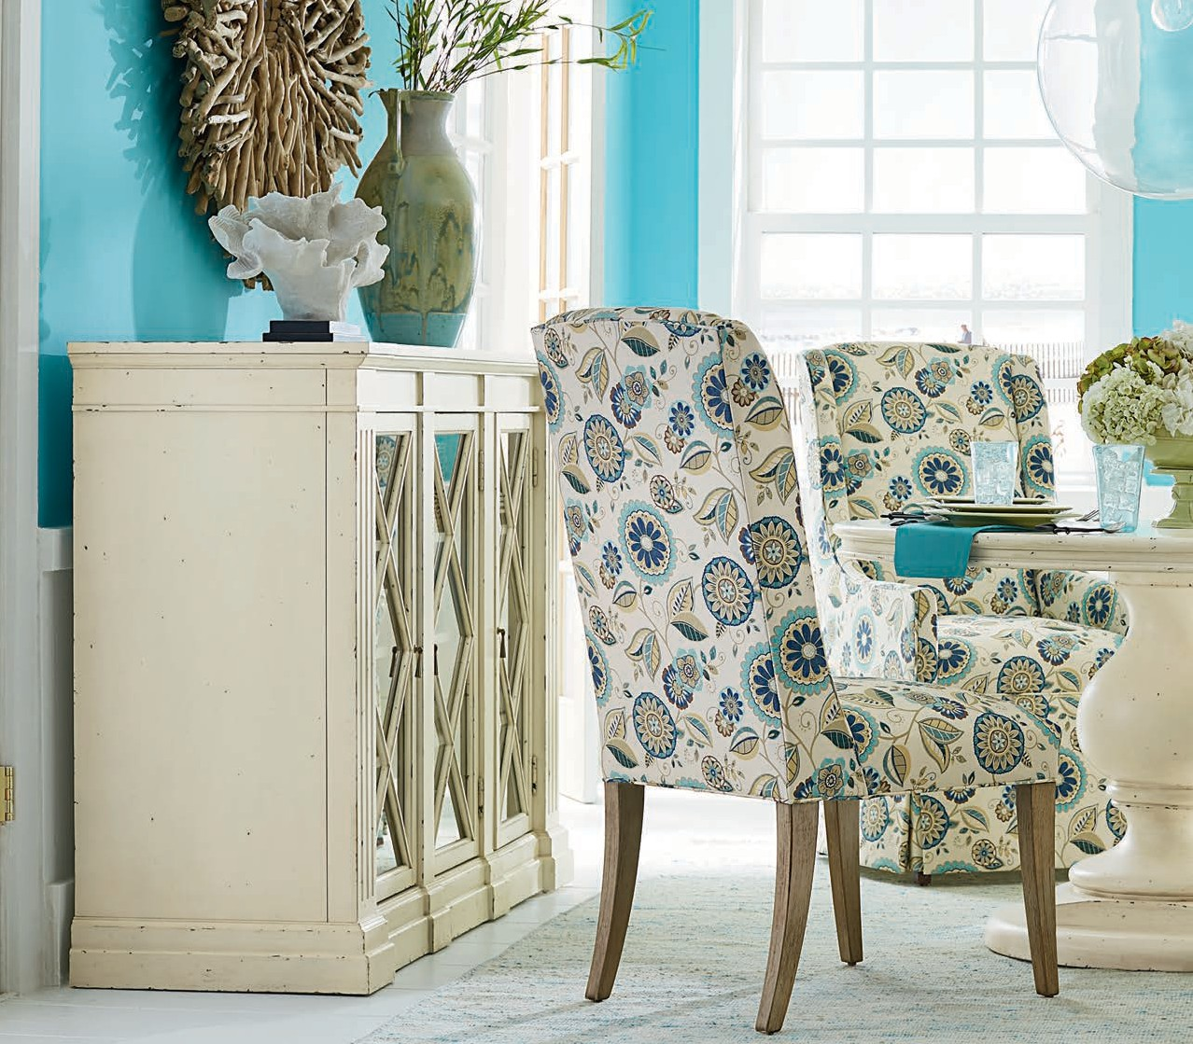

STYLE
ADD A LITTLE
TO YOUR LIFE
WOOD PRODUCT
SOLID HERITAGE. QUALITY CRAFTSMANSHI P. STYLISH SELECTION. DEDICATED SER VICE.

Slide 2
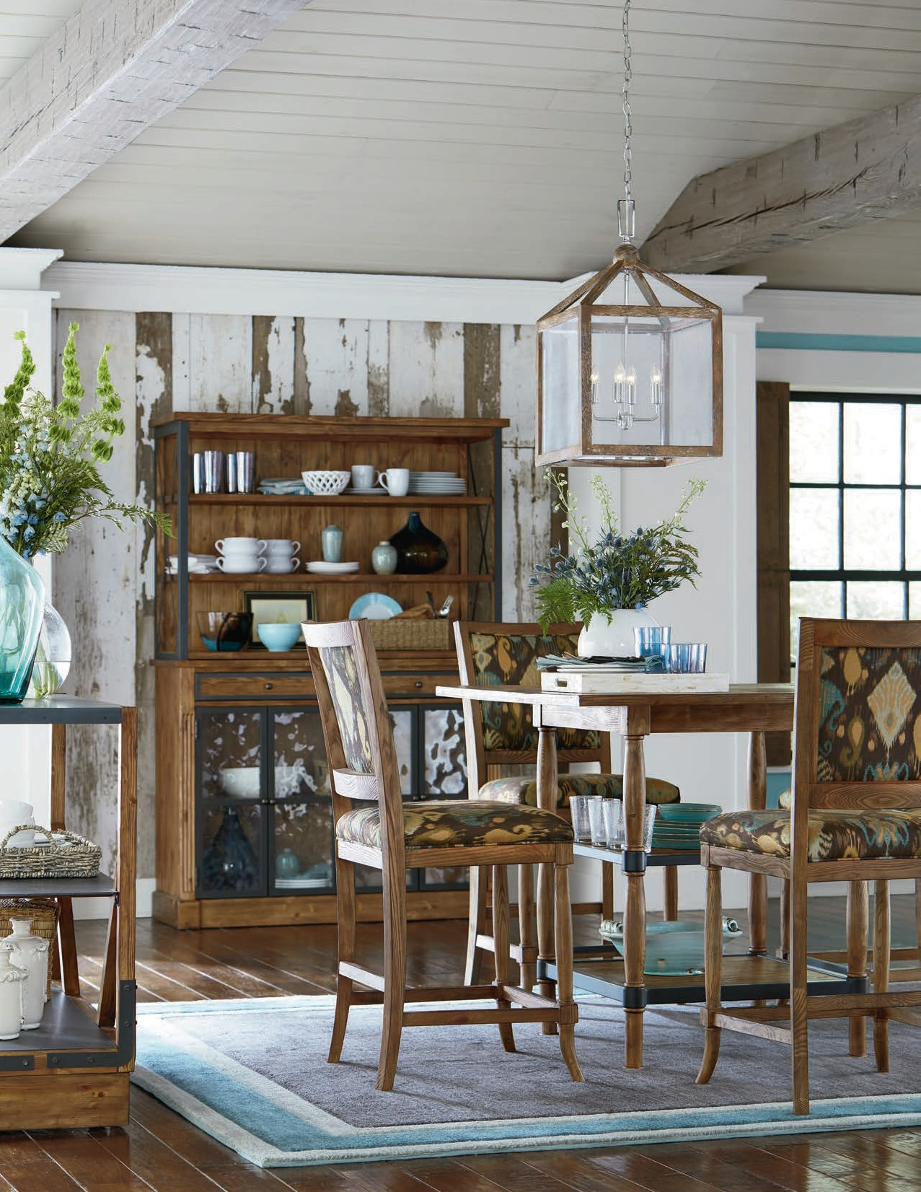
SHOWN: 8104-48 MOBILE SERVER | 8104-83 DECK | 8104-45 LOW BOOKCASE | 8104-B7 BISTRO STOOL 8104-BT BISTRO TABLE

Slide 3

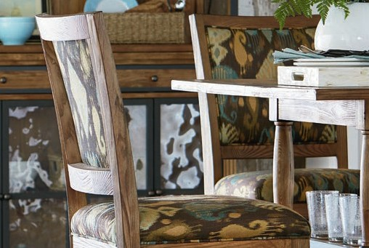
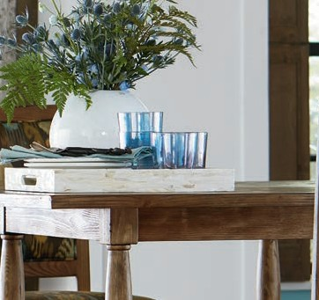
STYLE
ADD A LITTLE
TO YOUR LIFE
EVERYTHING WE DO STARTS AND FINISHES WITH YOU.
SOLID HERITAGE
For nearly a century, we’ve combined masterful craftsmanship with fashion-forward design of fine furnishings for the home. We’re a family of craftspeople who care about our community, the environment, and you.
QUALITY CRAFTSMANSHIP
It’s part of our DNA. It’s the fabric of our company, and it’s woven into everything we do. It’s why we put attention to detail first, second, and third.
STYLISH SELECTION
Choose from a wide variety of fashionable style and comfort for the living room, dining room, and everywhere in between.
DEDICATED SERVICE
We make it easy for you. Quality, value, style, and comfort delivered in a timely fashion by people who care.

Slide 4
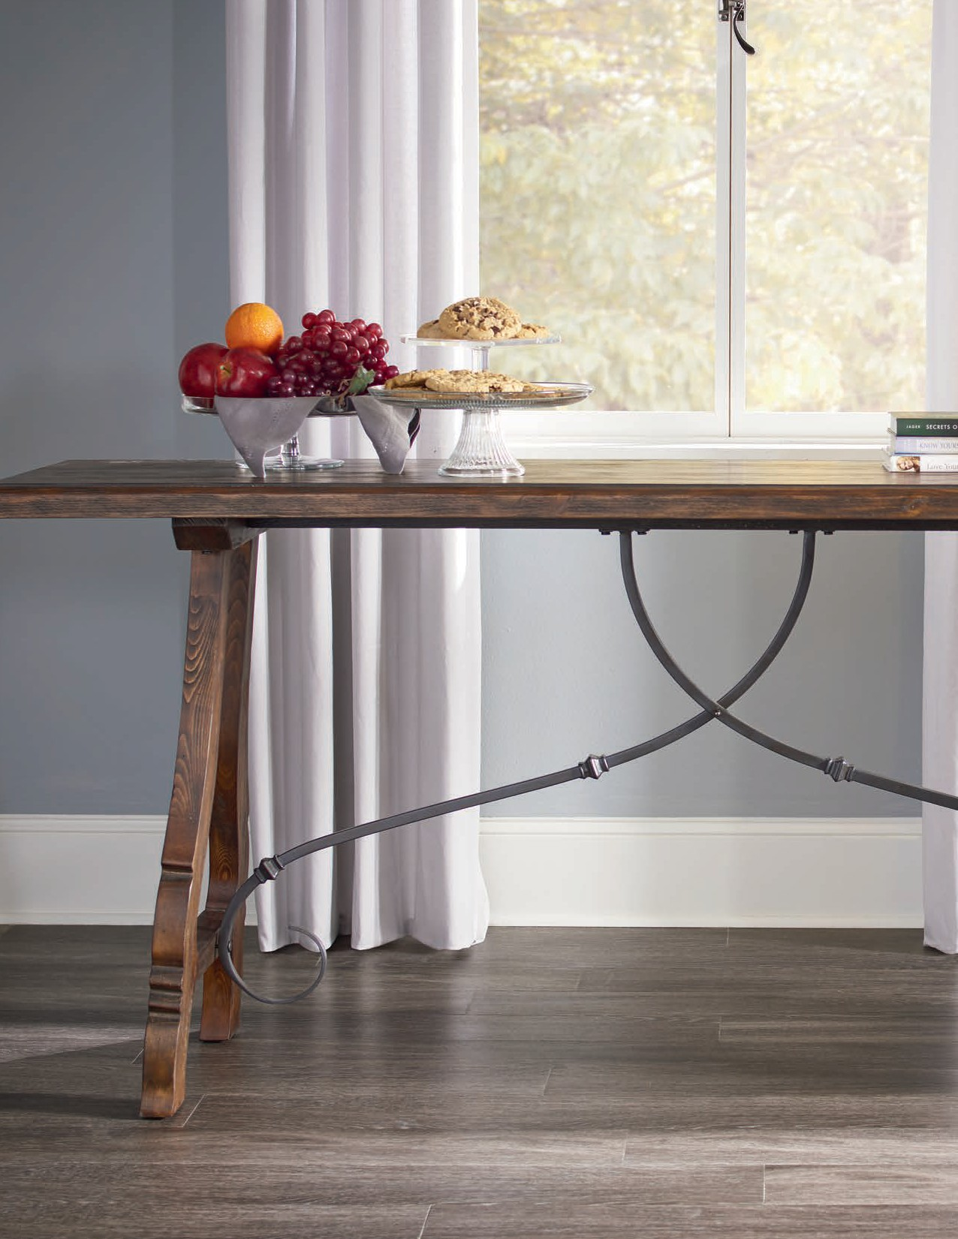
SHOWN: 8109-99 Console Table

Slide 5
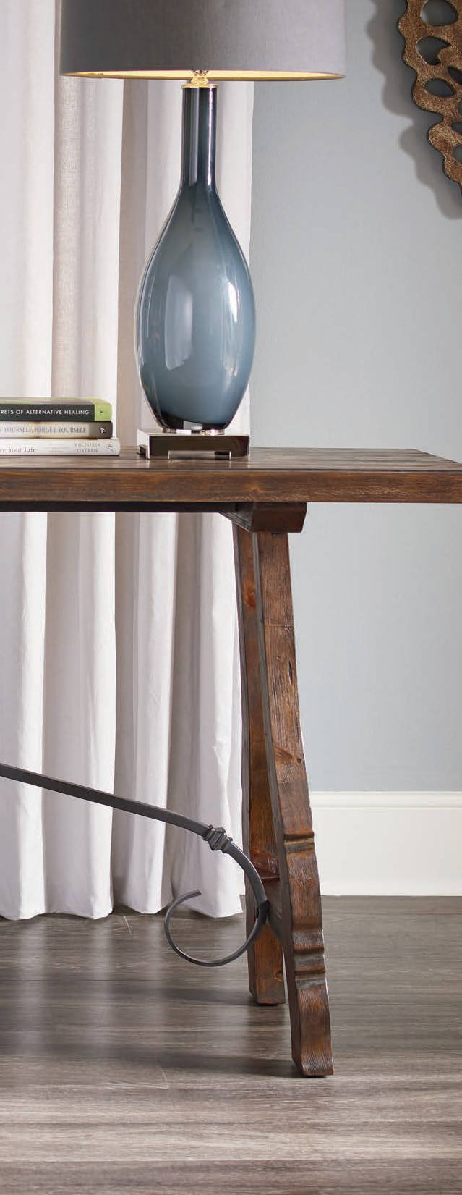
STYLE
ADD A LITTLE
TO YOUR LIFE
1300/1301 Expedition.............................4
8010 Regency..........................................6
8050 Heirloom.......................................10
8055 Heritage........................................14
8065 Highland Ridge ............................16
8095 Cambridge ...................................20
8097 Havana Hill ...................................22
8101 Chatham .......................................26
8104 Boone Forge ................................28
8105 Belmont ........................................34
8106 Edgewood....................................40
8107 Atwood .........................................44
8109 Churchill........................................46
8110 Tribeca ..........................................50
8111 Antiquity .......................................54
8113 Rustiqué........................................56
8114 Tranquility Shores ........................58
8115 Grandview ....................................60
8116 Park West......................................64
8117 Silverstone....................................66
8120 Manhattan ....................................68
8122 Lumieré.........................................76
8123 Harborside....................................78
8124 Stockbridge..................................80
8125 Portica...........................................82
8127 Nottington Cottage.....................84
8129 Newcastle.....................................86
8150 Genesis .........................................88
8155 Café Noir ......................................92
8160 Revelation.....................................94
8190 Townsend .....................................98
8196 Artisan.........................................102
8199 Berkeley......................................106
Finishes................................................108
Construction/Care & Cleaning ..........110 Warranty ..............................................111
Frame Index ........................................112

Slide 6
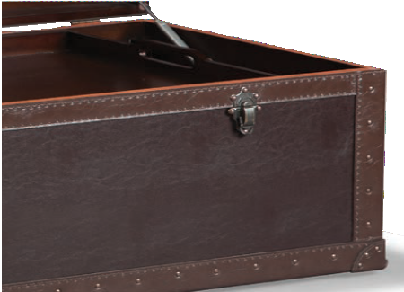
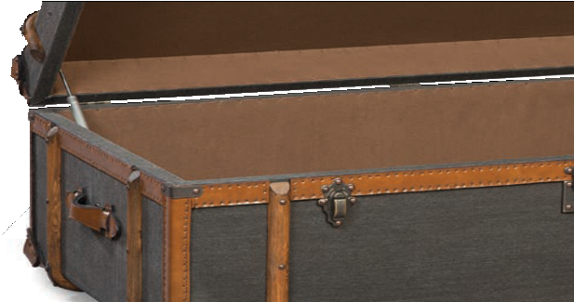
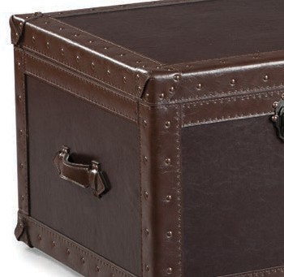
THE EXPEDITION COLLECTION
While the Cocktail Trunks of the Expedition
Collection may remind you of antique steamer
trunks that hail from yesteryear, make no mistake about it: these have been handcrafted for today.
Choose from dark brown leather with nail-head
trim or gray canvas accented with wood trim and
antiqued leather. Both models feature lift tops with
safety slow-close hinges, a modern touch that makes these pieces as functional as they are beautiful.

Slide 7
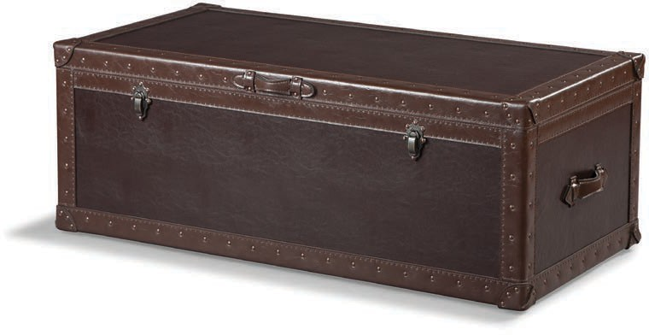
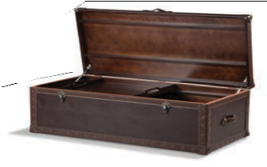
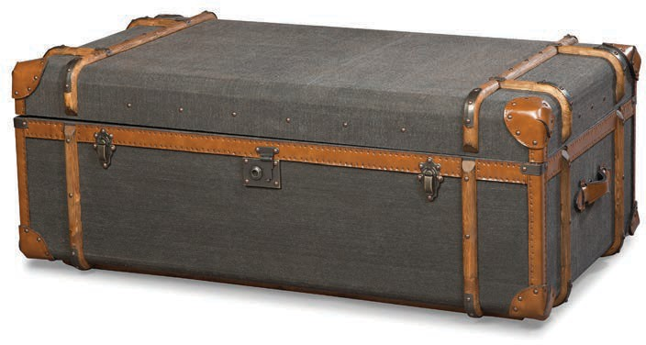
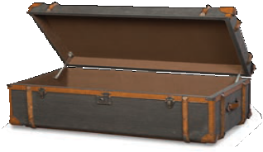

1300/1301 - ExPEDITION COLLECTION | 5
1300-TK C OCKTAIL TRUNK w 48 | d 24 | h 18 in.
Features a lift top with storage, one removable tray, casters for easy movement, and a slow-close hinge for safety.
1301-TK COCKTAIL TRUNK w 49 | d 26.5 | h 19 in.
Features a lift top with storage and a slow-close hinge for safety.

Slide 8
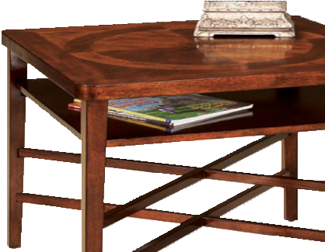
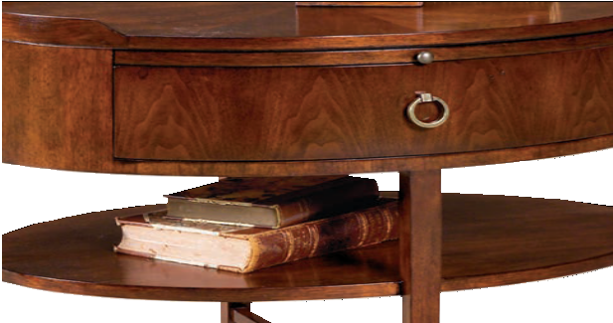
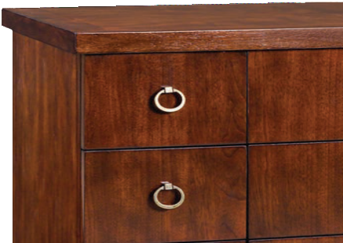
THE REGENCY COLLECTION
CANDLELIGHT FINISH
While the Regency Collection is steeped in
European tradition, it’s also been subtly updated to offer transitional appeal. Evoking Regency and Biedermeier period antiques, these pieces merge classic forms with tapered legs to create elegant options that fit any living space.
Finishing touches include an antique brass finish
found on hardware, and a Candlelight finish found on Asian cherry solids and veneers. With the
Regency Collection, cultivating a sense of style and sophistication has never been easier.

Slide 9
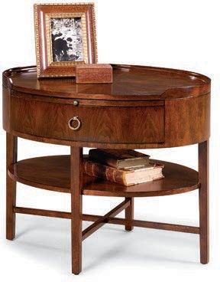
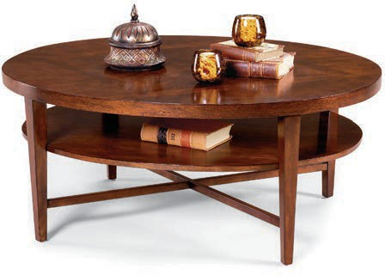
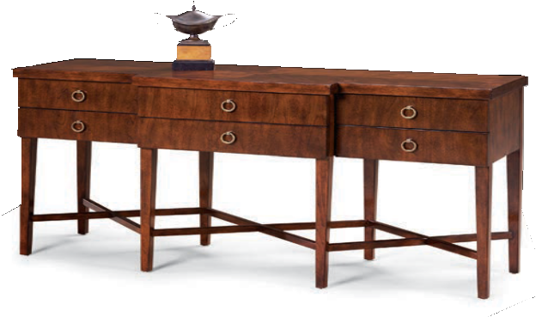
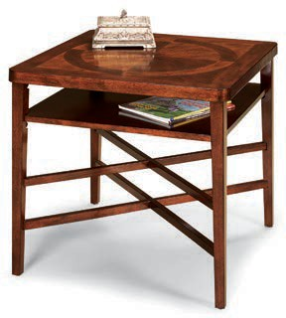
8010 - REGENCY COLLECTION | 7
8010-46 OVAL COCKTAIL TABLE w 48 | d 38 | h 20 in.
Features one fixed shelf.
8010-47 OVAL END TABLE w 30 | d 22 | h 25 in.
Features one drawer, a top pull-out tray, and one fixed shelf.
8010-94 SQUARE END TABLE w 26 | d 26 | h 24 in.
Features one fixed shelf.
8010-99 SOFA TABLE w 56 | d 18 | h 29 in.
Features 6 individual drawers.

Slide 10
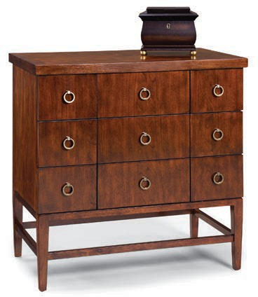
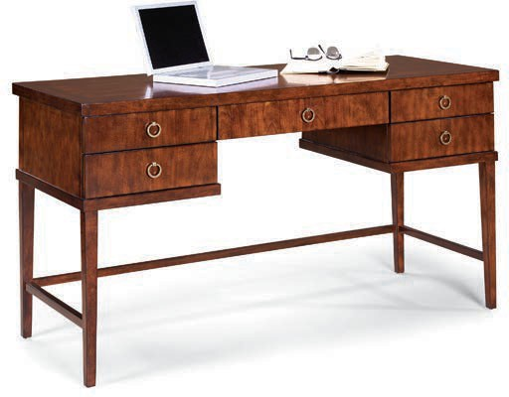

8 | 8010 - REGENCY COLLECTION
8010-38 SMALL CONSOLE CHEST w 32 | d 18-1/2 | h 33 in.
Features 9 individual drawers.
8010-81 WRITING DESK w 56 | d 22 | h 30.5 | Apron Height: 24.5 in.
Features 5 drawers. Center drawer has drop-front for laptop keyboard use.

Slide 11
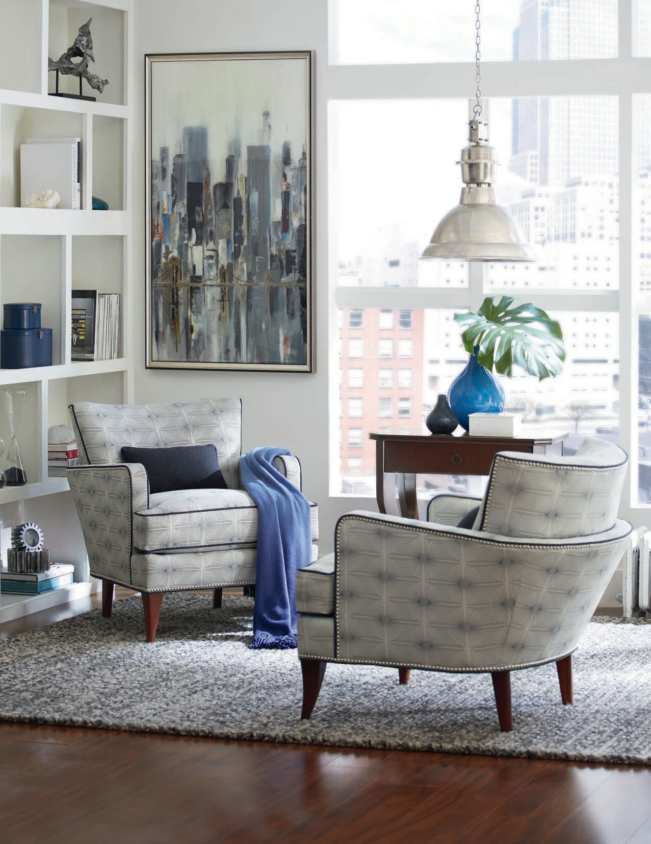
SHOWN: 8115-95 END TABLE

Slide 12
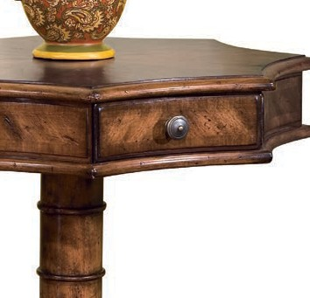
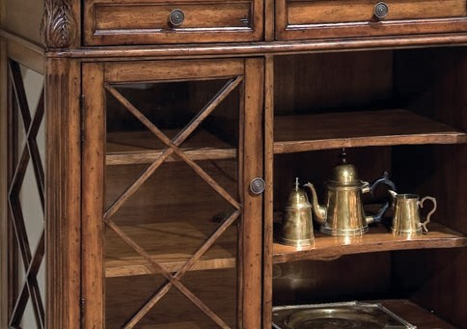
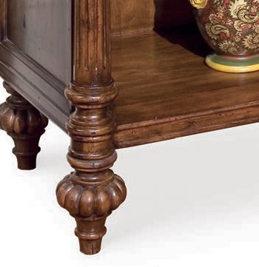
THE HEIRLOOM COLLECTION
HEIRLOOM FINISH
Much like the treasures found in a Paris flea market,
the pieces of the Heirloom Collection have the feel
of antiques passed down from generation to generation.
For these pieces, warm stains and glazes have been
deepened with hand burnishing, while cast zinc hardware pairs with unique design flourishes like
molded and hand-carved edges. To create a living
space with Old World charm, the Heirloom Collection delivers now, and for many years to come.

Slide 13
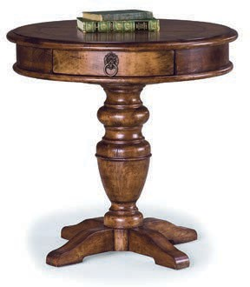
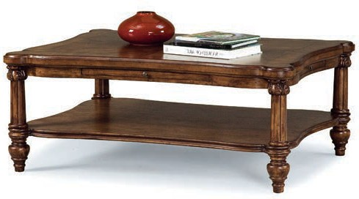
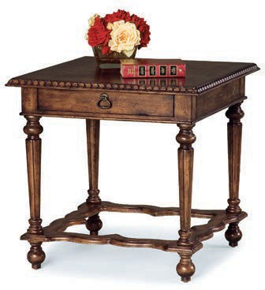
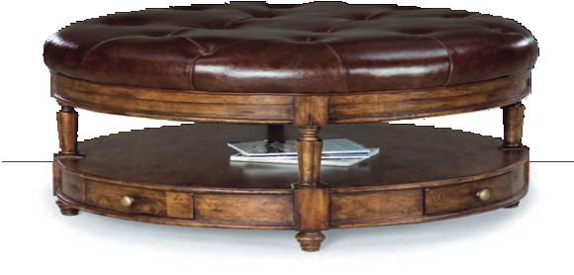
8050 - HEIRLOOM COLLECTION | 11
8050-93 RECTANGULAR COCKTAIL TABLE w 48 | d 36 | h 19 in.
Features 2 pull-outs (one on each side) and one fixed shelf.
8050-19 ROUND END TABLE w 26 | d 26 | h 26 in.
Features one drawer. Consists of: 8050-19-T (top) and 8050-19-B (base).
8050-94 SQUARE END TABLE w 26 | d 26 | h 25 in.
Features one drawer.
8050-20 COCKTAIL OTTOMAN w 42 | d 42 | h 20.5 in.
Features 4 drawers and a finished bottom shelf. Available only as shown in Chestnut color leather.

Slide 14
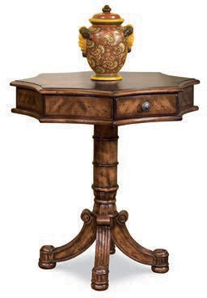
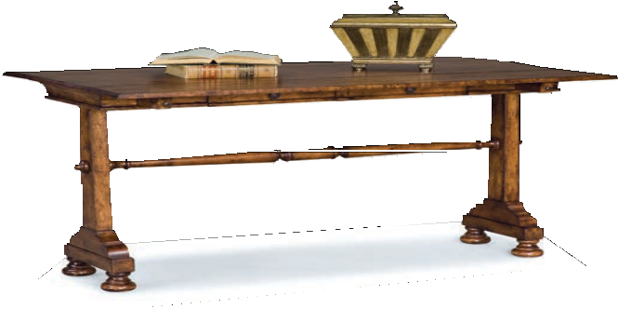
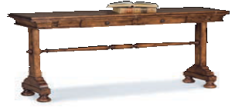
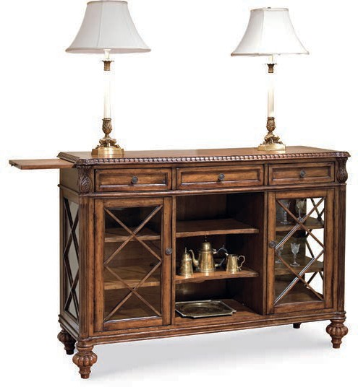
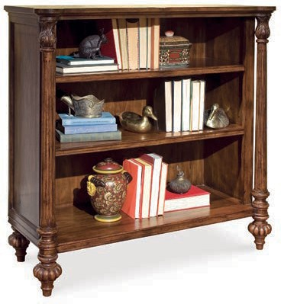
12 | 8050 - HEIRLOOM COLLECTION
8050-98 LAMP TABLE w 26 | d 26 | h 26 in.
Features one drawer. Consists of: 8050-98-T (top) and 8050-98-B (base).
8050-99 SOFA TABLE w 60 | d 32 | h 30 in. Closed: w 60 | d 16 | h 31.5 in.
Features 2 drawers and a two-piece flip top with pull-out supports.
8050-85 BOOKCASE w 42 | d 18 | h 42 in.
Features 2 adjustable shelves.
8050-82 SERVER w 48 | d 16 | h 38.5 in.
Features 2 pull-outs (one on each end), 3 drawers on top, 2 fixed shelves, and 2 adjustable/removable shelves behind each door.

Slide 15
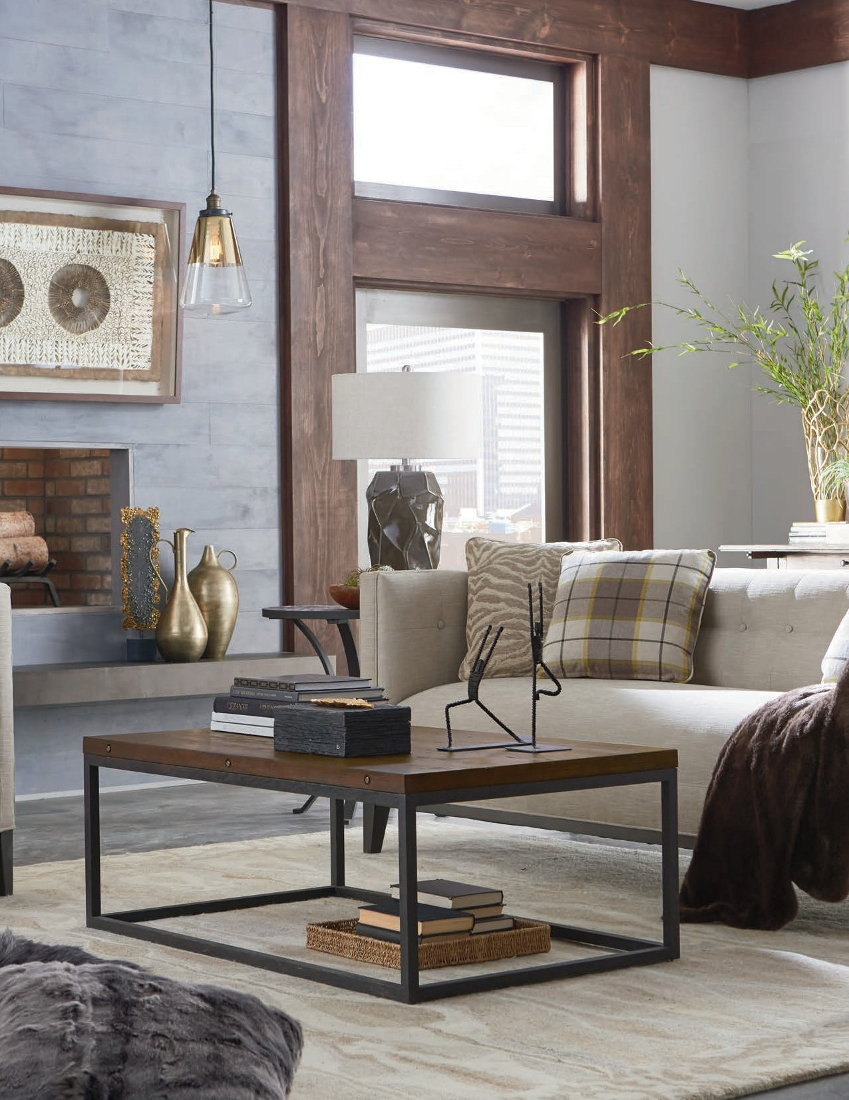
SHOWN: 8109-RC RECTANGULAR COCKTAIL TABLE | 8109-19 LAMP TABLE | 8109-FT FLIP-TOP TABLE

Slide 16
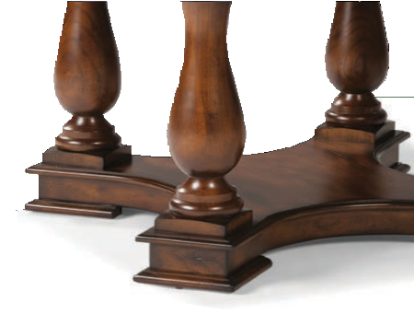
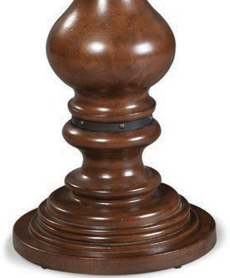
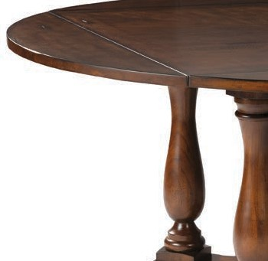
THE HERITAGE COLLECTION
OLD ENGLISH FINISH
With Southern European design as an inspiration,
the Heritage Collection offers pieces with the
sophisticated elegance you’d expect from the old country. This is clearly evident in the generously
scaled and shaped post and leg turnings, as twisted rope pedestal carvings prove our commitment to
meticulous craftsmanship.
Elm veneers and solids feature our Old English finish,
which is distressed by hand with added burnishing that perfectly complements these classic forms.

Slide 17
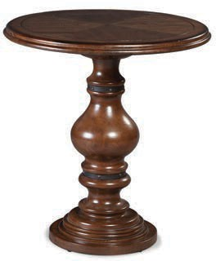
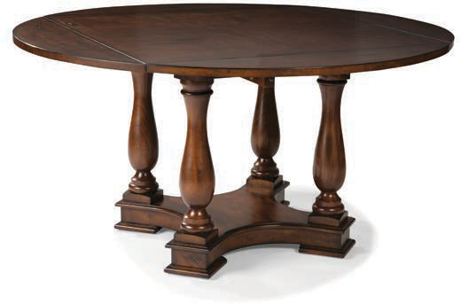
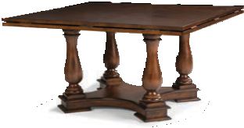
8055 - HERITAGE COLLECTION | 15
8055-90 LAMP TABLE w 26 | d 26 | h 28 in.
Consists of: 8055-90-T (top) and 8055-90-B (base).
8055-DT DINING TABLE w 59 | d 59 | h 30 in. Closed: w 42 | d 42 | h 30 in.
Goes from square to round with supported flip top. Consists of: 8055-DT-T (top) and 8055-DT-B (base).

Slide 18
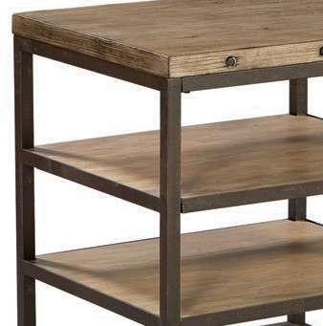
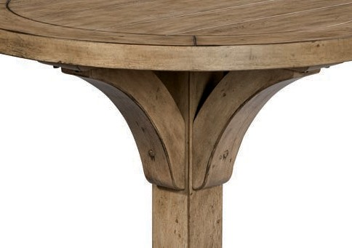
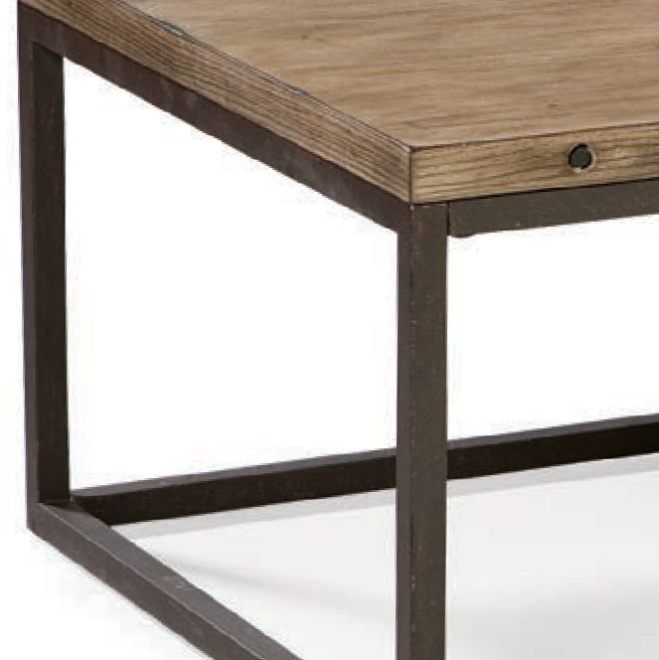
THE HIGHLAND RIDGE COLLECTION
BRUSHED LINEN FINISH
With its architectural flair and roots in post-industrial
design, the Highland Ridge Collection brings clean lines to any living space. While the distinctive grain patterns of elm solids and veneers come with a
Brushed Linen finish, the grain is first brought to the forefront with a light wire brushing technique.
This effect complements the textured surfaces found
on the hand-forged steel frames, giving this set of tables a more relaxed feel. Whether one piece
is part of your eclectic ensemble, or the complete collection is ideal for your personal aesthetic, the Highland Ridge Collection delivers sleek style and casual elegance.

Slide 19
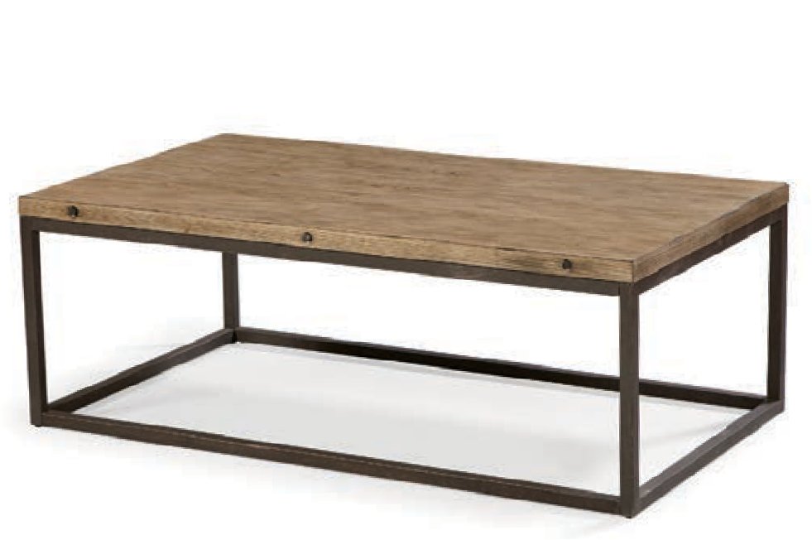
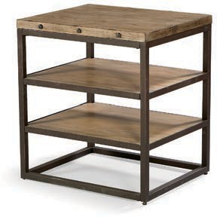
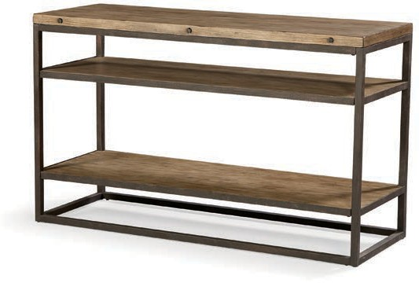
8065 - HIGHLAND RIDGE COLLECTION | 17
8065-93 RECTANGULAR COCKTAIL TABLE
w 48 | d 28 | h 17.5 in.
8065-98 TRAY TABLE w 24 | d 20 | h 25.5 in.
Features 2 fixed shelves.
8065-99 SOFA TABLE w 52 | d 18 | h 31.5 in.
Features 2 fixed shelves.

Slide 20
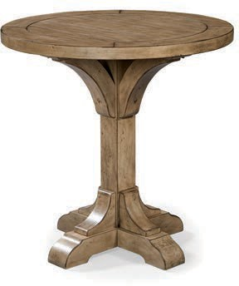
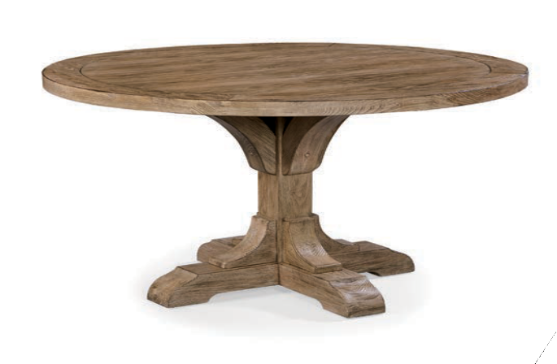

18 | 8065 - HIGHLAND RIDGE COLLECTION
8065-BT BISTRO TABLE
w 36 | d 36 | h 36 in.
8065-15 DINING TABLE w 48 | d 48 | h 30 in. Apron Height: 28.5 in.
Consists of: 8065-15-T (top) and 8065-15-B (base).

Slide 21

SHOWN: 8065-98 TRAY TABLE

Slide 22



THE CAMBRIDGE COLLECTION
OLD ENGLISH FINISH
Hand-distressed hardwood solids with cherry
veneers, beautifully scaled wood turnings, and
our exclusive Old English finish—these are just a
handful of the elements comprising the Cambridge Collection. The Tuscan influence on these two pieces is obvious, with traditional shapes and forms taking
center stage.
The Dining Table provides a refined sense of style.
The Hall Console follows suit offering storage with five drawers and adjustable shelving behind its two doors. If you’re looking for pieces with Old World
charm to add a touch of sophistication to your home, the Cambridge Collection certainly is a perfect fit.

Slide 23



8095 - CAMBRIDGE COLLECTION | 21
8095-15 DINING TABLE w 60 | d 42 | h 30 | Apron Height: 27 in.
Frame not warranted for contract/commercial application. Consists of: 8095-15-T (top) and 8095-15-B (base).
8095-96 HALL CONSOLE w 54 | d 18 | h 36.5 in.
Features 5 drawers (3 across the top and 2 deep center drawers) with an adjustable/removable shelf behind each door.

Slide 24



THE HAVANA HILL COLLECTION
OLD HAVANA FINISH
Inspired by the manor houses of Old England, the
Havana Hill Collection offers traditional style, all while striking a balance with design details that provide casual appeal.
Hand-distressed hardwood solids with cherry
veneers have rich undertones that are hand- rubbed to achieve an oiled bronze look. The
end result is a stunning two-tone effect, one that features our Old Havana finish with Old English
accents. To make a definitive statement—and turn heads in the process—look no further than the
Havana Hill Collection.

Slide 25




8097 - HAVANA HILL COLLECTION | 23
8097-98 END TABLE w 26 | d 26 | h 26 in.
Consists of: 8097-98-T (top) and 8097-98-B (base).
8097-19 ROUND END TABLE
w 26 | d 26 | h 25.5 in.
8097-RC RECTANGULAR COCKTAIL TABLE w 40 | d 28 | h 20 in.
Features one pull-out tray (each side) and one fixed shelf.
8097-90 LAMP TABLE w 26 | d 20 | h 25 in.
Features one drawer.

Slide 26


24 | 8097 - HAVANA HILL COLLECTION
8097-99 SOFA TABLE w 60 | d 32.5 | h 30 in. Closed: w 60 | d 16 | h 31.5 in.
Features a two-piece flip top with pull-out supports and 2 drawers (on one side only).

Slide 27

SHOWN: 8117-99 SOFA TABLE

Slide 28



THE CHATHAM COLLECTION
AMARETTO FINISH
Inspired by 18th century design, the handsome
Chest found in the Chatham Collection features a convex front curve, bracket feet, and brushed brass hardware details that give the piece a
traditional feel.
Made from mahogany veneers with walnut inlays
and selected hardwood solids, you’ll find our Heirloom finish on the top and our Amaretto
finish on the base, which makes for a fashionable two tone effect. To soften this formal style, the
finishes have been distressed by hand, giving the Chest the look of an aged antique.

Slide 29

8101 - CHATHAM COLLECTION | 27
8101-97 THREE DRAWER CHEST w 40.5 | d 17.5 | h 33 in.
Features one pull-out shelf, 2 drawers, and a bottom file drawer.

Slide 30



THE BOONE FORGE COLLECTION
WEATHERED PECAN FINISH
While the rustic, organic designs of the extensive
Boone Forge Collection offer a fresh approach
to vintage forms, these pieces also have Factory Chic leanings.
The Weathered Pecan wood finish found on
Russian pine solids and veneers has been
distressed for an aged, weathered look that pairs perfectly with the textured surface used on hand- forged steel elements. Eclectic and transitional, the unique pieces found in the Boone Forge
Collection can stand on their own or be paired together to transform your living space.

Slide 31




8104 - BOONE FORGE COLLECTION | 29
8104-93 RECTANGULAR COCKTAIL TABLE
w 46 | d 28 | h 18 in.
8104-90 LAMP TABLE
w 20 | d 14 | h 27 in.
8104-CS CHAIRSIDE TABLE
w 20 | d 20 | h 26 in.
8104-ET END TABLE w 25.5 | d 23 | h 26 in.
Features 2 fixed shelves.

Slide 32







30 | 8104 - BOONE FORGE COLLECTION
8104-38 THREE DRAWER CHEST w 48 | d 18 | h 35.5 in.
Features 3 drawers with faux silver paint and metal wrap.
8104-FT FLIP-TOP TABLE w 60 | d 32 | h 29.5 in. Closed: w 60 | d 16 | h 30.5 in.
Features two-piece flip top with pull-out supports.
8104-CH CHEST w 86 | d 20 | h 42 in.
Features 2 drawers and 4 doors with adjustable/ removable shelves behind each set of doors.
8104-12 NESTING TABLES Small: w 19 | d 16 | h 18.5 in. Medium: w 22 | d 20 | h 19.5 in. Large: w 23 | d 22 | h 21 in.
Three nesting table set. Folds for easy storage. Frame not warranted for contract/commercial application.

Slide 33




8104 - BOONE FORGE COLLECTION | 31
8104-83 DECK w 48 | d 17 | h 35 in.
Deck features 2 adjustable/removable shelves.
8104-45 LOW BOOKCASE w 50 | d 18 | h 38 in.
Bookcase features 4 metal doors with antique glass, one fixed shelf, and two metal-wrapped drawers.
8104-99 CONSOLE w 56 | d 18 | h 36 in.
Features one fixed shelf.
8104-MC MEDIA CONSOLE w 56 | d 18 | h 29.5 in.
Features 2 drawers, 2 adjustable/removable shelves, and casters for easy movement.

Slide 34




32 | 8104 - BOONE FORGE COLLECTION
8104-BT BISTRO TABLE w 42 | d 42 | h 36 in.
Features 2 fixed shelves.
8104-B7 BISTRO STOOL ^{L} w 20 | d 22.5 | h 42.5 | sh 26 | sd 17 in.
Standard with Aged Bronze kickplate.
8104-07 BAR STOOL w 18 | d 18 | h 32.5 | sh 28.5 in.
Features a swivel seat.
8104-48 MOBILE SERVER w 48 | d 16 | h 35.5 in.
Features metal-clad shelves and hidden casters.
L Available in Leather

Slide 35


8104 - BOONE FORGE COLLECTION | 33
8104-DT DINING TABLE
w 54 | d 54 | h 30 | Apron Height: 25.5 in.
8104-44 DINING TABLE
w 84 | d 40 | h 30 in.

Slide 36



THE BELMONT COLLECTION
SABLE FINISH
What happens when you blend traditional forms
with transitional style? The answer is the Belmont Collection, which features elm and birch solids
and veneers in our Sable finish.
Though familiar designs offer clean lines and
structured characteristics, the random veneer patterns offer a neoclassical look, softening pieces that have more formal elements. The offerings of the Belmont Collection are as
gorgeous as they are versatile. That’s what affords them the unique ability to bring form and function to any living space.

Slide 37




8105 - BELMONT COLLECTION | 35
8105-90 CHAIRSIDE TABLE w 20 | d 20 | h 26 in.
Features one drawer and 2 fixed shelves.
8105-96 SIDE TABLE w 40 | d 18 | h 29 in.
Features one drawer and one fixed shelf.
8105-93 RECTANGULAR COCKTAIL TABLE w 48 | d 32 | h 19 in.
Features one fixed shelf.
8105-94 SQUARE END TABLE
w 24 | d 24 | h 26 in.

Slide 38




36 | 8105 - BELMONT COLLECTION
8105-47 OVAL END TABLE w 26 | d 22 | h 25 in.
Features one fixed shelf.
8105-19 ROUND END TABLE w 24 | d 24 | h 28 in.
Features 2 fixed shelves.
8105-ET ROUND END TABLE w 22 | d 22 | h 26 in.
Features one fixed shelf.
8105-88 MARTINI TABLE w 14.5 | d 14.5 | h 24 in.
Features one fixed shelf.

Slide 39




8105 - BELMONT COLLECTION | 37
8105-AT ACCENT TABLE w 26 | d 26 | h 26 in.
Features one fixed shelf.
8105-86 ENTRY TABLE w 36 | d 36 | h 30 in.
Consists of: 8105-86-T (top) and 8105-86-B (base).
8105-CS CHAIRSIDE TABLE
w 26 | d 26 | h 25 in.
8105-99 SOFA TABLE
w 60 | d 17 | h 29 in.

Slide 40



38 | 8105 - BELMONT COLLECTION
8105-AC ACCENT CHEST w 48 | d 18 | h 36 in.
Features 3 drawers with silver leaf inlay under drawer carvings.
8105-17 SIDEBOARD w 60 | d 21 | h 42 in.
Features 2 left side (facing) doors with one removable shelf and 2 top trays. Right side features one door opening to a separate section with a removable shelf and one tray. Features silver leaf inlay.

Slide 41


8105 - BELMONT COLLECTION | 39
8105-15 ROUND DINING TABLE
w 48 | d 48 | h 30 | Apron Height: 26 in.

Slide 42



THE EDGEWOOD COLLECTION
GRAYSTONE FINISH
For a fresh take on Factory Chic, look no further
than the organic forms of the Edgewood Collection.
Here Russian pine solids and veneers have been
hand-worn and distressed with our Graystone finish, while metal elements have been hand-forged for
added texture, ultimately giving pieces a weathered look and an immediately-at-home feel. When the
relaxed aspects of the Edgewood Collection meet, its unique design flourishes, with results that are
truly special.

Slide 43






8106 - EDGEWOOD COLLECTION | 41
8106-20 OTTOMAN ^{L}
w 22.5 | d 18.5 | h 20 in.
8106-93 COCKTAIL TABLE
w 52 | d 34 | h 18 in.
8106-FT FLIP-TOP TABLE w 36 | d 36 | h 29.5 in. Closed: w 36 | d 18 | h 30.5 in.
Features two-piece flip top with pull-out supports and one drawer.
8106-95 END TABLE w 27 | d 15 | h 27 in.
Features one drawer.
L Available in Leather

Slide 44




42 | 8106 - EDGEWOOD COLLECTION
8106-96 HALL CONSOLE TABLE
w 54 | d 19 | h 29 in.
8106-RC RECTANGULAR COCKTAIL TABLE
w 48 | d 28 | h 17.5 in.
8106-ET END TABLE w 25.5 | d 23 | h 26 in.
Features 2 fixed shelves.
8106-19 LAMP TABLE
w 26 | d 26 | h 26 in.

Slide 45



8106 - EDGEWOOD COLLECTION | 43
8106-99 CONSOLE TABLE
w 76 | d 20 | h 33 in.
8106-AC ACCENT CHEST w 48 | d 18 | h 36 in.
Features 3 drawers.
8106-MC MEDIA CONSOLE w 63 | d 20 | h 32 in.
Features 3 doors with framed glass and metal overlays, with one removable shelf behind each door.

Slide 46



THE ATWOOD COLLECTION
SL ATE FINISH
The Atwood Collection Console Chest has clean,
straight lines and a casual design.
Built from quartered white oak solids and elm
veneers, the inherent grain pattern found on this piece is underscored by our Slate finish, which provides soft gray undertones that give the Chest its singular look. Square ring pulls
add another transitional touch, ensuring that the Atwood Collection’s traditional furniture design is balanced with a modern aesthetic.

Slide 47

8107 - ATWOOD COLLECTION | 45
8107-97 CONSOLE CHEST w 44 | d 17 | h 36 in.
Features 4 drawers.

Slide 48



THE CHURCHILL COLLECTION
TOBACCO FINISH
In love with that reclaimed look? The Churchill
Collection merges traditional forms with rustic
style elements to deliver memorable pieces that fit seamlessly into your living spaces.
Russian pine solids and veneers come with our
rich Tobacco finish, which gives the collection its signature look. With additional options like
leather upholstery, planked tops, and nail-head trim, the Churchill Collection makes it easy to
create your own personal style.

Slide 49





8109 - CHURCHILL COLLECTION | 47
8109-93 COCKTAIL TABLE
w 52 | d 34 | h 18 in.
8109-20 OTTOMAN ^{L}
w 22.5 | d 18.5 | h 20 in.
8109-FT FLIP-TOP TABLE w 36 | d 36 | h 29.5 in. Closed: w 36 | d 18 | h 30.5 in.
Features two-piece flip top with pull-out supports and one drawer.
8109-95 END TABLE w 27 | d 15 | h 27 in.
Features one drawer.
L Available in Leather

Slide 50




48 | 8109 - CHURCHILL COLLECTION
8109-19 LAMP TABLE
w 26 | d 26 | h 26 in.
8109-ET END TABLE w 25.5 | d 23 | h 26 in.
Features 2 fixed shelves.
8109-RC RECTANGULAR COCKTAIL TABLE
w 48 | d 28 | h 17.5 in.
8109-99 CONSOLE TABLE
w 76 | d 20 | h 33 in.

Slide 51




8109 - CHURCHILL COLLECTION | 49
8109-ST DRAWER CONSOLE w 66 | d 17 | h 34 in.
Features 3 drawers and one fixed shelf.
8109-96 HALL CONSOLE TABLE
w 54 | d 19 | h 29 in.
8109-CH CHEST w 86 | d 20 | h 42 in.
Features 2 drawers and 4 doors with adjustable/ removable shelves behind each set of doors.
8109-MC MEDIA CONSOLE w 63 | d 20 | h 32 in.
Features 3 doors with framed glass and metal overlays, with one removable shelf behind each door.

Slide 52



THE TRIBECA COLLECTION
CHERR Y FINISH
With the Tribeca Collection, modern cabriole posts,
chamfered corners, and molded edges converge to offer an attractive set for those seeking clean yet
elegant style for their living spaces.
Birch solids and intricately spliced cherry veneers
feature our exclusive Cherry finish, giving pieces a “merlot” hue that accentuates the transitional designs. The Tribeca Collection offers the unique ability to unite subtle, contemporary touches with classic furniture design.

Slide 53




8110 - TRIBECA COLLECTION | 51
8110-47 OVAL END TABLE w 26 | d 18 | h 25 in.
Features one fixed shelf.
8110-19 ROUND END TABLE w 24 | d 24 | h 25 in.
Features one fixed shelf.
8110-94 SQUARE END TABLE w 24 | d 24 | h 25 in.
Features one fixed shelf.
8110-46 OVAL COCKTAIL TABLE w 48 | d 24 | h 18 in.
Features one fixed shelf.

Slide 54


52 | 8110 - TRIBECA COLLECTION
8110-99 SOFA TABLE w 56 | d 18 | h 29 in.
Features one fixed shelf.
8110-86 CONFERENCE TABLE
w 46 | d 46 | h 30 | Apron Height: 26 in.

Slide 55

SHOWN: 8115-46 OVAL COCKTAIL TABLE | 8115-19 ROUND LAMP TABLE | 8115-95 END TABLE

Slide 56



THE ANTIQUITY COLLECTION
PALL ADIUM FINISH
What’s most striking about the pair that makes
up the Antiquity Collection is the two-tone finish: birch solids feature ebonized cherry
veneers, which are embellished by the satiny Palladium finish.
Hand-painted silver leaf hardware, like
traditional knobs and ring pulls, illustrate
the collection’s commitment to clean design
elements...reinforcing its classic European roots and structured refinement.

Slide 57


8111 - ANTIQUITY COLLECTION | 55
8111-99 SOFA TABLE w 56 | d 14 | h 36 in.
Features 2 doors with a center shelf behind each door and silver leaf door fronts.
8111-CH CHEST w 40 | d 17 | h 37 in.
Features 3 drawers with silver leaf accents.

Slide 58



THE RUSTIQUÉ COLLECTION
RUSTIQUE FINISH
With the Rustiqué Collection, it’s all about the
finish, which is obvious in the name alone.
Elm and ash solids and veneers are meticulously
wire-brushed by hand, giving the collection not only highlights and lowlights in the grain, but
also its clear-cut rustic appeal. Acid-etched mirror doors with veneered overlays are just another
example of the superior craftsmanship and
attention to detail found in this memorable piece.

Slide 59

8113 - RUSTIQUé COLLECTION | 57
Need Image + Specs
8113-CH CHEST w 36 | d 16 | h 35 in.
Features 2 doors with an adjustable/removable shelf and acid etched mirror doors with veneered overlays.

Slide 60



THE TRANQUILITY SHORES COLLECTION
TRANQUILITY FINISH
The first thing you notice about the Tranquility
Shores Collection is the one-of-a-kind color
palette. Your second impression is the additional surprising details: glass door panels with aged
pewter metal grills, carved x-framed end panels, and European carved posts.
All of these elements combine to create this
impressive collection. But, the multi-colored finish, which is layered and hand-applied to provide
rich depth and character on every piece, is still the star here.

Slide 61




8114 - TRANQUILITY SHORES COLLECTION | 59
8114-AT ACCENT TABLE w 26 | d 26 | h 26 in.
Features one fixed shelf.
8114-94 END TABLE w 24 | d 24 | h 26 in.
Features carved X-framed end panels and 2 fixed shelves.
8114-CS CHAIRSIDE TABLE w 14.5 | d 22 | h 26.5 in.
Features one drawer and one fixed shelf.
8114-17 SIDEBOARD w 40 | d 17 | h 40 in.
Features 2 glass doors with an aged pewter metal grill and 2 adjustable/removable shelves.

Slide 62



THE GRANDVIEW COLLECTION
CANDLELIGHT FINISH
As a traditional luxury offering, the Grandview
Collection offers abundant examples of modern
flair, ultimately culminating as a furniture category all its own.
Cherry solids and veneers are balanced by our
Candlelight finish to offer timeless appeal, while split matched veneer insets and solid edge
perimeters serve as additional examples of
superior craftsmanship. When you indulge with
the Grandview Collection, you find yourself at the crossroads where vintage, traditional, and modern styles meet.

Slide 63




8115 - GRANDVIEW COLLECTION | 61
8115-90 CHAIRSIDE TABLE w 28 | d 28 | h 27.5 in.
Features 2 fixed shelves.
8115-47 OVAL END TABLE w 30 | d 22 | h 26.5 in.
Features one drawer and one fixed shelf.
8115-46 OVAL COCKTAIL TABLE w 42 | d 28 | h 19.5 in.
Features one fixed shelf.
8115-94 SQUARE END TABLE
w 21 | d 21 | h 23.5 in.

Slide 64




62 | 8115 - GRANDVIEW COLLECTION
8115-95 END TABLE w 29 | d 17 | h 27 in.
Features one drawer and one fixed shelf.
8115-19 ROUND LAMP TABLE
w 26 | d 26 | h 26 in.
8115-99 SOFA TABLE w 56 | d 18 | h 30.5 in. | Apron Height: 27 in.
Consists of: 8115-99-T (top) and 8115-99-B (base).
8115-15 DINING TABLE w 48 | d 48 | h 30.5 | Apron Height: 27.5 in.
Consists of: 8115-15-T (top) and 8115-15-B (base).

Slide 65

SHOWN: 8115-15 DINING TABLE

Slide 66



THE PARK WEST COLLECTION
VENEZIA FINISH
Maybe it’s the blended Regency styling with subtle
transitional overtones. Perhaps it’s the birch solids with book-matched Asian cherry veneers that
come with our Venezia finish. Or, possibly, it could be the finishing touch that comes in the form of
antique brass accents and hardware...
No matter the reason, the Park West Collection’s
allure is obvious, and its commitment to craftsmanship unmatched.

Slide 67




8116 - PARK WEST COLLECTION | 65
8116-93 COCKTAIL TABLE w 52 | d 30 | h 21 in.
Features 2 drawers and one fixed shelf.
8116-CS CHAIRSIDE TABLE
w 22 | d 22 | h 26 in.
8116-95 END TABLE w 22 | d 26 | h 28 in.
Features one drawer and one fixed shelf.
8116-CH CHEST w 40 | d 18 | h 36 in.
Features 3 drawers.

Slide 68



THE SILVERSTONE COLLECTION
GRAYSTONE FINISH
With the Silverstone Collection, the Graystone
finish found on the collection’s white oak and elm solids and veneers marries beautifully with silver
leaf inlays to create a duo of rustic pieces that
would be right at home in countless living spaces.
Additional design details found on doors and
drawers: quarter-cut doors with pierced and
carved overlays on the Sofa Table, and black ring pulls on the Chest. In the end, the Silverstone
Collection offers unique architectural elements, all while making its own refined statement.

Slide 69


8117 - SILVERSTONE COLLECTION | 67
8117-CH CHEST w 30 | d 16 | h 28 in.
Features 3 drawers with silver leaf inlay on drawer fronts.
8117-99 SOFA TABLE w 56 | d 14 | h 36 in.
Features 2 quarter-cut white oak doors with pierced and carved overlays and silver leaf inlay and a fixed center shelf behind each door.

Slide 70



THE MANHATTAN COLLECTION
MANHATTAN FINISH
Urban style and subtle sophistication often go
hand-in-hand. That’s certainly the case with the Manhattan Collection, a series of pieces
influenced by both Regency and 18th century European styles.
Alder solids and cherry veneers feature a dark
brown finish, only adding to the collection’s luxurious feel. However, the Manhattan
Collection’s uptown elegance isn’t just for city
dwellers—these warm and inviting pieces would be welcome additions in any home.

Slide 71




8120 - MANHATTAN COLLECTION | 69
8120-93 RECTANGULAR COCKTAIL TABLE
w 42 | d 26.5 | h 19.5 in.
8120-68 MAGAZINE TABLE w 22 | d 16 | h 25 in.
Features 3 fixed shelves.
8120-19 ROUND END TABLE w 30 | d 30 | h 29 in.
Features 2 fixed shelves.
8120-ST SOFA TABLE w 48 | d 18 | h 36 in.
Features one fixed shelf.

Slide 72




70 | 8120 - MANHATTAN COLLECTION
8120-47 OVAL END TABLE w 26.5 | d 22 | h 25 in.
Features one fixed shelf with drawer.
8120-98 STORAGE LAMP TABLE w 24 | d 24 | h 26 in.
Features 2 doors that open to a center storage area.
8120-94 SQUARE END TABLE w 26 | d 26 | h 26 in.
Features 2 drawers.
8120-91 CHEST COCKTAIL w 48.5 | d 28.5 | h 19 in.
Features 2 pull-outs (one on each end) and 3 pass-through drawers.

Slide 73




8120 - MANHATTAN COLLECTION | 71
8120-90 LAMP TABLE
w 26 | d 26 | h 25.5 in.
8120-CS CHAIRSIDE TABLE
w 27.5 | d 27.5 | h 25.5 in.
8120-ET END TABLE w 28 | d 24 | h 26 in.
Features 2 fixed shelves.
8120-96 SIDE TABLE w 32 | d 18 | h 32.5 in.
Features 3 fixed shelves.

Slide 74




72 | 8120 - MANHATTAN COLLECTION
8120-88 MARTINI TABLE
w 18 | d 18 | h 24 in.
8120-28 ACCENT TABLE w 18 | d 12 | h 25.5 in.
Features one pull-out tray and one fixed shelf.
8120-12 TABLE SET small: w 6.5 | d 6.5 | h 19 in. medium: w 11 | d 11 | h 24 in. large: w 14.5 | d 14.5 | h 26 in.
Features three nesting tables.
8120-38 CHEST w 30.5 | d 17.5 | h 32 in.
Features 3 drawers.

Slide 75





8120 - MANHATTAN COLLECTION | 73
8120-CH CHEST w 36.5 | d 18 | h 30 in.
Features 6 drawers.
8120-97 HALL CONSOLE w 38 | d 22 | h 29 in.
Features 2 drawers and one pull-out tray.
8120-17 FLIP-TOP CONSOLE w 60.5 | d 36.5 | h 36 in. closed: w 60.5 | d 18 | h 37 in.
Features one removable shelf on each side, 2 removable beverage trays, and 2 lower drawers.
8120-MC MEDIA CONSOLE w 63.5 | d 21 | h 36 in.
Features 3 drawers, 2 doors with 2 adjustable/removable shelves behind each door, and 2 adjustable/removable glass shelves in center section.

Slide 76





74 | 8120 - MANHATTAN COLLECTION
8120-15 DINING TABLE w 48 | d 48 | h 30 | Apron Height: 29.25 in. Consists of: 8120-15-T (top) and 8120-15-B (base).
Shown with (2) 8368-04 Arm Chairs and (2) 8368-05 Side Chairs.
8120-43 DINING TABLE w 92 | d 40 | h 31 in. Closed: w 72 | d 40 | h 31 in. Apron Height: 27.5 in.
Features a 20” leaf extension. Consists of: 8120-43-T (top) and 8120-43-B (base).

Slide 77

SHOWN: 8120-43 DINING TABLE

Slide 78



THE LUMIERÉ COLLECTION
CRÉME BRULEE FINISH
With its balanced scroll carvings and turnings,
the Lumieré Collection’s Accent Table certainly suggests the Baroque period.
But even with Old World European design
elements—such as the generous Ogee profile—
its acid-etched, mirror-top inlay and Créme Brulee finish are modern details that make it ideal in any home.

Slide 79

8122 - LUMIERé COLLECTION | 77
8122-AT ACCENT TABLE w 22 | d 22 | h 28 in.
Features an acid etched mirror top inlay.

Slide 80



THE HARBORSIDE COLLECTION
TARNISHED CREME FINISH
Evoking the warmth of the French countryside,
the Harborside Collection features multi-layered
finishes that have been conscientiously applied by hand to add depth and character. Dependent on the piece, additional design elements compete
for your attention: carved x-framed end panels, glass door panels with aged pewter metal grills, and handcrafted gallery moldings.
Capping things off is our signature Tarnished
Crème finish, which lends these pieces their shabby-chic appeal.

Slide 81




8123 - HARBORSIDE COLLECTION | 79
8123-94 END TABLE w 24 | d 24 | h 26 in.
Features carved X-framed end panels and 2 fixed shelves.
8123-CS CHAIRSIDE TABLE w 14.5 | d 22 | h 26.5 in.
Features one drawer and one fixed shelf.
8123-17 SIDEBOARD w 40 | d 17 | h 40 in.
Features 2 glass doors with an aged pewter metal grill and 2 adjustable/removable shelves.
8123-48 BAR CABINET w 38 | d 18 | h 42 in.
Features 2 doors with an adjustable/removable shelf and 6 drawers.

Slide 82



THE STOCKBRIDGE COLLECTION
STOCKBRIDGE FINISH
The heavily carved fronts and end panels of this
handsome Chest owe a debt to British Gentry
design, infusing the Stockbridge Collection with Old World charm.
The birch solids and veneers are offered in a
distinctive blue finish. As a finishing touch, we’ve added antique brass ring pulls on drawers, which
only add to the Stockbridge Collection’s time-worn antique feel and uncommon sense of style.

Slide 83

8124 - STOCKBRIDGE COLLECTION | 81
8124-38 CHEST w 39 | d 20 | h 36 in.
Features 4 drawers.

Slide 84



THE PORTICA COLLECTION
CHERR Y FINISH
This Sofa Table in the Portica Collection brings in
styling reliant on a combination of Biedermeier and 19th century design.
Classic shaping, combined with sophisticated
construction integrity, gives this piece a one-of- a-kind feel. A Cherry finish on birch solids and
intricately spliced cherry veneers, combined with antique brass hardware and accents allow this
collection to acknowledge its central European roots, and would be an ideal addition in your
home.

Slide 85

8125 - PORTICA COLLECTION | 83
8125-ST SOFA TABLE w 52 | d 20 | h 33.5 in.
Features one drawer. Consists of: 8125-ST-T (top) and 8125-ST-B (base).

Slide 86



THE NOTTINGTON COTTAGE COLLECTION
ANTIQUE PARCHMENT FINISH
The Nottington Cottage Collection is a perfect
example of what can happen when you pair strong design elements with the right finish.
While the pieces here are neoclassical in nature,
the Antique Parchment finish found on birch solids and select veneers has a softening effect, giving the collection a more casual feel. For a blend of
Old World European styles, the Nottington Cottage Collection is a savvy choice, one that will brighten
your living space for many years to come.

Slide 87



8127 - NOTTINGTON COTTAGE COLLECTION | 85
827R-48 48" TABLE TOP 827R-60 60" TABLE TOP (INSET) Top (-48): w 48 | d 48 | h 2.5 | Top (-60): w 60 | d 60 | h 2.5 in.
8127-TB TABLE BASE Base: w 26 | d 26 | h 27.5 in.
Frame not warranted for contract/commercial application.
8127-17 SIDEBOARD w 60 | d 20 | h 42 in.
Features 3 wood frame glass doors with carved X-inserts, with 3 adjustable/removable shelves behind each door.

Slide 88



THE NEWCASTLE COLLECTION
ENGLISH LINEN FINISH
The Chests found in the Newcastle Collection
have different design influences, but they have
one important characteristic in common: they’re a stylish choice for your interior.
While heavily carved fronts and end panels evoke
British Gentry design, an Empire influence also delivers casual-transitional undertones. The
English Linen finish is grey-white, which offers a tone-on-tone effect. Traditional pendant and knob pulls, in a smart pewter finish provide the finishing touch.

Slide 89


8129 - NEWCASTLE COLLECTION | 87
8129-38 CHEST w 39 | d 20 | h 36 in.
Features 4 drawers.
8129-CH CHEST w 42 | d 18 | h 33 in.
Features 4 drawers.

Slide 90



THE GENESIS COLLECTION
DUSTY KHAKI FINISH
The true artistry of the Genesis Collection is found
in its blend of subtle curves and clean lines. These occasional tables feature transitional designs that share a structured and sophisticated sensibility.
The Dusty Khaki finish delivers light cream
undertones to casual solids and veneers, giving this collection a relaxed vibe.
By updating classic forms, the Genesis Collection
honors the past, all while offering pieces perfectly crafted for present-day living spaces.

Slide 91




8150 - GENESIS COLLECTION | 89
8150-90 LAMP TABLE w 28 | d 28 | h 29 in.
Features one fixed shelf.
8150-47 OVAL END TABLE w 26 | d 22 | h 25 in.
Features one fixed shelf.
8150-95 RECTANGULAR END TABLE w 28 | d 19 | h 28 in.
Features one drawer and one fixed shelf.
8150-93 RECTANGULAR COCKTAIL TABLE w 44 | d 28 | h 20 in.
Features one drawer and one fixed shelf.

Slide 92




90 | 8150 - GENESIS COLLECTION
8150-46 OVAL COCKTAIL TABLE
w 44 | d 26 | h 19.5 in.
8150-86 ENTRY TABLE w 36 | d 36 | h 30 in.
Consists of: 8150-86-T (top) and 8150-86-B (base).
8150-96 DRAWER CHEST w 49 | d 20.5 | h 35 in.
Features 4 drawers and a curved front.
8150-38 CHEST w 32 | d 16 | h 30 in.
Features 3 drawers with silver leaf inlays.

Slide 93

SHOWN: 8129-CH CHEST | 8122-AT ACCENT TABLE

Slide 94



THE CAFÉ NOIR COLLECTION
ESPRESSO FINISH
Created as a casual-transitional set of tables for
bistro and café settings, the Café Noir Collection incorporates clean lines and sophisticated design elements in a warm Espresso finish to create a
truly tasteful look.
Dependent on the piece, additional design
details include hand-glazed finishes and antique brass hardware in the form of square ring pulls. Whether you’re serving yourself, or your guests, the Café Noir Collection is sure to impress.

Slide 95



8155 - CAFé NOIR COLLECTION | 93
8155-97 CHEST w 44 | d 17 | h 36 in.
Features 4 drawers.
8155-98 BISTRO TABLE w 30 | d 30 | h 36 in.
Consists of: 8155-98-T (top) and 8155-98-B (base).
8155-15 DINING TABLE w 48 | d 48 | h 30 in.
Consists of: 8155-15-T (top) and 8155-15-B (base).

Slide 96



THE REVELATION COLLECTION
GRAPHITE FINISH
Blending modern and traditional styles should be
easy. That’s exactly what the Revelation Collection offers with such a structured transitional look that also integrates elegant lines and subtle curves
into its distinct pieces.
The elm solids and veneers come with a rich
Graphite finish that’s been hand-wiped to reveal deep, rich brown undertones. Whether you
need a Dining Table, Chest, or Occasional Table, the Revelation Collection effortlessly offers
fashionable options.

Slide 97




8160 - REVELATION COLLECTION | 95
8160-90 LAMP TABLE w 28 | d 28 | h 29 in.
Features one fixed shelf.
8160-47 OVAL END TABLE w 26 | d 22 | h 25 in.
Features one fixed shelf.
8160-95 RECTANGULAR END TABLE w 28 | d 19 | h 28 in.
Features one drawer and one fixed shelf.
8160-93 RECTANGULAR COCKTAIL TABLE w 44 | d 28 | h 20 in.
Features one drawer and one fixed shelf.

Slide 98




96 | 8160 - REVELATION COLLECTION
8160-19 ROUND END TABLE
w 24 | d 24 | h 26 in.
8160-46 OVAL COCKTAIL TABLE
w 44 | d 26 | h 19.5 in.
8160-96 DRAWER CHEST w 49 | d 20.5 | h 35 in.
Features 4 drawers and a curved front.
8160-CC CHAIRSIDE CHEST w 14.5 | d 22 | h 26.5 in.
Features one drawer, one door, and one adjustable/removable shelf.

Slide 99



8160 - REVELATION COLLECTION | 97
8160-86 ENTRY TABLE w 36 | d 36 | h 30 in.
Consists of: 8160-86-T (top) and 8160-86-B (base).
8160-15 DINING TABLE
w 48 | d 48 | h 30 | Apron Height: 26 in.
8160-DT DINING TABLE
w 48 | d 48 | h 30 in.

Slide 100



THE TOWNSEND COLLECTION
COGNAC FINISH
For those with eclectic tastes, the Townsend
Collection will be an undeniable favorite. Though the pieces have a distinct European descent, the mix of options makes for endless combinations.
Warm stains and glazes over lightly distressed
elm solids and veneers accentuate the beautiful wood grain, and mate brilliantly with antique
metal accents. The traditional European stylings continue with clover leaf shapes, antique brass
foot rests, and fixed shelving. With the Townsend Collection, Old World charm is always on display.

Slide 101





8190 - TOWNSEND COLLECTION | 99
8190-88 MARTINI TABLE w 14.5 | d 14.5 | h 24 in.
Features one fixed shelf.
8190-28 ACCENT TABLE w 18 | d 17 | h 26 in.
Features a clover leaf design with 2 fixed shelves.
8190-19 ROUND END TABLE w 22 | d 22 | h 26 in.
Features 2 fixed shelves.
8190-13 COCKTAIL TABLE
w 42 | d 42 | h 19 in.

Slide 102





100 | 8190 - TOWNSEND COLLECTION
8190-94 SQUARE END TABLE w 24 | d 24 | h 27 in.
Features one drawer and one fixed shelf.
8190-93 RECTANGULAR COCKTAIL TABLE w 50 | d 30 | h 19 in.
Consists of: 8190-93-T (top) and 8190-93-B (base).
8190-CC CHAIRSIDE CHEST w 14.5 | d 22 | h 26.5 in.
Features one drawer, one door and one adjustable/removable shelf.
8190-99 FLIP-TOP TABLE w 56 | d 36 | h 30 in. closed: w 56 | d 18 | h 30.5 in.
Features a two-piece flip top with pull-out supports and 2 drawers (on one side only).

Slide 103



8190 - TOWNSEND COLLECTION | 101
8190-BT BISTRO TABLE w 36 | d 36 | h 36 in.
Consists of: 8190-BT-T (top) and 8190-BT-B (base).
8190-43 DINING TABLE w 84 | d 40 | h 30 in.
Inset detail shown right. Consists of: 8190-43-T (top) and 8190-43-B (base).

Slide 104



THE ARTISAN COLLECTION
MICA FINISH
The Artisan Collection only has one rule—expect
the unexpected. This transitional style comes from a unique merger of Art Deco elements blended
with mid-century modern designs.
The Mica finish incorporates a gray stain
that’s been lightly wiped to achieve a warm
transparency of grain. Some pieces are made solely from birch solids and fashioned cherry
veneers, while others mix materials by including antique brass bases. In the end, the Artisan
Collection is designed to capture your attention and never let go.

Slide 105




8196 - ARTISAN COLLECTION | 103
8196-28 ACCENT TABLE
w 20 | d 20 | h 25 in.
8196-90 CHAIRSIDE TABLE
w 20 | d 20 | h 25 in.
8196-CS CHAIRSIDE TABLE
w 29 | d 29 | h 29 in.
8196-88 MARTINI TABLE
w 19 | d 19 | h 25 in.

Slide 106





104 | 8196 - ARTISAN COLLECTION
8196-MT MOBILE TANDEM TABLE w 22 | d 22 | h 20 in.
Features hidden casters.
8196-96 DEMILUNE w 54 | d 18.5 | h 32 in.
Features 2 drawers and 2 doors.
(two shown)
8196-15 DINING TABLE w 36 | d 36 | h 30 in.
Consists of: 8196-15-T (top) and 8196-15-B (base).
8196-DT DINING TABLE w 48 | d 48 | h 30 | Apron Height: 26 in.
Consists of: 8196-DT-T (top) and 8196-DT-B (base).

Slide 107

SHOWN: 8116-CS CHAIRSIDE TABLE

Slide 108



THE BERKELEY COLLECTION
OLD ENGLISH FINISH
The country elegance of Old England is clearly
evident in the Berkeley Collection, as design elements like bulbous leg turnings and pulled corners make a sophisticated statement.
The Game Table top features an intricate veneer
pattern, as well as offset drawers on all four sides.
The table serves as an ideal companion to the collection’s upholstered chairs. For those with
well-cultivated tastes, the luxurious pieces of the Berkeley Collection are a worthy investment.

Slide 109


8199 - BERKELEY COLLECTION | 107
8199-A4 OCCASIONAL CHAIR ^{L N}
w 24.5 | d 23 | h 36.5 in.
ah 25 | sh 20 | sd 18 | iw 21 in.
8199-87 GAME TABLE w 42 | d 42 | h 30.5 | Apron Height: 24.75 in.
Features 4 drawers and 4 antique metal coasters.
L Available in Leather
N Nail-head trim standard

Slide 110
















108 | FINISHES
FINISHES
Amaretto 8101
Antique Parchment 8127
Brushed Linen 8065
Candlelight 8010/8115
Cherry 8110/8125
Cognac 8190
Créme Brulee 8122
Dusty Khaki 8150
English Linen 8129
Espresso 8155
Graphite 8160
Graystone 8106/8117
Heirloom 8050
Manhattan 8120
Mica 8196
Old English 8055/8095/8199

Slide 111











FINISHES | 109
FINISHES
Old Havana 8097
Palladium 8111
Rustique 8113
Sable 8105
Slate 8107
Stockbridge 8124
Tarnished Creme 8123
Tobacco 8109
Tranquility 8114
Venezia 8116
Weathered Pecan 8104

Slide 112
110 | CONSTRUCTION/CARE & CLEANING
WOOD PRODUCT
WOOD PRODUCT: CONSTRUCTION
All occasional products manufactured by Fairfield Chair are built using the most trusted construction techniques that have been in practice for centuries. Ensuring the integrity of a piece of furniture is the number one priority in furniture construction. Therefore, we insist on holding to the furniture standards established through years of handcrafted furniture experience. Wood is a natural product which reacts to the environment and these furniture standards will allow the product to react without compromising the longevity.
The interior construction of a piece of wood furniture often plays a more important role in its longevity than its beautifully finished or natural exterior wood. Fairfield’s wood furniture construction uses a combination of solid hardwoods, plies and engineered wood. These parts are machined using Joinery techniques such as Mortise and Tenon joints, Dowel Joints and Dovetail joinery. While the design may demand a different type of joinery, all of our tops are constructed using veneer and engineered substrate (core) materials. This construction falls under the Plies and engineered wood application which allows beautiful veneers to be used on tops that will not move or transfer reaction to the environment into the tops.
We consider these manufacturing applications to be critical to our success. Wood furniture construction is both an art and a science. The beauty achieved through elaborate finishing techniques coupled with today’s advanced manufacturing techniques results in wood furniture that is not only very attractive, but sturdy and durable, too. Quality wood furniture, such as that you’ll find here at Fairfield Chair, may last several lifetimes.
For your health and safety, all Fairfield products meet California CARB Phase II standards for formaldehyde emissions.
WOOD PRODUCT: CARE AND CLEANING
For day to day maintenance, regular dusting with a dry soft cloth is recommended.
Cleaning requires only wiping with a clean, damp cloth and then drying. To remove general soil, the coated surface may be wiped clean with a fresh solution of mild soap (ie, Murphy’s Oil Soap; mix as directed) and water. The cloth should be soft and dampened with the soap solution. The surface should then be wiped down with a clean dry, soft cloth to remove excess moisture. It is important to ensure that the surface is dried. Always wipe in the direction of the wood grain.
Other “wood cleaning” products exist but may contain alkaline reagents or other ingredients which may damage the coated surface. Over time these materials can soften the finish potentially leading to film failure. The softening may also lead to incidental damage from environmental influences such as water or moisture damage, increased susceptibility to scratching or abrasion, and staining.
Household polishes that are wax free and silicone free can be used on an infrequent basis (we recommend Guardsman Furniture Polish).
Points to remember:
Routine cleaning will prevent long term damage from dirt and grease which will form a film over time, dulling and discoloring the finish. Using anything other than a mild soap solution and then drying the surface with a soft cloth may damage the finish.
Where possible, keep finish away from exposure to direct sun. Over time sunlight may change the color of the finish, and/or damage the finish.
Avoid extremes in temperature or moisture as they can cause wood to expand or contract leading to potential coating damage.

Slide 113
WARRANTY | 111
WARRANTY
LIFETIME LIMITED WARR ANTY: RESIDENTIAL
Fairfield warrants its merchandise to be free of defects in materials and workmanship for the life of the piece under normal residential use and conditions to the original purchaser.
fabrics are not covered by this warranty. Customer’s Own Material (COM) is not warranted.
Exceptions to this warranty include:
Seat cushion cores have a lifetime warranty against loss of resiliency. Through normal use, all cushion cores will soften and lose loft with time. Loose seat cushions and back pillows should be fluffed and turned weekly. Polyester fibers will lose loft with normal use and is not to be considered defective.
Commercial/Contract use (see separate warranty)
Fabrics – One (1) year
Customer’s Own Material (COM) – Not warranted
Standard Executive Swivel Bases and Mechanisms
  Five (5) years
Knee Tilt and Gas Lift Mechanisms – Five (5) years
Casters – Five (5) years
Glides – Not Warranted
Recliner Mechanisms (non-motorized) – Three (3) years
Recliner Mechanisms (motorized) – One (1) year
Swivel, Swivel Rocker and Swivel Glider Mechanisms
  Three (3) years
Sleeper Mechanisms – Three (3) years
Innerspring Sleeper Mattresses – Five (5) years
Renting, recovering, misuse or abuse
Damage due to carrier or customer handling
Case Goods – One (1) year
Warranty service is handled through the original furniture agent/dealer. Should service be needed, contact your furniture agent/dealer. After receiving Fairfield authorization, the agent/dealer will either repair or return the defective item to the factory for repair or replacement. Fairfield’s responsibility for transportation and labor is limited to one year from the original purchase date and to the transportation between the agent/dealer’s location and the factory. Outside the USA, warranty is limited to replacement parts only.
Replacement parts for office mechanisms, office bases, loose seat and back pillow cores and swivel rocker bases are without charge. Installation of these items is the responsibility of the dealer and is not covered by this warranty.
Fabrics will naturally stretch and wear with normal use and is not considered evidence of defectiveness. Fabric fading, piling, heavily soiled, improperly cleaned and “after-market” chemically treated
Consequential and incidental damages are excluded from this warranty. This warranty gives you specific legal right, and you may also have other rights that vary from state to state.
Our frames are constructed to support individuals up to 300 pounds.
LIFETIME LIMITED WARR ANTY: COMMERCIAL/CONTR ACT
Fairfield warrants its merchandise to be free of defects in materials and workmanship for Five (5) years under normal single shift use and conditions to the original purchaser.
Fabrics are not covered by this warranty (please use an appropriate wear tested fabric for use conditions).
Exceptions to this warranty include:
The warranty for seat cushion cores is against a loss of resiliency. Through normal use, all cushion cores will soften and lose loft with time. Loose seat cushions and back pillows should be fluffed and turned weekly. Polyester fibers will lose loft with normal use and is not to be considered defective.
Certain frames with delicate features, as denoted in the catalog and/or on our website, will not be warranted. Please refer to our website for the most current information.
Fabrics – Not warranted
Customer’s Own Material (COM) – Not warranted
Ultra Plush and Blend Down Seat Cushions – One (1) year (HR-40, Ultra Firm and Dual Zone Seat Cushions – 5 years)
Back Pillows and Arm Pillows – One (1) year
Knee Tilt and Gas Lift Mechanisms – Two (2) years
(Standard Executive Swivel Bases and Mechanisms – 5 years)
Casters – Two (2) years
Glides – Not warranted
Recliner Mechanisms (non-motorized) – Two (2) years
Recliner Mechanisms (motorized) – One (1) year
Swivel, Swivel Rocker and Swivel Glider Mechanisms – Two (2) years
Sleeper Mechanisms – Two (2) years
Renting, recovering, misuse or abuse
Damage due to carrier or customer handling
Case Goods – One (1) year, with the exception of the frames denoted in the catalog and/or on our website, which will
not be warranted. Please refer to our website for the most current information.
Warranty service is handled through the original furniture agent/dealer. Should service be needed, contact your furniture agent/dealer. After receiving Fairfield authorization, the agent/dealer will either repair or return the defective item to the factory for repair or replacement. Fairfield’s responsibility for transportation is from the location to which Fairfield originally shipped. Transportation and labor are limited to one year from the original purchase date. Outside of the U.S.A., warranty is limited to replacement parts only.
Replacement parts for office mechanisms, office bases, loose seat and back pillow cores and swivel rocker bases are without charge. Installation of these items is the responsibility of the dealer and is not covered by this warranty.
Consequential and incidental damages are excluded from this warranty. This warranty gives you specific legal right, and you may also have other rights that vary from state to state.
Our frames are constructed to support individuals up to 300 pounds.

Slide 114
112 | FRAME INDEx
1300-TK | Cocktail Trunk ................................5 | 8105-15 | Round Dining Table .....................39
1301-TK | Cocktail Trunk ................................5 | 8105-17 | Sideboard ....................................38
8010-38 | Small Console Chest .....................8 | 8105-19 | Round End Table .........................36
8010-46 | Oval Cocktail Table........................7 | 8105-47 | Oval End Table ............................36
8010-47 | Oval End Table ..............................7 | 8105-86 | Entry Table ...................................37
8010-81 | Writing Desk ..................................8 | 8105-88 | Martini Table ................................36
8010-94 | Square End Table...........................7 | 8105-90 | Chairside Table ............................35
8010-99 | Sofa Table ......................................7 | 8105-93 | Rectangular Cocktail Table..........35
8050-19 | Round End Table .........................11 | 8105-94 | Square End Table.........................35
8050-20 | Cocktail Ottoman ........................11 | 8105-96 | Side Table ....................................35
8050-82 | Server ...........................................12 | 8105-99 | Sofa Table ....................................37
8050-85 | Bookcase......................................12 | 8105-AC | Accent Chest ...............................38
8050-93 | Rectangular Cocktail Table..........11 | 8105-AT | Accent Table ................................37
8050-94 | Square End Table.........................11 | 8105-CS | Chairside Table ............................37
8050-98 | Lamp Table ..................................12 | 8105-ET | Round End Table .........................36
8050-99 | Sofa Table ....................................12 | 8106-19 | Lamp Table ..................................42
8055-90 | Lamp Table ..................................15 | 8106-20 | Ottoman.......................................41
8055-DT | Dining Table.................................15 | 8106-93 | Cocktail Table ..............................41
8065-15 | Dining Table.................................18 | 8106-95 | End Table .....................................41
8065-93 | Rectangular Cocktail Table..........17 | 8106-96 | Hall Console Table.......................42
8065-98 | Tray Table .............................. 17, 19 | 8106-99 | Console Table ..............................43
8065-99 | Sofa Table ....................................17 | 8106-AC | Accent Chest ...............................43
8065-BT | Bistro Table ..................................18 | 8106-ET | End Table .....................................42
8095-15 | Dining Table.................................21 | 8106-FT | Flip-Top Table ..............................41
8095-96 | Hall Console ................................21 | 8106-MC | Media Console ............................43
8097-19 | Round End Table .........................23 | 8106-RC | Rectangular Cocktail Table..........42
8097-90 | Lamp Table ..................................23 | 8107-97 | Console Chest .............................45
8097-98 | End Table .....................................23 | 8109-19 | Lamp Table ........................... 13, 48
8097-99 | Sofa Table ....................................24 | 8109-20 | Ottoman.......................................47
8097-RC | Rectangular Cocktail Table..........23 | 8109-93 | Cocktail Table ..............................47
8101-97 | Three Drawer Chest.....................27 | 8109-95 | End Table .....................................47
8104-07 | Bar Stool ......................................32 | 8109-96 | Hall Console Table.......................49
8104-12 | Nesting Tables .............................30 | 8109-99 | Console Table ......................... 2, 48
8104-38 | Three Drawer Chest.....................30 | 8109-CH | Chest ............................................49
8104-44 | Dining Table.................................33 | 8109-ET | End Table .....................................48
8104-45 | Low Bookcase ..............................31 | 8109-FT | Flip-Top Table ..............................47
8104-48 | Mobile Server ..............................32 | 8109-MC | Media Console ............................49
8104-83 | Deck .............................................31 | 8109-RC | Rectangular Cocktail Table... 13, 48
8104-90 | Lamp Table ..................................29 | 8109-ST | Drawer Console ...........................49
8104-93 | Rectangular Cocktail Table..........29 | 8110-19 | Round End Table .........................51
8104-99 | Console........................................31 | 8110-46 | Oval Cocktail Table......................51
8104-B7 | Bistro Stool ..................................32 | 8110-47 | Oval End Table ............................51
8104-BT | Bistro Table ..................................32 | 8110-86 | Conference Table ........................52
8104-CH | Chest ............................................30 | 8110-94 | Square End Table.........................51
8104-CS | Chairside Table ............................29 | 8110-99 | Sofa Table ....................................52
8104-DT | Dining Table.................................33 | 8111-99 | Sofa Table ....................................55
8104-ET | End Table .....................................29 | 8111-CH | Chest ............................................55
8104-FT | Flip-Top Table ..............................30 | 8113-CH | Chest ............................................57
8104-MC | Media Console ............................31 | 8114-17 | Sideboard ....................................59

Slide 115
FRAME INDEx | 113
8114-94 | End Table .....................................59 | 8129-CH | Chest ..................................... 87, 91
8114-AT | Accent Table ................................59 | 8150-38 | Chest ............................................90
8114-CS | Chairside Table ............................59 | 8150-46 | Oval Cocktail Table......................90
8115-15 | Dining Table.......................... 62, 63 | 8150-47 | Oval End Table ............................89
8115-19 | Round Lamp Table................ 53, 62 | 8150-86 | Entry Table ...................................90
8115-46 | Oval Cocktail Table............... 53, 61 | 8150-90 | Lamp Table ..................................89
8115-47 | Oval End Table ............................61 | 8150-93 | Rectangular Cocktail Table..........89
8115-90 | Chairside Table ............................61 | 8150-95 | Rectangular End Table ................89
8115-94 | Square End Table.........................61 | 8150-96 | Drawer Chest ...............................90
8115-95 | End Table .......................... 9, 53, 62 | 8155-15 | Dining Table.................................93
8115-99 | Sofa Table ....................................62 | 8155-97 | Chest ............................................93
8116-93 | Cocktail Table ..............................65 | 8155-98 | Bistro Table ..................................93
8116-95 | End Table .....................................65 | 8160-15 | Dining Table.................................97
8116-CH | Chest ............................................65 | 8160-19 | Round End Table .........................96
8116-CS | Chairside Table ................... 65, 105 | 8160-46 | Oval Cocktail Table......................96
8117-99 | Sofa Table ............................. 25, 67 | 8160-47 | Oval End Table ............................95
8117-CH | Chest ............................................67 | 8160-86 | Entry Table ...................................97
8120-12 | Table Set ......................................72 | 8160-90 | Lamp Table ..................................95
8120-15 | Dining Table.................................74 | 8160-93 | Rectangular Cocktail Table..........95
8120-17 | Flip-Top Console .........................73 | 8160-95 | Rectangular End Table ................95
8120-19 | Round End Table .........................69 | 8160-96 | Drawer Chest ...............................96
8120-28 | Accent Table ................................72 | 8160-CC | Chairside Chest ...........................96
8120-38 | Chest ............................................72 | 8160-DT | Dining Table.................................97
8120-43 | Dining Table.......................... 74, 75 | 8190-13 | Cocktail Table ..............................99
8120-47 | Oval End Table ............................70 | 8190-19 | Round End Table .........................99
8120-68 | Magazine Table............................69 | 8190-28 | Accent Table ................................99
8120-88 | Martini Table ................................72 | 8190-43 | Dining Table...............................101
8120-90 | Lamp Table ..................................71 | 8190-88 | Martini Table ................................99
8120-91 | Chest Cocktail..............................70 | 8190-93 | Rectangular Cocktail Table........100
8120-93 | Rectangular Cocktail Table..........69 | 8190-94 | Square End Table.......................100
8120-94 | Square End Table.........................70 | 8190-99 | Flip-Top Table ............................100
8120-96 | Side Table ....................................71 | 8190-BT | Bistro Table ................................101
8120-97 | Hall Console ................................73 | 8190-CC | Chairside Chest .........................100
8120-98 | Storage End Table .......................70 | 8196-15 | Dining Table...............................104
8120-CH | Chest ............................................73 | 8196-28 | Accent Table ..............................103
8120-CS | Chairside Table ............................71 | 8196-88 | Martini Table ..............................103
8120-ET | End Table .....................................71 | 8196-90 | Chairside Table ..........................103
8120-MC | Media Console ............................73 | 8196-96 | Demilune....................................104
8120-ST | Sofa Table ....................................69 | 8196-CS | Chairside Table ..........................103
8122-AT | Accent Table ......................... 77, 91 | 8196-DT | Dining Table...............................104
8123-17 | Sideboard ....................................79 | 8196-MT | Mobile Tandem Table ................104
8123-48 | Bar Cabinet ..................................79 | 8199-87 | Game Table................................107
8123-94 | End Table .....................................79 | 8199-A4 | Occasional Chair........................107
8123-CS | Chairside Table ............................79 | 827R-48 | 48” Round Table Top ...................85
8124-38 | Chest ............................................81 | 827R-60 | 60” Round Table Top ...................85
8125-ST Sofa Table ....................................83 8127-17 Sideboard ....................................85 8127-TB Table Base....................................85 8129-38 Chest ............................................87 |  | Construction | Care & Cleaning...................110 Finishes ...................................................108 Warranty ...................................................111
09/2017

Slide 116







FAIRFIELD CHAIR COMPANY
Post Office Box 1710 | Lenoir, North Carolina 28645 phone: 828.758.5571 | fax: 828.758.0211
www.fairfieldchair.com
A D D A L I T T LE
ST YL E
TO YOUR LIFE
info@fairfieldchair.com
#fairfieldchair

