Slide 1
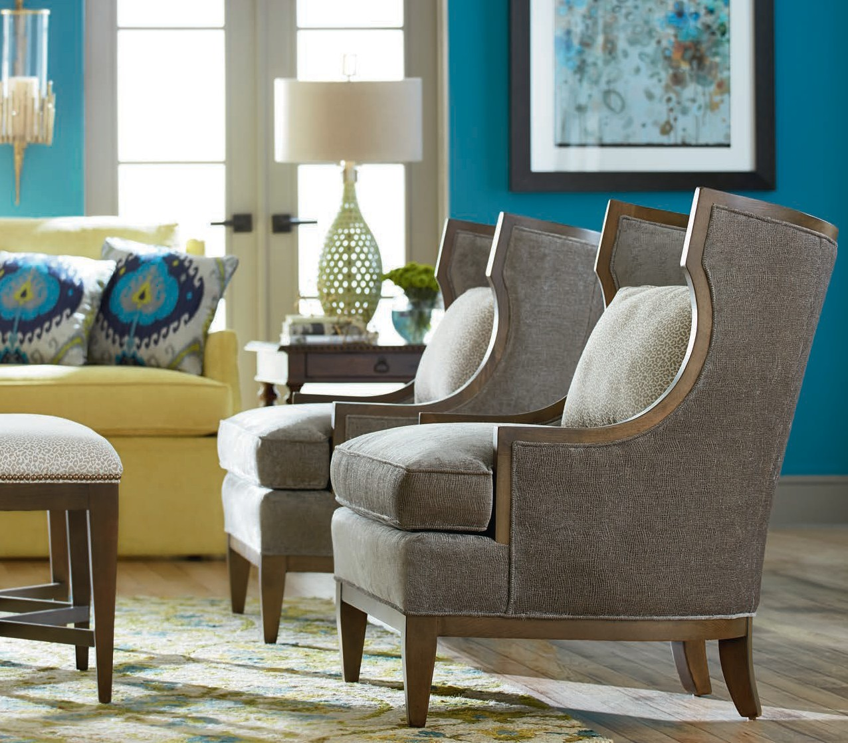
STYLE
ADD A LITTLE
TO YOUR LIFE
UPHOLSTERY SUPPLEMENT
MARCH 2018
SOLID HERITAGE. QUALITY CRAFTSMANSHI P. STYLISH SELECTION. DEDICATED SER VICE.

Slide 2
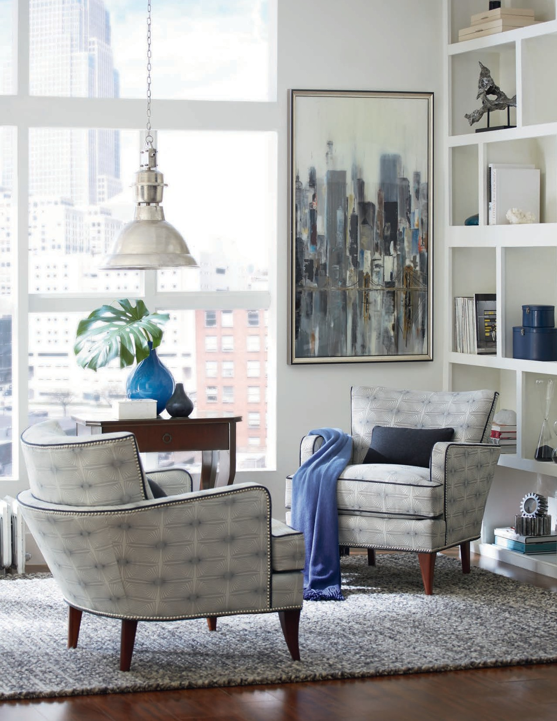
SHOWN: 1434-01 LOUNGE CHAIRS | 8115 COLLECTION

Slide 3
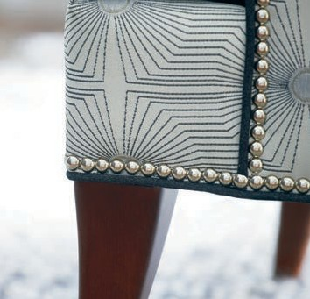
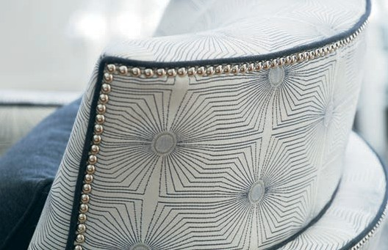
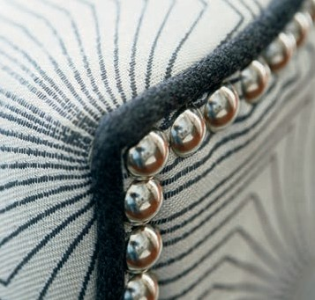
STYLE
ADD A LITTLE
TO YOUR LIFE
EVER YTHING WE DO STARTS AND FINISHES WITH YOU.
SOLID HERITAGE
For nearly a century, we’ve combined masterful craftsmanship with fashion-forward design of fine furnishings for the home. We’re a family of craftspeople who care about our community, the environment, and you.
QUALITY CRAFTSMANSHIP
It’s part of our DNA. It’s the fabric of our company, and it’s woven into everything we do. It’s why we put attention to detail first, second, and third.
STYLISH SELECTION
Choose from a wide variety of fashionable style and comfort for the living
room, dining room, and everywhere in between.
DEDICATED SERVICE
We make it easy for you. Quality, value, style, and comfort delivered in a timely fashion by people who care.

Slide 4
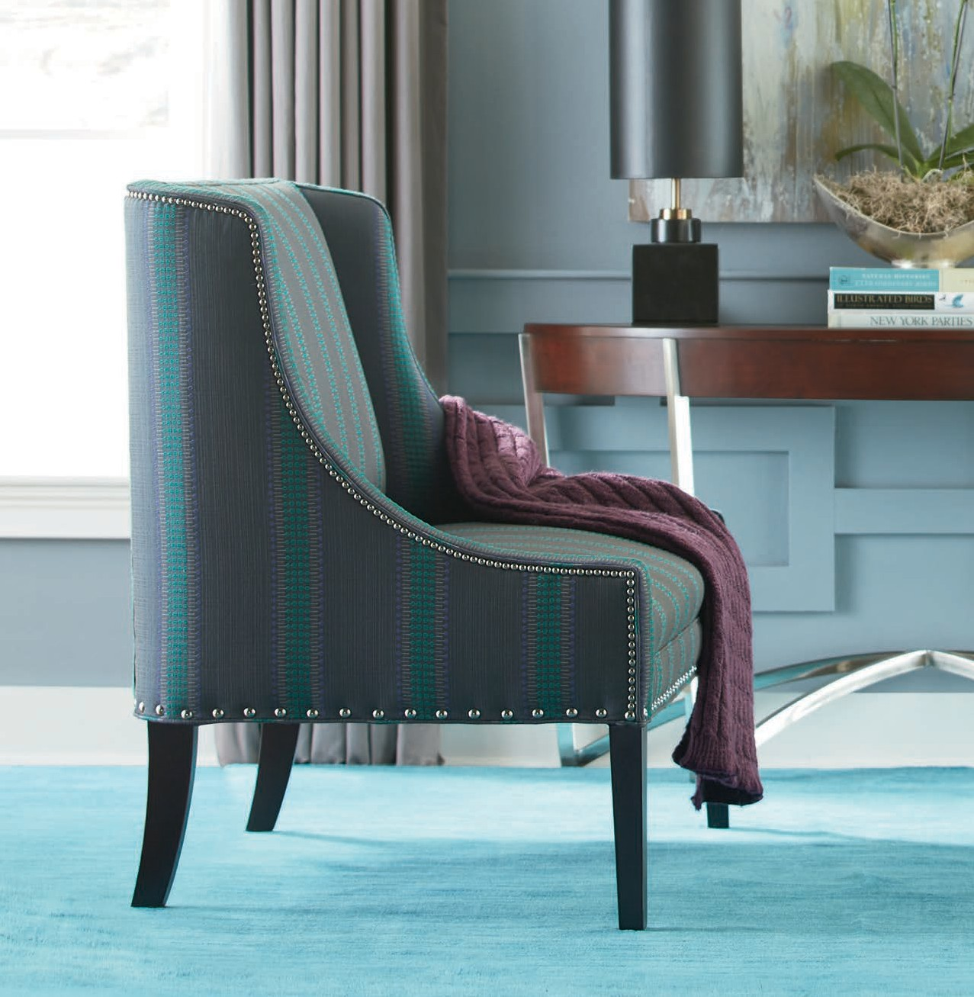

CONTENTS
SHOWN: 5750-40 SETTEES | 8194 COLLECTION
4CHAIRS
Accent | Wing | Lounge |
Swivel | Reclining | Dining | Bar & Counter | Game
24SOFAS
Sofa | Loveseat
30SETTEES/CHAISES
33BENCHES

Slide 5
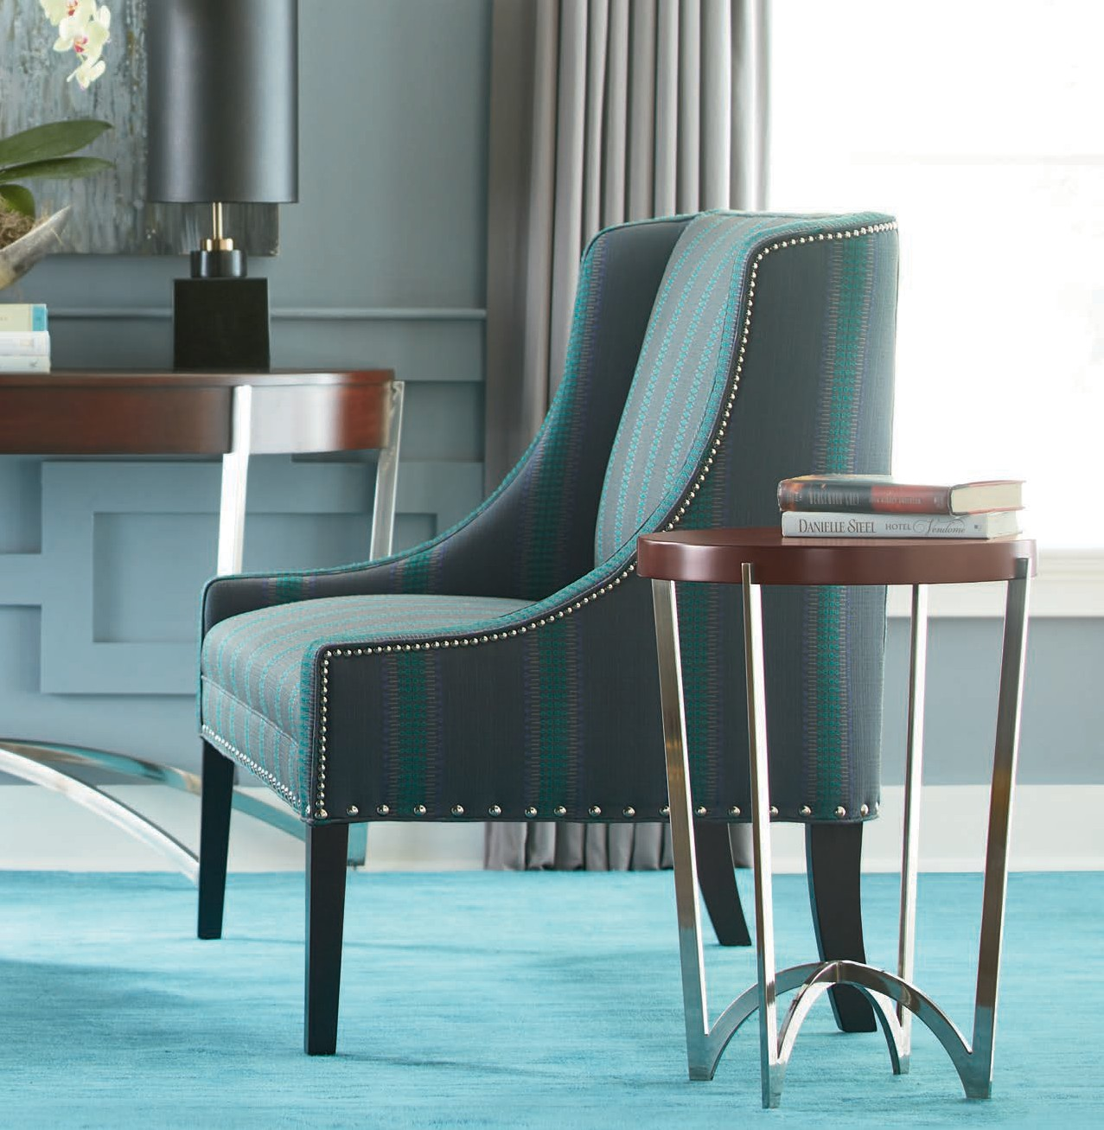

ADD A LITTLE
STYLE
TO YOUR LIFE
F
I
34OTTOMANS
36OFFICE/COMMERCIAL
47FINISHES
Nail-Head Trim
48INDEX
Numerical Index
Desk Swivel | Accent | Lounge | Dining | Bar and Counter | Stackable | Bariatric | Game | Modular | Sleeper

Slide 6
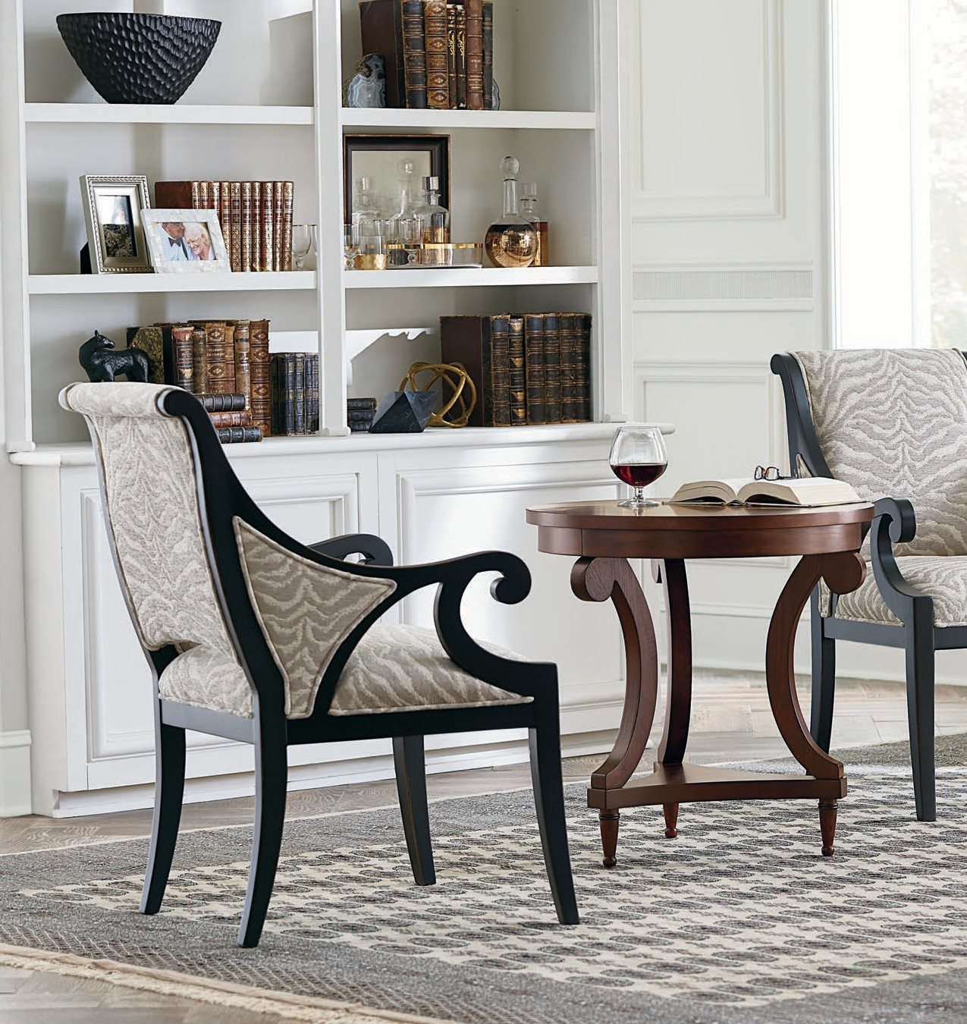
SHOWN: 5345-01 OCCASIONAL CHAIRS | 8105 COLLECTION

Slide 7
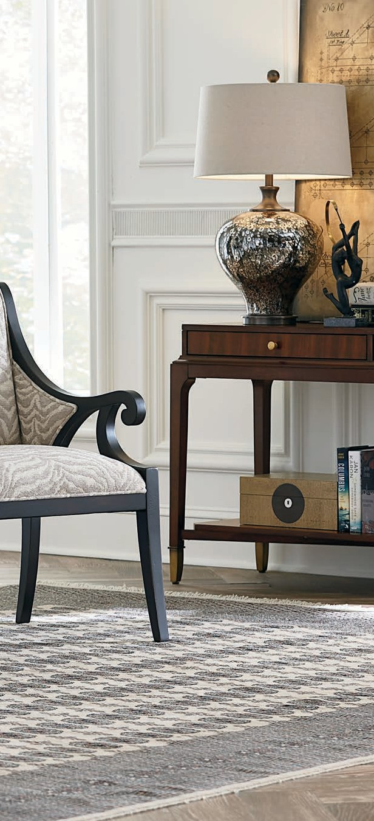


CHAIR
COLLECTION
FUNCTION MEETS FORM
While a chair is certainly one of the most practical pieces of furniture ever created, that doesn’t mean your choices can’t convey your singular sense
of style. Our Chair Collection, with its extensive offerings, grants you the ability to personalize your living spaces. Whether you’re lounging, dining, or reclining, you can select a seat with textured fabric, luxurious leather, or high-quality cushioning—the combinations are endless.
For formal or relaxed living spaces, and classic or contemporary styles, our Chair Collection brilliantly merges function with form.

Slide 8
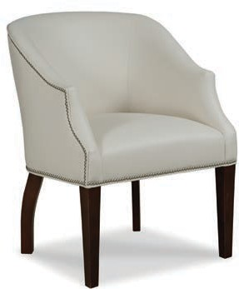
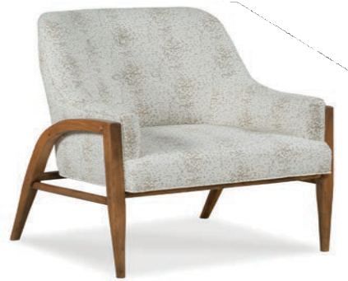
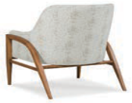

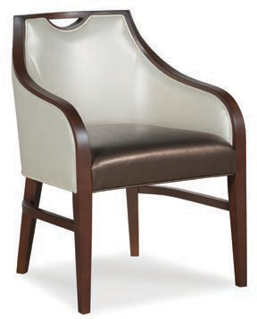
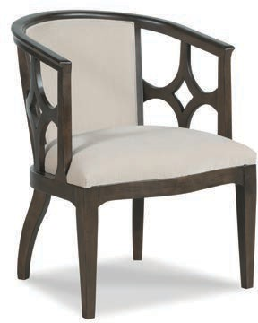
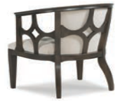
6 | CHAIR COLLECTION – ACCENT
6014-01 OCCASIONAL CHAIR ^{L} w 26 | d 26.5 | h 32 in. ah 24 | sh 20 | sd 19.5 | iw 19 in.
Shown with optional nail-head trim. Also available: 6014-A4, see page 22.
6085-01 OCCASIONAL CHAIR ^{L}
w 29.5 | d 33 | h 35.5 in.
ah 24 | sh 19 | sd 21 | iw 20 in.
8741-04 ARM CHAIR ^{L} w 24 | d 26 | h 33 in. ah 24.5 | sh 19.5 | sd 20 | iw 18 in.
Also available: 8741-A4, see pages 22, 42.
5419-01 OCCASIONAL CHAIR ^{L}
w 26 | d 26 | h 33 in.
ah 30 | sh 19.5 | sd 20 | iw 21.5 in.
L Available in Leather
N Nail-head trim standard

Slide 9
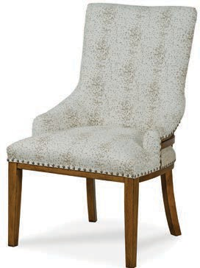
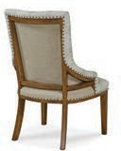
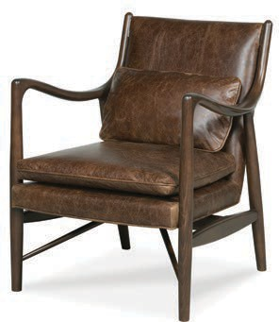
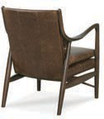
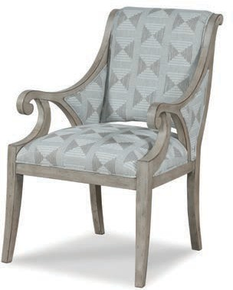
CHAIR COLLECTION – ACCENT | 7
8359-01 OCCASIONAL CHAIR ^{L N}
w 25.5 | d 29.5 | h 38 in.
ah 23 | sh 19.5 | sd 19 | iw 18 in.
6054-01 OCCASIONAL CHAIR ^{L} w 27 | d 30.5 | h 34.5 in. ah 26 | sh 18 | sd 17.5 | iw 23 in.
Standard with (1) 16” x 25” kidney pillow.
5345-01 OCCASIONAL CHAIR ^{L}
w 24 | d 27.5 | h 37 in.
ah 26 | sh 20 | sd 20 | iw 19 in.
L Available in Leather
N Nail-head trim standard

Slide 10
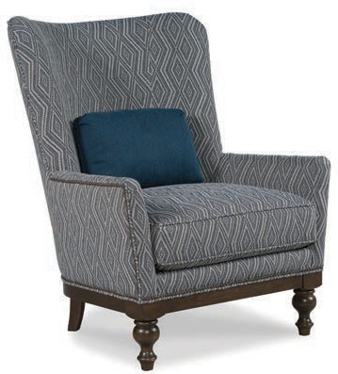
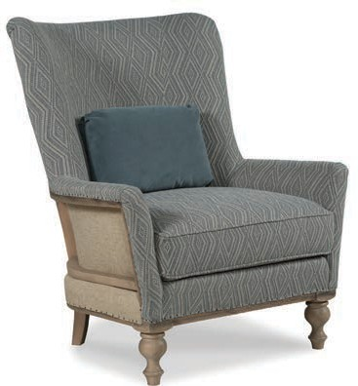
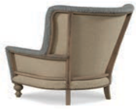
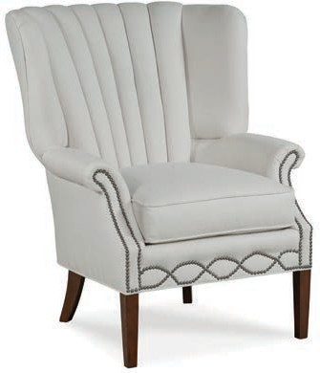
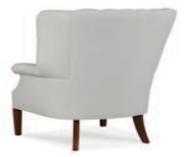
8 | CHAIR COLLECTION – WING
5132-01 WING CHAIR ^{L} w 36 | d 39.5 | h 43.5 in. ah 25 | sh 21 | sd 20 | iw 27.5 in.
Standard with (1) 16” x 25” kidney pillow. Shown with optional nail-head trim.
5133-01 WING CHAIR ^{L} w 36 | d 39.5 | h 43.5 in. ah 25 | sh 21 | sd 20 | iw 27.5 in.
Standard with (1) 16” x 25” kidney pillow. Deconstructive barrier available in fabric pattern 9633 only (any color). Available in Charpente finish only.
5212-01 WING CHAIR ^{L N} w 34 | d 35 | h 43.5 in. ah 25.5 | sh 22.5 | sd 22.5 | iw 22 in.
Standard with decorative nail-head trim. Also available without nail-head trim: 5232-01 and 5232-20.
L Available in Leather
N Nail-head trim standard

Slide 11
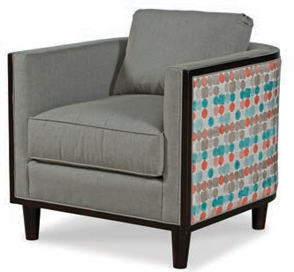
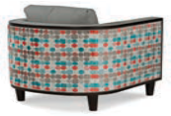
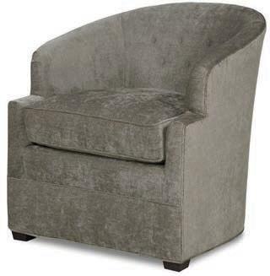
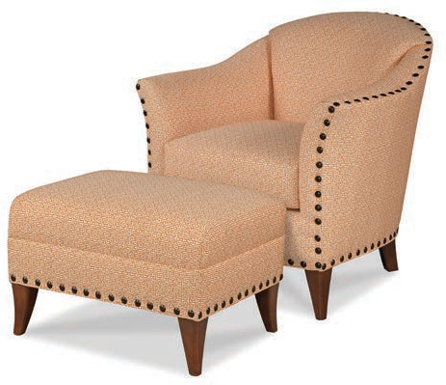
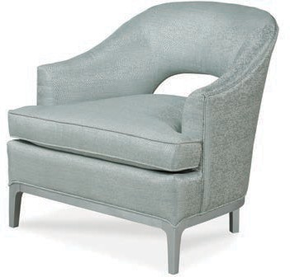
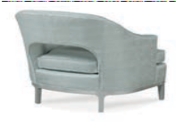
CHAIR COLLECTION – LOUNGE | 9
6057-01 LOUNGE CHAIR ^{L} w 31 | d 34.5 | h 27.5 in. ah 27.5 | sh 21 | sd 19.5 | iw 22 in.
Features a loose back cushion.
6138-01 LOUNGE CHAIR ^{L} w 29 | d 32 | h 32 in. ah 27 | sh 21 | sd 22 | iw 22 in.
Also available: 6138-31, see page 13.
6082-01 LOUNGE CHAIR ^{L}
w 32 | d 30.5 | h 32 in.
ah 23.5 | sh 20.5 | sd 24 | iw 22 in.
6111-01 LOUNGE CHAIR ^{L N} w 34 | d 34 | h 34 in. ah 27.5 | sh 20 | sd 20.5 | iw 20 in.
6111-20 OTTOMAN ^{L N} w 26.5 | d 21 | h 17.5 in.
Also available 6111-31 and 6111-32, see page 13. Also available 6101-01 (without nail-head trim).
L Available in Leather
N Nail-head trim standard

Slide 12
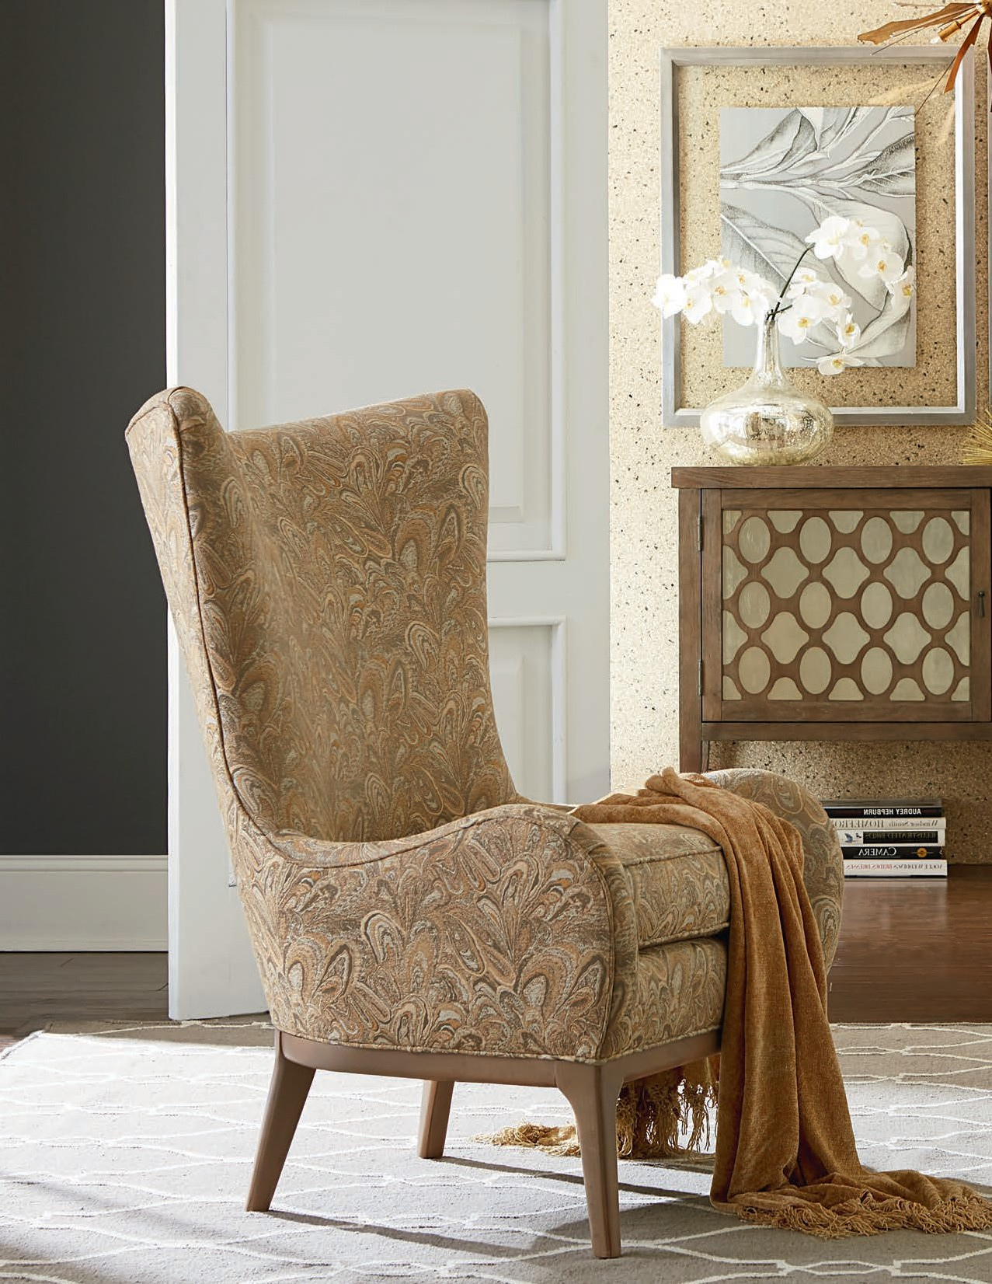

Slide 13
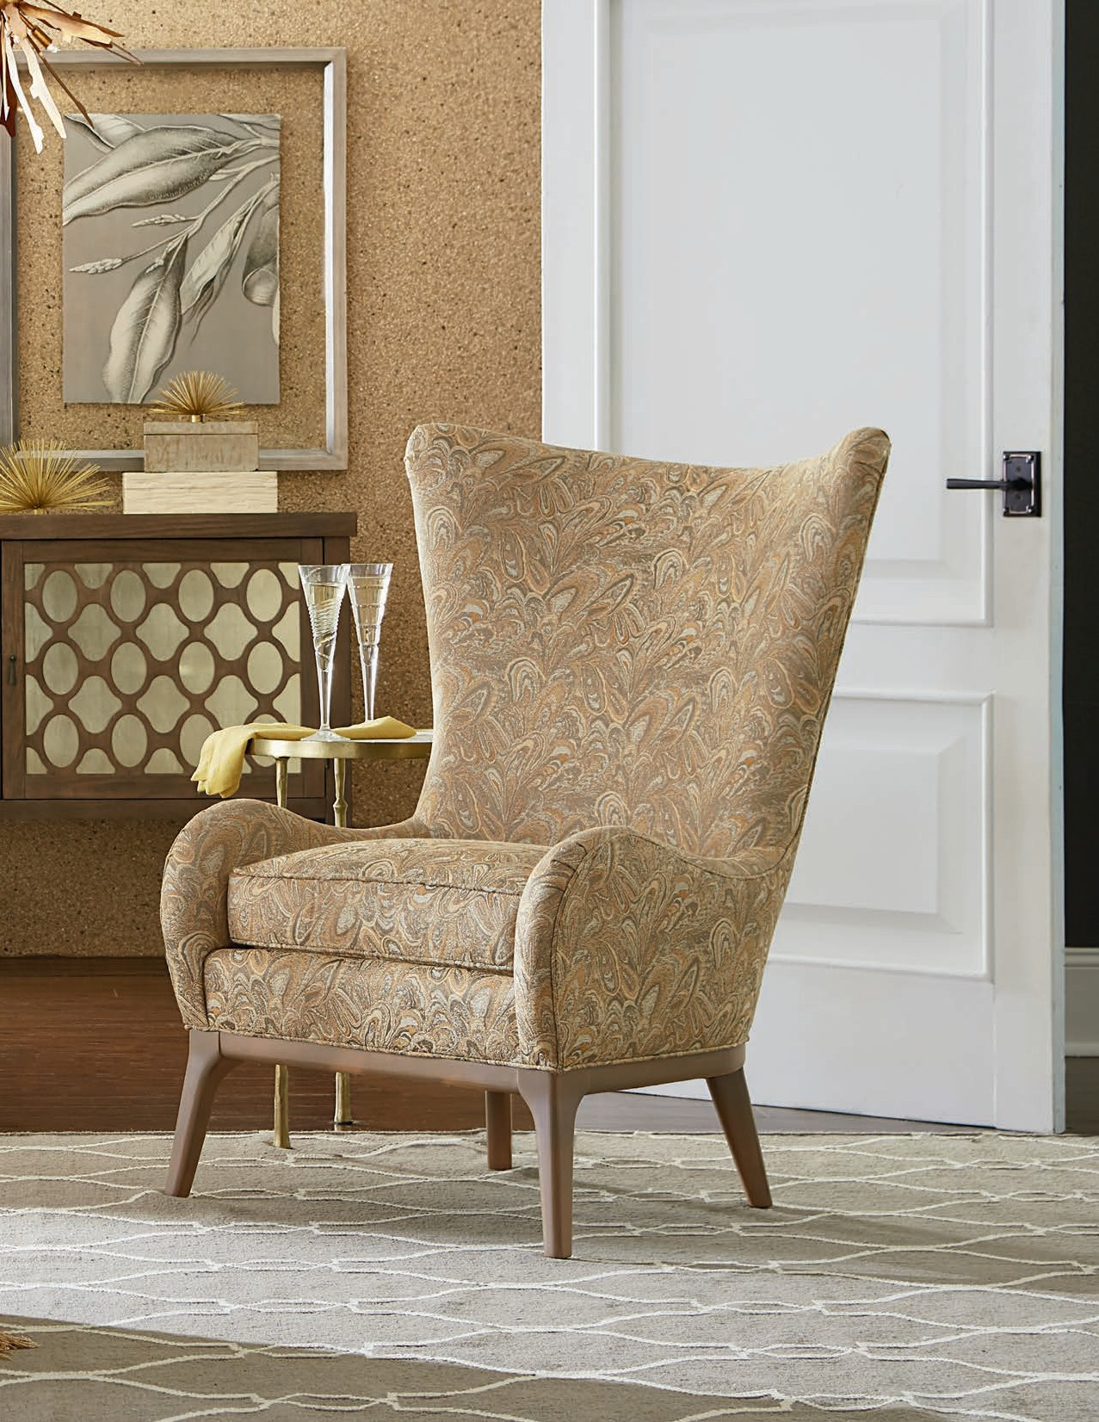
SHOWN: 5135-01 WING CHAIRS | 8105 COLLECTION

Slide 14
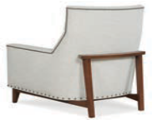
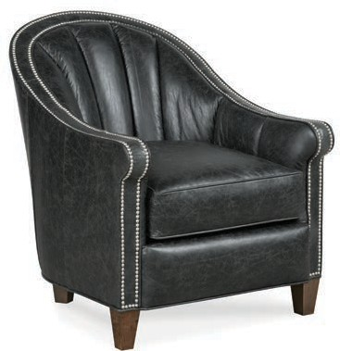
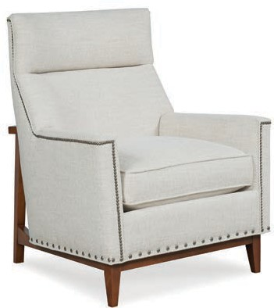
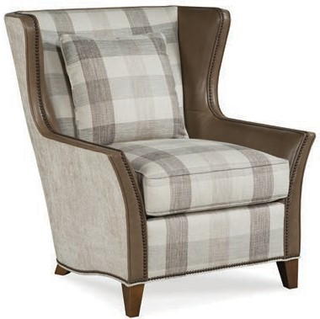
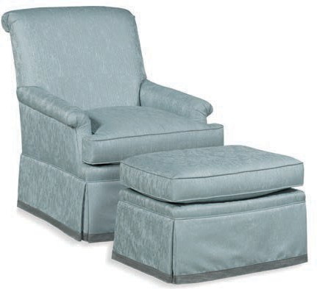
12 | CHAIR COLLECTION – LOUNGE
1448-01 LOUNGE CHAIR ^{L} w 30 | d 36.5 | h 36.5 in. ah 24.5 | sh 20 | sd 24 | iw 20 in.
Shown with optional nail-head trim. Also available: 1448-31 and 1448-32, see page 13.
5300-01 LOUNGE CHAIR ^{L} w 34 | d 33 | h 41 in. ah 24.5 | sh 21 | sd 22.5 | iw 25 in.
Shown with optional nail-head trim.
5108-01 LOUNGE CHAIR ^{L} w 34 | d 38 | h 40 in. ah 23 | sh 20.5 | sd 20.5 | iw 24 in.
Standard with (1) 20” pillow. Pillow not standard with leather/vinyl application. Shown with optional nail-head trim. Also available: 5108-20 Ottoman.
6123-01 LOUNGE CHAIR w 30 | d 34 | h 37 in. ah 22.5 | sh 20.5 | sd 21.5 | iw 21 in.
6123-20 OTTOMAN w 25 | d 21.5 | h 19 in.
Also available: 6123-31 and 6123-32, see page 14.
L Available in Leather
N Nail-head trim standard

Slide 15
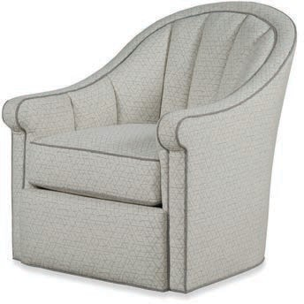
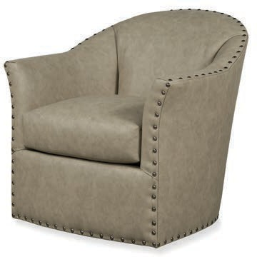
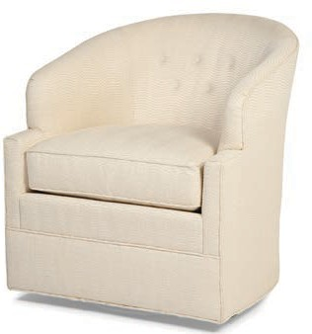
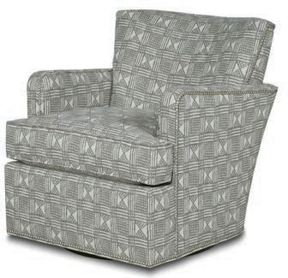
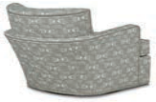
CHAIR COLLECTION – SWIVEL | 13
1448-31 SWIVEL CHAIR ^{L} 1448-32 SWIVEL GLIDER ^{L} w 30 | d 36.5 | h 36.5 in. ah 24.5 | sh 20 | sd 24 | iw 20 in.
Also available: 1448-01, see page 12.
6111-31 SWIVEL CHAIR ^{L N} 6111-32 SWIVEL GLIDER ^{L N} w 34 | d 34 | h 34 in. ah 27.5 | sh 20 | sd 20.5 | iw 20 in.
Also available: 6111-01 and 6111-20, see page 9. Also available: 6101-31 and 6101-32 (without nail-head trim).
6138-31 SWIVEL CHAIR ^{L} w 29 | d 32 | h 32 in. ah 27 | sh 21 | sd 22 | iw 22 in.
Also available: 6138-01, see page 9.
1144-31 SWIVEL CHAIR ^{L} w 28.5 | d 35 | h 31.5 in. ah 25.5 | sh 20 | sd 23 | iw 22 in.
Shown with optional nail-head trim. Also available: 1434-01 and 1434-20.
L Available in Leather
N Nail-head trim standard

Slide 16
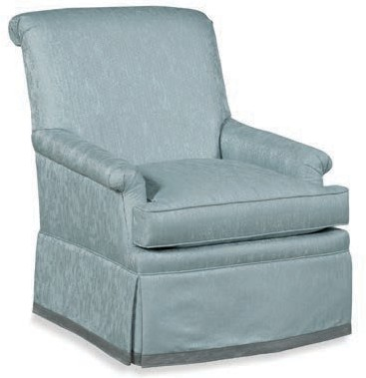
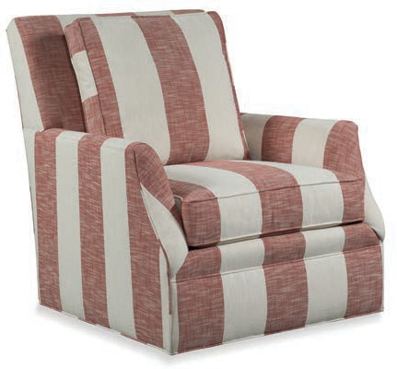
14 | CHAIR COLLECTION – SWIVEL
6123-31 SWIVEL CHAIR 6123-32 SWIVEL GLIDER w 30 | d 34 | h 37 in. ah 22.5 | sh 20.5 | sd 21.5 | iw 21 in.
Also available: 6123-01 and 6123-20, see page 12.
1154-31 SWIVEL CHAIR ^{L} 1154-32 SWIVEL GLIDER ^{L} w 35 | d 39.5 | h 39.5 in. ah 25.5 | sh 20.5 | sd 20 | iw 25 in.
Features a loose back cushion. Also available: 1154-20 Ottoman (w-24.5 d-18.5 h-19.5 in).
L Available in Leather
N Nail-head trim standard

Slide 17
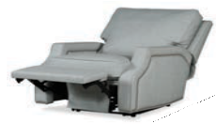
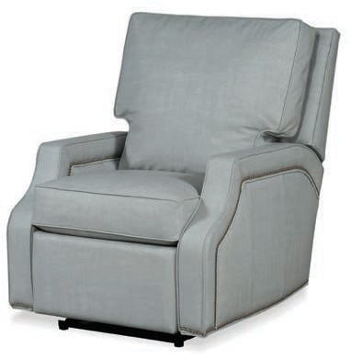
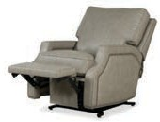
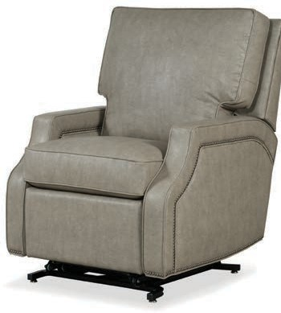
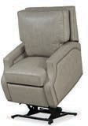






CHAIR COLLECTION – RECLINING | 15
7006-33 RECLINER ^{L} w 31 | d 37 | h 41 in. ah 25 | sh 21 | sd 20 | iw 23 in.
Reclining depth: 68". Required wall clearance: 5.5". Features pull tab recline.
7006-ER MOTORIZED RECLINER ^{L R} w 31 | d 37 | h 41 in. ah 25 | sh 21 | sd 20 | iw 23 in
Reclining depth: 68". Required wall clearance: 5.5". Features a semi-attached back cushion. Shown with optional nail-head trim.
7006-LR LIFT RECLINER ^{L R} w 31 | d 37 | h 41 in. ah 25 | sh 21 | sd 20 | iw 23 in.
Reclining depth: 68”. Required wall clearance: 5.5”. Features a semi-attached back cushion. Shown with optional nail-head trim.
7008-33 RECLINER ^{L} w 33 | d 39.5 | h 41 in. ah 24 | sh 21.5 | sd 21 | iw 23 in.
Reclining depth: 65.5". Required wall clearance: 14”. Features pull tab recline.
7008-ER MOTORIZED RECLINER ^{L R} w 33 | d 39.5 | h 41 in. ah 24 | sh 21.5 | sd 21 | iw 23 in
Reclining depth: 65.5”. Required wall clearance: 14”. Features a semi-attached back cushion. Shown with optional nail-head trim.
L Available in Leather
N Nail-head trim standard
R Remote with motorized recliner

Slide 18








16 | CHAIR COLLECTION – DINING
5077-05 SIDE CHAIR ^{L} w 22 | d 24.5 | h 38 in. sh 20 | sd 18 | iw 18.5 in.
Shown with optional nail-head trim. Also available: 5077-07 and 5077-C7, see page 19.
8359-01 OCCASIONAL CHAIR ^{L N} w 25.5 | d 29.5 | h 38 in. ah 23 | sh 19.5 | sd 19 | iw 18 in.
Also available: 8359-06 and 8359-C6, see page 20.
8749-04 ARM CHAIR ^{L} w 24 | d 24 | h 38.5 in. ah 25 | sh 20 | sd 18 | iw 19.5 in.
Also available: 8749-A4, see pages 22, 42.
8741-04 ARM CHAIR ^{L} w 24 | d 26 | h 33 in. ah 24.5 | sh 19.5 | sd 20 | iw 18 in.
8741-05 SIDE CHAIR ^{L} w 22.5 | d 25 | h 33.5 in. ah 20 | sh 19.5 | sd 19.5 | iw 18 in.
Also available: 8741-A4, 8741-07, and 8741-C7, see pages 22, 42.
L Available in Leather
N Nail-head trim standard

Slide 19






CHAIR COLLECTION – DINING | 17
8781-04 ARM CHAIR ^{L} w 22 | d 23.5 | h 36.5 in. ah 26.5 | sh 18.5 | sd 18 | iw 20 in.
Also available: 8781-A4, see page 22, 42.
8745-04 ARM CHAIR ^{L} w 24 | d 23 | h 35 in. ah 26.5 | sh 19 | sd 18.5 | iw 20 in.
Also available: 8745-06 and 8745-C6, see pages 21, 40.
8779-04 ARM CHAIR ^{L} w 23 | d 24 | h 41 in. ah 27 | sh 20 | sd 17.5 | iw 20 in.
Also available: 8779-A4, see pages 23, 43.
6086-04 ARM CHAIR w 24.5 | d 29 | h 44 in. ah 24 | sh 21 | sd 18.5 | iw 19 in.
6086-05 SIDE CHAIR w 21 | d 29 | h 44 in. sh 21 | sd 18.5 in.
Also available: 6086-07 and 6086-C7, see page 21.
L Available in Leather
N Nail-head trim standard

Slide 20

SHOWN: 5039-C7 COUNTER STOOLS

Slide 21












CHAIR COLLECTION – BAR AND COUNTER | 19
8379-06 BAR STOOL ^{L} w 23 | d 25 | h 47.5 in. ah 33 | sh 31 | sd 18.5 | iw 15 in.
8379-C6 COUNTER STOOL ^{L} w 23 | d 25 | h 43.5 in. ah 29 | sh 27 | sd 18.5 | iw 15 in.
Also available: 8379-01.
5077-07 BAR STOOL ^{L} w 20.5 | d 21.5 | h 42.5 in. sh 30.5 | sd 18 | iw 19 in.
5077-C7 COUNTER STOOL ^{L} w 20.5 | d 21.5 | h 38.5 in. sh 26.5 | sd 18 | iw 19 in
Shown with optional nail-head trim. Also available: 5077-05, see page 16.
6069-07 BAR STOOL ^{L} w 21 | d 24.5 | h 45 in. sh 31 | sd 16.5 in.
6069-C7 COUNTER STOOL ^{L} w 21 | d 24.5 | h 41 in. sh 27 | sd 16.5 in.
Shown with optional nail-head trim. Also available: 6069-04 and 6069-05.
1013-07 BAR STOOL ^{L N} w 19.5 | d 23 | h 45.5 in. sh 30 | sd 16 in.
1013-C7 COUNTER STOOL ^{L N} w 19.5 | d 23 | h 41.5 in. sh 26 | sd 16 in.
Also available without nail-head trim: 1015-07 and 1015-C7.
L Available in Leather
N Nail-head trim standard

Slide 22











20 | CHAIR COLLECTION – BAR AND COUNTER
6013-07 BAR STOOL ^{L} w 19.5 | d 23 | h 47.5 in. sh 31 | sd 16 in.
6013-C7 COUNTER STOOL ^{L} w 19.5 | d 23 | h 43.5 in. sh 27 | sd 16 in.
Shown with optional nail-head trim. Also available: 6013-04 and 6013-05.
5047-07 BAR STOOL ^{L} w 18.5 | d 16.5 | h 30 in.
5047-C7 COUNTER STOOL ^{L} w 18.5 | d 16.5 | h 26 in.
Shown with optional nail-head trim.
8378-07 BAR STOOL ^{L} w 20 | d 21.5 | h 44.5 in. sh 30.5 | sd 17 in.
8378-C7 COUNTER STOOL ^{L} w 20 | d 21.5 | h 40.5 in. sh 26.5 | sd 17 in.
Also available: 8378-04, 8378-05, and 8378-14, see page 41.
8359-06 BAR STOOL ^{L N} w 23 | d 25 | h 47.5 in. ah 33 | sh 31 | sd 18.5 | iw 15 in.
8359-C6 COUNTER STOOL ^{L N} w 23 | d 25 | h 43.5 in. ah 33 | sh 27 | sd 18.5 | iw 15 in.
Also available: 8359-01, see pages 7, 16.
L Available in Leather
N Nail-head trim standard

Slide 23







CHAIR COLLECTION – BAR AND COUNTER | 21
8389-06 BAR STOOL ^{L} w 23 | d 25 | h 47.5 in. ah 33 | sh 31 | sd 18.5 | iw 15 in.
8389-C6 COUNTER STOOL ^{L} w 23 | d 25 | h 43.5 in. ah 29 | sh 27 | sd 18.5 | iw 15 in.
Also available: 8389-01.
8745-06 BAR STOOL ^{L} w 22 | d 22.5 | h 44 in. ah 35.5 | sh 30 | sd 18 | iw 19 in.
8745-C6 COUNTER STOOL ^{L} w 22 | d 22.5 | h 40 in. ah 31.5 | sh 26 | sd 18 | iw 19 in.
Also available: 8745-04, see pages 17, 40.
5004-B7 BISTRO STOOL ^{L} w 20 | d 22.5 | h 42.5 in. sh 26 | sd 17 in.
Features wire brushed distressing. Available in Tobacco, Graystone and Linen finishes only. Also available in Weathered Pecan: 8104-B7.
6086-07 BAR STOOL w 20.5 | d 25 | h 46 in. sh 30.5 | sd 17.5 in.
6086-C7 COUNTER STOOL w 20.5 | d 25 | h 42 in. sh 26.5 | sd 17.5 in.
Also available: 6086-04 and 6086-05, see page 17.
L Available in Leather
N Nail-head trim standard

Slide 24




22 | CHAIR COLLECTION – GAME
6014-A4 OCCASIONAL CHAIR ^{L} w 26 | d 26.5 | h 32 in. ah 24 | sh 20 | sd 19.5 | iw 19 in.
Shown with optional nail-head trim. Also available: 6014-01, see page 6.
8741-A4 ARM CHAIR ^{L} w 24 | d 26 | h 33 in. ah 24.5 | sh 19.5 | sd 20 | iw 18 in.
Also available: 8741-04, 8741-05, 8741-07, and 8741-C7, see pages 6, 16, 39.
8749-A4 ARM CHAIR ^{L} w 24 | d 24 | h 38.5 in. ah 25 | sh 20 | sd 18 | iw 19.5 in.
Also available: 8749-04, see pages 16, 39.
8781-A4 ARM CHAIR ^{L} w 22 | d 23.5 | h 36.5 in. ah 26.5 | sh 18.5 | sd 18 | iw 20 in.
Also available: 8781-04, see pages 17, 39.
L Available in Leather
N Nail-head trim standard

Slide 25


CHAIR COLLECTION – GAME | 23
5452-A4 ARM CHAIR ^{L} w 23 | d 24 | h 37.5 in. ah 24.5 | sh 19.5 | sd 19 | iw 18.5 in.
Also available: 5452-04, see page 39.
8779-A4 ARM CHAIR ^{L} w 23 | d 24 | h 41 in. ah 27 | sh 20 | sd 17.5 | iw 20 in.
Also available: 8779-04, see pages 17, 40.
L Available in Leather
N Nail-head trim standard

Slide 26

SHOWN: 2715-50 SOFA | 1677-20 COCKTAIL OTTOMAN | 1405-01 LOUNGE CHAIR | 8116 COLLECTION

Slide 27

SOFA
COLLECTION
ENHANCE YOUR HOME
Plush fabrics. Rich leathers. Subtle finishes. Nail-head trims. This is just a short list of the possibilities within our Sofa Collection—
possibilities that allow you to make a personal statement within the cozy confines of your home. Need something more traditional for a formal area? Or are you looking to introduce a transitional piece to a relaxed living space?
No matter your need, or individual aesthetic, our Sofa Collection has a wide variety of options to choose from, and every single one is designed to enhance your home.

Slide 28



26 | SOFA COLLECTION
2735-50 SOFA ^{L} w 74.5 | d 35 | h 31.5 in. ah 25.5 | sh 20 | sd 23 | iw 68 in.
Standard with (2) 18” throw pillows. Pillows not standard with leather/vinyl application. Shown with optional nail-head trim.
2745-50 SOFA ^{L} w 87.5 | d 40 | h 41 in. ah 27 | sh 22 | sd 21.5 | iw 79 in.
Features loose back cushions. Standard with (2) 18” throw pillows. Pillows not standard with leather/vinyl application.
L Available in Leather
N Nail-head trim standard

Slide 29


SOFA COLLECTION | 27
2973-50 SOFA ^{N} w 93 | d 38.5 | h 41 in. ah 25 | sh 21.5 | sd 21.5 | iw 86.5 in.
Features loose back cushions. Standard with (2) 18” throw pillows. Pillows not standard with leather/vinyl application. Also available: 2963-50 (w 83” with 2 back pillows and a bench seat), 2983-50 (w 83” with 2 back pillows and 2 seat cushions), and 2993-50 (w 93” with 3 back pillows and 3 seat cushions). Standard with Ultra Plush seat cushions and sinuous wire springs.
3973-50 SOFA ^{N} w 93 | d 38.5 | h 41 in. ah 25 | sh 21.5 | sd 21.5 | iw 86.5 in.
Features loose back cushions. Standard with (2) 18” Blend Down throw pillows. Pillows not standard with leather/vinyl application. Also available: 3963-50 (w 83” with 2 back pillows and a bench seat), 3983-50 (w 83” with 2 back pillows and 2 seat cushions), and 3993-50 (w 93” with 3 back pillows and 3 seat cushions). Standard with Supreme Comfort seat cushions and pocketed coil springs.
L Available in Leather
N Nail-head trim standard

Slide 30


28 | SOFA COLLECTION
2764-50 SOFA ^{L} w 92 | d 41 | h 36 in. ah 36 | sh 21.5 | sd 26 | iw 69 in.
Standard with (2) 20” throw pillows. Pillows not standard with leather/vinyl application. Shown with optional nail-head trim.
2734-50 SOFA ^{L} w 86.5 | d 42.5 | h 38 in. ah 27.5 | sh 21.5 | sd 21 | iw 71.5 in. |  |  |  | 2734-70 LOVESEAT ^{L} w 63 | d 42.5 | h 38 in. ah 27.5 | sh 21.5 | sd 21 | iw 48 in.
Features loose back cushions. Standard with (2) 18” throw pillows. Pillows not standard with leather/vinyl application. Also available with a bench seat: 2733-50.
L Available in Leather
N Nail-head trim standard

Slide 31

SHOWN: 2735-50 SOFA | 6052-01 OCCASIONAL CHAIR | 8109 COLLECTION | 8113 COLLECTION

Slide 32

SHOWN: 2674-25 CHAISE LOUNGE | 8133 COLLECTION

Slide 33

SETTEE/ CHAISE/ BENCH/
OTTOMAN
COLLECTION
PERFECTLY PROPORTIONED
While our accent pieces offer traditional and transitional styling, there’s also the luxurious fabrics, soft leathers, delicate carvings, and subtle design details to consider. Generously proportioned solely for your comfort, you can customize your choice to be the perfect complement for your current ensemble.
Whether you want a piece that is partially or fully upholstered, we’re confident that you’ll be content—and, most importantly, comfortable—with our offerings.

Slide 34





32 | SETTEE | CHAISE COLLECTION
8741-40 SETTEE ^{L} w 46 | d 26 | h 33.5 in. ah 24.5 | sh 19.5 | sd 20 | iw 40 in.
Also available: 8741-04 and 8741-10, see pages 6, 16, 39.
1434-25 CHAISE ^{L} w 25.5 | d 65 | h 31.5 in. ah 25.5 | sh 20 | sd 53 | iw 22 in.
lso available: 1434-01.
A
2674-25 CHAISE LOUNGE ^{L} w 76.5 | d 27.5 | h 30 in. ah 30 | sh 22 | sd 28 | iw 45.5 in.
tandard with (2) 22” x 7” bolsters. Pillows not tandard with leather/vinyl application.
S
s
L Available in Leather
N Nail-head trim standard

Slide 35






BENCH COLLECTION | 33
1775-10 BENCH ^{L}
w 55 | d 21.5 | h 26.5 in.
ah 26.5 | sh 19.5 | sd 21.5 | iw 43.5 in.
1777-10 BENCH ^{L}
w 52.5 | d 21.5 | h 19.5 in.
.
1786-10 BENCH ^{L}
w 54 | d 23 | h 25.5 in.
ah 25 | sh 19 | sd 17.5 | iw 46 in.
1787-10 BENCH ^{L}
w 54.5 | d 23.5 | h 25 in.
ah 25 | sh 19 | sd 23.5 | iw 46 in.
1742-10 BENCH ^{L} w 58 | d 23.5 | h 26.5 in. ah 26.5 | sh 19 | sd 18 | iw 46.5 in.
Shown with optional nail-head trim.
1603-10 BENCH ^{L}
w 56 | d 22 | h 26.5 in.
ah 26.5 | sh 19.5 | sd 22 | iw 48 in.
L Available in Leather
N Nail-head trim standard

Slide 36







34 | OTTOMAN COLLECTION
1600-20 SWIVEL OTTOMAN ^{L}
w 22 | d 22 | h 18.5 in.
1669-20 COCKTAIL OTTOMAN ^{L}
w 35 | d 35 | h 19.5 in.
1609-20 COCKTAIL OTTOMAN ^{L} w 52.5 | d 39 | h 19 in.
Available with casters: 1629-20, see page 34.
1629-20 COCKTAIL OTTOMAN ^{L} w 52.5 | d 39 | h 19 in.
Standard with casters. Available without casters: 1609-20, see page 34.
1604-20 COCKTAIL OTTOMAN ^{L} w 52 | d 38 | h 19 in.
Also available with casters: 1654-20.
1707-20 COCKTAIL OTTOMAN ^{L}
w 42.5 | d 42.5 | h 21 in.
L Available in Leather
N Nail-head trim standard

Slide 37

SHOWN: 2601-25 CHAISE

Slide 38

SHOWN: 2713-02 RAF LOUNGE CHAIR | 2713-03 LAF LOUNGE CHAIR | 2713-78 ARMLESS LOUNGE CHAIR | 2713-20 OTTOMAN | 2723-78 ARMLESS LOUNGE CHAIR | 2723-02 RAF LOUNGE CHAIR | 8109 COLLECTION |
8010 COLLECTION

Slide 39


OFFICE/
COMMERCIAL
COLLECTION
BRING A LITTLE STYLE INTO THE OFFICE
Don’t overlook comfort when it comes to your workplace. In fact, you should always strive to bring a little style into the office, too. With our Office/Commercial Collection, the superior craftsmanship is obvious across our vast selection of seating—whether you’re seeking luxurious leather swivel chairs for executives, occasional chairs for your guests, or stackable options if you’re short on space. Sofas and settees, with a variety of fabrics and wood finishes, can be added to the mix as well. Our stylish designs offer refined appeal, whether you’re furnishing a business or your home office.

Slide 40








38 | OFFICE / COMMERCIAL – DESK SWIVEL | ACCENT | LOUNGE
6072-35 OFFICE SWIVEL ^{L N} w 25.5 | d 25.5 | h 31-35 in. ah 25-29 | sh 19-23 | sd 20.5 | iw 20.5 in.
Gas lift and knee-tilt available.
6054-01 OCCASIONAL CHAIR ^{L} w 27 | d 30.5 | h 34.5 in. ah 26 | sh 18 | sd 17.5 | iw 23 in.
Standard with (1) 16” x 25” kidney pillow.
6085-01 OCCASIONAL CHAIR ^{L}
w 29.5 | d 33 | h 35.5 in.
ah 24 | sh 19 | sd 21 | iw 20 in.
6082-01 LOUNGE CHAIR ^{L}
w 32 | d 30.5 | h 32 in.
ah 23.5 | sh 20.5 | sd 24 | iw 22 in.
L Available in Leather
N Nail-head trim standard

Slide 41







OFFICE / COMMERCIAL – DINING | 39
8749-04 ARM CHAIR ^{L} w 24 | d 24 | h 38.5 in. ah 25 | sh 20 | sd 18 | iw 19.5 in.
Also available: 8749-A4, see pages 22, 42.
8741-04 ARM CHAIR ^{L} w 24 | d 26 | h 33 in. ah 24.5 | sh 19.5 | sd 20 | iw 18 in.
8741-05 SIDE CHAIR ^{L} w 22.5 | d 25 | h 33.5 in. ah 20 | sh 19.5 | sd 19.5 | iw 18 in.
Also available: 8741-A4, 8741-07 and 8741-C7, see pages 22, 42.
5452-04 ARM CHAIR ^{L} w 23 | d 24 | h 37.5 in. ah 24.5 | sh 19.5 | sd 19 | iw 18.5 in.
Also available: 5452-A4, see pages 23, 42.
8781-04 ARM CHAIR ^{L} w 22 | d 23.5 | h 36.5 in. ah 26.5 | sh 18.5 | sd 18 | iw 20 in.
Also available: 8781-A4, see pages 22, 42.
L Available in Leather
N Nail-head trim standard

Slide 42





40 | OFFICE / COMMERCIAL – DINING | BAR AND COUNTER
8789-04 ARM CHAIR ^{L} w 23 | d 23 | h 34 in. ah 26 | sh 19.5 | sd 17.5 | iw 19 in.
Also available: 8789-BC, see page 41.
8779-04 ARM CHAIR ^{L} w 23 | d 24 | h 41 in. ah 27 | sh 20 | sd 17.5 | iw 20 in.
Also available: 8779-A4, see pages 23, 43.
8745-04 ARM CHAIR ^{L} w 24 | d 23 | h 35 in. ah 26.5 | sh 19 | sd 18.5 | iw 20 in.
Also available: 8745-06 and 8745-C6, see pages 21, 40.
8745-06 BAR STOOL ^{L} w 22 | d 22.5 | h 44 in. ah 35.5 | sh 30 | sd 18 | iw 19 in.
8745-C6 COUNTER STOOL ^{L} w 22 | d 22.5 | h 40 in. ah 31.5 | sh 26 | sd 18 | iw 19 in.
Also available: 8745-04, see pages 17, 40.
L Available in Leather
N Nail-head trim standard

Slide 43






OFFICE / COMMERCIAL – STACKABLE CHAIRS | BARIATRIC | 41
8378-14 ARMLESS STACK CHAIR ^{L} w 20 | d 24 | h 36 in. sh 19 | sd 18.5 in.
Available in Fair-Shield Plus finishes only, see page 47. Stacks 3 high.
8721-BC BARIATRIC CHAIR ^{L} w 34 | d 26 | h 39 in. ah 25.5 | sh 19 | sd 19.5 | iw 30.5 in.
BIFMA tested up to 500 lbs. (static/dynamic). Also available: 8721-04 and 8721-05.
8411-BC BARIATRIC CHAIR ^{L} w 35 | d 22 | h 37 in. ah 25.5 | sh 19 | sd 17.5 | iw 30.5 in.
BIFMA tested up to 500 lbs. (static/dynamic). Also available: 8411-04 and 8411-05.
8789-BC BARIATRIC CHAIR ^{L} w 34.5 | d 23.5 | h 34.5 in. ah 26.5 | sh 19 | sd 18 | iw 30 in.
BIFMA tested up to 500 lbs. (static/dynamic). Also available: 8789-04, see page 40.
L Available in Leather
N Nail-head trim standard

Slide 44



42 | OFFICE / COMMERCIAL – GAME
8741-A4 ARM CHAIR ^{L} w 24 | d 26 | h 33 in. ah 24.5 | sh 19.5 | sd 20 | iw 18 in.
Also available: 8741-04, 8741-05, 8741-07, and 8741-C7, see pages 6, 16, 39.
8749-A4 ARM CHAIR ^{L} w 24 | d 24 | h 38.5 in. ah 25 | sh 20 | sd 18 | iw 19.5 in.
Also available: 8749-04, see pages 16, 39.
8781-A4 ARM CHAIR ^{L} w 22 | d 23.5 | h 36.5 in. ah 26.5 | sh 18.5 | sd 18 | iw 20 in.
Also available: 8781-04, see pages 17, 39.
5452-A4 ARM CHAIR ^{L} w 23 | d 24 | h 37.5 in. ah 24.5 | sh 19.5 | sd 19 | iw 18.5 in.
Also available: 5452-04, see page 39.
L Available in Leather
N Nail-head trim standard

Slide 45

OFFICE / COMMERCIAL – GAME | 43
8779-A4 ARM CHAIR ^{L} w 23 | d 24 | h 41 in. ah 27 | sh 20 | sd 17.5 | iw 20 in.
Also available: 8779-04, see pages 17, 40.
L Available in Leather
N Nail-head trim standard

Slide 46










44 | OFFICE / COMMERCIAL – MODULAR COLLECTION
-10
-78
-78
-03
-02
2713-02 RIGHT ARM FACING LOUNGE CHAIR ^{L}
w 25.5 | d 25.5 | h 31.5 in.
ah 31.5 | sh 19.5 | sd 20 | iw 20 in.
2713-03 LEFT ARM FACING LOUNGE CHAIR ^{L}
w 25.5 | d 25.5 | h 31.5 in.
ah 31.5 | sh 19.5 | sd 20 | iw 20 in.
2713-78 ARMLESS LOUNGE CHAIR ^{L}
w 21 | d 25.5 | h 31.5 in.
sh 19.5 | sd 20
2713-10 BENCH ^{L}
w 23.5 | d 23.5 | h 19.5 in.
2713-20 OTTOMAN ^{L}
w 21 | d 23.5 | h 19.5 in.
L Available in Leather
N Nail-head trim standard

Slide 47










OFFICE / COMMERCIAL – MODULAR COLLECTION | 45
-02
-03
-03
-02
2723-02 RIGHT ARM FACING LOUNGE CHAIR ^{L}
w 25.5 | d 25.5 | h 31.5 in.
ah 31.5 | sh 19.5 | sd 20 | iw 20 in.
2723-03 LEFT ARM FACING LOUNGE CHAIR ^{L}
w 25.5 | d 25.5 | h 31.5 in.
ah 31.5 | sh 19.5 | sd 20 | iw 20 in.
2723-78 ARMLESS LOUNGE CHAIR ^{L}
w 21 | d 25.5 | h 31.5 in.
sh 19.5 | sd 20
2723-10 BENCH ^{L}
w 23.5 | d 23.5 | h 19.5 in.
2723-20 OTTOMAN ^{L}
w 21 | d 23.5 | h 19.5 in.
L Available in Leather
N Nail-head trim standard

Slide 48




46 | OFFICE / COMMERCIAL – SLEEPER SOFAS
7977-60 QUEEN SLEEPER ^{L} w 79.5 | d 37 | h 38 in. ah 25 | sh 21.5 | sd 20 | iw 59 in. Open Depth: 88.5 in.
Shown with optional nail-head trim.
7987-60 QUEEN SLEEPER ^{L} w 79.5 | d 37 | h 38 in. ah 25 | sh 21.5 | sd 20 | iw 59 in. Open Depth: 88.5 in.
Shown with optional nail-head trim.
L Available in Leather
N Nail-head trim standard

Slide 49











WOOD FINISHES | 47
FINISH
STANDARD WOOD FINISHES
Aged Brass
Aged Silver
Metallic Gold
Metallic Silver
PREMIUM WOOD FINISH
FAIR-SHIELD PLUS FINISH
Our Fair-Shield Plus finish offers enhanced chemical, moisture, mar and scratch resistance, ideal for high use commercial environments. Fair-Shield Plus’ clear top-coat conversion varnish forms a chemically cross-linked barrier that is more resistant to wear and abrasion and is more impervious to moisture and commercial cleaning materials. Fair- Shield Plus is also formulated with UV inhibitors to reduce the harmful effects of sunlight and features silver ion technology (antimicrobial agent) to help preserve the finish and protect it against mold, mildew, fungus, and odor- causing bacteria. Fair-Shield Plus is denoted by the suffix “FS” following the name of the finish (i.e. Barley-FS).
Relic Black
Mica-FS
NAIL-HEAD TRIM
We offer a variety of nail-head trim for all applicable frames. When selecting your nail-head trim, please indicate the name shown below (example, 1009 Nickel). If a frame is standard with nails, 1009 Brass will be applied, unless otherwise specified. Upcharges, if applicable, are listed in the current price list for each individual frame.
Small Medium Large
1009 BLACK NICKEL
1/2" (Shown Actual Size)
1054 BLACK NICKEL
5/8" (Shown Actual Size)
1037 BLACK NICKEL
7/8" (Shown Actual Size)
Please note that all our finishes are applied by hand and require multiple steps from skilled artisans to achieve the fine, rich look that is the hallmark of our finishes. As a result, each piece will be unique. Variations in color, shading, burnishing, distressing, crackle, texture and other characteristics should be expected from piece to piece, especially in our “Premium” and “Premium Plus” finishes, as they involve even more steps of individualized hand applications. We treat each piece as a true work of art to provide our customers with furniture that is rich in beauty and character.

Slide 50
48 | INDEX
1013-07 | Bar Stool ........................................... 19 | 5004-B7 | Bistro Stool ....................................... 21
1013-C7 | Counter Stool.................................... 19 | 5047-07 | Bar Stool ........................................... 20
1015-07 | Bar Stool ........................................... 19 | 5047-C7 | Counter Stool.................................... 20
1015-C7 | Counter Stool.................................... 19 | 5077-05 | Side Chair ......................................... 16
1144-31 | Swivel Chair ...................................... 13 | 5077-07 | Bar Stool ........................................... 19
1154-20 | Ottoman ........................................... 14 | 5077-C7 | Counter Stool.................................... 19
1154-31 | Swivel Chair ...................................... 14 | 5108-01 | Lounge Chair..................................... 12
1154-32 | Swivel Glider .................................... 14 | 5108-20 | Ottoman ............................................ 12
1434-25 | Chaise ............................................... 32 | 5132-01 | Wing Chair ......................................... 8
1448-01 | Lounge Chair .................................... 12 | 5133-01 | Wing Chair ......................................... 8
1448-31 | Swivel Chair ...................................... 13 | 5212-01 | Wing Chair ......................................... 8
1448-32 | Swivel Glider .................................... 13 | 5232-01 | Wing Chair ......................................... 8
1600-20 | Swivel Ottoman ................................ 34 | 5232-20 | Ottoman ............................................. 8
1603-10 | Bench ............................................... 33 | 5300-01 | Lounge Chair .................................... 12
1604-20 | Cocktail Ottoman ............................. 34 | 5345-01 | Occasional Chair ............................ 4, 7
1609-20 | Cocktail Ottoman ............................. 34 | 5419-01 | Occasional Chair ................................ 6
1629-20 | Cocktail Ottoman ............................. 34 | 5452-04 | Arm Chair ......................................... 39
1669-20 | Cocktail Ottoman ............................. 34 | 5452-A4 | Arm Chair ................................... 23, 42
1707-20 | Cocktail Ottoman ............................. 34 | 6013-07 | Bar Stool ........................................... 20
1742-10 | Bench ............................................... 33 | 6013-C7 | Counter Stool.................................... 20
1775-10 | Bench ............................................... 33 | 6014-01 | Occasional Chair ................................ 6
1777-10 | Bench ............................................... 33 | 6014-A4 | Occasional Chair ............................... 22
1786-10 | Bench ............................................... 33 | 6054-01 | Occasional Chair .......................... 7, 38
1787-10 | Bench ............................................... 33 | 6057-01 | Lounge Chair ...................................... 9
2674-25 | Chaise Lounge ........................... 30, 32 | 6069-07 | Bar Stool ........................................... 19
2713-02 | RAF Lounge Chair ....................... 36, 44 | 6069-C7 | Counter Stool.................................... 19
2713-03 | LAF Lounge Chair ....................... 36, 44 | 6072-35 | Office Swivel .................................... 38
2713-10 | Bench ................................................ 44 | 6082-01 | Lounge Chair ................................ 9, 38
2713-20 | Ottoman ...................................... 36, 44 | 6085-01 | Occasional Chair .......................... 6, 38
2713-78 | Armless Lounge Chair................. 36, 44 | 6086-04 | Arm Chair ......................................... 17
2723-02 | RAF Lounge Chair ....................... 36, 45 | 6086-05 | Side Chair ......................................... 17
2723-03 | LAF Lounge Chair ............................. 45 | 6086-07 | Bar Stool ........................................... 21
2723-10 | Bench ................................................ 45 | 6086-C7 | Counter Stool.................................... 21
2723-20 | Ottoman ............................................ 45 | 6101-01 | Lounge Chair ...................................... 9
2723-78 | Armless Lounge Chair................. 36, 45 | 6111-01 | Lounge Chair....................................... 9
2733-50 | Sofa .................................................. 28 | 6111-20 | Ottoman .............................................. 9
2734-50 | Sofa ................................................... 28 | 6111-31 | Swivel Chair ...................................... 13
2734-70 | Loveseat ............................................ 28 | 6111-32 | Swivel Glider .................................... 13
2735-50 | Sofa ............................................ 26, 29 | 6123-01 | Lounge Chair .................................... 12
2745-50 | Sofa .................................................. 26 | 6123-20 | Ottoman ............................................ 12
2764-50 | Sofa .................................................. 28 | 6123-31 | Swivel Chair ...................................... 14
2963-50 | Sofa .................................................. 27 | 6123-32 | Swivel Glider .................................... 14
2973-50 | Sofa .................................................. 27 | 6138-01 | Lounge Chair ...................................... 9
2983-50 | Sofa .................................................. 27 | 6138-31 | Swivel Chair ...................................... 13
2993-50 | Sofa .................................................. 27 | 7006-33 | Recliner ............................................ 15
3963-50 | Sofa ................................................... 27 | 7006-ER | Motorized Recliner............................ 15
3973-50 | Sofa .................................................. 27 | 7006-LR | Lift Recliner ...................................... 15
3983-50 | Sofa .................................................. 27 | 7008-33 | Recliner ............................................ 15
3993-50 | Sofa ................................................... 27 | 7008-ER | Motorized Recliner............................ 15

Slide 51
INDEX | 49
7977-60
7987-60
8359-01
8359-06
8359-C6
8378-07
8378-14
8378-C7
8379-06
8379-C6
8389-06
8389-C6
8411-BC
8721-BC
8741-04
8741-05
8741-07
8741-10
8741-40
8741-A4
8741-C7
8745-04
8745-06
8745-C6
8749-04
8749-A4
8779-04
8779-A4
8781-04
8781-A4
8789-04
8789-BC
Queen Sleeper ................................. 46
Queen Sleeper ................................. 46
Occasional Chair .......................... 7, 16
Bar Stool .......................................... 20
Counter Stool.................................... 20
Bar Stool .......................................... 20
Armless Stack Chair ......................... 41 Counter Stool.................................... 20
Bar Stool ........................................... 19
Counter Stool.................................... 19
Bar Stool ........................................... 21
Counter Stool.................................... 21
Bariatric Chair .................................. 41
Bariatric Chair .................................. 41
Arm Chair ................................6, 16, 39
Side Chair.................................... 16, 39
Bar Stool .................................... 16, 39
Bench ............................................... 32
Settee ............................................... 32
Arm Chair ................................... 22, 42
Counter Stool............................. 16, 39
Arm Chair ................................... 17, 40
Bar Stool...................................... 21, 40
Counter Stool.............................. 21, 40
Arm Chair ................................... 16, 39
Arm Chair ................................... 22, 42
Arm Chair ................................... 17, 40
Arm Chair ................................... 23, 43
Arm Chair ................................... 17, 39
Arm Chair ................................... 22, 42
Arm Chair ......................................... 40
Bariatric Chair .................................. 41
Wood Finishes, Standard..................................... 47
Wood Finishes, Premium ..................................... 47
Wood Finishes, Fair-Shield Plus .......................... 47 Nail-head Trim Options ....................................... 47
03/2018

Slide 52

Post Office Box 1710 | Lenoir, North Carolina 28645 phone: 828.758.5571 | fax: 828.758.0211
ADD A LITTLE
STYLE
TO YOUR LIFE

