Slide 1
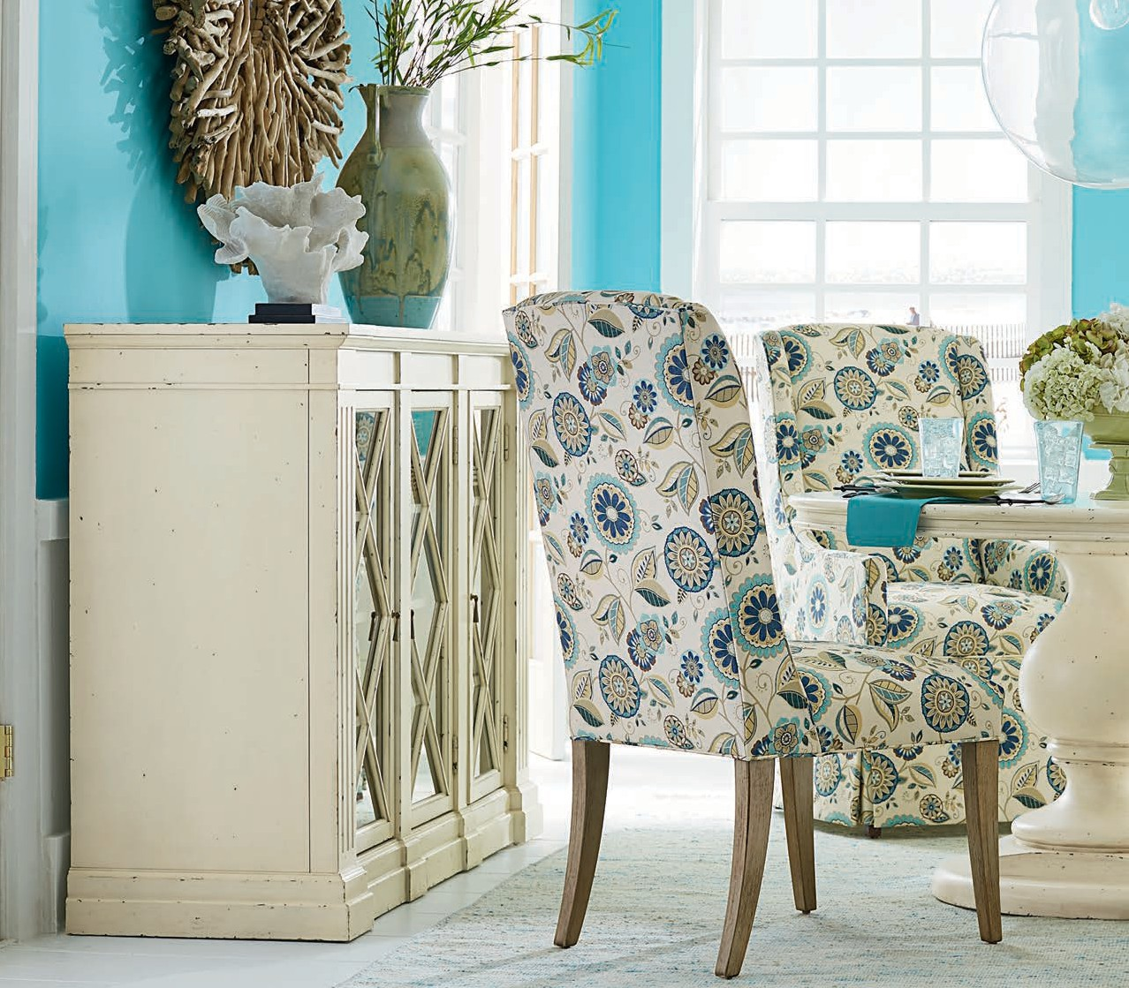
STYLE
ADD A LITTLE
TO YOUR LIFE
WOOD PRODUCT SUPPLEMENT
MARCH 2018
SOLID HERITAGE. QUALITY CRAFTSMANSHI P. STYLISH SELECTION. DEDICATED SER VICE.

Slide 2
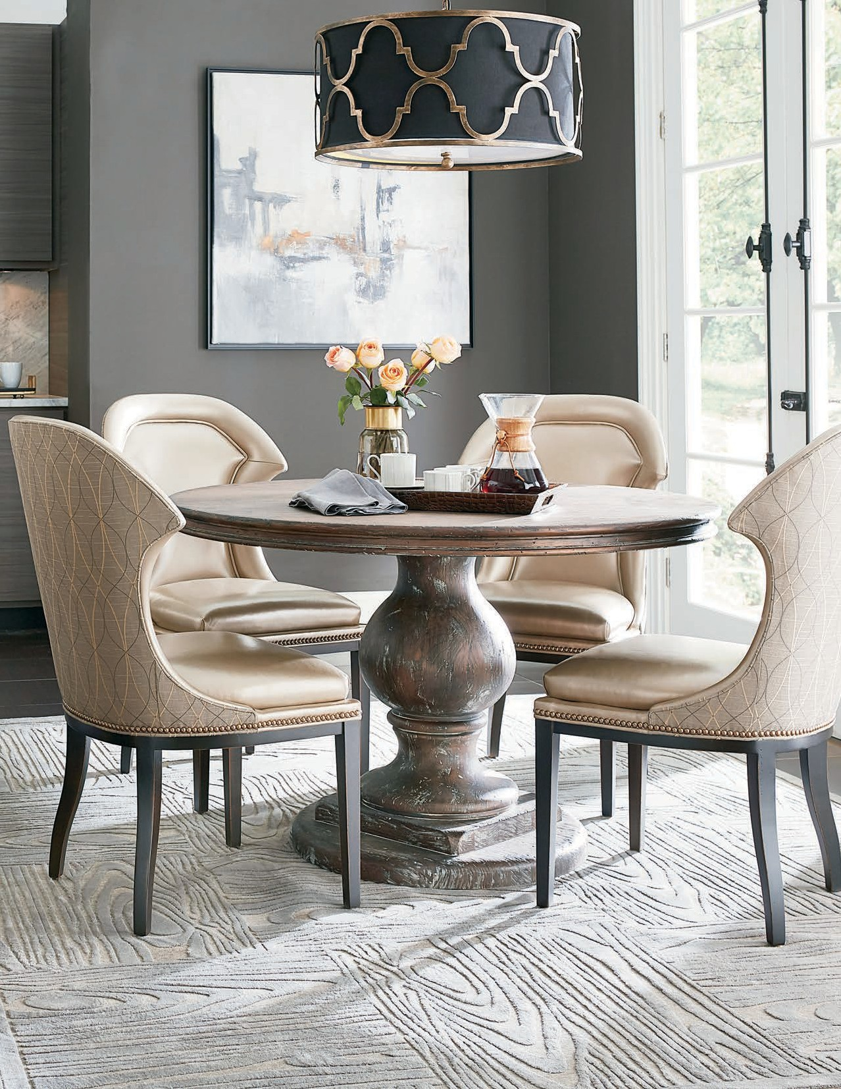
SHOWN:813R-48 ROUND TABLE TOP | 8113-TB TABLE BASE

Slide 3
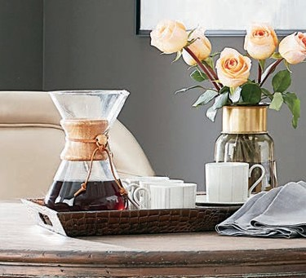
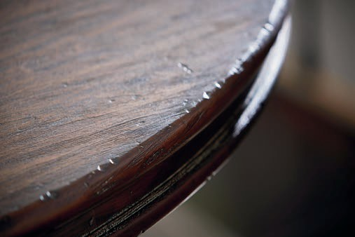
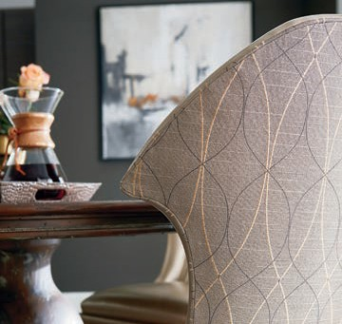
STYLE
ADD A LITTLE
TO YOUR LIFE
EVER YTHING WE DO STARTS AND FINISHES WITH YOU.
SOLID HERITAGE
For nearly a century, we’ve combined masterful craftsmanship with fashion-forward design of fine furnishings for the home. We’re a family of craftspeople who care about our community, the environment, and you.
TABLE OF CONTENTS
8109 Churchill............................ 2
8113 Rustiqué............................ 4
8116 Park West........................ 10
8118 Caláis .............................. 12
8119 Provence......................... 16
8124 Stockbridge.................... 20
8127 Nottington Cottage....... 22
8131 Cordera........................... 24
8133 St. Jérome ...................... 26
8164 Westwood ...................... 30
8190 Townsend ....................... 34
Finishes.................................... 36
Frame Index ............................ 37
QUALITY CRAFTSMANSHIP
It’s part of our DNA. It’s the fabric of our company, and it’s woven into everything we do. It’s why we put attention to detail first, second, and third.
STYLISH SELECTION
Choose from a wide variety of fashionable style and comfort for the living room, dining room, and everywhere in between.
DEDICATED SERVICE
We make it easy for you. Quality, value, style, and comfort delivered in a timely fashion by people who care.

Slide 4
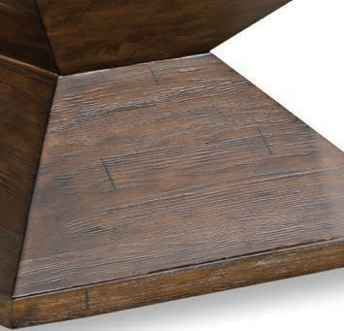
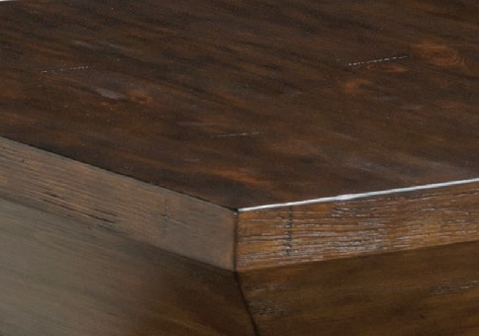
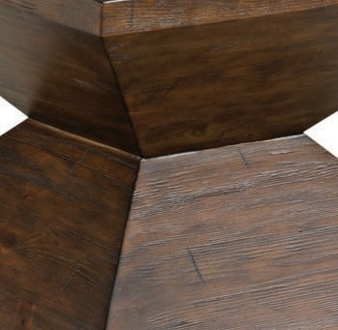
THE CHURCHILL COLLECTION
TOBACCO FINISH
In love with that reclaimed look? The Churchill
Collection merges traditional forms with rustic
style elements to deliver memorable pieces that fit seamlessly into your living spaces.
Russian pine solids and veneers come with our
rich Tobacco finish, which gives the collection its signature look. With additional options like
leather upholstery, planked tops, and nail-head trim, the Churchill Collection makes it easy to
create your own personal style.

Slide 5
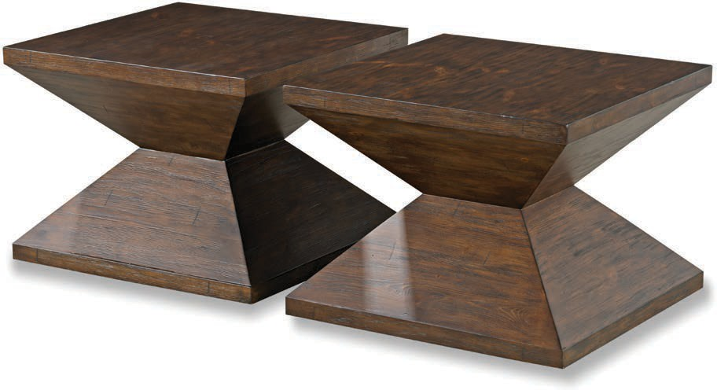
8109 – CHURCHILL COLLECTION | 3
8109-BC BUNCHING COCKTAIL TABLE w 24 | d 24 | h 18 in.
Two shown.

Slide 6
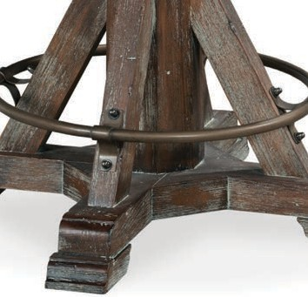
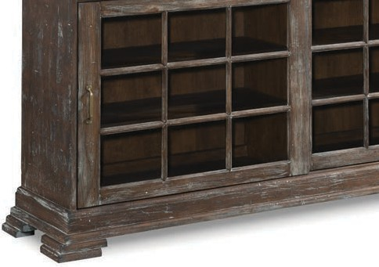
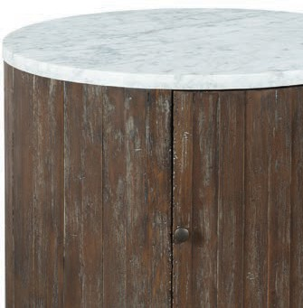
THE RUSTIQUÉ COLLECTION
RUSTIQUE FINISH
With the Rustiqué Collection, it’s all about the
finish, which is obvious in the name alone.
Elm and ash solids and veneers are meticulously
wire-brushed by hand, giving the collection not only highlights and lowlights in the grain, but
also its clear-cut rustic appeal. Acid-etched mirror doors with veneered overlays are just another
example of the superior craftsmanship and
attention to detail found in this memorable piece.

Slide 7
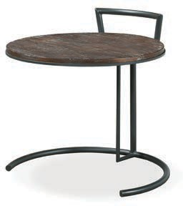
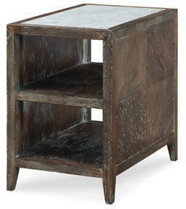
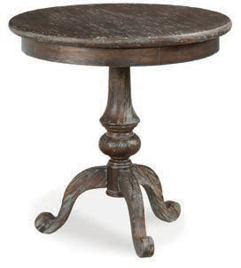
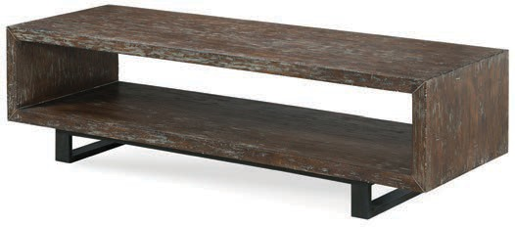
8113 – RUSTIQUÉ COLLECTION | 5
8113-19 ROUND END TABLE w 26 | d 25 | h 24 in.
Features a gun metal frame with wood top.
8113-ET END TABLE w 18 | d 28 | h 27 in.
Features one fixed shelf with a marble inset top.
8113-RC COCKTAIL TABLE w 64 | d 22 | h 18 in.
Features a gun metal base.
8113-90 LAMP TABLE
w 28 | d 28 | h 28 in.

Slide 8
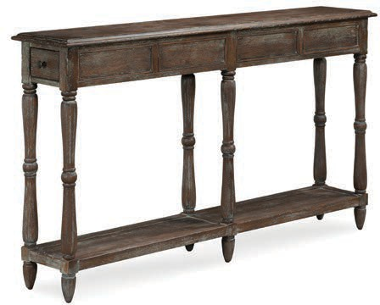
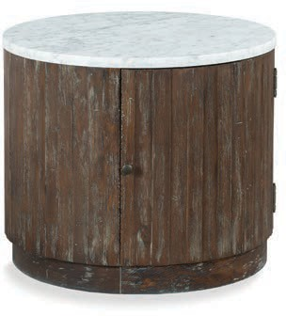
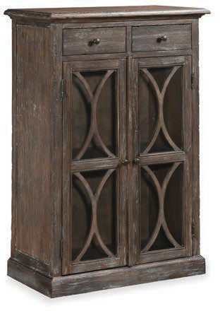
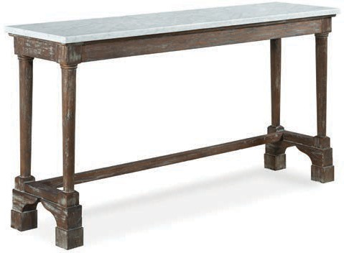
6 | 8113 – RUSTIQUÉ COLLECTION
8113-96 CONSOLE TABLE w 60 | d 12 | h 35 in.
Features 2 drawers and one fixed shelf.
8113-98 DRUM TABLE w 28 | d 28 | h 24 in.
Features one door and one adjustable shelf. Fixed marble top.
8113-99 BISTRO SOFA TABLE w 68 | d 18 | h 36 in.
Features a fixed marble top. Will accommodate 2 Counter Stools.
8113-AC ACCENT CHEST w 32 | d 18 | h 48 in.
Features 2 drawers and 2 glass panel doors with one fixed shelf behind each door.

Slide 9
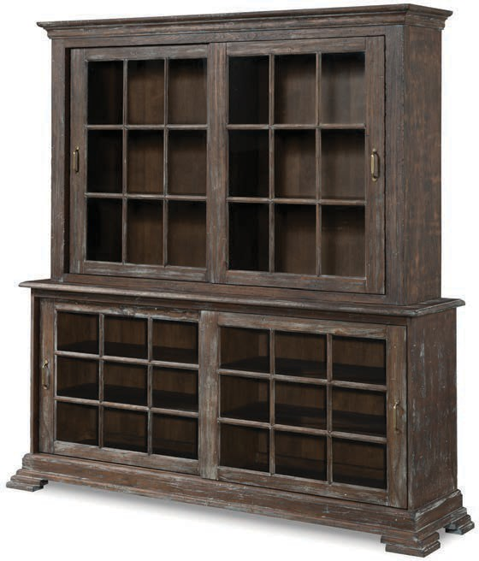
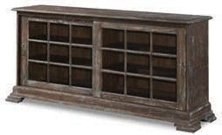
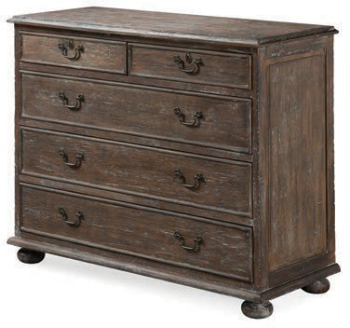
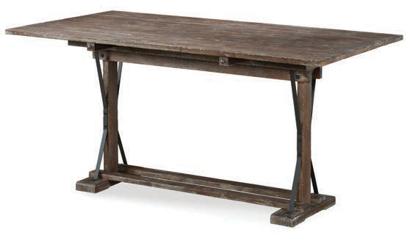
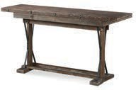
8113 – RUSTIQUÉ COLLECTION | 7
8113-83 DECK w 71.5 | d 16 | h 46 in.
Features 2 overlapping sliding doors and 2 removable/ adjustable wood frame glass shelves behind each door. Features three-way adjustable touch lighting.
8113-82 CREDENZA w 79 | d 19.5 | h 36.5 in.
Features 2 overlapping sliding doors and 2 removable/ adjustable shelves behind each door.
8113-97 CHEST w 44 | d 18 | h 36 in.
Features 5 drawers.
8113-FT FLIP-TOP TABLE Open: w 60 | d 32 | h 29.5 in. Closed: w 60 | d 16 | h 30.5 in.
Features gun metal accents.

Slide 10
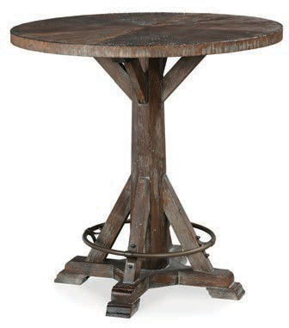
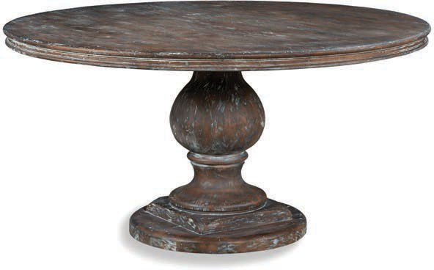
8 | 8113 – RUSTIQUÉ COLLECTION
8113-BT BISTRO TABLE w 36 | d 36 | h 36 in.
Features antique brass accents. Consists of: 8113-BT-T (top) and 8113-BT-B (base).
813R-60 60” ROUND TABLE TOP 813R-48 48” ROUND TABLE TOP (ALSO AVAILABLE) Top (-48): w 48 | d 48 | h 2.5 | Top (-60): w 60 | d 60 | h 2.5 in.
8113-TB TABLE BASE Base: w 26 | d 26 | h 27.5 in.

Slide 11
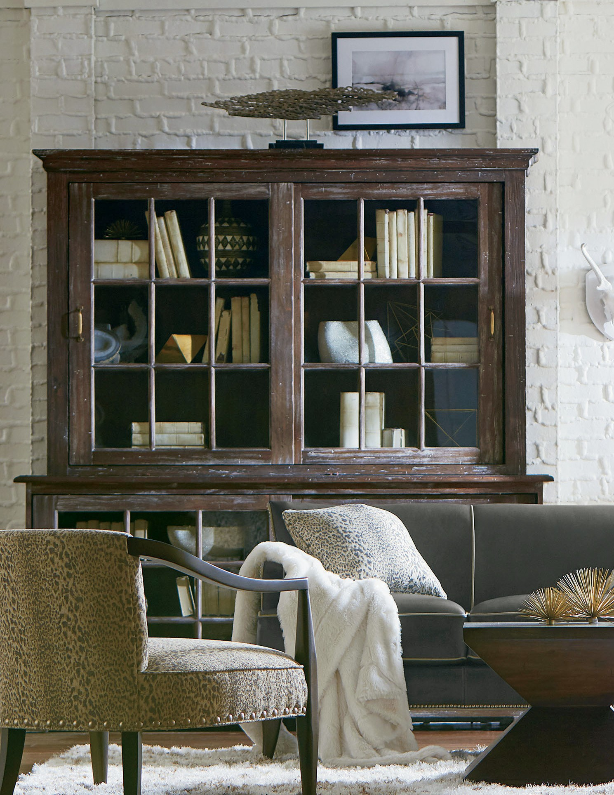
SHOWN: 8109-BC BUNCHING COCKTAIL TABLE | 8113-83 DECK | 8113-82 CREDENZA

Slide 12
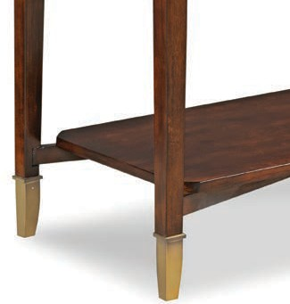
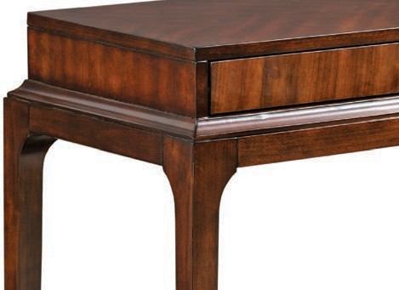
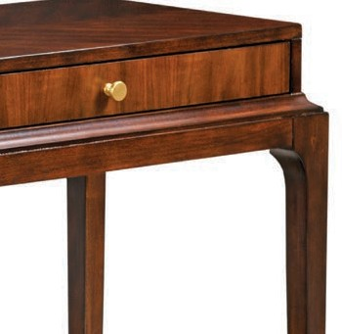
THE PARK WEST COLLECTION
VENEZIA FINISH
Maybe it’s the blended Regency styling with subtle
transitional overtones. Perhaps it’s the birch solids with book-matched Asian cherry veneers that
come with our Venezia finish. Or, possibly, it could be the finishing touch that comes in the form of
antique brass accents and hardware...
No matter the reason, the Park West Collection’s
allure is obvious, and its commitment to craftsmanship unmatched.

Slide 13
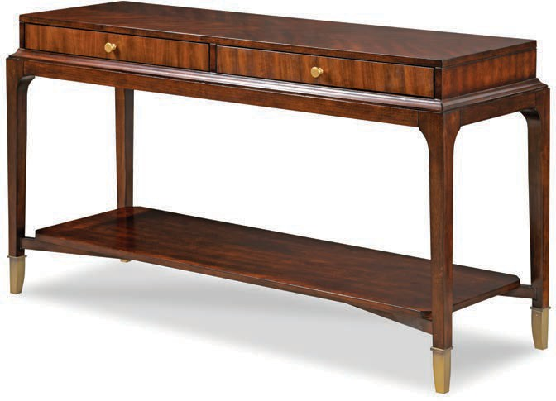
8116 – PARK WEST COLLECTION | 11
8116-96 CONSOLE TABLE w 56 | d 18 | h 30.5 in.
Features 2 drawers, one fixed shelf and antique brass accents.

Slide 14
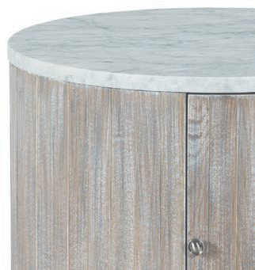
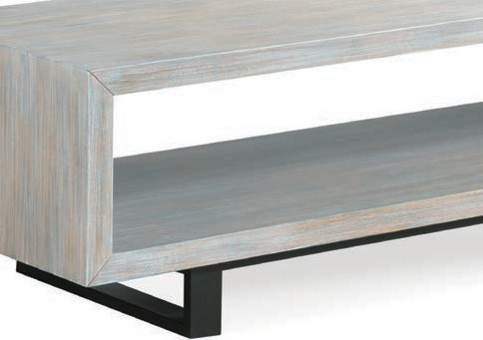
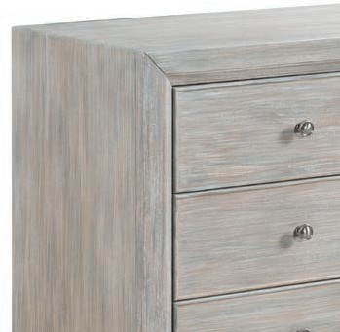
THE CALÁIS COLLECTION
CALÁIS FINISH
The Caláis Collection is a transitional grouping
of occasional pieces in various shapes and
sizes. These unique tables pair nicely with our upholstery offerings to create an eclectic, yet clean-lined aesthetic.
The Caláis finish features a multi-layered, hand-
stripped technique that gives pieces a one-of-a- kind feel. The gun metal frames, found on some tables, provide a final touch of sophistication.

Slide 15
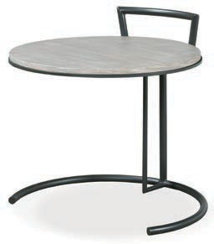
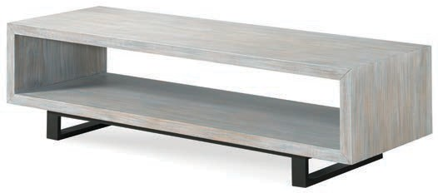
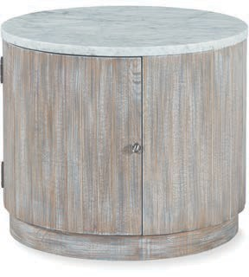
8118 – CALÁIS COLLECTION | 13
8118-RC COCKTAIL TABLE w 64 | d 22 | h 18 in.
Features a gun metal base.
8118-19 ROUND END TABLE w 26 | d 25 | h 24 in.
Features a gun metal frame with wood top.
8118-98 DRUM TABLE w 28 | d 28 | h 24 in.
Features one door, one adjustable shelf and a fixed marble top.

Slide 16
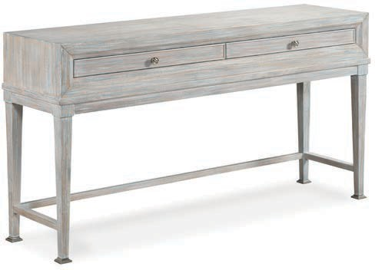
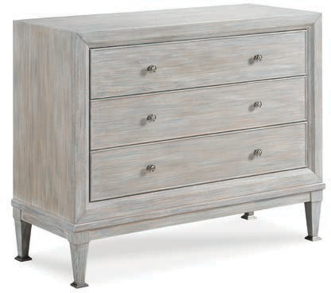
14 | 8118 – CALÁIS COLLECTION
8118-99 SOFA TABLE w 60 | d 16 | h 32 in.
Features 2 drawers.
8118-CH CHEST w 44 | d 18 | h 36 in.
Features 3 drawers.

Slide 17
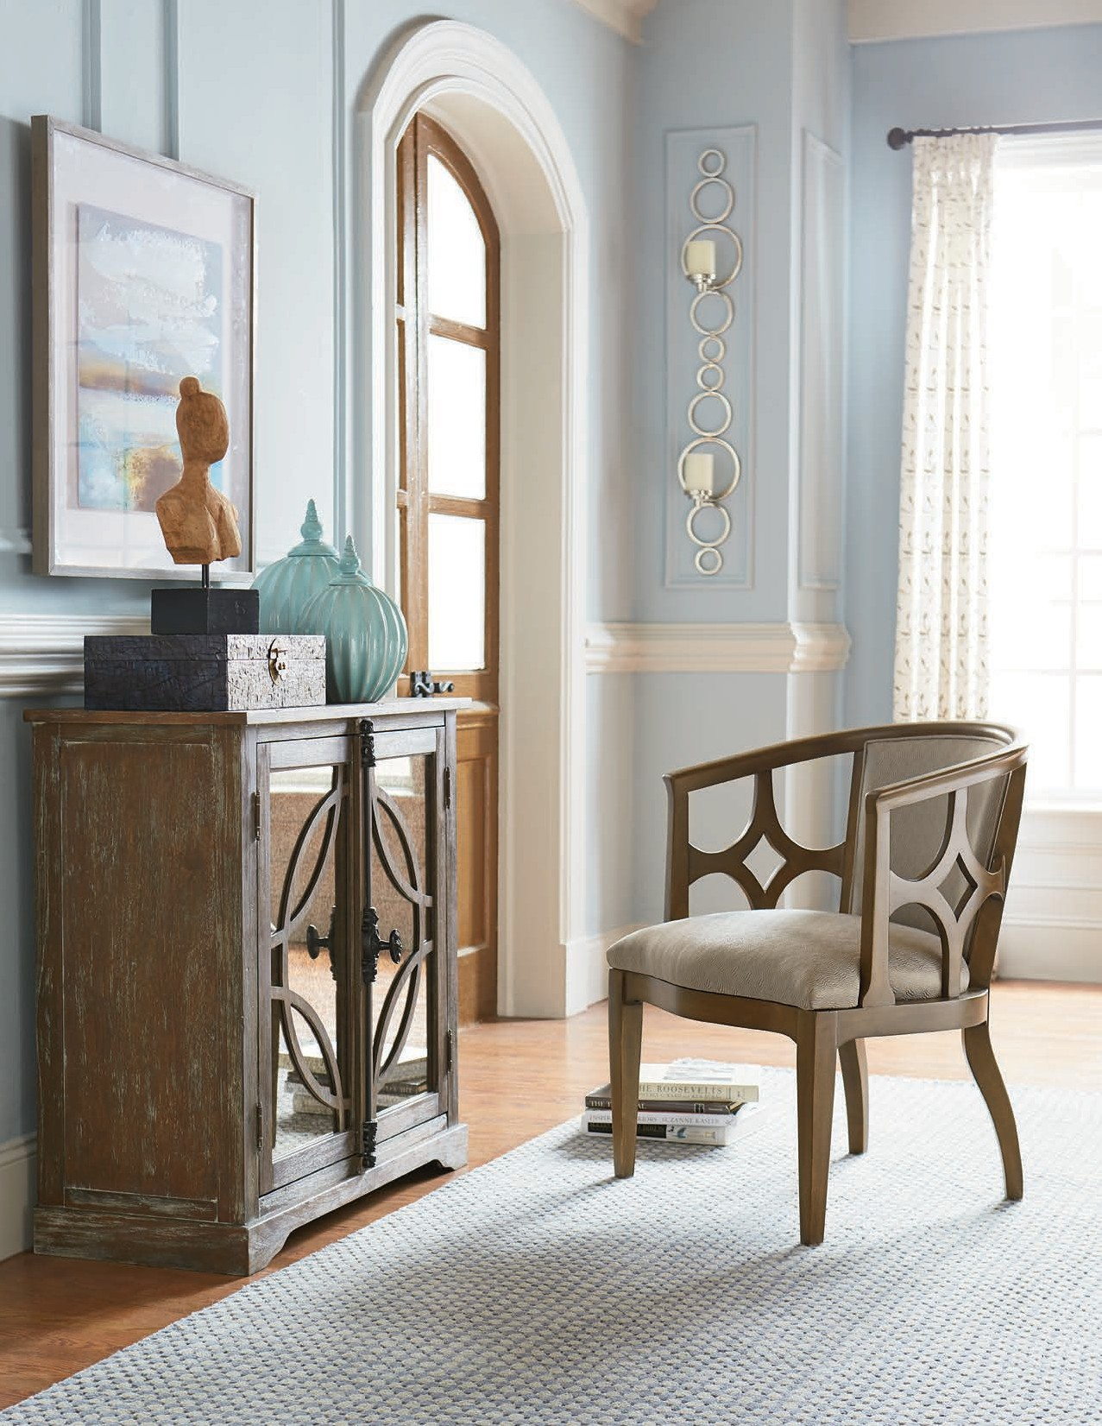
SHOWN: 8113-CH CHEST

Slide 18
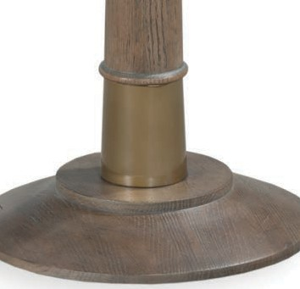
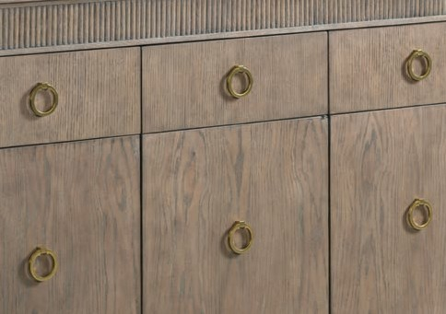
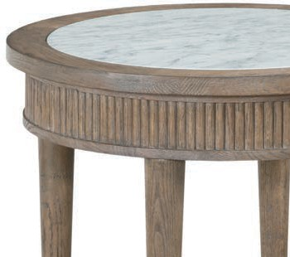
THE PROVENCE COLLECTION
SANDSTONE FINISH
The Provence Collection starts with a
sophisticated and unique design influence which is clearly evident in the materials it employs.
Select oak veneers merge seamlessly with brass accents, while the use of marble inset tops offers
further proof of the collection’s sense of elegance.
The Sandstone finish found on the Provence
Collection’s Sideboard, Chest, and various
tables ties all the pieces together, and allows
the distinctive wood grain to shine through with subtle contrasts and textures.

Slide 19
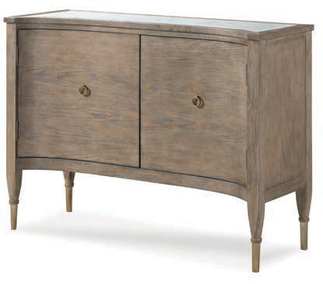
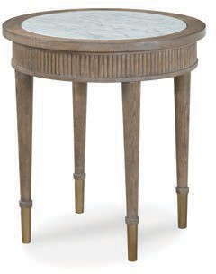
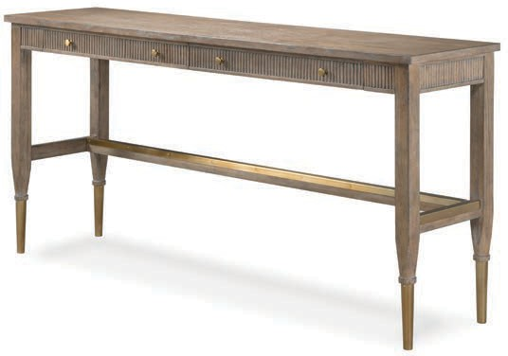
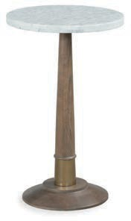
8119 – PROVENCE COLLECTION | 17
8119-19 ROUND END TABLE w 24 | d 24 | h 26 in.
Features a marble inset top.
8119-AC ACCENT TABLE w 48 | d 18 | h 36 in.
Features 2 doors with one adjustable shelf behind each door and a marble inset top.
8119-99 BISTRO SOFA TABLE w 74 | d 18 | h 36 in.
Features 2 drawers. Will accommodate 2 Counter Stools.
8119-88 MARTINI TABLE w 16 | d 16 | h 26 in.
Features a marble top.

Slide 20
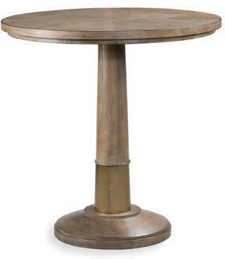
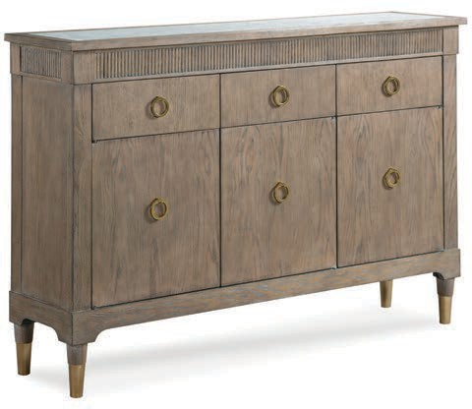
18 | 8119 – PROVENCE COLLECTION
8119-BT BISTRO TABLE w 36 | d 36 | h 36 in.
Features brass accents.
8119-17 SIDEBOARD w 60 | d 15 | h 41 in.
Features 3 top drawers with 3 base level doors, one adjustable shelf behind each door and a marble inset top.

Slide 21

SHOWN: 8133-ST SOFA TABLE

Slide 22



THE STOCKBRIDGE COLLECTION
STOCKBRIDGE FINISH
The heavily carved fronts and end panels of these
handsome pieces owe a debt to British Gentry design, infusing the Stockbridge Collection with Old World charm.
The birch solids and veneers are offered in a
distinctive blue finish. As a finishing touch, we’ve added antique brass ring pulls on drawers, which
only add to the Stockbridge Collection’s time-worn antique feel and uncommon sense of style.

Slide 23


8124 – STOCKBRIDGE COLLECTION | 21
8124-95 END TABLE w 36 | d 22 | h 32.5 in.
Features one center drawer.
8124-96 CANTED CONSOLE TABLE w 62 | d 18 | h 40 in.
Features one center drawer.

Slide 24



THE NOTTINGTON COTTAGE COLLECTION
ANTIQUE PARCHMENT FINISH
The Nottington Cottage Collection is a perfect
example of what can happen when you pair strong design elements with the right finish.
While the pieces here are neoclassical in nature,
the Antique Parchment finish found on birch solids and select veneers has a softening effect, giving the collection a more casual feel. For a blend of
Old World European styles, the Nottington Cottage Collection is a savvy choice, one that will brighten
your living space for many years to come.

Slide 25


8127 – NOTTINGTON COTTAGE COLLECTION | 23
8127-95 END TABLE w 36 | d 22 | h 32.5 in.
Features one center drawer.
8127-96 CANTED CONSOLE TABLE w 62 | d 18 | h 40 in.
Features one center drawer.

Slide 26



THE CORDERA COLLECTION
PEBBLESTONE FINISH
The accent chest found in the Cordera Collection
is inspired by a blended design that offers unique scale and function. The stand-out feature is the
Pebblestone finish found on Tulipwood solids and birch veneers; the white, distressed feel gives the piece its singular look, as well as a handcrafted
feel.
Though stunningly beautiful, the piece also offers
practicality with two upper drawers that are
complemented by two lower glass panel doors.

Slide 27

8131 – CORDERA COLLECTION | 25
8131-AC ACCENT CHEST w 32 | d 18 | h 48 in.
Features 2 drawers and 2 glass panel doors with one fixed shelf behind each door.

Slide 28



THE ST. JÉROME COLLECTION
AGED BRASS FINISH
When traditional eloquence merges with metallic
ambience, the result is the remarkable St. Jérome Collection. Here, alder solids and cherry veneers come with an Aged Brass finish, which gives every piece its own stately sense of style. While the
collection’s Chest serves as a stunning centerpiece, the accompanying selection of tables offers unique shapes and forms, all while providing functional
shelving for any room.
To create a sophisticated living space with classic
designs, the St. Jérome Collection is an obvious— and exceptional—choice.

Slide 29



8133 – ST. JÉROME COLLECTION | 27
8133-88 MARTINI TABLE
w 14.5 | d 14.5 | h 24 in.
8133-AT ACCENT TABLE w 26 | d 26 | h 26 in.
Features one fixed shelf.
8133-68 MAGAZINE TABLE w 22 | d 16 | h 25 in.
Features 3 fixed shelves.

Slide 30


28 | 8133 – ST. JÉROME COLELCTION
8133-CH CHEST w 42 | d 18 | h 33 in.
Features 4 drawers.
8133-ST SOFA TABLE w 48 | d 18 | h 36 in.
Features one fixed shelf.

Slide 31

SHOWN: 8133-CH CHEST

Slide 32



THE WESTWOOD COLLECTION
GRAPHITE FINISH
With their cosmopolitan feel rooted in traditional
design, the pieces of the Westwood Collection are a welcome and sophisticated addition to any home. Select oak veneers and solids are paired
with brass accents and, in some cases, handsome marble inset tops.
Ultimately, the Westwood Collection’s allure lies
in its exquisite details: the dark Graphite finish highlights the wood grain, while the delicate
brass ring pulls deliver a jewelry-like feel to the Sideboard and Chest.

Slide 33



8164 – WESTWOOD COLLECTION | 31
8164-88 MARTINI TABLE w 16 | d 16 | h 26 in.
Features a marble top and brass accents.
8164-19 ROUND END TABLE w 24 | d 24 | h 26 in.
Features a marble inset top and brass accents.
8164-AC ACCENT CHEST w 48 | d 18 | h 36 in.
Features 2 doors with one adjustable shelf behind each door and a marble inset top.

Slide 34


32 | 8164 – WESTWOOD COLLECTION
8164-BT BISTRO TABLE w 36 | d 36 | h 36 in.
Features brass accents.
8164-17 SIDEBOARD w 60 | d 15 | h 41 in.
Features 3 top drawers with 3 base level doors, one adjustable shelf behind each door and a marble inset top.

Slide 35

SHOWN: 8109-RC RECTANGULAR COCKTAIL TABLE | 8109-19 LAMP TABLE | 8109-FT FLIP-TOP TABLE

Slide 36



THE TOWNSEND COLLECTION
COGNAC FINISH
For those with eclectic tastes, the Townsend
Collection will be an undeniable favorite. Though the pieces have a distinct European descent, the mix of options makes for endless combinations.
Warm stains and glazes over lightly distressed
elm solids and veneers accentuate the beautiful wood grain, and mate brilliantly with antique
metal accents. The traditional European stylings continue with clover leaf shapes, antique brass
foot rests, and fixed shelving. With the Townsend Collection, Old World charm is always on display.

Slide 37


8190 – TOWNSEND COLLECTION | 35
8190-83 DECK w 71.5 | d 16 | h 46 in.
Features 2 overlapping sliding doors and 2 removable/ adjustable wood frame glass shelves behind each door. Features three-way adjustable touch lighting.
8190-82 CREDENZA w 79 | d 19.5 | h 36.5 in.
Features 2 overlapping sliding doors and 2 removable/ adjustable shelves behind each door.

Slide 38











36 | FINISHES
FINISHES
Aged Brass 8133
Antique Parchment 8127
Caláis 8118
Cognac 8190
Graphite 8164
Pebblestone 8131
Rustique 8113
Sandstone 8119
Stockbridge 8124
Tobacco 8109
Venezia 8116

Slide 39
FRAME INDEX | 37
8109-BC
8113-19
8113-82
8113-83
8113-90
8113-96
8113-97
8113-98
8113-99
8113-AC
8113-BT
8113-ET
8113-FT
8113-RC
8113-TB
8116-96
8118-19
8118-98
8118-99
8118-CH
8118-RC
8119-17
8119-19
8119-88
8119-99
8119-AC
8119-BT
8124-95
8124-96
8127-95
8127-96
8131-AC
8133-68
8133-88
8133-AT
8133-CH
8133-ST
813R-48
813R-60
8164-17
8164-19
8164-88
8164-AC
8164-BT
8190-82
8190-83
Bunching Cocktail Table................................................................3, 9
Round End Table ............................................................................... 5
Credenza........................................................................................7, 9
Deck ...............................................................................................7, 9
Lamp Table ........................................................................................ 5
Console Table .................................................................................... 6
Chest .................................................................................................. 7
Drum Table ........................................................................................ 6
Bistro Sofa Table ................................................................................ 6
Accent Chest ..................................................................................... 6
Bistro Table ........................................................................................ 8
End Table ........................................................................................... 5
Flip-Top Table .................................................................................... 7
Cocktail Table .................................................................................... 5 Table Base......................................................... 8, Inside Front Cover
Console Table .................................................................................. 11
Round End Table ............................................................................. 13
Drum Table ...................................................................................... 13
Sofa Table ........................................................................................ 14
Chest ................................................................................................ 14
Cocktail Table .................................................................................. 13
Sideboard ........................................................................................ 18
Round End Table ............................................................................. 17
Martini Table .................................................................................... 17
Bistro Sofa Table .............................................................................. 17
Accent Chest ................................................................................... 17
Bistro Table ...................................................................................... 18
End Table ......................................................................................... 21
Canted Console Table ..................................................................... 21
End Table ......................................................................................... 23
Canted Console Table ..................................................................... 23
Accent Chest ................................................................................... 25
Magazine Table................................................................................ 27
Martini Table .................................................................................... 27
Accent Table .................................................................................... 27
Chest ..........................................................................................28, 29
Sofa Table ..................................................................................19, 28
48” Round Table Top ........................................ 8, Inside Front Cover 60” Round Table Top ......................................................................... 8
Sideboard ........................................................................................ 32
Round End Table ............................................................................. 31
Martini Table .................................................................................... 31
Accent Chest ................................................................................... 31
Bistro Table ...................................................................................... 32
Credenza.......................................................................................... 35
Deck ................................................................................................. 35
03/2018

Slide 40

Post Office Box 1710 | Lenoir, North Carolina 28645 phone: 828.758.5571 | fax: 828.758.0211
ADD A LITTLE
STYLE
TO YOUR LIFE

